Slide 1

Dr. D. Y. Patil Unitech Society’s Dr. D. Y. Patil Institute of Technology, Pimpri, Pune
Seminar and Technical Communication (310249)
Third Year (B.E.-Computer Engineering)
Gaming Technology
Presented By
Kunal Kawate (Exam Seat No. S190244341)
Department of Computer Engineering,
Dr. D. Y. Patil Institute of Technology,
Pimpri, Pune-411018.
Under the Guidance of
Dr. Atul Kathole
Department of Computer Engineering,
Dr. D. Y. Patil Institute of Technology,
Pimpri, Pune-411018.
A. Y. 2023-24

Slide 2

Contents
Introduction
Literature Survey
Report of the Present Investigation
Result and Discussion
Conclusion
References

Slide 3
Introduction
In our rapidly evolving digital age, gaming technology has emerged as a transformative force, reshaping the way we live, learn, and interact with the world. This seminar explores the multifaceted realm of gaming technology, delving into its components, applications, and its tangible impact on our daily lives.
Gaming technology, at its core, encompasses the amalgamation of sophisticated hardware and software designed to create and play video games. It transcends mere entertainment, bridging the gap between virtual worlds and real-life applications, offering a host of benefits to individuals and society at large.

Slide 4
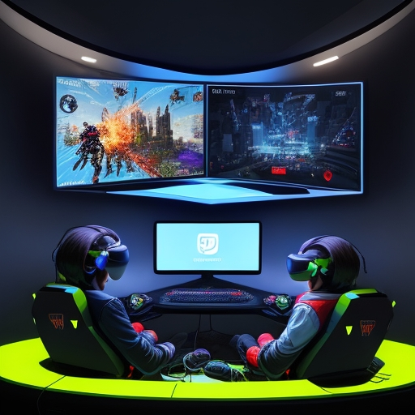
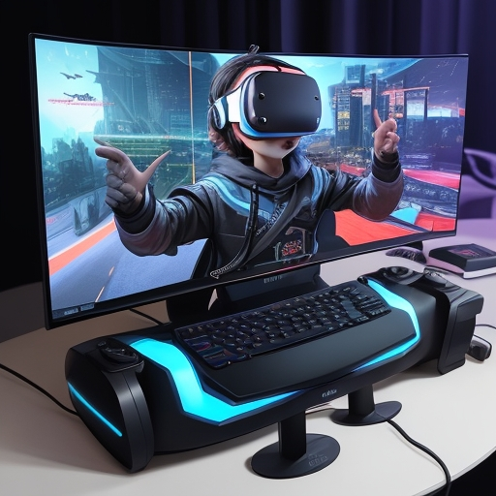
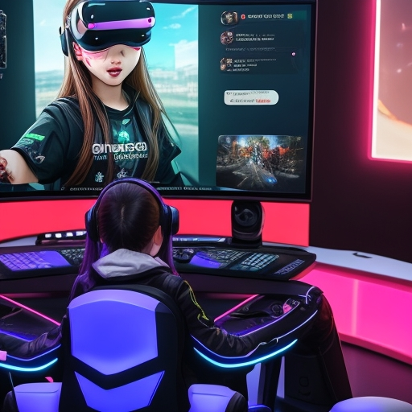

Introduction
From enhancing hand-eye coordination to fostering problem-solving skills, gaming technology has found its way into our everyday existence, demonstrating that its influence extends far beyond the gaming screen. In this seminar, we will navigate the intriguing landscape of gaming technology, uncovering its potential to empower and improve our lives.

Slide 5
Introduction
Purposes and Objectives
Purpose:
The primary purpose of this seminar is to provide a comprehensive understanding of gaming technology, its applications, and its role in shaping our present and future.
Objectives:
To define and explain gaming technology, covering the hardware and software components.

Slide 6
Introduction
To analyze the various uses of gaming technology in entertainment and beyond.
To evaluate the extent to which gaming technology influences and aids real-life scenarios.
To investigate the potential of gaming technology in addressing real-world problems.
To highlight why gaming technology is considered the future of technology.
To explore the current technological trends and innovations in the gaming industry.
To discuss transformative capabilities of GT in various domains.

Slide 7
Literature Survey
Sr. No. | Name | Author Name | Year | Advantage | Future Scope
1 | The Impact of Video Games on Cognitive Function. | Green, C. S., & Bavelier, D. | 2003 | This seminal study explores the positive effects of action video games on cognitive skills such as attention, memory, and problem-solving. | Future research in this area can delve deeper into specific cognitive improvements and their real-world applications, particularly in education and professional training.
2 | Gamification by Design: Implementing Game Mechanics in Web and Mobile Apps. | Zichermann, G., & Cunningham, C. | 2011 | This book comprehensively examines the concept of gamification and its applications in various industries, offering practical insights for implementation. | Future research can focus on the refinement of gamification techniques and their effectiveness in different contexts, exploring new ways to engage users.
3 | Therapeutic Video Game Use in Children with Disabilities: A Review | Anderson, C. A., Dill, K. E., & Dill, J. C. | 2000 | This review discusses the use of video games as therapeutic tools, particularly in pediatric healthcare, highlighting their potential for physical and mental health improvement. | Future studies could delve into optimizing game-based therapies and expanding their use to address a broader range of medical conditions.

Slide 8
Literature Survey
Sr. No. | Name | Author Name | Year | Advantage | Future Scope
4 | The Gamification of Learning and Instruction: Game-based Methods and Strategies for Training and Education | Kapp, K. M. | 2012 | This book offers a comprehensive examination of gamification in education and training, presenting a range of practical methods and strategies. | Future research can explore the evolution of gamified learning methods, assess their long-term effectiveness, and adapt them to changing educational and professional landscapes.
5 | The Ethics of Computer Games | Sicart, M. | 2009 | This book provides an ethical perspective on gaming technology, discussing issues like violence, addiction, and privacy, offering insights into the ethical considerations of gaming. | Future research can delve into the development of ethical guidelines and regulations for the gaming industry and explore the impact of these guidelines on gaming content and user behavior.
These literature survey entries offer a broad spectrum of perspectives on gaming technology, from its cognitive impacts to its applications in healthcare, education, and ethics. They also point to future research directions, such as further investigating the intricacies of cognitive improvements and the ethical implications of gaming content.

Slide 9
Report of the Present Investigation
The multifaceted impact of gaming technology on various aspects of our lives. Gaming technology is more than just a medium for entertainment; it serves as a dynamic tool with significant implications for cognition, education, healthcare, and even ethical considerations.
Cognitive Enhancement: Numerous studies, such as Green and Bavelier's (2003) research on "The Impact of Video Games on Cognitive Function," have established that gaming can improve cognitive skills, including attention, memory, and problem-solving. This cognitive enhancement is attributed to the demand for precision and quick decision-making in many video games.

Slide 10
Report of the Present Investigation
Gamification and Education: The concept of gamification, as discussed in Zichermann and Cunningham's book "Gamification by Design" (2011), has gained prominence. It introduces game mechanics into non-gaming contexts, making learning and training more engaging and effective. This approach has applications in educational settings, professional training, and beyond.
Therapeutic Applications: Anderson, Dill, and Dill's review on "Therapeutic Video Game Use in Children with Disabilities" (2000) has shown the potential of video games in pediatric healthcare. Gaming technology is leveraged for physical therapy, pain management, and mental health treatment, offering therapeutic benefits to a wide range of patients.

Slide 11
Report of the Present Investigation
Case Studies
Case Study 1: Cognitive Improvement in Action Gamers In the study by Green and Bavelier (2003), it was found that individuals who engaged in action video games showed significant improvements in cognitive skills, with enhanced attention spans and improved problem-solving abilities. This case underscores the potential for gaming technology to have a profound impact on cognitive functions.
Case Study 2: Gamified Learning in Education The application of gamification in education has been exemplified by numerous institutions. The Khan Academy, for instance, utilizes game elements like badges and rewards to make learning more engaging. This case study highlights the successful integration of gaming technology into traditional education.

Slide 12
Report of the Present Investigation
Case Study 3: Therapeutic Use in Physical Rehabilitation In the realm of healthcare, case studies have showcased the use of gaming technology in physical rehabilitation. For example, VR-based rehabilitation exercises have been used to help patients regain mobility after injuries. Such cases demonstrate the practicality of gaming technology in therapeutic settings.
Examples
Example 1: VR-based Physical Therapy A noteworthy example is the utilization of virtual reality in physical therapy. Patients recovering from injuries or surgeries engage in VR exercises, which are not only more engaging but also effective in helping them regain strength and mobility. This technology offers a more enjoyable rehabilitation process.

Slide 13
Report of the Present Investigation
Example 2: Khan Academy's Gamified Learning Khan Academy's online platform has incorporated gamified elements such as badges, points, and interactive challenges to motivate students in their learning journey. This example highlights how gaming technology can be integrated into mainstream education to boost engagement and learning outcomes.
Example 3: The Rise of Cloud Gaming The emergence of cloud gaming services like Google Stadia and NVIDIA GeForce Now is revolutionizing how games are accessed and played. Gamers can now stream high-quality games on a variety of devices, eliminating the need for expensive gaming hardware. This example underscores the evolving trends in gaming technology.

Slide 14
Results and Discussions
Impact of Virtual Reality (VR) on Cognitive Skills: Investigate the effect of VR gaming on cognitive skills such as memory, attention, and problem-solving, and whether it can be utilized for cognitive enhancement.
Efficacy of Educational Gamification: Examine the effectiveness of educational games and gamified learning platforms in improving student engagement and learning outcomes, and explore the factors that contribute to their success.
Ethical Considerations in Gaming: Investigate the ethical concerns related to gaming technology, such as addiction, violence, and privacy issues, and propose strategies to mitigate these concerns.

Slide 15
Results and Discussions
The Role of Gaming in Healthcare: Analyze the therapeutic applications of gaming technology in healthcare, specifically in physical therapy, pain management, and mental health treatment. Assess the effectiveness of such applications and their long-term benefits.
Gaming and Global Connectivity: Examine how gaming technology fosters global connectivity through online gaming communities and the potential for cross-cultural interactions and collaborations.
Economic Impact of the Gaming Industry: Research the economic impact of the gaming industry, considering factors like job creation, revenue generation, and the market's contribution to the broader technology sector.

Slide 16
Results and Discussions
These research and analysis points can provide a deeper understanding of the multifaceted nature of gaming technology and its far-reaching impact on our lives. Each point offers an opportunity to contribute to the growing body of knowledge in this field and explore potential avenues for future research.
Trends:
Artificial Intelligence (AI) in Gaming: AI is being used to create intelligent non-player characters (NPCs), enhance game realism, and personalize gaming experiences.
Retro Gaming Revival: Nostalgia for classic video games has led to a resurgence in retro gaming, with re-releases, remakes, and vintage consoles making a comeback.

Slide 17
Results and Discussions
Significant Outcomes:
Impact on Learning and Education: The significant outcome is the use of gaming technology for educational purposes, enhancing learning outcomes and engagement through gamification and educational games.
Economic Influence: The gaming industry has a significant economic influence, generating substantial revenue, creating jobs, and contributing to the broader technology sector.
Understanding these trends and significant outcomes is crucial for appreciating the evolving role of gaming technology in our lives and its potential to drive innovation and change in various domains.

Slide 18
Conclusion
In this seminar, we have explored the multifaceted world of gaming technology, uncovering its profound impact on our lives and its potential to shape the future. As a brief summary of our main points and findings –
Gaming technology, a fusion of hardware and software, has evolved into a powerful tool with applications spanning entertainment, education, healthcare, and various industries.
We have seen how gaming technology contributes to our real lives, enhancing hand-eye coordination, problem-solving skills, and social interaction, while also providing stress relief, therapeutic applications, and opportunities for training.

Slide 19
Conclusion
It is evident that gaming technology is more than just a pastime; it is a catalyst for real-world change. From educational gamification to healthcare therapies, gaming tech has become an invaluable resource.
We have explored its applications in training, data processing, and scientific research, underscoring its significance beyond the gaming world
The significance of this topic is unquestionable. Gaming technology has the potential to redefine how we approach learning, therapy, and skill development. Its influence extends to a diverse audience, impacting various sectors, and fostering a sense of community.

Slide 20
Conclusion
As technology continues to advance, so does the potential for gaming technology to revolutionize our lives.
As we conclude, it's essential to consider potential future research directions. Gaming technology is a dynamic field, and research can delve deeper into its cognitive and psychological impacts, its potential for further revolutionizing healthcare and education, and its role in fostering global connections through online gaming communities. Additionally, exploring the ethical considerations of gaming technology and its long-term societal impact is an avenue worth investigating.

Slide 21
Conclusion
In the years to come, we can anticipate a world where gaming technology continues to evolve, shaping our lives in ways we may not yet fully comprehend. Embracing and understanding this transformation is the first step in harnessing its potential for a brighter and more innovative future.

Slide 22
References
"The Art of Game Design: A Book of Lenses" by Jesse Schell - This book provides insights into the art and science of game design, offering a comprehensive overview of gaming technology. YouTube Link - https://www.youtube.com/watch?v=-RuVVHV8xqg
"Reality Is Broken: Why Games Make Us Better and How They Can Change the World" by Jane McGonigal - This book explores how gaming technology can be harnessed to solve real-world problems and improve lives. Book PDF Link- https://hci.stanford.edu/courses/cs047n/readings/Reality_is_Broken.pdf

Slide 23
References
"The Gamification of Learning and Instruction: Game-based Methods and Strategies for Training and Education" by Karl M. Kapp - This book focuses on the educational applications of gaming technology.SCIRP- https://www.scirp.org/(S(351jmbntvnsjt1aadkozje))/reference/referencespapers.aspx?referenceid=2598253
"The Innovators: How a Group of Hackers, Geniuses, and Geeks Created the Digital Revolution" by Walter Isaacson - While not exclusively about gaming technology, this book provides a historical context for the development of technology, including the early days of video games.

Slide 24
References
Academic Journals: Scholarly journals like the "International Journal of Computer Games Technology" and "Simulation & Gaming" offer academic insights into gaming technology.
TED Talks: such as Jane McGonigal's "Gaming Can Make a Better World“.

Slide 25

Thank You

