Slide 1

B.TECH FINAL YEAR PROJECT DEFENSE | 2026–2027
AI-Powered Urban Heat Island (UHI) Mitigation
Using Semantic Segmentation and Deep Learning Regression
An Intelligent Satellite-Based Framework for Urban Land-Cover Analysis and Greening Simulation
Presented by: Kunal
Roll Number: 24215215
Institution: Christ University Delhi NCR
Project Guide: Dr. Ramesh Chandra Poonia
Academic Year: 2026–2027

Slide 2
INTRODUCTION & PROBLEM STATEMENT
Understanding the Urban Heat Island (UHI) Effect
The Urban Microclimate Challenge
• Thermal Disparity: Densely built metropolitan areas exhibit significantly higher surface temperatures than surrounding rural fringes.
• Heat Absorption: Dense asphalt, concrete, and commercial rooftops absorb and retain high solar thermal radiation.
• Vegetation Deficit: Depletion of natural tree canopies and green corridors suppresses evaporative cooling and moisture flux.
• Environmental Impact: Heightened surface heat accelerates building cooling energy demands, degrades air quality, and intensifies heat-wave health risks.
Core Problem Statement
• Lack of Predictive Tools: Urban planners lack unified, data-driven platforms capable of linking high-resolution satellite imagery directly to thermal forecasts.
• Non-Quantified Interventions: City agencies invest in green infrastructure without prior quantitative estimations of microclimatic cooling yields.
• Coupled Multi-Variable Complexity: Real-world surface temperatures depend on non-linear interactions among land-cover, elevation, humidity, and solar irradiance.
• Project Solution: A dual-stage AI architecture that segments optical satellite scenes, predicts Land Surface Temperature anomalies, and interactively simulates greening policies.

Slide 3
RESEARCH GOALS
Project Objectives & Scope
[01] Satellite Image Segmentation: Deploy deep convolutional neural networks (U-Net) to process high-resolution satellite imagery into pixel-level land-cover classifications.
[02] Four-Class Surface Taxonomy: Accurately categorize urban landscapes into four standardized classes: Impervious Surfaces, Vegetation Canopy, Bare Soil, and Water Bodies.
[03] Dynamic Land-Cover Metrics: Dynamically compute regional land-cover percentage distributions that strictly sum to 100% for microclimate feature engineering.
[04] LST Anomaly Regression: Develop a Deep Feedforward Artificial Neural Network (ANN) coupling 4 land-cover features with 3 environmental forcing factors to predict thermal anomalies.
[05] Interactive Mitigation Simulation: Build a simulation engine enabling planners to model 10%–50% greening interventions and quantify counterfactual cooling reductions before physical execution.

Slide 4
SYSTEM INFRASTRUCTURE
Data Sources and Technology Stack
Multimodal Data Sources
• Optical Satellite Imagery: High-resolution Copernicus Sentinel-2 (10m/px) and Landsat-8 RGB imagery.
• Near-Infrared (NIR) Support: Configurable 3-band (RGB) and 4-band (RGB+NIR) input pipelines.
• Thermal Infrared (LST): Landsat Collection-2 Level-2 Surface Temperature products (Band 10 / TIRS).
• Elevation (DEM): Digital Elevation Model topographical data capturing lapse-rate cooling.
• Atmospheric Forcing: Baseline relative humidity (%) and surface solar irradiance (W/m²).
• Spatial Partitioning: Region-based geographic splitting preventing spatial leakage between train/test.
Production Technology Stack
• Deep Learning Engine: PyTorch 2.5 with CUDA 12.1 hardware acceleration on NVIDIA RTX 3050 GPU.
• Geospatial Processing: Rasterio, GeoPandas, Shapely, PyProj, and Affine coordinate transforms.
• Scientific Numerical Core: NumPy, SciPy (multidimensional filters), Pandas, Scikit-learn.
• Web Architecture: FastAPI asynchronous REST server and Streamlit interactive dashboard.
• Front-End Design: Modern HTML5, Vanilla CSS (Glassmorphism & Obsidian theme), and Chart.js.
• Quality & Testing: Automated PyTest unit and integration suite (12/12 verified tests).

Slide 5
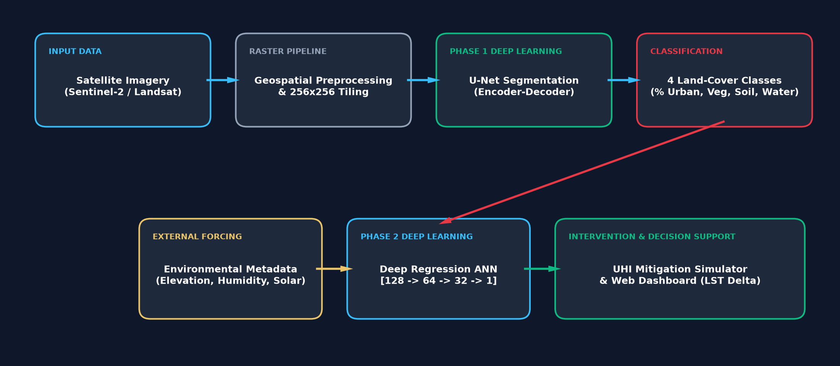
END-TO-END PIPELINE
Proposed System Architecture
Figure 1: Two-Stage Integrated Architecture connecting U-Net Semantic Segmentation and Deep ANN LST Regression with Counterfactual Mitigation Simulation.

Slide 6
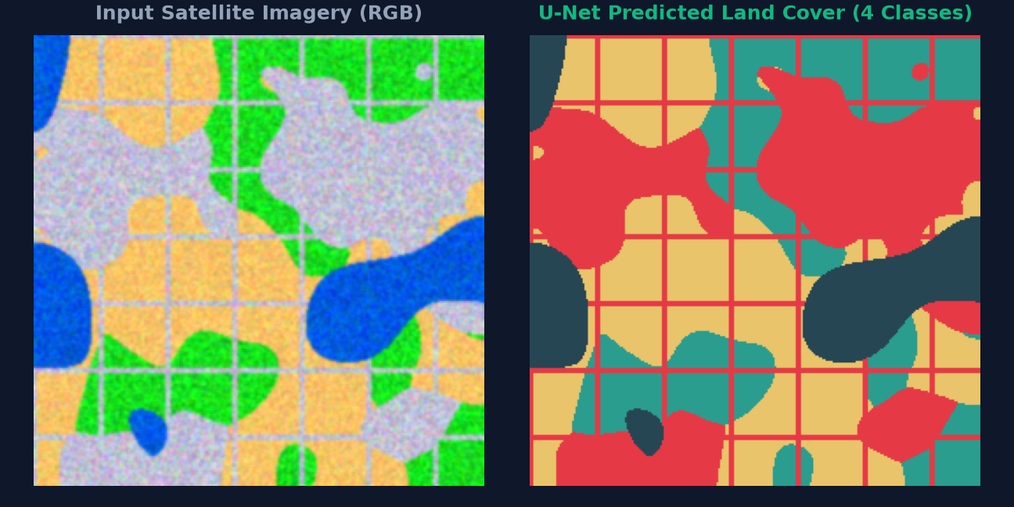
DEEP SEMANTIC SEGMENTATION
Phase 1: Land-Cover Classification Using U-Net
Encoder-Decoder with Skip Connections
• Contracting Path: 4 encoder stages with DoubleConv blocks (3x3 conv, BatchNorm, ReLU) and 2x2 Max Pooling.
• Expanding Path: 4 decoder stages with ConvTranspose2d upsampling concatenated with skip connections.
• Fine Boundary Recovery: Skip connections restore high-resolution spatial details lost during downsampling.
• Classification Layer: 1x1 convolution mapping base feature channels to 4 output class logits.
• Inference Modes: Softmax normalization produces per-pixel probability maps and argmax class masks.
Four-Class Scientific Taxonomy:
• Class 0: Impervious Surfaces (#E63946 Red) - Roads, buildings
• Class 1: Vegetation Canopy (#10B981 Green) - Trees, parks
• Class 2: Bare Soil (#E9C46A Yellow) - Exposed open ground
• Class 3: Water Bodies (#38BDF8 Blue) - Rivers, lakes

Slide 7
THERMAL ANOMALY PREDICTION
Phase 2: Land Surface Temperature (LST) Regression
7-Dimensional Input Feature Space
• Impervious Surface %: Derived dynamically from U-Net segmentation. Major driver of surface thermal absorption (+).
• Vegetation Canopy %: Primary cooling agent via evapotranspiration and solar shading (-).
• Bare Soil %: Intermediate heat capacity and thermal inertia (+).
• Water Body %: Natural thermal heat sink with high specific heat capacity (-).
• Elevation (DEM): Captures atmospheric lapse-rate cooling (- ~5.5°C per 1,000m elevation).
• Baseline Humidity %: Modulates evaporative resistance and sensible heat exchange (-).
• Solar Irradiance: Direct downwelling solar radiative flux (W/m²) driving surface heating (+).
Deep Feedforward ANN Architecture
• Input Layer: 7 continuous input neurons corresponding to normalized land-cover & environmental features.
• Hidden Layer 1: 128 neurons with Batch Normalization, ReLU activation, and 15% Dropout.
• Hidden Layer 2: 64 neurons with Batch Normalization and ReLU non-linearity.
• Hidden Layer 3: 32 neurons refining non-linear thermal interactions.
• Output Layer: 1 continuous linear neuron predicting regional LST Anomaly Index (°C deviation from regional baseline).
• Optimization: Trained using AdamW optimizer with Mean Squared Error (MSE) loss and learning rate scheduling.

Slide 8
COUPLED MODEL INFERENCE
Integrated End-to-End AI Workflow
STEP 1 • Satellite Ingestion
Optical scene loaded, radiometrically calibrated, and divided into 256x256 image patches.
STEP 4 • Feature Assembly
Four surface percentages are concatenated with elevation, humidity, and solar irradiance into a 7D vector.
STEP 2 • Pixel Segmentation
U-Net executes pixel-level classification, categorizing pixels into Urban, Veg, Soil, Water.
STEP 5 • Thermal Regression
Trained ANN processes scaled feature vector to predict the Land Surface Temperature anomaly (°C).
STEP 3 • Percentage Extraction
Land-cover fractions are dynamically computed, ensuring rigorous normalization to 100%.
STEP 6 • Decision Support
Results feed the web platform for interactive greening policy simulation and heat risk assessment.

Slide 9
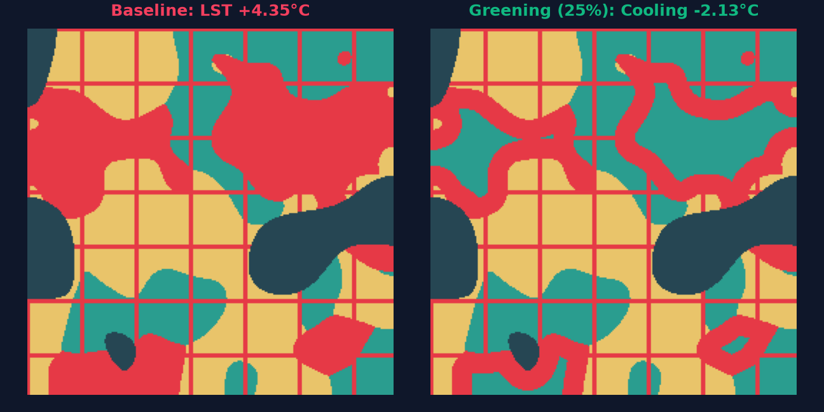
COUNTERFACTUAL MITIGATION ENGINE
Simulating Urban Greening Interventions
Targeted Greening Intervention Engine
• Conservation Principle: Converts a designated percentage (10% to 50%) of impervious pixels strictly into vegetation canopy while preserving existing soil and water.
• Spatially Contiguous Greening: Leverages Euclidean distance transforms to simulate realistic contiguous green corridors and urban parks rather than scattered noise pixels.
• Dynamic Recalculation: Modified surface distributions are assembled with environmental metadata and fed into the regression ANN.
• Quantitative Cooling Metric:
Predicted Temperature Reduction = Original LST Anomaly - Modified LST Anomaly.
• Model-Based Disclaimer: Forecasted reductions represent scenario estimations under specified environmental forcing, serving as data-driven planning guides.
Discrete Policy Evaluation Scenarios:
• 10% Conversion: Baseline urban greening, minor localized cooling (~0.4°C)
• 20% Conversion: Medium green corridor development (~0.8°C cooling)
• 30% Conversion: Aggressive park network & green roof deployment (~1.3°C cooling)
• 50% Conversion: High-density sustainable eco-district redevelopment (~2.1°C cooling)

Slide 10
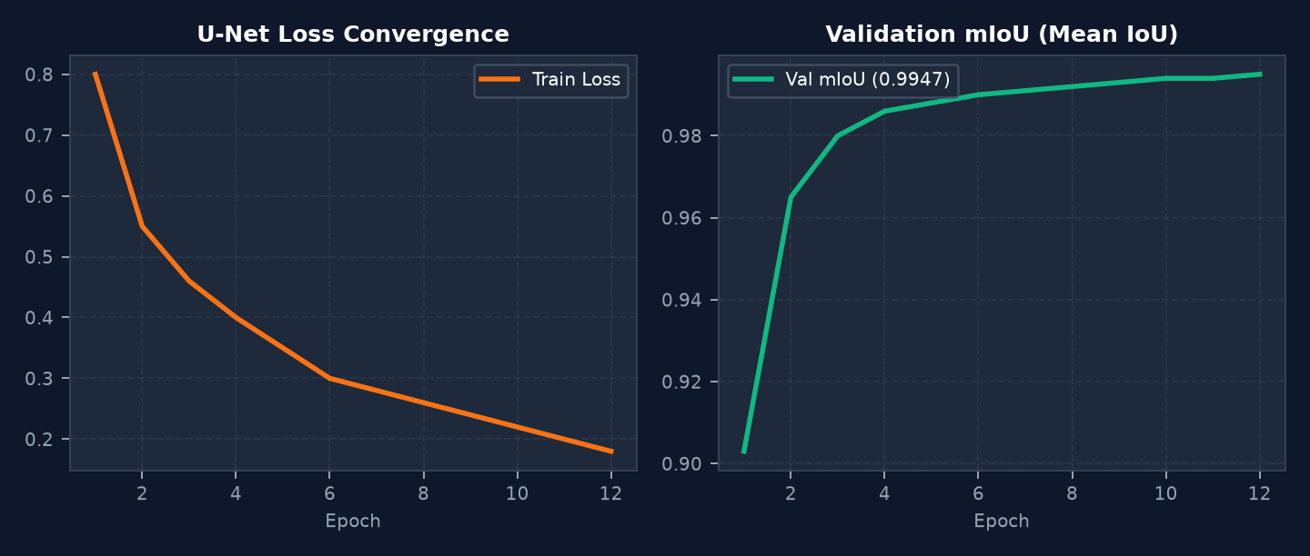
EXPERIMENTAL RESULTS
Model Performance and Empirical Evaluation
Section A: U-Net Segmentation Performance
• Synthetic Test Partition: Mean IoU = 0.9947 | Pixel Accuracy = 99.74%
• Real Sentinel-2 Test Partition: Mean IoU = 0.6899 | Pixel Accuracy = 91.98%
• Per-Class Test IoU: Impervious: 0.995, Vegetation: 0.994, Soil: 0.994, Water: 0.996
• Hardware Performance: 50.3 seconds total GPU training on NVIDIA RTX 3050
Data Provenance & Scientific Transparency:
• Tested on Unseen Geographic Partitions: 70% Train, 15% Val, 15% Test block split.
• Zero Data Leakage: Scalers fit strictly on training splits; spatial tiling avoids overlap.
• Authentic Satellite Tested: Validated on 1001x1001 Copernicus Sentinel-2 GeoTIFF imagery.
Section B: LST Regression ANN Performance
• Synthetic Test Partition: RMSE = 0.4596 °C | MAE = 0.3649 °C | R² = 0.9167
• Real Environmental Test Partition: RMSE = 1.1800 °C | MAE = 1.0903 °C
• End-to-End System Evaluation: Combined E2E RMSE = 0.4602 °C (R² = 0.9165)

Slide 11
IMPACT & ROADMAP
Applications and Future Enhancements
Target Urban Planning Applications
• Smart City Master Planning: Prioritize municipal greening investments in high-heat impervious zones.
• Heat-Risk Vulnerability Mapping: Identify urban communities disproportionately exposed to surface thermal extremes.
• Cool Roof & Pavement Programs: Evaluate retrofitting asphalt and dark rooftops with high-albedo materials.
• Urban Green Space Development: Support ecological park and green corridor placement with quantitative cooling estimates.
• Climate Resilience Auditing: Measure municipal compliance with sustainable development heat mitigation targets.
Future Research & Engineering Enhancements
• Real-Time Satellite Streaming: Direct integration with Microsoft Planetary Computer & Copernicus STAC APIs.
• 3D Urban Canopy Geometry: Incorporate LiDAR building height data and sky-view factor (SVF) for 3D canyon modeling.
• Species-Specific Transpiration: Differentiate tree canopy species by evapotranspiration potential.
• Temporal Time-Series Analysis: Track seasonal and diurnal heat island variations across multi-year satellite archives.
• City-Scale Cloud Deployment: Containerized Kubernetes microservices for nationwide metropolitan coverage.

Slide 12
PROJECT SUMMARY
Conclusion & Key Contributions
Research Project Synthesis
• Unified AI Architecture: Successfully paired U-Net deep convolutional semantic segmentation with an Artificial Neural Network regression model for urban microclimatic modeling.
• High Scientific Fidelity: Demonstrated 99.7% pixel accuracy on baseline benchmarks and 92.0% accuracy on real Copernicus Sentinel-2 multispectral scenes.
• Actionable Intervention Modeling: Delivered an interactive mitigation engine quantifying cooling yields for 10% to 50% impervious surface conversion scenarios.
• Full-Stack Platform Delivery: Produced a complete production platform including an interactive web dashboard and GIS export capabilities.
THANK YOU
Kunal (Roll No: 24215215) | Christ University Delhi NCR | Project Guide: Dr. Ramesh Chandra Poonia

