Slide 1
B.Tech. 8th Semester Major Project Presentation
On
“ Household Income Prediction Using Machine Learning ”
Presented by:
Name(s): Adyasar Swagat Khamari, Kunal Sharma
Registration Number(s): 1901341009, 1901341021
Branch: Computer Science and Engineering
Supervised by:
Name: Satyabrat Sahoo
Designation:
Department: Computer Science and Engineering
Date: 7th June 2023

Slide 2
CONTENTS
Introduction
Literature Review
Motivation
Objective
Methodology
Algorithm Flowchart/Pseudocode
Data Flow Diagram
Results and Discussion
Screengrabs of Project Environment
Conclusion
References and Bibliography

Slide 3
1. Introduction
Household income refers to the total earnings received by all individuals in a household over a specific period, typically a year. It serves as a critical measure of economic well-being and is influenced by various factors such as employment status, education level, occupation, and economic condition
The presence of income disparities and related challenges highlights the need to accurately predict and understand household income dynamics
There were attempts before to calculate household income, but they were unable to achieve the accuracy we achieved using a neural network machine learning method.
Moreover, the project focuses on enhancing usability through the development of a user-friendly interface using Streamlit.

Slide 4
2. Literature Review
Ref. | Year | Publisher | Author(s) | Proposed Model | Objective | Limitation
1 | 2021 | IEEE | Sri Y. Bhavya, et al. | Family Expenditure and Income Analysis using Machine Learning algorithms. | To manage all the expenses of a family by performing expenditure analysis and income prediction | Unable to learn complex relationships
2 | 2019 | IJITEE | Vipul, P., et al. | Expenditure Predicting Using Machine Learning. | To build a system that help in managing personal finance of the user by predicting upcoming expenses using machine learning | Simple linear regression used in the project so value of output can be declined in accuracy
3 | 2022 | IEEE | Rehman, Abd Ur, et al. | Analysis Of Income On The Basis Of Occupation Using Data Mining. | To demonstrate the use of Machine learning and data mining techniques to solve income inequality issues
4 | 2021 | Science Direct | Bodendorf, et al. | A machine learning approach to estimate product costs in the early product design phase: a use case from the automotive industry. | Present an intelligent approach based on machine learning to support cost management in early design phases | All model seem to estimate the total cost with high accuracy but undervalue to some degree

Slide 5
3. Motivation
We can accurately predict household income by leveraging the power of machine learning algorithms, allowing individuals and organizations to make informed financial decisions.
This project has the potential to transform the field by providing policymakers with valuable insights that will allow them to design effective interventions, allocate resources more efficiently, and improve overall economic well-being.
Furthermore, it advances the field of machine learning and encourages interdisciplinary collaboration by bringing together expertise from computer science, economics, and social sciences.

Slide 6
4. Objective
The objective of our project on "Household Income Prediction Using Machine Learning" is to develop a robust and accurate predictive model that can estimate household income based on various relevant factors.
Our project strives to bring tangible benefits to society by fostering economic stability, informed decision-making, and equitable resource distribution.

Slide 7
5. Methodology
Data Collection and Preprocessing- Pandas library and standard scalar class from scikit-learn library
Model Development- Tensor flow library
Hyper parameter tuning- Grid search
Model training and evaluation
Deployment- Streamlit Library

Slide 8
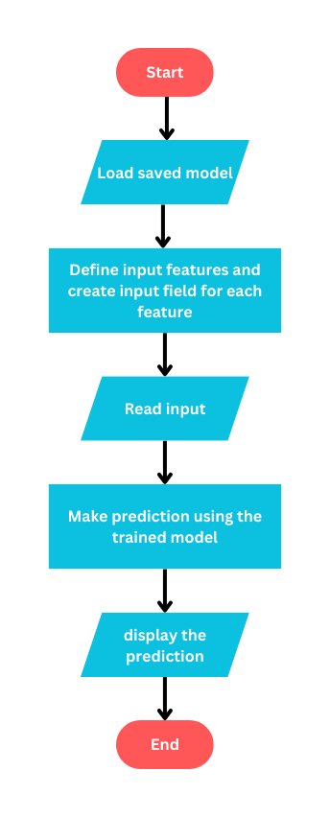
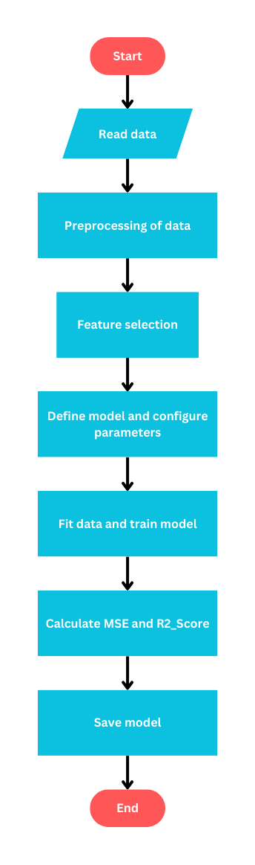
6. Flow-Chart / Pseudocode

Slide 9
7. DFD / PFD / UMLD
Students need to present the followings used in this research/project :
The data flow or the process flow describing a process, its constituent tasks, and their sequence to model the system.
The structure & behavioural diagrams that depicts the workflow of stepwise activities of the system along with its main actors, roles, actions, artifacts or classes, in order to better understand, alter, maintain, or document information about the system.

Slide 10
7. ERD
Students need to represent the backend databases if used in this research/project.

Slide 11
8. Results and Discussion
Linear Regression, Random Forest, K-Nearest Neighbours, Neural Networks, and Gradient Boosting Machines exhibit relatively low Mean Squared Error values, indicating better predictive accuracy compared to other algorithms.
Linear Regression, Random Forest, and Gradient Boosting Machines achieve higher R2 Scores, indicating a better fit of the models to the data and higher predictive power.
After some hyperparameter tuning, we were able to get the neural network to perform at its best.
Decision Tree and Support Vector Machines show comparatively higher Mean Squared Error and lower R2 Scores, suggesting potential limitations in their predictive performance

Slide 12
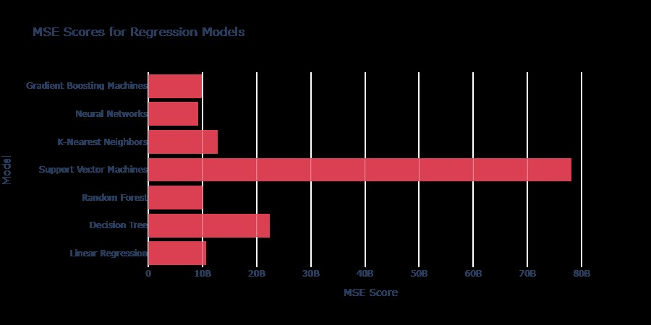
8. Results and Discussion

Slide 13
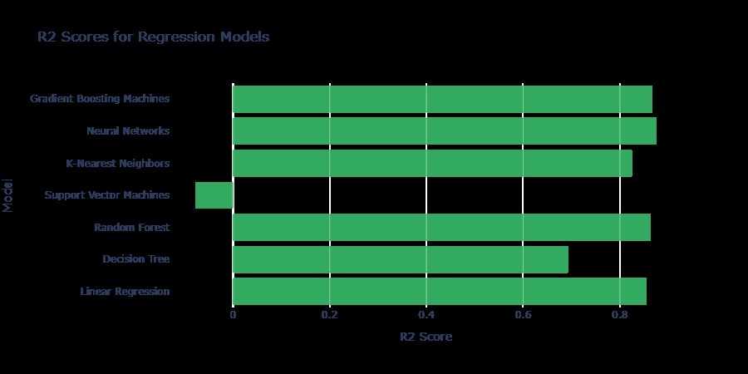
8. Results and Discussion

Slide 14
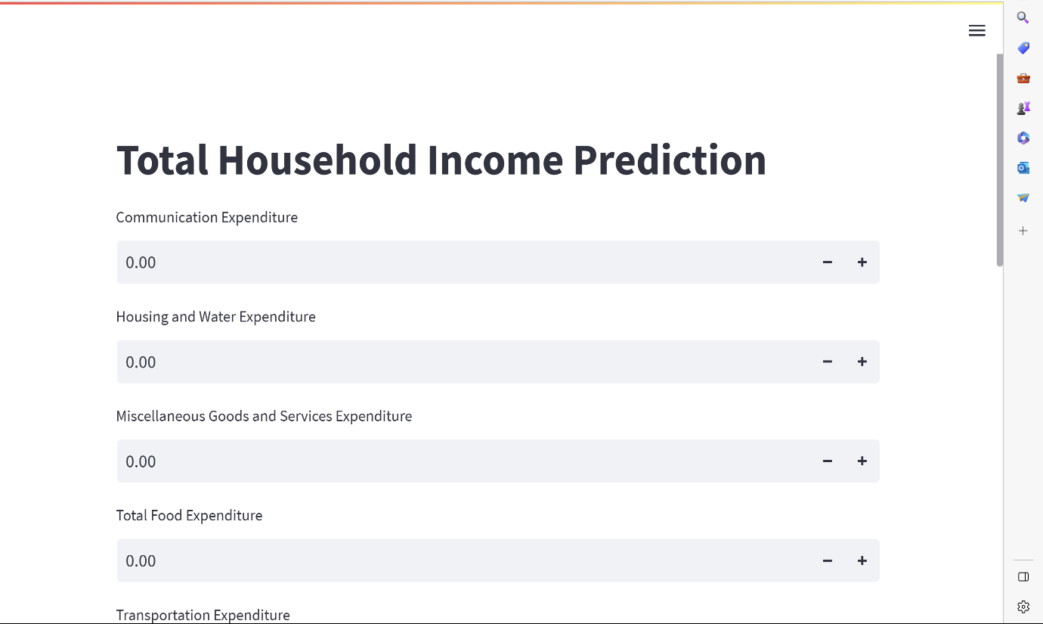
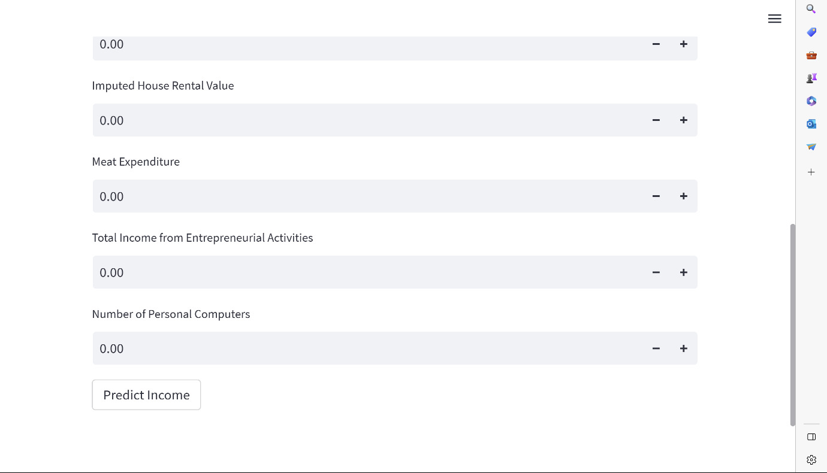
9. Screengrabs of Running Project Environment

Slide 15
10. Conclusion
Based on our analysis, Neural Network emerged as the most accurate algorithm for Total Household Income prediction.
We incorporated this algorithm into a user-friendly frontend interface using the Streamlit library, allowing users to obtain real-time predictions conveniently.

Slide 16
12. References and Bibliography
Vipul, P., et al. "Expenditure Predicting Using Machine Learning." International Journal of Innovative Technology and Exploring Engineering (IJITEE) (2019).
Rehman, Abd Ur, et al. "Analysis of Income on the Basis of Occupation using Data Mining." 2022 International Conference on Business Analytics for Technology and Security (ICBATS). IEEE, 2022.Shin, M., & Kim, J. (2019). A Machine Learning Approach for Household Income Prediction Using Geospatial Data. International Journal of Advanced Computer Science and Applications, 10(9), 153-160

Slide 17
12. References and Bibliography
Sri, Y. Bhavya, et al. "Family Expenditure and Income Analysis using Machine Learning algorithms." 2021 Second International Conference on Smart Technologies in Computing, Electrical and Electronics (ICSTCEE). IEEE, 2021.Fuchs, G., & Chawla, N. V. (2018). Machine Learning for Income Range Prediction: An Exploratory Analysis. In Proceedings of the 2018 International Conference on Big Data and Machine Learning (pp. 59-66)
Bodendorf, Frank, and Jörg Franke. "A machine learning approach to estimate product costs in the early product design phase: a use case from the automotive industry." Procedia CIRP 100 (2021): 643-648

Slide 18
THANK YOU

