Slide 1
Reduction to Relation Schemas
Primary keys allow entity sets and relationship sets to be expressed uniformly as relation schemas that represent the contents of the database.
A database which conforms to an E-R diagram can be represented by a collection of schemas.
For each entity set and relationship set there is a unique schema that is assigned the name of the corresponding entity set or relationship set.
Each schema has a number of columns (generally corresponding to attributes), which have unique names.

Slide 2
Representing Entity Sets as Schemas
A strong entity set reduces to a schema with the same attributes.
A weak entity set becomes a table that includes a column for the primary key of the identifying strong entity set
payment =
( loan_number, payment_number, payment_date, payment_amount )

Slide 3
Representing Relationship Sets as Schemas
A many-to-many relationship set is represented as a schema with attributes for the primary keys of the two participating entity sets, and any descriptive attributes of the relationship set.
Example: schema for relationship set borrower
borrower = (customer_id, loan_number )

Slide 4
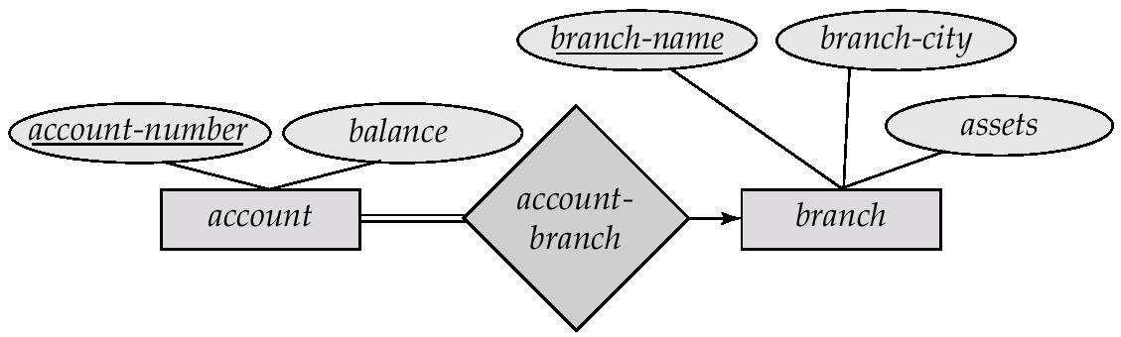
Redundancy of Schemas
Many-to-one and one-to-many relationship sets that are total on the many-side can be represented by adding an extra attribute to the “many” side, containing the primary key of the “one” side
Example: Instead of creating a schema for relationship set account_branch, add an attribute branch_name to the schema arising from entity set account

Slide 5
Redundancy of Schemas (Cont.)
For one-to-one relationship sets, either side can be chosen to act as the “many” side
That is, extra attribute can be added to either of the tables corresponding to the two entity sets
If participation is partial on the “many” side, replacing a schema by an extra attribute in the schema corresponding to the “many” side could result in null values
The schema corresponding to a relationship set linking a weak entity set to its identifying strong entity set is redundant.
Example: The payment schema already contains the attributes that would appear in the loan_payment schema (i.e., loan_number and payment_number).

Slide 6
Composite and Multivalued Attributes
Composite attributes are flattened out by creating a separate attribute for each component attribute
Example: given entity set customer with composite attribute name with component attributes first_name and last_name the schema corresponding to the entity set has two attributes name.first_name and name.last_name
A multivalued attribute M of an entity E is represented by a separate schema EM
Schema EM has attributes corresponding to the primary key of E and an attribute corresponding to multivalued attribute M
Example: Multivalued attribute dependent_names of employee is represented by a schema: employee_dependent_names = ( employee_id, dname)
Each value of the multivalued attribute maps to a separate tuple of the relation on schema EM
For example, an employee entity with primary key 123-45-6789 and dependents Jack and Jane maps to two tuples: (123-45-6789 , Jack) and (123-45-6789 , Jane)

Slide 7
Representing Specialization via Schemas
Method 1:
Form a schema for the higher-level entity
Form a schema for each lower-level entity set, include primary key of higher-level entity set and local attributes schema attributes person name, street, city customer name, credit_rating employee name, salary
Drawback: getting information about, an employee requires accessing two relations, the one corresponding to the low-level schema and the one corresponding to the high-level schema

Slide 8
Representing Specialization as Schemas (Cont.)
Method 2:
Form a schema for each entity set with all local and inherited attributes
schema attributes person name, street, city customer name, street, city, credit_rating employee name, street, city, salary
Drawback: street and city may be stored redundantly for people who are both customers and employees

Slide 9
Schemas Corresponding to Aggregation
To represent aggregation, create a schema containing
primary key of the aggregated relationship,
the primary key of the associated entity set
any descriptive attributes

Slide 10
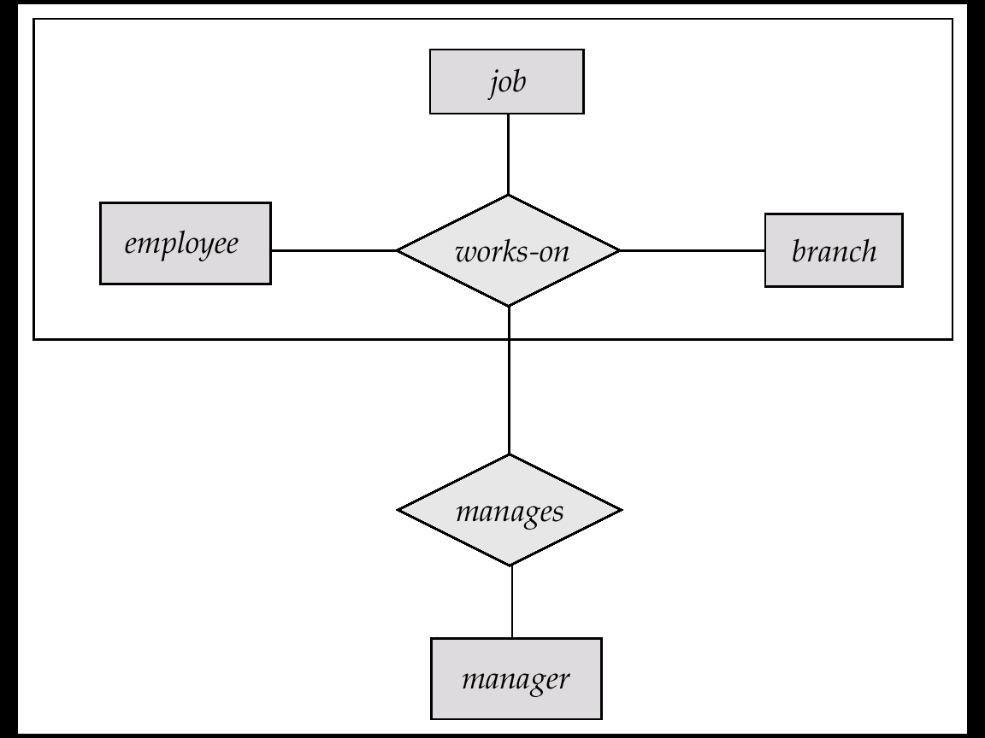
Schemas Corresponding to Aggregation (Cont.)
For example, to represent aggregation manages between relationship works_on and entity set manager, create a schema
manages (employee_id, branch_name, title, manager_name)
Schema works_on is redundant

