Slide 1
CIS 674
Introduction to Data Mining
Srinivasan Parthasarathy
srini@cse.ohio-state.edu
Office Hours: TTH 2-3:18PM
DL317
© Prentice Hall

Slide 2
Introduction Outline
Goal: Provide an overview of data mining.
Define data mining
Data mining vs. databases
Basic data mining tasks
Data mining development
Data mining issues
© Prentice Hall

Slide 3
Introduction
Data is produced at a phenomenal rate
Our ability to store has grown
Users expect more sophisticated information
How?
UNCOVER HIDDEN INFORMATION
DATA MINING
© Prentice Hall

Slide 4
Data Mining
Objective: Fit data to a model
Potential Result: Higher-level meta information that may not be obvious when looking at raw data
Similar terms
  Exploratory data analysis
  Data driven discovery
  Deductive learning
© Prentice Hall

Slide 5
Data Mining Algorithm
Objective: Fit Data to a Model
  Descriptive
  Predictive
Preferential Questions
  Which technique to choose?
    ARM/Classification/Clustering
    Answer: Depends on what you want to do with data?
  Search Strategy – Technique to search the data
    Interface? Query Language?
    Efficiency
© Prentice Hall

Slide 6
Database Processing vs. Data Mining Processing
Query
  Well defined
  SQL
Query
  Poorly defined
  No precise query language
Output
  Precise
  Subset of database
Output
  Fuzzy
  Not a subset of database
© Prentice Hall

Slide 7
Query Examples
Database
Data Mining
Find all credit applicants with last name of Smith.
  Identify customers who have purchased more than $10,000 in the last month.
        Find all customers who have purchased milk
  Find all credit applicants who are poor credit risks. (classification)
        Identify customers with similar buying habits. (Clustering)
        Find all items which are frequently purchased with milk. (association rules)
© Prentice Hall

Slide 8
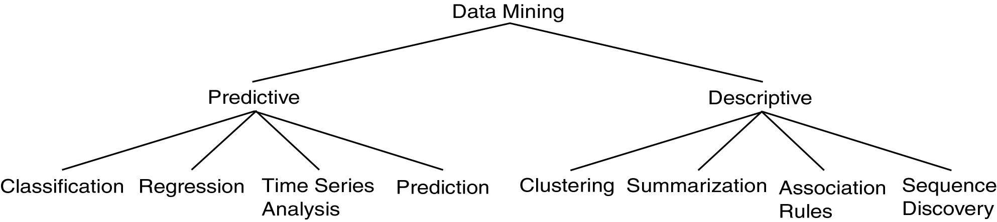
Data Mining Models and Tasks
© Prentice Hall

Slide 9
Basic Data Mining Tasks
Classification maps data into predefined groups or classes
  Supervised learning
  Pattern recognition
  Prediction
Regression is used to map a data item to a real valued prediction variable.
Clustering groups similar data together into clusters.
  Unsupervised learning
  Segmentation
  Partitioning
© Prentice Hall

Slide 10
Basic Data Mining Tasks (cont’d)
Summarization maps data into subsets with associated simple descriptions.
  Characterization
  Generalization
Link Analysis uncovers relationships among data.
  Affinity Analysis
  Association Rules
  Sequential Analysis determines sequential patterns.
© Prentice Hall

Slide 11
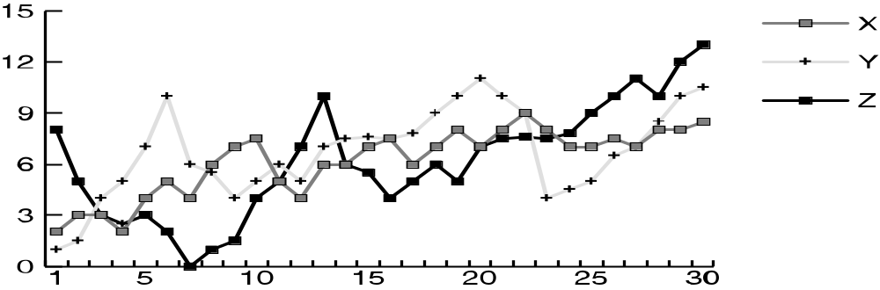
Ex: Time Series Analysis
Example: Stock Market
Predict future values
Determine similar patterns over time
Classify behavior
© Prentice Hall

Slide 12
Data Mining vs. KDD
Knowledge Discovery in Databases (KDD): process of finding useful information and patterns in data.
Data Mining: Use of algorithms to extract the information and patterns derived by the KDD process.
© Prentice Hall

Slide 13
Knowledge Discovery Process
Knowledge
  Data mining: the core of knowledge discovery process.
Knowledge Interpretation
Data Mining
Task-relevant Data
Data transformations
Preprocessed Data
Selection
Data Cleaning
Data Integration
Databases

Slide 14
KDD Process Ex: Web Log
Selection:
  Select log data (dates and locations) to use
Preprocessing:
  Remove identifying URLs
  Remove error logs
Transformation:
  Sessionize (sort and group)
Data Mining:
  Identify and count patterns
  Construct data structure
Interpretation/Evaluation:
  Identify and display frequently accessed sequences.
Potential User Applications:
  Cache prediction
  Personalization
© Prentice Hall

Slide 15
Data Mining Development
Similarity Measures
Hierarchical Clustering
IR Systems
Imprecise Queries
Textual Data
Web Search Engines
Relational Data Model
SQL
Association Rule Algorithms
Data Warehousing
Scalability Techniques
Bayes Theorem
Regression Analysis
EM Algorithm
K-Means Clustering
Time Series Analysis
DATA MINING
Algorithm Design Techniques
Algorithm Analysis
Data Structures
Neural Networks
Decision Tree Algorithms
HIGH PERFORMANCE
© Prentice Hall

Slide 16
KDD Issues
Human Interaction
Overfitting
Outliers
Interpretation
Visualization
Large Datasets
High Dimensionality
© Prentice Hall

Slide 17
KDD Issues (cont’d)
Multimedia Data
Missing Data
Irrelevant Data
Noisy Data
Changing Data
Integration
Application
© Prentice Hall

Slide 18
Social Implications of DM
Privacy
Profiling
Unauthorized use
© Prentice Hall

Slide 19
Data Mining Metrics
Usefulness
Return on Investment (ROI)
Accuracy
Space/Time
© Prentice Hall

Slide 20
Database Perspective on Data Mining
Scalability
Real World Data
Updates
Ease of Use
© Prentice Hall

Slide 21
Outline of Today’s Class
Statistical Basics
  Point Estimation
  Models Based on Summarization
  Bayes Theorem
  Hypothesis Testing
  Regression and Correlation
Similarity Measures
© Prentice Hall

Slide 22
Point Estimation
Point Estimate: estimate a population parameter.
May be made by calculating the parameter for a sample.
May be used to predict value for missing data.
Ex:
  R contains 100 employees
  99 have salary information
  Mean salary of these is $50,000
  Use $50,000 as value of remaining employee’s salary.
  Is this a good idea?
© Prentice Hall

Slide 23

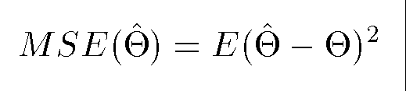
Estimation Error
Bias: Difference between expected value and actual value.
Mean Squared Error (MSE): expected value of the squared difference between the estimate and the actual value:
Why square?
Root Mean Square Error (RMSE)
© Prentice Hall

Slide 24
Jackknife Estimate
Jackknife Estimate: estimate of parameter is obtained by omitting one value from the set of observed values.
  Treat the data like a population
  Take samples from this population
  Use these samples to estimate the parameter
Let θ(hat) be an estimate on the entire pop.
Let θ_{(j)}(hat) be an estimator of the same form with observation j deleted
Allows you to examine the impact of outliers!
© Prentice Hall

Slide 25
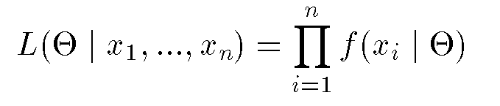
Maximum Likelihood Estimate (MLE)
Obtain parameter estimates that maximize the probability that the sample data occurs for the specific model.
Joint probability for observing the sample data by multiplying the individual probabilities. Likelihood function:
Maximize L.
© Prentice Hall

Slide 26
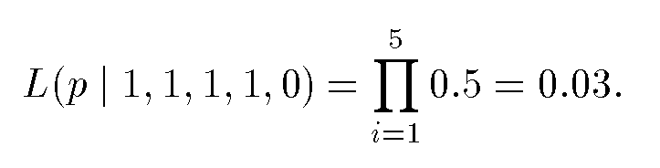
MLE Example
Coin toss five times: {H,H,H,H,T}
Assuming a perfect coin with H and T equally likely, the likelihood of this sequence is:
However if the probability of a H is 0.8 then:
© Prentice Hall

Slide 27
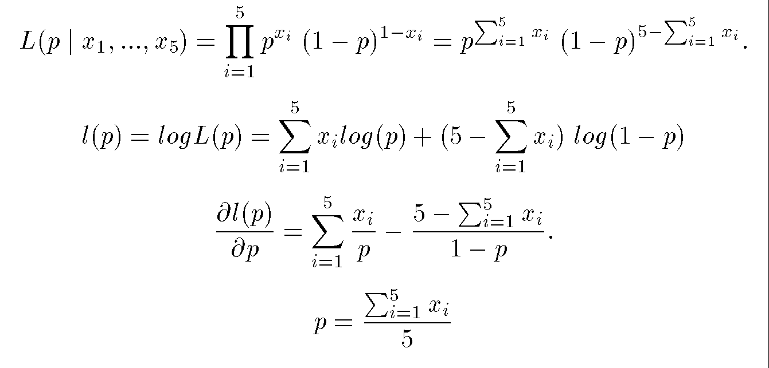
MLE Example (cont’d)
General likelihood formula:
Estimate for p is then 4/5 = 0.8
© Prentice Hall

Slide 28
Expectation-Maximization (EM)
Solves estimation with incomplete data.
Obtain initial estimates for parameters.
Iteratively use estimates for missing data and continue until convergence.
© Prentice Hall

Slide 29
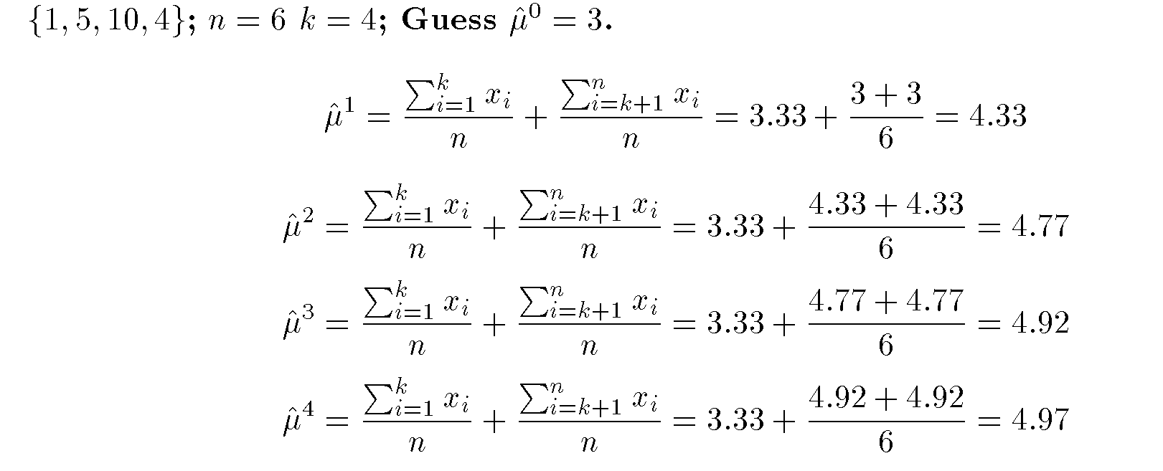
EM Example
© Prentice Hall

Slide 30
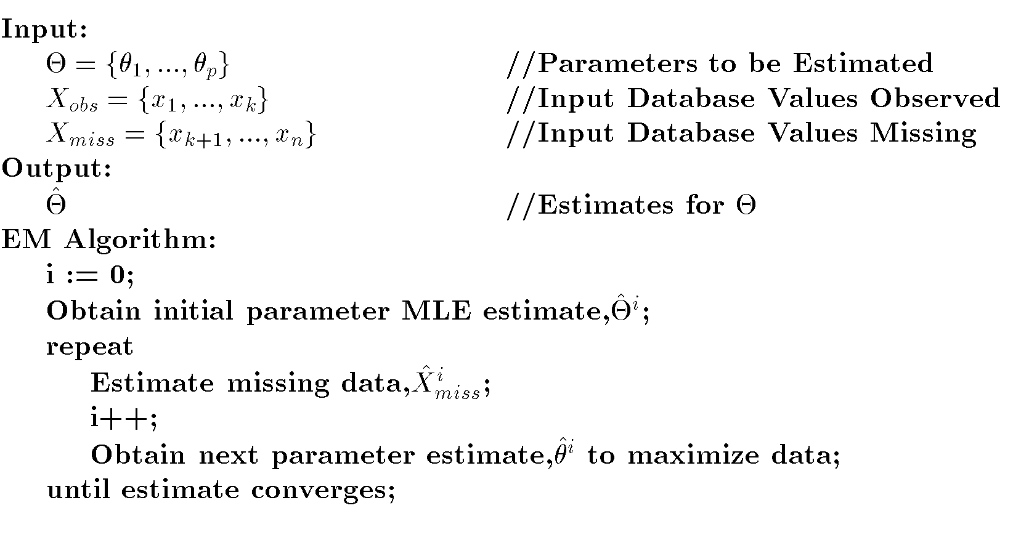
EM Algorithm
© Prentice Hall

Slide 31

Bayes Theorem Example
Credit authorizations (hypotheses): h₁=authorize purchase, h₂ = authorize after further identification, h₃=do not authorize, h₄= do not authorize but contact police
Assign twelve data values for all combinations of credit and income:
From training data: P(h₁) = 60%; P(h₂)=20%; P(h₃)=10%; P(h₄)=10%.
© Prentice Hall

Slide 32
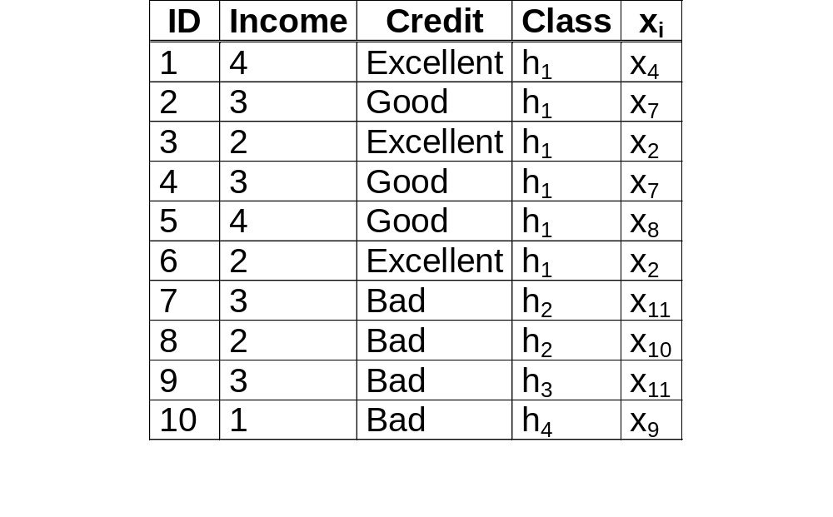
Bayes Example(cont’d)
Training Data:
© Prentice Hall

Slide 33
Bayes Example(cont’d)
Calculate P(x_{i}|h_{j}) and P(x_{i})
Ex: P(x₇|h₁)=2/6; P(x₄|h₁)=1/6; P(x₂|h₁)=2/6; P(x₈|h₁)=1/6; P(x_{i}|h₁)=0 for all other x_{i}.
Predict the class for x₄:
  Calculate P(h_{j}|x₄) for all h_{j}.
  Place x₄ in class with largest value.
  Ex:
    P(h₁|x₄)=(P(x₄|h₁)(P(h₁))/P(x₄)
    =(1/6)(0.6)/0.1=1.
    x₄ in class h₁.
© Prentice Hall

Slide 34
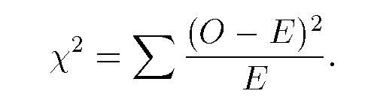
Other Statistical Measures
Chi-Squared
  O – observed value
  E – Expected value based on hypothesis.
Jackknife Estimate
  estimate of parameter is obtained by omitting one value from the set of observed values.
Regression
  Predict future values based on past values
  Linear Regression assumes linear relationship exists.
y = c₀ + c₁ x₁ + … + c_{n} x_{n}
    Find values to best fit the data
Correlation
© Prentice Hall

Slide 35
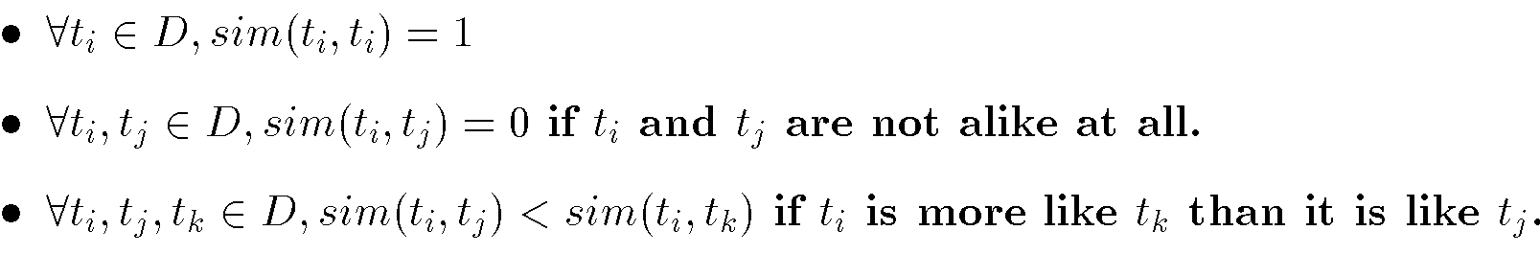
Similarity Measures
Determine similarity between two objects.
Similarity characteristics:
Alternatively, distance measure measure how unlike or dissimilar objects are.
© Prentice Hall

Slide 36
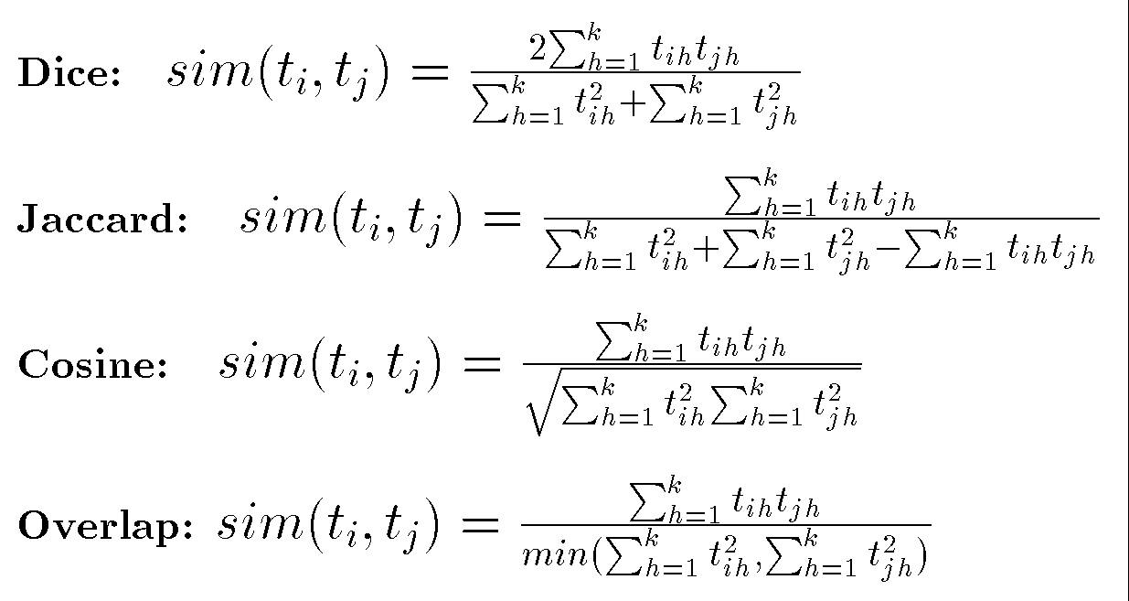
Similarity Measures
© Prentice Hall

Slide 37
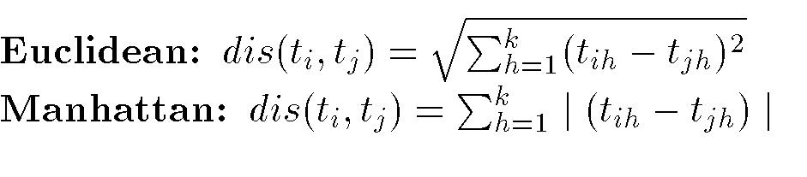
Distance Measures
Measure dissimilarity between objects
© Prentice Hall

Slide 38
Information Retrieval
Information Retrieval (IR): retrieving desired information from textual data.
Library Science
Digital Libraries
Web Search Engines
Traditionally keyword based
Sample query:
  Find all documents about “data mining”.
DM: Similarity measures;
Mine text/Web data.
© Prentice Hall

Slide 39
Information Retrieval (cont’d)
Similarity: measure of how close a query is to a document.
Documents which are “close enough” are retrieved.
Metrics:
  Precision = |Relevant and Retrieved|
  |Retrieved|
  Recall = |Relevant and Retrieved|
  |Relevant|
© Prentice Hall

Slide 40
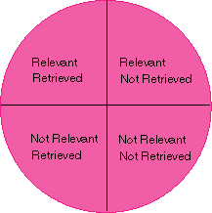
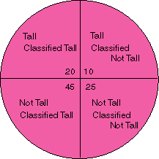
IR Query Result Measures and Classification
IR
Classification
© Prentice Hall

