Slide 1
Unit-5
Failure types
Remote Backup Systems
ARIES Recovery Algorithm
Overview of NoSQL
History of NoSQL
Types of NoSQL
Basic CRUD operations of NoSQL (Using MongoDb)

Slide 2
Failure Classification
To find that where the problem has occurred, we generalize a failure into the following categories:
1. Transaction failure
The transaction failure occurs when it fails to execute or when it reaches a point from where it can't go any further. If a few transaction or process is hurt, then this is called as transaction failure.
Reasons for a transaction failure could be -
Logical errors: If a transaction cannot complete due to some code error or an internal error condition, then the logical error occurs.
Syntax error: It occurs where the DBMS itself terminates an active transaction because the database system is not able to execute it. For example, The system aborts an active transaction, in case of deadlock or resource unavailability.

Slide 3
2. System Crash
System failure can occur due to power failure or other hardware or software failure. Example: Operating system error.
Fail-stop assumption: In the system crash, non-volatile storage is assumed not to be corrupted.
3. Disk Failure
It occurs where hard-disk drives or storage drives used to fail frequently. It was a common problem in the early days of technology evolution.
Disk failure occurs due to the formation of bad sectors, disk head crash, and unreachability to the disk or any other failure, which destroy all or part of disk storage.

Slide 4
Remote Backup Systems
Remote backup systems are used to ensure high availability by allowing transactions to be processed even though primary site got damaged.
Primary site – system at which actual database transactions are carried out and log records are preserved.
Remote site – system at which copies of primary site database,transactions and log records are replicated. Also called secondary site.
Remote site gets synchronized periodically with primary site by recording log records of primary site.
When a primary site is crashed, remote site is activated as alternative system to continue database transactions. This ensures high availability of data access despite of system failures.

Slide 5
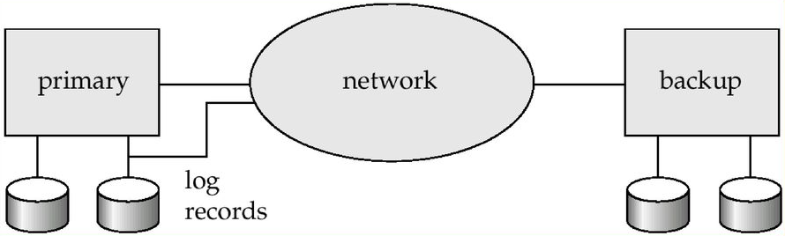
Remote Backup Systems

Slide 6
Remote Backup Systems
Several issues can be addressed with the design of Remote backup systems.
Detection of failure
Remote back system should be able to detect the failure of primary site
Sometimes failure of communication lines may also fool the backup system that primary got failed.
So multiple alternative communication links were used between primary and backup systems.
Example: Internet connection through telecommunication links.
Transfer of control
If primary site gets failed,backup site takes over and perform transaction processing.
First it restores the database to a consistent state and perform redo or undo operations by consulting the synchronized log records.
If primary site got recovered,it can pretend like either primary or secondary site. But once recovered, all the updates performed so far by secondary should be synced with primary site.

Slide 7
Remote Backup Systems
Several issues can be addressed with the design of Remote backup systems.
Time to recover
Remote system also stores log records whose size may grows large. This leads to delay in recovery of databases.
So remote system also should clean the unnecessary log information by implementing frequent checkpoints
Time to commit
A transaction is declared as commit only when its log records from stable storage are synced with backup site. This ensures durability of transactions.
Degrees of durability
One-safe – Transaction is said to be committed if only primary site stores the log records
Two-very safe – Transaction is said to be committed if both primary,remote sites stores the log records
Two safe – Transaction is said to be committed if both primary, remote sites both are active.

Slide 8
ARIES Recovery Algorithm
Stands for Advanced Recovery Isolation & Exploiting Semantics
Industry’s most widely used recovery mechanism
Used to recover data from system crashes.
Uses number of techniques to reduce the time taken to recover data
Reduces the overhead of checkpointing
Avoids redoing unnecessary logging information which periodically grows with transactions

Slide 9
ARIES Recovery Algorithm
Characteristics
Uses LSN (Logical Sequence Number)
A unique identifier of log records
Performs Physiological Redo operations
Performs redo,undo operations using LSN
Uses Dirty Page Tables
Buffer blocks that stores transaction updates in Main memory but not output to disk.
Fuzzy Checkpointing
Allows other transactions to input and output with interleaving current transaction during recording checkpoints

Slide 10
ARIES Recovery Algorithm
ARIES recovers the data from system crash using Three phases:
Analysis phase
Determines which transactions are eligible for redo and undo operations. Also records LSN of log records.
Redo phase
Performs redo operations for those transactions obtained from analysis phase.
Undo phase
Performs undo operations for those transactions obtained from analysis phase.

Slide 11
Overview of NoSQL
Stands for ‘Not only SQL’ and also ‘Non-SQL’.
It is a Non-Relational database used to store data differently other than tabular formats.
More suitable for web service based applications, Cloud services, Video/Audio Streamings for storing and retrieving huge data efficiently.
Comes with variety of formats

Slide 12
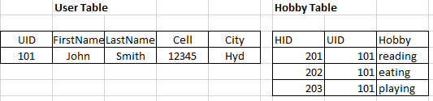
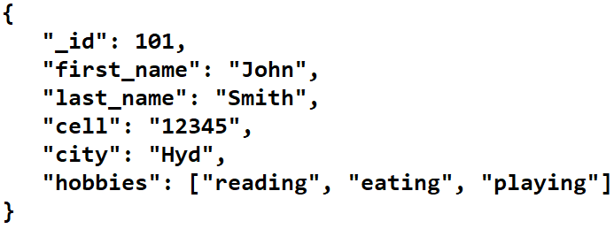
Sample Need of SQL
Suppose consider two tables User,Hobbies. We need to join two tables to fetch complete user details with hobbies.
But with NoSQL it can be done without any joins.

Slide 13
Advantages of NoSQL over RDBMS
Flexible schemas – uses data independent interchange formats to compatible with many variety of databases. Uses JSON format.
Horizontal scaling – ability to expand and share the database load by adding additional servers/systems
Fast execution of queries – No additional collections required to link documents
Ease of use for developers
Reduction of memory loads
Able to store huge amounts of data

Slide 14
Types of NoSQL databases
Document databases
Key-Value stores databases
Graph databases
Column oriented databases

Slide 15
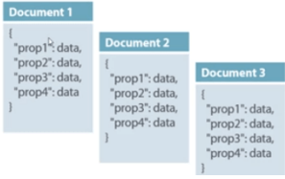
Document based databases
A document database stores data in JSON, BSON, or XML documents.
Structure
{Key1:Value1, Key2:Value2,....KeyN:ValueN}
Keys are like columns in RDBMS and All keys are string type
There could exists nested keys and values.
Convertible to Dictionaries in Python,Hash Tables in Java or C#, Objects in Javascript
Example databases
MongoDb, CouchDb

Slide 16
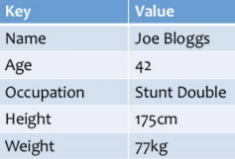
Key Value Store Databases
Simplest type of NoSQL Database.
Equivalent to document databases.Store huge amounts of data in JSON,BLOB etc.
But every data is in Key,Value type and there is no nesting of keys and values.Each key is like an attribute in Rdbms.
A key doesn’t know information about the value. And each key can be of any type.
Structure
{Key1:Value1,Key2:Value2,...KeyN:ValueN}
Example
Redis,Dynamo,Riak databases

Slide 17
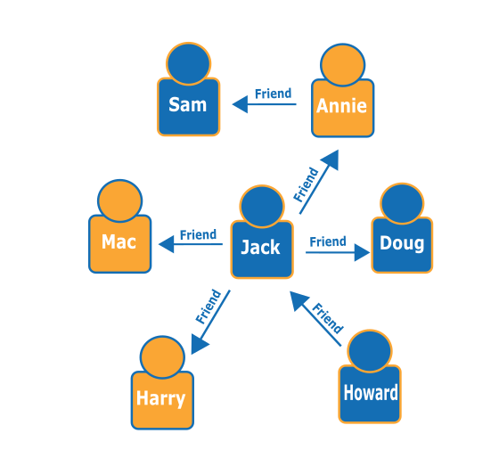
Graph Oriented databases
A graph database focuses on the relationship between data elements.
Each element is stored as a node.
The connections between elements are called edges or links or relationships.
Each edge has a start node and end node with a direction.
Eliminates the overhead of joining like tables in Rdbms.
Allows easy navigation between nodes.
Example: Neo4j,NebulaGraph, Ontotext GraphDb

Slide 18
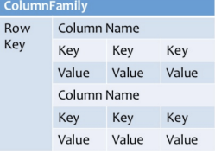
Column Oriented databases
Column-oriented databases work on columns and are based on BigTable paper by Google. Every column is treated separately.
Values of single column databases are stored contiguously.
They deliver high performance on aggregation queries like SUM, COUNT, AVG, MIN etc. as the data is readily available in a column.
They are so complex structured than other NoSQL databases.
Example: Cassandra,Hyper table, HBase databases

Slide 19
Basic CRUD operations of NoSQL (Using MongoDb)
Consider to store student data using NoSQL. We use below CRUD operations.
Creating a Collection and Inserting a Document
db.student.insertOne({‘_id’:101,’name’:’smith’,’branch’:’cse’,’marks’:70})
Retrieving existing documents from student collection
db.student.find()
Updating a document : Updating smith’s marks
db.updateOne({‘_id’:101},{$set:{’marks’:80}}) $set is a query operator to modify data
Deleting a document : Deleting smith’s document
db.student.deleteOne({‘_id’:101})

