Slide 1
CREATE COMMAND
CREATE DATABASE [IF NOT EXISTS] database_name;
USE database_name;
CREATE TABLE [IF NOT EXISTS] table_name ( column_list );
Column List:
column_name data_type(length) [NOT NULL] [DEFAULT value] [AUTO_INCREMENT]
column_list section, columns are separated by commas.

Slide 2
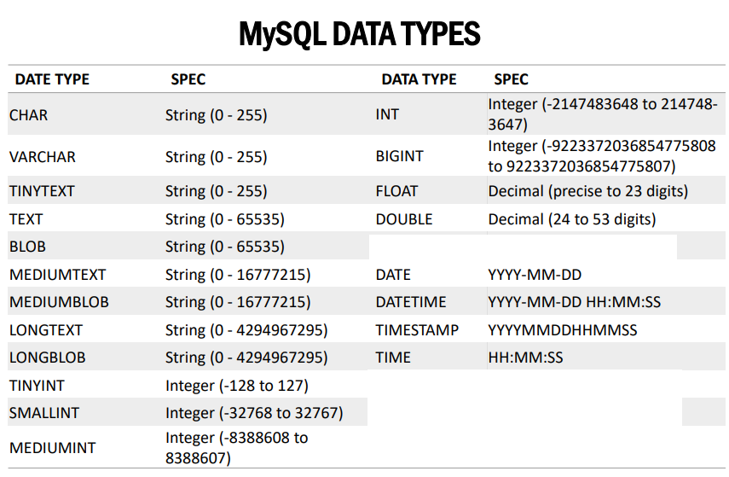
BOOLEAN TINYINT(1)

Slide 3
INSERT COMMAND
INSERT INTO table(c1,c2,...)
VALUES (v1,v2,...);
INSERT INTO table(c1,c2,...)
VALUES
(v11,v12,...),
(v21,v22,...),
...
(vnn,vn2,...);

Slide 4
SELECT COMMAND
SELECT
column_1, column_2, ...
FROM
table_1
[INNER | LEFT |RIGHT] JOIN table_2 ON conditions
WHERE
conditions
GROUP BY column_1
HAVING group_conditions
ORDER BY column_1
LIMIT offset, length;
SELECT DISTINCT columns
FROM table_name
WHERE where_conditions;
SELECT true, false, TRUE, FALSE, True, False;
SELECT true OR false AND false;
SELECT (true OR false) AND false;

Slide 5
UPDATE COMMAND
UPDATE table_name
SET
column_name1 = expr1,
column_name2 = expr2,
...
[WHERE
condition];
DELETE COMMAND
DELETE FROM table_name
WHERE condition;
TRUNCATE COMMAND
TRUNCATE TABLE table_name;

Slide 6
ALTER COMMAND
ALTER TABLE table_name action1[,action2,…]
Actions: change column, add column, drop column.
ALTER TABLE tab_name ADD COLUMN col_name datatype AFTER col_name;
ALTER TABLE tab_name DROP COLUMN col_name;
ALTER TABLE tab_name RENAME TO new_table;
DROP TABLE COMMAND:
DROP TABLE [IF EXISTS] table_name [, table_name];

Slide 7
CREATE TABLE IF NOT EXISTS tasks (
task_id INT AUTO_INCREMENT,
title VARCHAR(255) NOT NULL,
start_date DATE,
due_date DATE,
status TINYINT NOT NULL,
priority TINYINT NOT NULL,
description TEXT,
PRIMARY KEY (task_id)
) ENGINE=INNODB;

