Slide 1
Chapter 2: Entity-Relationship Model
Entity Sets
Relationship Sets
Mapping Constraints
Keys
Participation Constraints
E-R Diagram
Extended E-R Features
Design of an E-R Database Schema
Reduction of an E-R Schema to Tables
Objective: conceptual DB design using ER diagrams

Slide 2
Overview of Database Design
Conceptual design
  Use ER diagrams
    Pictorial representation of DB schema
  What are the entities and relationships in the enterprise?
    E.g. customer & account entity; deposit relationship
  What information about the entities and relationships should we store in DB?
  What are the integrity constraints or business rules that hold?
Logical design
  Transform conceptual schema into implementation model
  e.g., map an ER diagram into a relational schema
Physical design and database tuning
Notes:
2

Slide 3
Entity Sets
A database can be modeled as:
  a collection of entities,
  relationship among entities.
An entity is an object that exists and is distinguishable from other objects.
  E.g. an individual customer, account
Entities have attributes
  E.g. people have names and addresses
An entity set is a set of entities of the same type that share the same properties.
  Example: set of all customers, accounts

Slide 4
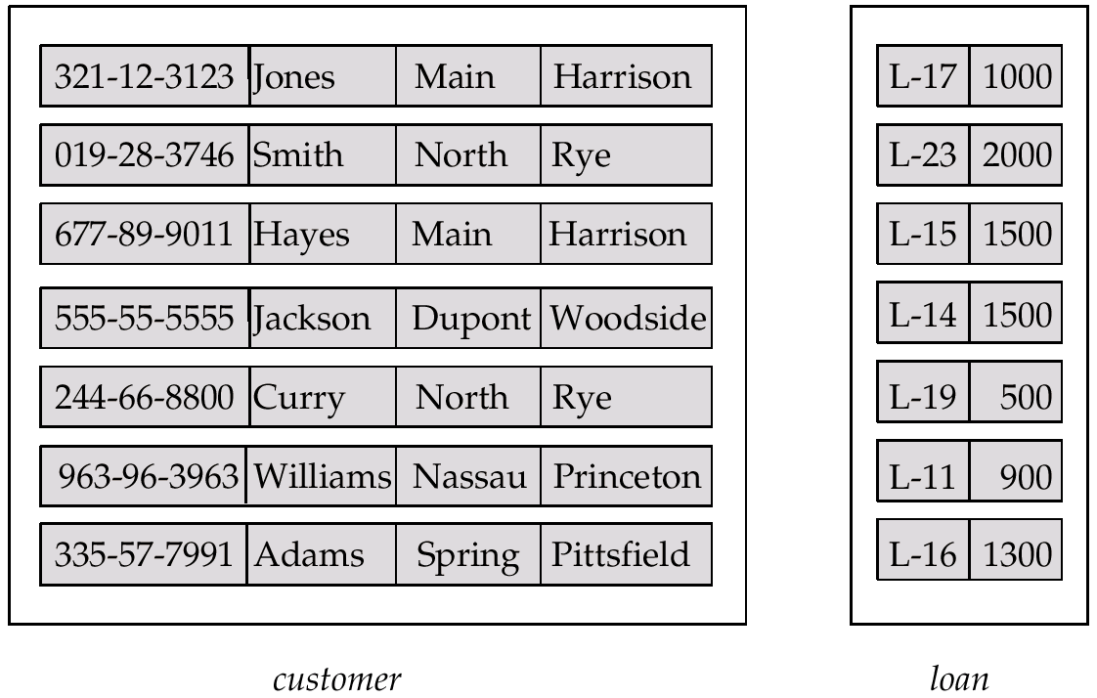
Entity Sets customer and loan
customer-id customer- customer- customer- loan- amount
name street city number

Slide 5
Attributes
Descriptive properties possessed by all members of an entity set.
Domain
  set of permitted values for each attribute
Attribute types:
  Simple and composite attributes.
  Single-valued and multi-valued attributes
    E.g. multivalued attribute: phone-numbers
  Derived attributes
    Can be computed from other attributes
    E.g. age, given date of birth

Slide 6

Composite Attributes

Slide 7
Relationship Sets
A relationship is an association among several entities
Example:
Hayes depositor A-102
customer entity relationship set account entity
A relationship set is a mathematical relation among entities {(e₁, e₂, … e_{n}) | e₁ ∈ E₁, e₂ ∈ E₂, …, e_{n} ∈ E_{n}}
where (e₁, e₂, …, e_{n}) is a relationship
  Example:
  (Hayes, A-102) ∈ depositor

Slide 8

Relationship Set borrower

Slide 9
Degree of a Relationship Set
Refers to number of entity sets that participate in a relationship set.
Binary Relationship sets
  Involve two entity sets
  Most relationship sets in DB
N-ary Relationships
  Not common
  Can be converted to binary relations
    E.g. Two binary relationships, mother and father, relating a child to her farther and mother vs. one ternary relationship parent

Slide 10
Constraints: Mapping Cardinalities
Express the number of entities to which another entity can be associated via a relationship set.
Most useful in describing binary relationship sets.
For a binary relationship set the mapping cardinality must be one of the following types:
  One to one
  One to many
  Many to one
  Many to many

Slide 11

Mapping Cardinalities
One to one
Customer to SSN
One to many
Customer to Accounts

Slide 12

Mapping Cardinalities
Many to one
More than one customer
may share a loan
Many to many
Also, one customer may
have several loans

Slide 13

Does cardinality affect ER design?
Access-date: an attribute in a relationship set
  If depositor relationship is one-to-one (many), access date can be an attribute of account entity

Slide 14
Keys
A super key of an entity set
  A set of one or more attributes whose values uniquely determine each entity
  E.g. customer id & customer name
A candidate key
  A minimal super key
  Customer id is candidate key of customer
  Account-number is candidate key of account
Although several candidate keys may exist, one of the candidate keys is selected to be the primary key.
  The DB designer has chosen to identify entities
  Can customer id be the primary key in customer entity?
  Can customer name be the primary key?

Slide 15
Keys for Relationship Sets
The combination of primary keys of the participating entity sets forms a super key of a relationship set.
  (customer-id, account-number) is the super key of depositor
    Primary-key(E1) U primary-key(E2) … U primary-key(En)
  A pair of entity sets can have at most one relationship in a particular relationship set.
    E.g. if we wish to track all access-dates to each account by each customer, we cannot assume a relationship for each access. We can use a multivalued attribute though.
    Primary-key(E1) U … primary-key(En) U {A1, A2, …, An} when the relationship set has attributes A1, A2, … An

Slide 16
Participation Constraints
Given a relationship set borrower, defined between customer and loan, do you expect every loan entity to be related to at least one customer?
  Total participation of loan in the relationship set borrower
Is each customer related to a loan entity through the borrower relationship?
  Partial participation

Slide 17

E-R Diagrams
Rectangles represent entity sets.
Diamonds represent relationship sets.
Lines link attributes to entity sets and entity sets to relationship sets.
Ellipses represent attributes
  Double ellipses represent multivalued attributes.
  Dashed ellipses denote derived attributes.
Underline indicates primary key attributes

Slide 18

E-R Diagram With Composite, Multivalued, and Derived Attributes

Slide 19

Relationship Sets with Attributes

Slide 20

Cardinality Constraints
We express cardinality constraints by drawing either a directed line (→), signifying “one,” or an undirected line (—), signifying “many,” between the relationship set and the entity set.
E.g.: One-to-one relationship
  A customer is associated with at most one loan via the relationship borrower
  A loan is associated with at most one customer via borrower

Slide 21
One-To-Many Relationship
In the one-to-many relationship a loan is associated with at most one customer via borrower, a customer is associated with several (including 0) loans via borrower

Slide 22
Many-To-One Relationships
In a many-to-one relationship a loan is associated with several (including 0) customers via borrower, a customer is associated with at most one loan via borrower

Slide 23
Many-To-Many Relationship
A customer is associated with several (possibly 0) loans via borrower
A loan is associated with several (possibly 0) customers via borrower

Slide 24

Participation of an Entity Set in a Relationship Set
Total participation: indicated by double line
Partial participation

Slide 25

Alternative Notation for Cardinality Limits
Cardinality limits can also express participation constraints

Slide 26
How about doing an ER design interactively on the board?
Suggest an application to be modeled.

Slide 27

E-R Diagram with a Ternary Relationship
works-on: naturally non-binary
Compare to the case of parent vs. father & mother relations

Slide 28

Converting Non-Binary Relationships to Binary Form
In general, any non-binary relationship can be represented using binary relationships by creating an artificial entity set.
  Replace R between entity sets A, B and C by an entity set E, and three relationship sets:
1. R_{A}, relating E and A 2.R_{B}, relating E and B
3. R_{C}, relating E and C
  Create a special identifying attribute for E
  Add any attributes of R to E
  For each relationship (a_{i} , b_{i} , c_{i}) in R, create
1. a new entity e_{i} in the entity set E 2. add (e_{i} , a_{i} ) to R_{A}
3. add (e_{i} , b_{i} ) to R_{B} 4. add (e_{i} , c_{i} ) to R_{C}

Slide 29
Weak Entity Sets
An entity set that does not have a primary key
The existence of a weak entity set depends on the existence of a identifying entity set
  it must relate to the identifying entity set via a total, one-to-many relationship set from the identifying to the weak entity set
  Identifying relationship depicted using a double diamond
The discriminator (or partial key) of a weak entity set
The primary key of a weak entity set
  primary key of the strong entity set + weak entity set’s discriminator.

Slide 30

Weak Entity Sets (Cont.)
Double rectangles
Underline the discriminator with a dashed line.
payment-number – discriminator of the payment entity set
Primary key for payment – (loan-number, payment-number)

Slide 31
Specialization: ISA
Top-down design process
Attribute inheritance
  A lower-level entity set inherits all the attributes and relationship participation of the higher-level entity set to which it is linked.
Lower-level entity sets can also have attributes or participate in relationships that do not apply to the higher-level entity set.

Slide 32

Specialization Example

Slide 33
Design Constraints on a Specialization
Constraint on which entities can be members of a given lower-level entity set.
  condition-defined
    E.g. all customers over 65 years are members of senior-citizen entity set; senior-citizen ISA person.
  user-defined
Constraint on whether or not entities may belong to more than one lower-level entity set within a single generalization.
  Disjoint
    an entity can belong to only one lower-level entity set
    Noted in E-R diagram by writing disjoint next to the ISA triangle
  Overlapping
    an entity can belong to more than one lower-level entity set

Slide 34
Design Constraints on a Specialization (Contd.)
Completeness constraint -- specifies whether or not an entity in the higher-level entity set must belong to at least one of the lower-level entity sets within a generalization.
  Total
    An entity must belong to one of the lower-level entity sets
    Double line
  Partial
    An entity need not belong to one of the lower-level entity sets
    Default

Slide 35

Aggregation
Used when we have to model a relationship involving (entitity sets and) a relationship set.
  Aggregation allows us to treat a relationship set as an entity set for purposes of participation in (other) relationships.

Slide 36

Summary of Symbols Used in E-R Notation

Slide 37
Summary of Symbols (Cont.)

Slide 38
Summary of Conceptual Design
Conceptual design follows requirements analysis,
  Yields a high-level description of data to be stored
ER model popular for conceptual design
  Constructs are expressive, close to the way people think about their applications.
Basic constructs: entities, relationships, and attributes (of entities and relationships)
Some additional constructs: weak entities, ISA hierarchies, and aggregation
Notes:
11

Slide 39
Summary of ER (Contd.)
Several kinds of integrity constraints can be expressed in the ER model: key constraints, participation constraints, and disjoint/overlapping constraints for ISA hierarchies.
Some constraints (notably, functional dependencies) cannot be expressed in the ER model.
  Constraints play an important role in determining the best database design for an enterprise.
Notes:
12

Slide 40
Summary of ER (Contd.)
ER design is subjective. There are often many ways to model a given scenario! Analyzing alternatives can be tricky, especially for a large enterprise. Common choices include:
Entity vs. attribute, entity vs. relationship, binary or n-ary relationship, whether or not to use ISA hierarchies, and whether or not to use aggregation.
Ensuring good database design: resulting relational schema should be analyzed and refined further. FD information and normalization techniques are especially useful.
Notes:
13

Slide 41
End of Chapter 2

