Slide 1



PROJECT NAME
Nazar
TAGLINE
Stop the scam before the money moves
TEAM NAME
CodeVators
TRACK
Open Innovation
LIVE PROTOTYPE
nazar-codevators.vercel.app
ORGANISED BY
Department of Computer Science & Engineering
Chandigarh University
Notes:
Open with one line: many Indian families have had a call from a fake police officer or bank. Nazar is built for that call.

Slide 2
Team Introduction & Contributions
01 · TEAM INTRODUCTION & CONTRIBUTIONS
Team Members | Roles | Skills | Division of Responsibilities
Kunal Mittal | Team lead, backend and AI/ML | Backend, AI/ML, web and mobile development, DSA | Live audio pipeline, speech to text, scam detector
Ansh Kumar | Frontend and demo | React, TypeScript, UI design, demo building | Live screen, warning overlay, voice prompt, Telegram alert
Shivani Kumari | Product, data and pitch | Research, call scripting, testing, presentation | Call scripts, testing, business story, pitch
Notes:
Edit names and roles to match the real team. Roles shown are a suggested split for this project.

Slide 3
Problem Statement
02 · PROBLEM STATEMENT
Problem Definition
Scammers call a victim, pretend to be an officer or bank staff, and pressure them to share OTPs or send money. The victim finds out only after the money is gone. Today's protection mostly works before or after the call, not during it.
Target Audience
Elders and first-time digital users, and the families who worry about them. Later: banks, payment apps and telecom operators who want to protect their customers.
Importance of the Problem
About ₹1,935 crore was lost to “digital arrest” scams in 2024 [2][3]. Only about ₹60 crore was refunded out of ₹36,448 crore lost to cyber fraud from 2021 to Feb 2025 [1]. Money is rarely returned, so the call itself must be stopped.
Sources: [1] Scroll.in, [2] Inc42, [3] Moneylife, citing figures given to Parliament in March 2025. Chart shows the two years reported in [3].
Notes:
References
[1] Scroll.in, 'Over 38 lakh cyber fraud complaints in India since 2021: Centre' - https://scroll.in/latest/1080247/scroll_in
[2] Inc42, 'Indians Lost INR 1,935 Cr To Digital Arrest Scams In 2024: Govt' - https://inc42.com/?p=504907
[3] Moneylife, 'Fraud Alert: India Is Losing over Rs 22,000 Crore a Year in Cyber Scams' - https://moneylife.in/article/fraud-alert-india-is-losing-over-22000-crore-a-year-in-cyber-scams-and-the-worst-is-yet-to-come/80612.html
Re-check for a newer government release before submitting.

Slide 4
Problem Context & Existing Solutions
03 · PROBLEM CONTEXT & EXISTING SOLUTIONS
Background
In a “digital arrest” scam the caller poses as CBI, police or a bank, says you are in a crime case, keeps you on a video call, asks for OTP and details, then asks for money to a “safe account” [4][5][6].
Research
We studied I4C and state cyber-crime advisories [4][5][6] and the figures given to Parliament [1][2][3]. From them we built our own five-step detection framework (right). That each step uses words that can be spotted in speech is our hypothesis, and we will test it.
Current Solutions
Spam-number apps, bank SMS alerts and awareness campaigns.
Identified Gaps
Spam lists need a number to be reported first. SMS alerts come after the money moves. Campaigns rely on the user to remember. In our assessment, none of them acts live during the call, in Hindi or Punjabi, or alerts the family. That is the gap Nazar fills.
Our five-step detection framework
1 Pretends to be an officer
2 Says you are in a crime case
3 Keeps you on video, tell no one
4 Asks for OTP and details
5 Asks for money to a “safe account”
Sources: [1] Scroll.in, [2] Inc42, [3] Moneylife, [4] PTI/Tribune on I4C advisory, [5] Gujarat Cyber Crime, [6] CyberSecure India. Five-step framework: our synthesis of [4][5][6]. Gap analysis: our own.
Notes:
References
[4] PTI via The Tribune, 'CBI, ED, police don't arrest people through video calls: I4C' (Oct 2024) - https://www.tribuneindia.com/news/india/cbi-ed-police-dont-arrest-people-through-video-calls-indian-cyber-crime-coordination-centre/amp
[5] Gujarat Cyber Crime, Digital Arrest awareness material - https://gujaratcybercrime.org/Digital_Arrest_Awareness_Watermarked.pdf
[6] CyberSecure India, 'Digital Arrest: A Global Trend and Its Solutions for Indian Residents' - https://cybersecureindia.in/digital-arrest-a-global-trend-and-its-solutions-for-indian-residents/
The five-step pattern is synthesised from these advisories. That each step is detectable from speech is our hypothesis.

Slide 5
Proposed Solution
04 · PROPOSED SOLUTION
Solution Overview
Nazar listens to a phone call on the user's own device, turns speech into text, scores the scam risk from 0 to 100, and warns the user the moment the risk is high.
Core Idea
Our five-step detection framework, drawn from cyber-crime advisories, models how these calls usually unfold. Nazar tracks how far a call has gone through it and acts before step 5, the money transfer.
How It Addresses the Problem
A live warning in Hindi, Punjabi or Hinglish, spoken aloud, plus an alert to a trusted family member. Audio stays on the device and is not saved.
Who gets what
Who | Value
Users and elders | A clear warning in real time, in their own language
Family | An instant alert, so they can call and stop the transfer
Banks and telecom partners | Fewer fraud cases and a protection feature to offer (expected, to be tested)
Business model: free for families; partners pay a licence or per-user fee. Not yet validated.
Notes:
Mention that 70 is a starting alert threshold that we tune on test calls. The business model is a plan, not a validated claim.

Slide 6
Key Features & Innovation
05 · KEY FEATURES & INNOVATION
Core Features
Live speech to text; a five-step risk score with reasons; a full-screen and spoken warning; a Telegram alert to family; a demo mode with scripted calls.
Unique Selling Points
Works during the call. Works on new numbers because it listens to what is said. Hindi, Punjabi and Hinglish. Family in the loop. Free for families, licensable by banks and telecom operators.
Innovative Aspects
It scores the progress of the scam script, not single words. A genuine line like “never share your OTP” lowers the score, so real bank calls are not flagged. Privacy by design: on-device, no audio stored.
Risk score in the prototype, sample call S1
Starting weights: Authority 0.35, Fear 0.50, Isolation 0.70, Control 0.80, Transfer 0.90. Alert at 70 or more. Real output of our prototype on scripted call S1: the alert fires at line 3, three lines before money is asked for.
Later we plan to add a MuRIL-based classifier, which understands Hindi, Punjabi and Roman-script Hindi [9].
Notes:
References
[9] Khanuja et al., 'MuRIL: Multilingual Representations for Indian Languages' (2021) - https://huggingface.co/google/muril-base-cased
The chart is illustrative. Replace it with a real test run in the final.

Slide 7
Proposed Workflow
06 · PROPOSED WORKFLOW
Working Mechanism
Microphone audio goes through a voice filter and Whisper large-v3-turbo on the device speech to text. A detector scores five scam steps from the text. At 70 or more, the warning screen and family alert start.
User Journey
The user switches Nazar on and agrees to listening. A call comes in, and a risk meter and live text appear. At 70 or more the screen turns red, a voice says “Hang up”, and the family gets a Telegram message.
Process Flow Diagram
Risk 70 or more?
Call starts
Listen and turn speech into text
Score risk 0 to 100
Warn: red screen and spoken alert
Alert family on Telegram
Yes
No: keep listening
Warning threshold of 70 is a starting value that we tune on test calls. Speech to text: Whisper [7].
Notes:
References
[7] OpenAI Whisper - https://github.com/openai/whisper (model card: https://huggingface.co/openai/whisper-small)
Walk through the flowchart left to right, then explain the No loop.

Slide 8
Proposed Tech Stack
07 · PROPOSED TECH STACK
Layer | Prototype today, and what we will use in the final
Frontend | Live now: HTML, CSS and JavaScript on Vercel, with the browser's speech recognition and speech output. Final: React, TypeScript and Tailwind.
Backend | Live now: none, all scoring runs in the browser. Final: Python and FastAPI with WebSockets for live audio and live results [12], on the user's own laptop.
Database | None in the prototype, by design: session data stays in memory and is cleared when the call ends. Optional PostgreSQL later, for anonymised pilot statistics.
AI/ML Tools | Whisper-small for Hindi and Punjabi speech to text [7]; Vosk Hindi models as an alternative under evaluation, not in the prototype [8]; word lists with a scoring rule; MuRIL classifier planned [9].
APIs and Frameworks | Telegram Bot API for family alerts, working in the prototype [13]; WhatsApp click-to-chat link; pydantic and pytest for data checks and tests.
Low cost to build and pilot: every tool is free or open source and runs on a normal laptop.
Notes:
References
[7] https://github.com/openai/whisper
[8] Alpha Cephei, Vosk model catalogue (Hindi models with reported word error rates) - https://alphacephei.com/vosk/models. Vosk is an alternative under evaluation, not part of the prototype.
[9] https://huggingface.co/google/muril-base-cased
[12] FastAPI WebSockets - https://fastapi.tiangolo.com/advanced/websockets/
[13] Telegram Bot API - https://core.telegram.org/bots/api
Privacy answer for judges: on-device, nothing stored, consent first.

Slide 9
Feasibility & Execution Plan
08 · FEASIBILITY & EXECUTION PLAN
Development Approach
Done before the hackathon: the detector, 20 scripted scam and genuine test calls, and a live web prototype (next slide). In the 24 hours: on-device Whisper speech to text, Punjabi word lists, and polish.
Milestones
Five milestones across the 24 hours (see the timeline on the right).
Technical Challenges
Android blocks call recording [10][11], so the demo uses the laptop microphone. Punjabi accuracy is weaker, so the demo leads with Hindi and Hinglish. False alarms are controlled by the multi-step score.
Execution Strategy
After the hackathon: pilot with senior-citizen groups, then partner with banks and telecom operators. We will measure time from key phrase to warning, false alarms per 100 genuine calls, and scam steps caught.
24-hour timeline
Hours 0–4 Speech to text and test calls
Hours 4–10 Word lists and risk score
Hours 10–16 Live screen with risk meter
Hours 16–21 Warning, voice and family alert
Hours 21–24 Testing and demo practice
Sources: [10] Engadget and [11] The Register on Android call-recording limits.
Notes:
References
[10] Engadget, 'Google is banning third-party call recording apps from the Play Store' (2022) - https://www.engadget.com/google-is-banning-third-party-call-recording-apps-from-the-play-store-093201443.html
[11] The Register (April 2022) - https://www.theregister.com/2022/04/22/google_banning_thirdparty_callrecording_apps/
State the Android limit yourself before a judge asks.

Slide 10
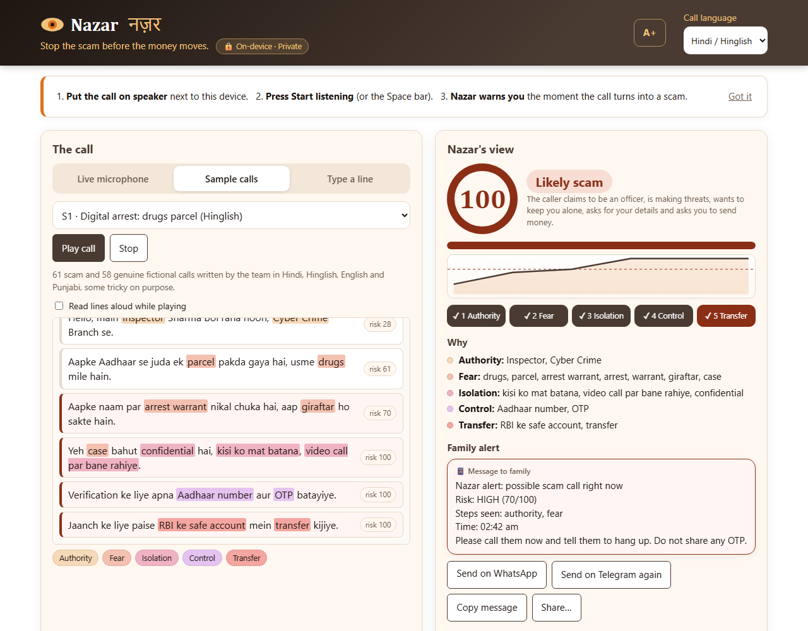
Working Prototype
09 · WORKING PROTOTYPE
Live Demo
On-device version: start.bat, then localhost:8000 (works with Wi-Fi off). Hosted version: nazar-codevators.vercel.app. Code: github.com/Kunal039/Nazar_CodeVators.
What Works Today
Live speech to text on the device in Hindi, English and Punjabi; five-step score with highlighted reasons; spoken warning; family alert by WhatsApp or Telegram; privacy panel.
Results on 119 Scripted Calls
54 of 54 digital-arrest scams caught before money was asked for, including Whisper-style transcripts; 1 of 58 genuine calls raised the alarm (a lawyer call, documented). Through Whisper on phone-quality audio: Hindi and Punjabi scams alarm at sentence 3; the genuine call stays safe.
Still to Build
Android app with dialer integration, listening only to unknown numbers, learning weights from real call data, and pilots with banks and telecom partners.
The app today
54/54
scams caught
1/58
false alarms
0.7 s
per sentence
Try it: nazar-codevators.vercel.app
Results from node web/test.js and node web/e2e_live.js. All test calls are fictional and written by our team, so they are not real-world accuracy.
Notes:
Open https://nazar-codevators.vercel.app and play sample call S1 (or speak a scam line into the microphone). Point out the score climbing step by step, the highlighted words, the red warning at line 3, and the family alert. Then play genuine call G2 (real bank fraud team) to show it stays safe. Finish with the test bench: 10 of 10 scams caught before the money ask, 0 of 10 false alarms. Be clear these are our own scripted calls.

Slide 11
What We Built at the Venue
10 · BUILT AT THE VENUE
On-device Speech Server
A FastAPI WebSocket server runs Whisper large-v3-turbo on the laptop's GPU. The browser streams mic audio; the server cuts it into sentences and returns text in about 0.7 s each. Falls back to a small CPU model, and works with Wi-Fi off.
Privacy by Design (raised at Evaluation 1)
On-device speech by default, call text forgotten after 30 seconds, everything wiped when listening stops, and family alerts that never contain what was said.
Accuracy Fixes
Threats count only when aimed at the listener (fixed a news-report false alarm); Whisper mishearings such as ग्रग and वोरेंट added; Hinglish 'don't tell your family' phrases; delivery OTP recognised as genuine.
Testing
119 test calls (64 new), unit tests, privacy tests and an end-to-end test through Whisper, all run by GitHub Actions on every change. 230+ commits and feature pull requests on GitHub.
The detector and web page started as our Phase 1 online-round prototype; the GitHub README marks what was built at the venue.
Notes:
Open https://nazar-codevators.vercel.app and play sample call S1 (or speak a scam line into the microphone). Point out the score climbing step by step, the highlighted words, the red warning at line 3, and the family alert. Then play genuine call G2 (real bank fraud team) to show it stays safe. Finish with the test bench: 10 of 10 scams caught before the money ask, 0 of 10 false alarms. Be clear these are our own scripted calls.

Slide 12
Privacy by Design
11 · PRIVACY BY DESIGN
Audio Never Leaves the Device
Whisper runs on the device, bound to localhost. Cloud speech is only an opt-in fallback, with a warning before it is used.
Nothing Is Recorded, Short Memory
Audio is transcribed in memory sentence by sentence and discarded. After 30 seconds a line keeps only its scam phrases, or nothing at all.
Wiped When the Call Ends
Stopping listening forgets all call text at once. No logs of call content are written anywhere.
Alerts Carry No Conversation
The family sees only the risk level, the warning signs and the time, never what was said. On a phone, Nazar would listen only to calls from unknown numbers.
A smoke detector, not a recorder. Every promise is checked by automated privacy tests on every change: PRIVACY.md on GitHub.
Notes:
Open https://nazar-codevators.vercel.app and play sample call S1 (or speak a scam line into the microphone). Point out the score climbing step by step, the highlighted words, the red warning at line 3, and the family alert. Then play genuine call G2 (real bank fraud team) to show it stays safe. Finish with the test bench: 10 of 10 scams caught before the money ask, 0 of 10 false alarms. Be clear these are our own scripted calls.

Slide 13
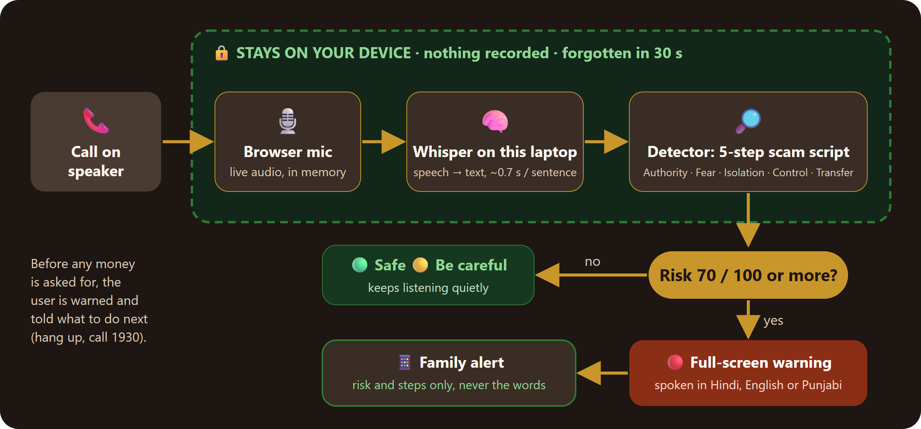
How It Works
12 · HOW IT WORKS
Everything that touches the call stays inside the green box: on the device, nothing recorded, forgotten in 30 seconds.
Notes:
Open https://nazar-codevators.vercel.app and play sample call S1 (or speak a scam line into the microphone). Point out the score climbing step by step, the highlighted words, the red warning at line 3, and the family alert. Then play genuine call G2 (real bank fraud team) to show it stays safe. Finish with the test bench: 10 of 10 scams caught before the money ask, 0 of 10 false alarms. Be clear these are our own scripted calls.

Slide 14
Why Nazar
13 · WHY NAZAR
Innovation
Recognises the scam script itself (five steps, in order) live during the call, in Hindi, English and Punjabi, instead of blocking numbers after the damage is done.
Implementation
On-device Whisper large-v3-turbo on GPU with a FastAPI WebSocket server; rule-based detector with script folding; six test suites and privacy tests run by GitHub Actions on every change.
Functionality
Works end to end today: live mic, alarm before money is asked (54 of 54 scam calls), spoken warning, family alert, complaint report, offline, installable, and a live website.
Impact
Digital-arrest scams target older people and their savings. Nazar warns in their language, brings in family, and keeps the call private, so people can trust it on every call.
Code: github.com/Kunal039/Nazar_CodeVators · Website: nazar-codevators.vercel.app
Notes:
Open https://nazar-codevators.vercel.app and play sample call S1 (or speak a scam line into the microphone). Point out the score climbing step by step, the highlighted words, the red warning at line 3, and the family alert. Then play genuine call G2 (real bank fraud team) to show it stays safe. Finish with the test bench: 10 of 10 scams caught before the money ask, 0 of 10 false alarms. Be clear these are our own scripted calls.

Slide 15
Expected Impact & Future Scope
14 · EXPECTED IMPACT & FUTURE SCOPE · OPTIONAL
Target Impact
Stop scam calls before money moves, starting with senior citizens and their families. Impact will be measured in pilots by scams caught and false alarms.
Potential Benefits
Families: peace of mind and protected savings. Banks and telecom operators: fewer fraud cases and a protection feature to offer (expected, to be tested).
Scalability
Free tools on a normal laptop. The same engine can move to phones through a dialer or telecom partner [10][11]. MuRIL covers 17 Indian languages [9].
Future Possibilities
WhatsApp and video calls, SMS and link checks, one-tap report to the 1930 helpline [4], a bank link to pause risky transfers, anonymised scam trends for cyber-crime teams, a fully offline mode.
Growth path
Now
Live web prototype: nazar-codevators.vercel.app
Next, 0 to 6 months
Pilots with senior-citizen groups; Android app with a partner
Later, 6 to 18 months
Banks, payment apps and telecom operators
Long term
More languages, offline mode, scam-trend feed
How it can earn: free for families to build trust; banks, payment apps and telecom operators pay a licence or per-user fee. Pricing and partner interest are not yet validated.
Notes:
Be clear that the business model and timeline are plans, to be tested in pilots. References: [4] PTI/Tribune on the I4C advisory (helpline 1930); [9] MuRIL; [10][11] Android call-recording limits - see slides 4, 6 and 9 notes for URLs.

Slide 16
References
15 · REFERENCES
[1] Scroll.in, “Over 38 lakh cyber fraud complaints in India since 2021: Centre” (reply to Parliament, March 2025)
https://scroll.in/latest/1080247/scroll_in
[2] Inc42, “Indians Lost INR 1,935 Cr To Digital Arrest Scams In 2024: Govt”
https://inc42.com/?p=504907
[3] Moneylife, “Fraud Alert: India Is Losing over ₹22,000 Crore a Year in Cyber Scams”
https://moneylife.in/article/fraud-alert-india-is-losing-over-22000-crore-a-year-in-cyber-scams-and-the-worst-is-yet-to-come/80612.html
[4] PTI via The Tribune, “CBI, ED, police don't arrest people through video calls: I4C” (Oct 2024)
https://www.tribuneindia.com/news/india/cbi-ed-police-dont-arrest-people-through-video-calls-indian-cyber-crime-coordination-centre/amp
[5] Gujarat Cyber Crime, “Digital Arrest” awareness material (cites I4C and MHA)
https://gujaratcybercrime.org/Digital_Arrest_Awareness_Watermarked.pdf
[6] CyberSecure India, “Digital Arrest: A Global Trend and Its Solutions for Indian Residents”
https://cybersecureindia.in/digital-arrest-a-global-trend-and-its-solutions-for-indian-residents/
[7] OpenAI, Whisper (GitHub) and whisper-small model card (Hugging Face)
https://github.com/openai/whisper
[8] Alpha Cephei, Vosk model catalogue (Hindi models with reported word error rates)
https://alphacephei.com/vosk/models
[9] Khanuja et al., “MuRIL: Multilingual Representations for Indian Languages” (2021)
https://huggingface.co/google/muril-base-cased
[10] Engadget, “Google is banning third-party call recording apps from the Play Store” (2022)
https://www.engadget.com/google-is-banning-third-party-call-recording-apps-from-the-play-store-093201443.html
[11] The Register, “Google bans third-party call-recording apps from Play Store” (April 2022)
https://www.theregister.com/2022/04/22/google_banning_thirdparty_callrecording_apps/
[12] FastAPI documentation, “WebSockets”
https://fastapi.tiangolo.com/advanced/websockets/
[13] Telegram, “Bot API” documentation
https://core.telegram.org/bots/api
Where a slide uses a number or claim from a source, the source number is shown in square brackets. Our own assessments and plans are marked as such on the slides.
Notes:
Full reference list. Open links once to confirm they load. Where possible, also cite the original Lok Sabha or Rajya Sabha reply (March 2025) for the figures in [1] to [3].

Slide 17
Thank You
CodeVators · Nazar
Live demo: nazar-codevators.vercel.app · Code: github.com/Kunal039/Nazar_CodeVators
ORGANISED BY
Department of Computer Science & Engineering
Chandigarh University
CODE YUDH HACKATHON · CHANDIGARH UNIVERSITY

