Slide 1

SENTIMENT ANALYSIS & RATING PREDICTION FOR CUSTOMER REVIEWS
Group 4
Members:
1) Kadam Vinod Maruti
2) Kenge Durgesh Raosaheb
3) Kothekar Harshada Vinayak
4) Kulkarni Shreya Avinash
5) Kunal Bendale
6) Patel Bhaumik Narendrabhai

Slide 2
Project Description
In this project we have analyzed customer reviews in the form of text comment using Natural Language Processing (NLP) for hotel businesses and build the model which can predict ratings of the customers based on their reviews and also classify sentiments as positive, negative and average.
We have use various machine learning and deep learning algorithms to improve accuracy. Sentiment classification and rating prediction have been manually tested.

Slide 3
Block Diagram
Data Collection:
Customer Reviews
Data Pre-processing
Fit and Transform
Analysis of dataset for feature extraction
Modelling
Visualization
Classifying the dataset and splitting it into the reviews and star.
Applying various algorithms and comparing them.
Removal of stopwords and punctuation.
Classification report
Vectorization
Rating Prediction

Slide 4
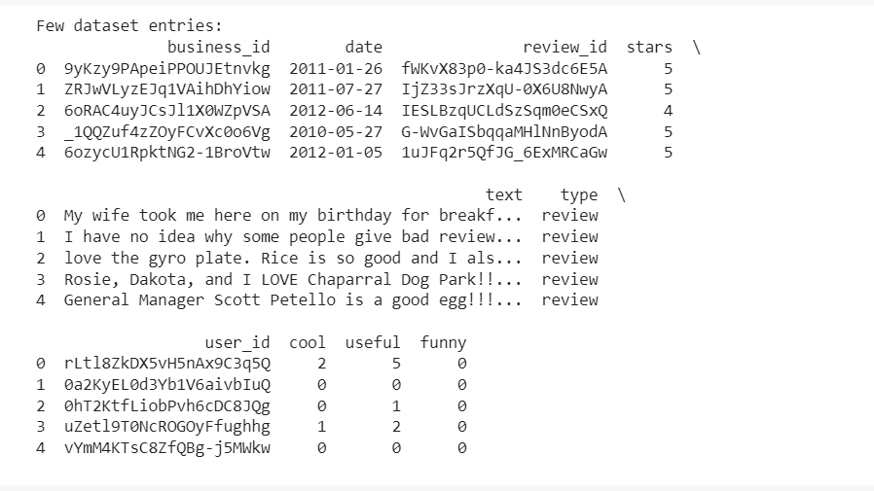
Dataset
This dataset consist of Yelp’s restaurant businesses reviews, and user data. Data set consists of the following columns :-

Slide 5
Steps
Pre – Processing Data :-
Importing all necessary libraries
Loading dataset and seeing the details
Shape of the dataset
Checking the datatypes
Concise summary of dataset
Checking for null values
Creating new columns

Slide 6
2) Feature Extraction
Correlation
Classifying the dataset.
Attribute Selection
Cleaning the reviews and Removal of stopwords and Punctuation.
Vectorization.

Slide 7
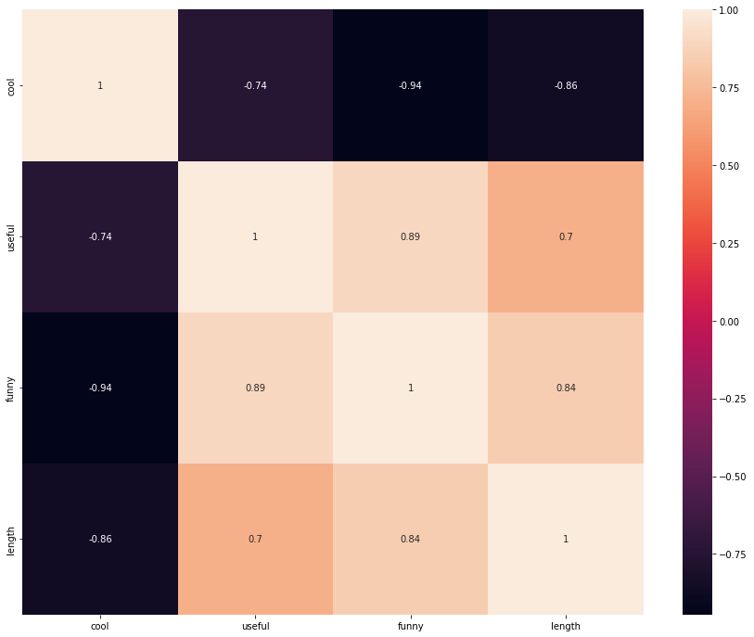
Correlation between vote columns

Slide 8
3) Model Creation
Splitting the dataset into training and testing set.
Choosing the classification model from scikit-learn.
Train the model with training dataset.

Slide 9
4) Algorithms Applied
K nearest neighbour
Decision Tree
Random Forest
Support Vector Machine (SVM)
Multinomial Naïve Bayes
Multilayer perceptron classifier

Slide 10
5) Model Evaluation Measures
Precision
Recall
F1 Score
Support
Accuracy

Slide 11
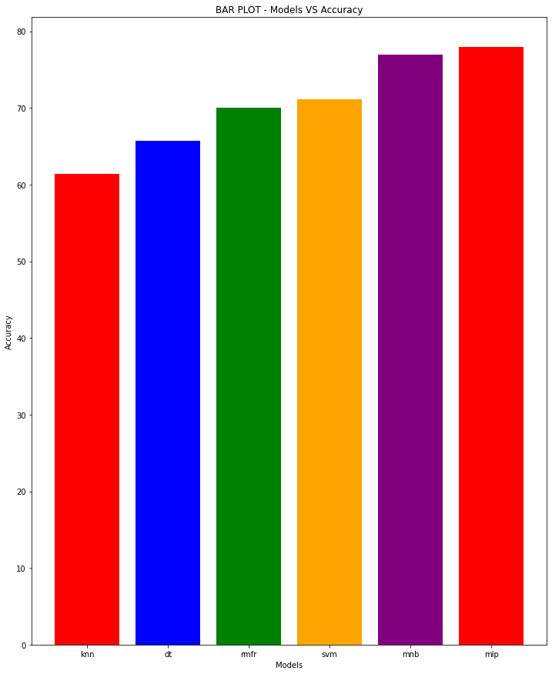
6)Comparison between Models

Slide 12
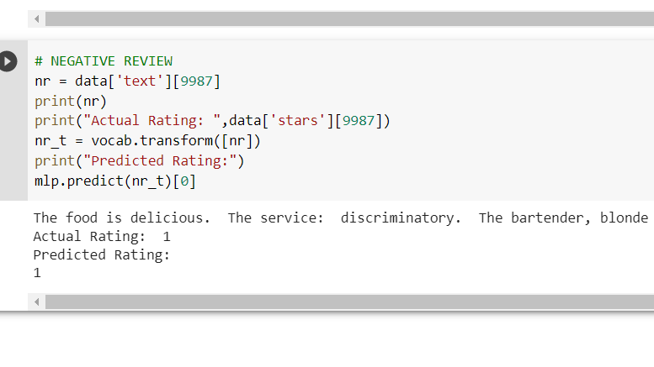
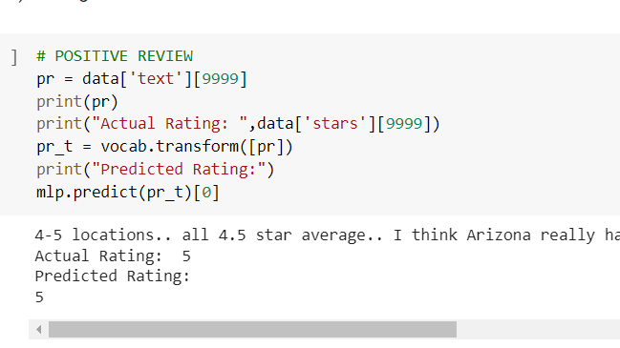
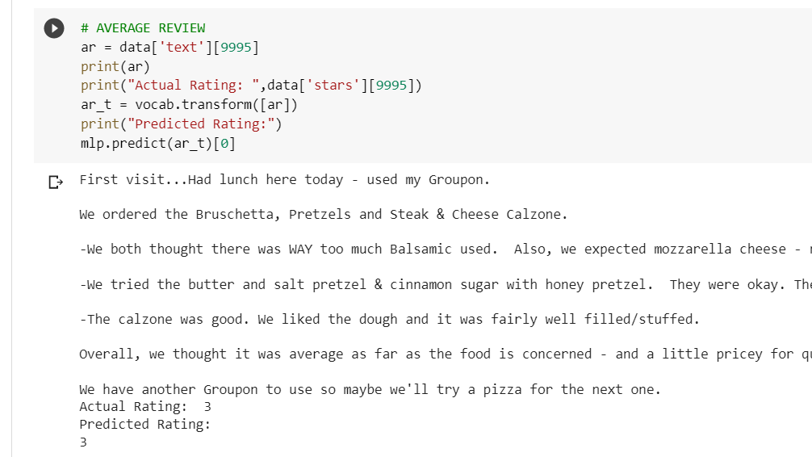
7) Testing the model – Rating prediction on the basis of review text.

Slide 13
7) Conclusion
After performing six algorithms we can clearly conclude that out of six algorithms which gave the best result is the: MULTILAYER PERCEPTRON CLASSIFIER.

Slide 14
References
Sunmin Lee “Sentiment Analysis Using BERT on Yelp Restaurant Reviews” Department of Computer and Information Technology West Lafayette, Indiana August 2022.
Boya Yu, Jiaxu Zhou, Yi Zhang, Yunong Cao “Identifying Restaurant Features via Sentiment Analysis on Yelp Reviews” Center for Urban Science & Progress New York University, New York, The United States.
Anish A. Parikh,¹ Carl Behnke,² Doug Nelson,² Mihaela Vorvoreanu^{,3} and Barbara Almanza² “A Qualitative Assessment of yelp.Com Users’ Motivations to Submit and Read Restaurant Reviews” ¹Department of Management, Montclair State University, Montclair, New Jersey, USA ²School of Hospitality and Tourism Management.

Slide 15
Thank you!

