Slide 1
Project Overview
This project analyzes crime data trends to identify patterns and anomalies.
Key focus:
- Dataset Overview
- Crime Trends Analysis
- Predictive Insights

Slide 2
Dataset Overview
The dataset consists of 157 records with 8 columns detailing different crime categories.
It includes:
- Major and Minor Crime Heads
- Monthly and Yearly Comparisons
- Trend Analysis

Slide 3
Crime Trends Analysis
Key observations:
- Crime hotspots identified
- Seasonal variations detected
- Year-over-year trends compared

Slide 4
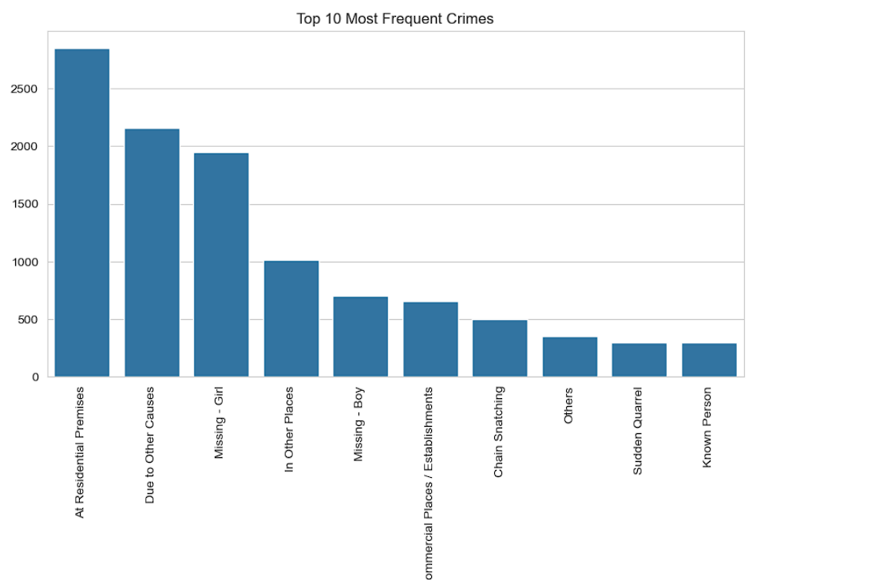
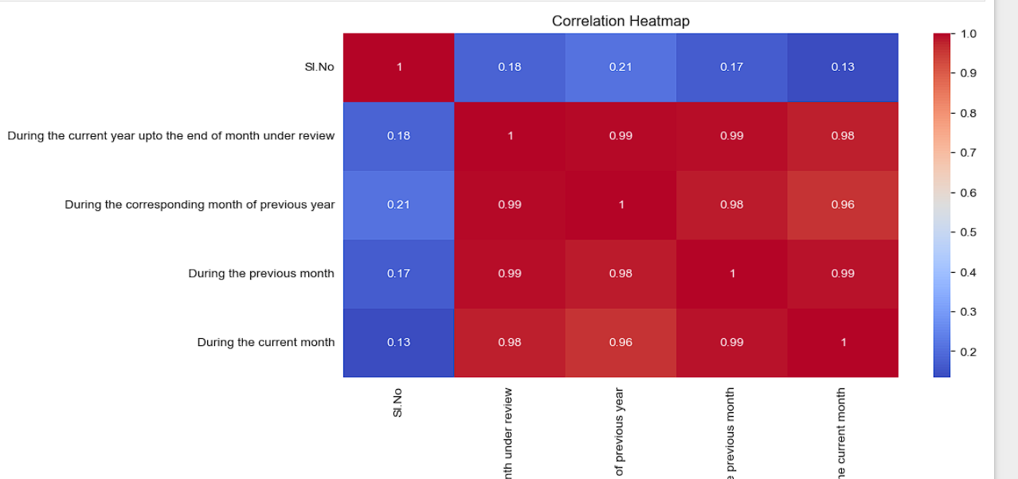
Example Plots
The following slides showcase some sample visualizations from the analysis.

Slide 5
Conclusion & Future Work
Key takeaways:
- Identified crime patterns and trends
- Possible predictive insights for crime prevention
Next Steps:
- Expand dataset
- Improve predictive modeling techniques

