Slide 1

Crime Data Analysis
Analysis of UCF Crime Dataset
Prepared by: [Kunal Sahu]

Slide 2
Introduction
This project analyzes crime trends using data from the UCF-Crime dataset. We explore patterns, crime hotspots, and trends over time to gain insights for security measures.

Slide 3
Dataset Overview
The dataset contains crime records categorized by type, time, and severity. It enables comparative and predictive analysis to aid law enforcement.

Slide 4
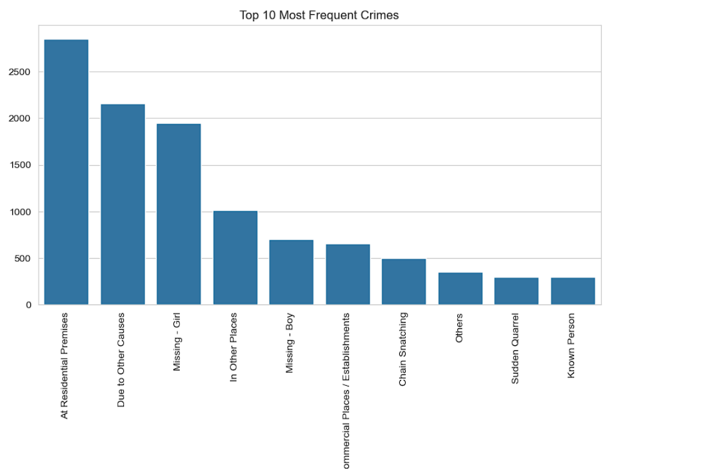
The chart on the right visualizes crime data trends.

Slide 5
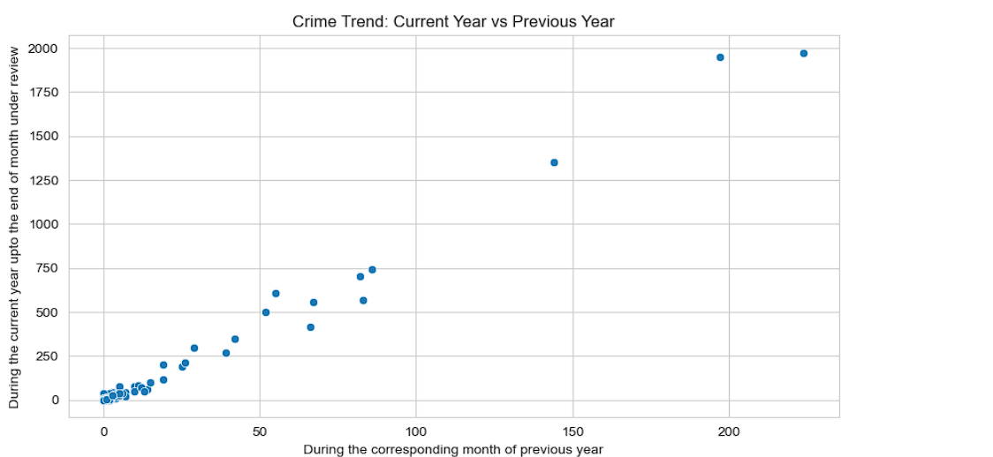
The chart on the right visualizes crime data trends.

Slide 6
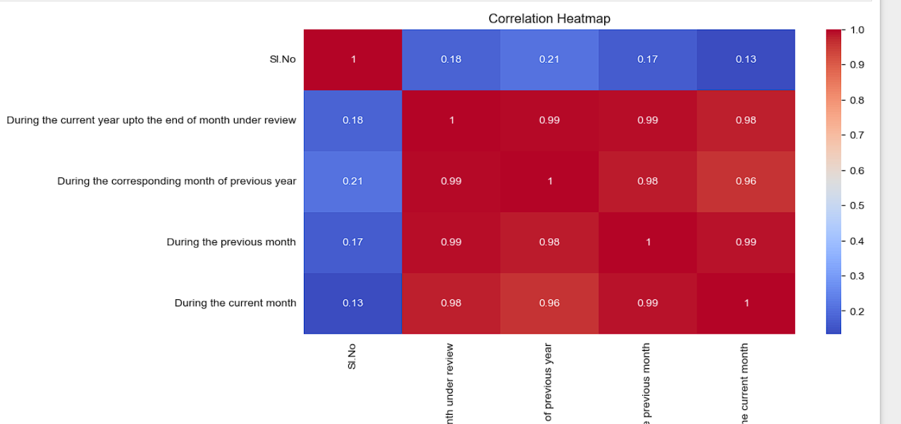
The chart on the right visualizes crime data trends.

Slide 7
Key Observations
- Crime trends indicate a rise in certain types of offenses.
- Comparative analysis shows fluctuations between months.
- Predictive analysis can help law enforcement take preventive measures.

Slide 8
Predictive Insights
By analyzing past trends, we can predict potential crime spikes and implement preventive measures accordingly.

Slide 9
Conclusion
This analysis provides insights into crime trends, helping authorities take informed actions for better crime prevention and response.

