Slide 1
Airbnb Homepage Clone Frontend Internship Project
Presented by:
Kunal Arya
B.Tech CSE
MRIIRS

Slide 2
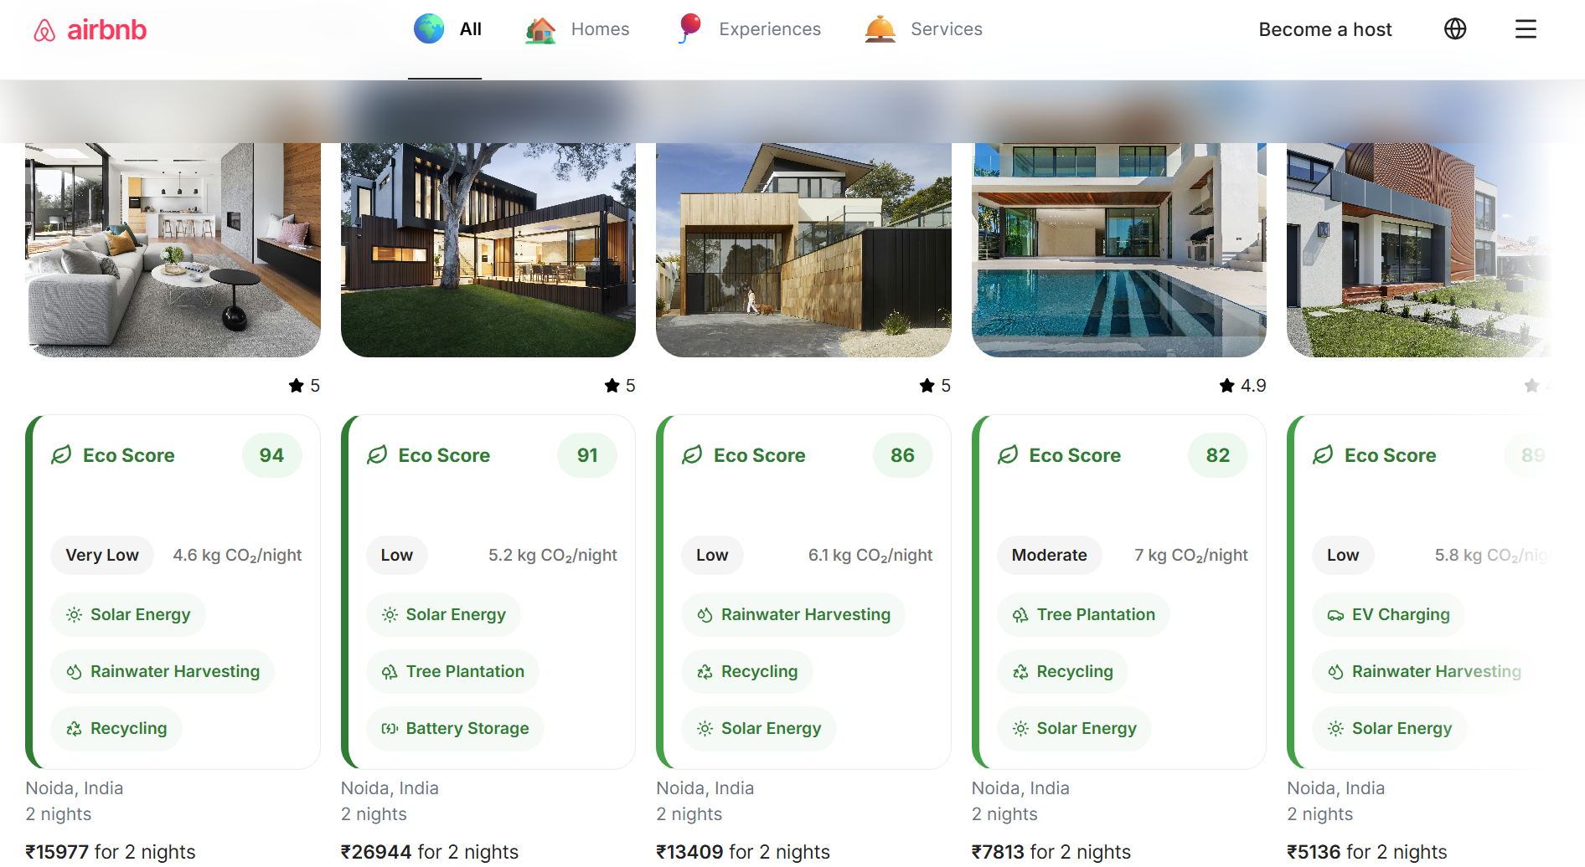
Objective The goal of this project was to recreate the Airbnb homepage while following modern frontend development practices.
Features
Responsive Airbnb Homepage
Interactive Search Bar
Property Listings
Experiences Section
Services Section
Lazy Loading
Error Boundary
Custom Eco Score System

Slide 3
Technologies Used
React
Tailwind CSS
React Router
Vite
Lucide React
CSS
JavaScript

Slide 4
Folder Structure
src
│
├── components
│
├── pages
│
├── data
│
├── context
│
├── assets
│
├── App.jsx
│
└── main.jsx

Slide 5
Major Components
App
Routes
Pages
ListingSection
PropertyCard
EcoScore
Ecopopup

Slide 6
Features Implemented
Airbnb Features
Responsive Homepage
Property Cards
Search Bar
Categories
Horizontal Slider
Favourite Button
Coming Soon Pages
Additional Features
Error Boundary
Lazy Loading
Eco Score
Carbon Footprint
Sustainability Popup

Slide 7
Eco Score Feature
Property
Eco Score
Popup
Carbon Level
CO₂/Night
Eco Features
Tips

Slide 8
Challenges Faced
Challenge | Solution
Routing | React Router
Component Reuse | Reusable Components
Large UI | Modular Design
Performance | Lazy Loading
Runtime Errors | Error Boundary
Eco Popup Crash | Added default props & safe handling

Slide 9
Future Improvements
AI Trip Planner
Weather Forecast
Price Prediction
Currency Converter
Multi-language Support
User Authentication
Backend Integration
Booking System
Dark Mode
Maps Integration

Slide 10
Thank You

