Slide 1

The AI Powered 3D Medical Visualization Tool
A Mini Project by
Kunal Redij | (23106067)
Makarand Panchal | (23106065)
Rishikesh Shinde | (23106061)
Under the guidance of
Dr. Tejashri Kolhe
Academic Year 2025-26

Slide 2
Presentation Outline:
Introduction
Literature Survey of existing systems
Limitations in existing systems
Problem Statement
System Design & Workflow
Technologies & Methodologies
Implementation Screenshots
Conclusion
References

Slide 3
Introduction:
Overview of the Project
This project uses AI and 3D rendering to convert medical scans (CT) into interactive 3D models. Users can view, rotate, and annotate anatomical structures through a web interface, improving diagnosis, surgical planning, and medical education.
Motivation/Inspiration
Traditional 2D scans can be hard to interpret. This tool was inspired by the need for clearer, interactive visuals and AI support to enhance accuracy, reduce errors, and improve learning in medical settings.

Slide 4

Sustainable Development Goal:
SDG 3: Good Health and Well-Being
The tool aids in early detection of lung diseases (like tumors, nodules, or other anomalies in CT scans).
By visualizing anomalies in 3D, doctors and researchers can make more accurate diagnoses and treatment plans.
Helps reduce misdiagnosis and improve patient survival rates.
SDG 9: Industry, Innovation, and Infrastructure
Uses AI, deep learning, and visualization technologies to advance healthcare innovation.
Promotes the development of digital medical infrastructure, enabling hospitals and labs to adopt smarter diagnostic workflows.
Encourages research–industry collaborations in health tech.
.

Slide 5
Literature survey:
Title | Year of Release | Key Points | Improvements Proposed
Segmentation and Image Analysis of Abnormal Lungs at CT | 2015 | Review of lung CT segmentation methods (thresholding, morphology, deformable models). Explains limitations of simple thresholding when pathology is present. | Suggests hybrid methods combining anatomy priors + robust algorithms for better handling of diseased lungs.
LGAN: Lung Segmentation in CT Scans Using Generative Adversarial Network | 2019 | GAN-based lung segmentation method; better automation than rule-based pipelines. Evaluated on CT scans. | Improves segmentation accuracy; limitations in GAN stability and dataset diversity. Proposes hybridization with classical methods.
Anomaly detection scheme for lung CT images | 2024 | CT-based anomaly detection; detects lesions deviating from “normal” patterns. | Proposes refinement of thresholds + shape filters to reduce false positives (similar to your size-based filtering).
Improved unsupervised 3D lung lesion detection in low-dose CT | 2025 | Detects lung lesions in 3D CT volumes using unsupervised anomaly learning. | Reduces dependence on annotated datasets;proposes hybrid supervised + unsuper- vised learning.

Slide 6
Limitations in existing systems:
Low Accuracy in Diseased Lungs Struggles
High False Positives in Anomaly Detection
Limited 3D Visualization
Dependence on Large Labeled Datasets
Slow Processing and Heavy Computation

Slide 7
Problem Statement:
Analyzing CT scans manually is slow, error-prone, and limited to 2D slice review, which increases the risk of missing critical anomalies. Existing methods struggle with diseased lungs, lack real-time 3D visualization, and are not well integrated into clinical workflows. Hence, there is a need for an AI-powered system that automates lung segmentation, detects anomalies, and provides interactive 3D visualization for faster and more accurate diagnosis.

Slide 8
System Design:
Input
CT Scan files (.mhd, .zraw) uploaded via Browser
Pre-Processing
Downsampling
Lung Segmentation (Threshold + Morphology)
Contrast Enhancement (Gamma Correction)
Analysis
Anomaly Detection (High-density regions)
Nodule Matching (CSV Annotations)
Evaluation (TP, FP, FN)

Slide 9
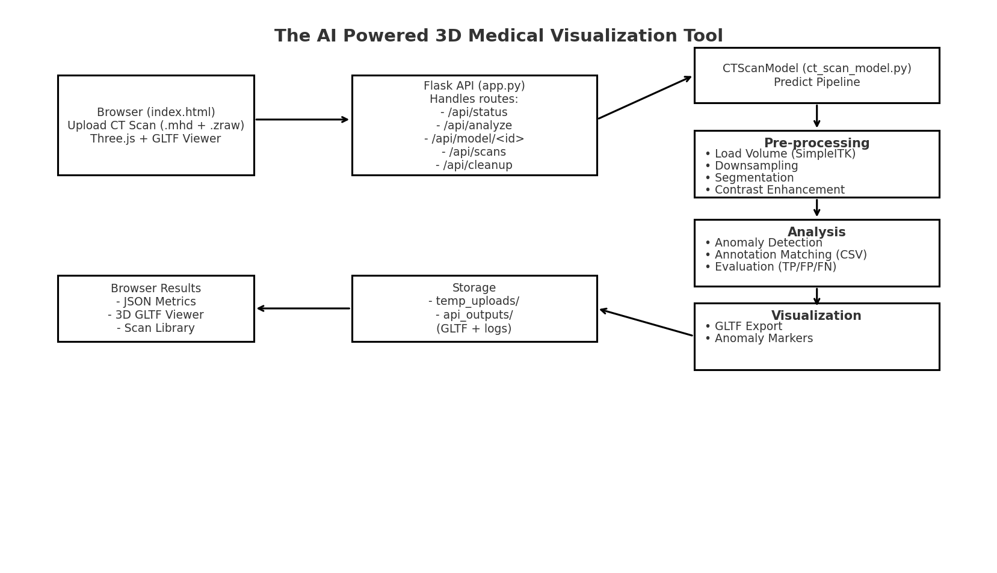
System Workflow:

Slide 10
Technologies & Methodologies:
Backend:
Python
Flask: Web framework & API endpoints
SimpleITK: CT scan reading (.mhd, .zraw)
NumPy, SciPy: Numerical operations
scikit-image: Image segmentation & morphology
Pandas: Annotation (CSV) handling
PyVista / VTK: 3D mesh generation & GLTF export

Slide 11
Technologies & Methodologies:
Frontend:
HTML, JavaScript
Three.js: 3D model rendering (GLTF viewer)
Visualization & Output:
GLTF (3D Lung Models)
JSON (Anomaly Metrics & Results)

Slide 12
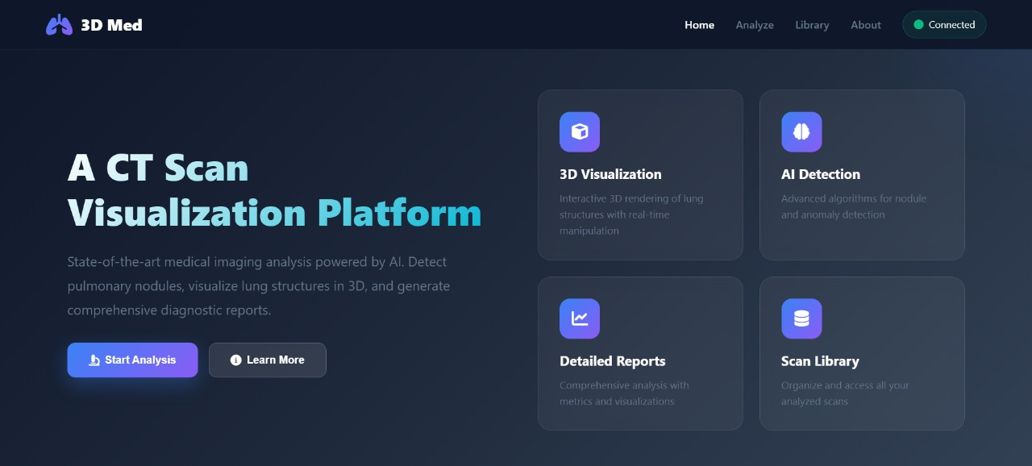
Implementation:

Slide 13
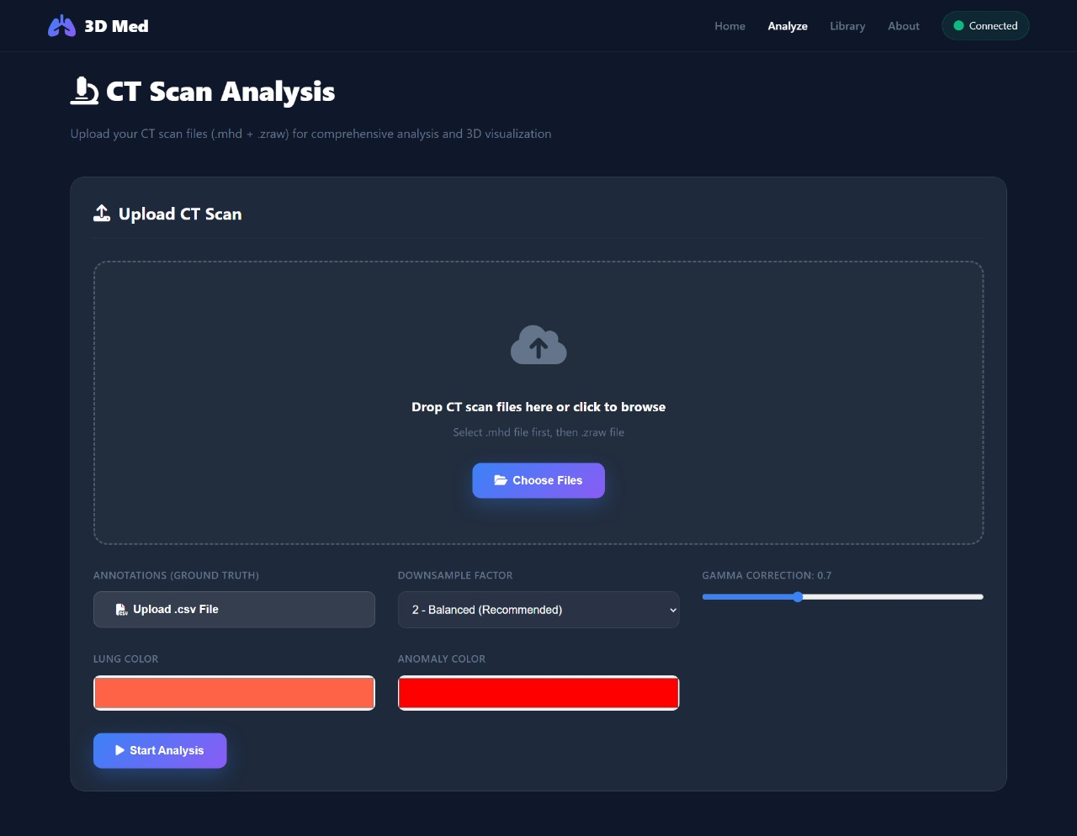
Implementation:

Slide 14
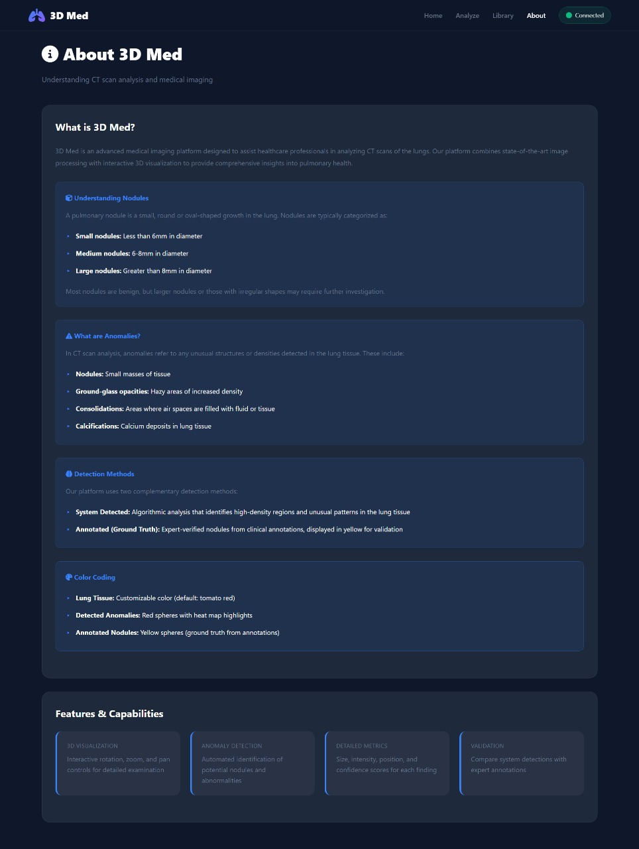
Implementation:

Slide 15
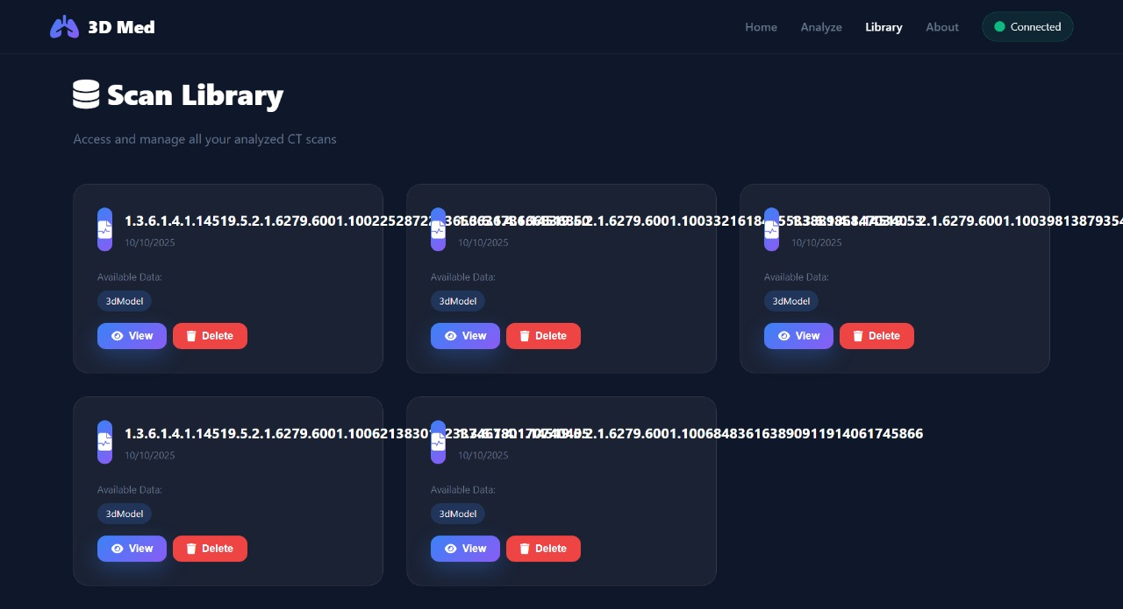
Implementation:

Slide 16
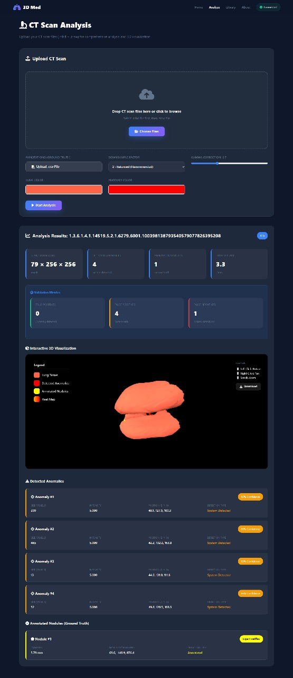
Implementation:

Slide 17
Conclusion:
Manual CT scan analysis is slow and error-prone.
The system automates lung segmentation and anomaly detection.
3D visualization makes diagnosis more accurate and interactive.
Reduces workload of radiologists and speeds up evaluation.
Provides a scalable solution for healthcare, research, and education.

Slide 18
References:
[1] Mansoor, A., Bagci, U., Xu, Z., Foster, B., Olivier, K. N., Elinoff, J. M., & Mollura, D. J., Segmentation and Image Analysis of Abnormal Lungs at CT, Radiographics, 2015.
[2] Tan, J., Jing, L., Huo, Y., Tian, Y., & Akin, O., LGAN: Lung Segmentation in CT Scans Using Generative Adversarial Network, arXiv preprint arXiv:1901.03473, 2019.
[3] Gao, Z., et al., Anomaly Detection Scheme for Lung CT Images, Journal of Healthcare Engineering, 2024.
[4] Lee, J. H., et al., Improved Unsupervised 3D Lung Lesion Detection in Low-Dose CT, Medical Image Analysis, Elsevier, 2025

Slide 19
THANK YOU

