Slide 1
AI Club Meeting 1/17
By: AI Club Leadership Team

Slide 2
Plan for this Semester
Learn Basic Knowledge about building AI Models
Finish Our Robot Project
Install the Camera
Getting the software running on it
Installing object Avodience On it
Finish Our ID scanner Project
Be able to detect whose name is on the ID
Finish Our Drone Project
Detect faces that are in front of the drone
All these finish projects, will be presented to our club sponsor Veloxity at the end of the semester

Slide 3
Plan for today
Split into groups and continue working on each project
Robot | Drone | ID
-Install the Camera -Look at the SSH connectivity of the robot to the computer -Debug the installation of that | - Connect to drone’s Wifi and access the Camera data - Run the API | -Start taking each frame from the webcam -Use OCD for detection for the name

Slide 4
Updates
Robot
Build has started and we are still trying to download code
SSH problem
Drone
We bought our drone and we can fly it
Still trying to access the camera
ID Scanner
Being able to detect the text on the ID card

Slide 5
New People
Projects
Choose your project
Pay
$15
OSP
Follow our Insta
Talk to leadership about remind and emails

Slide 6
People who have paid
# | Paid
1 | Aneja, Kunal
2 | Mir, Akil
3 | Rathod, Karni
4 | Vagehfi, Aria
5 | Allauddin, Saalih
6 | Gangavarupu, Sidd
7 | Pucha, Dhanush Reddy
8 | Vegiraju, Harsha Vardhan Varma
9 | Kumar, Aryan
10 | Poosapati, Rishik
11 | Prabhu, Ashwin
12 | Seshadri, Rishab
13 | Pallapolu, Aneesh

Slide 7
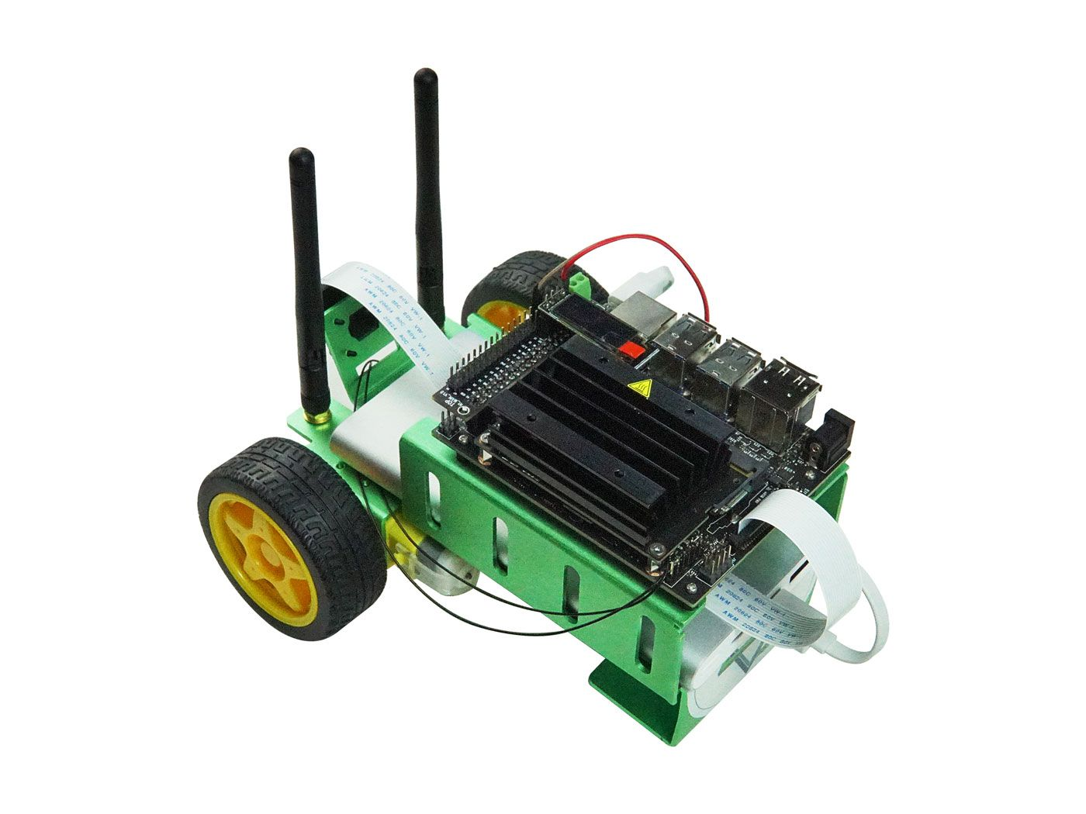
Robot
AI Club Project

Slide 8
Goal
Be able to install our own object detection model ontop the robot so it can get to a specific desitination with obstacle avoidance.

Slide 9
Things to do
Make sure the robot is intact
See the Ubuntu software install (today)
Learn what is happening (today)
Research and program the AI file (today)
Install the aviodence software
Instal the camera(today)

Slide 10
What to use
Model build
Google
Past project
Leadership (Kunal)
Robot Build
Seeed website
Working with Jetbot
Nvidia learning course

Slide 11
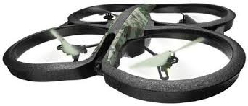
Drone
AI Club Project

Slide 12
Goal
Be able to fly the drone and wirelessly be able to detect and recognize the face in front of he drone

Slide 13
What to do
Learn what is happening
Be able to fly the drone
Attempt to get data from drone
Try installing the API into the drone
Use the website that goes step by step
Srihith and Rishab

Slide 14
Right Now
Split into groups
And bring our your computers, then start working on the projects

Slide 15
ID Scanner
AI Club Project

Slide 16
Goal
To build a program that can capture a picture of the ID and extract information from it.

Slide 17
Don’t we have an ID Scanner in this school?

Slide 18
Yes, we do. But the ID Scanners in this school are not automated.
Our scanner will capture information from our school ID and it will verify our identity with the use of a database.

Slide 19
What will we use for the project?
Webcam
Sample python code

Slide 20
Libraries
Cv2
NumPy
Mapper
OS
Random

Slide 21
Process
Read All the Data on the ID
Point ID for 5 secs at Camera
Final Result
Extract Photo from pic

Slide 22
First Assignment
Be able to Extract Face Data out of the Frame

Slide 23
2nd Assignment ID Scanner
Look at the code and see what is does, and what needs to be added on it
Look for ways to program the next step

