Slide 1

AI Club Presents
To view the videos email aiclub.ahs@gmail.com

Slide 2
Introduction
AHS cafeteria offers wide array of healthy food and drinks options. It is very crowded during lunch breaks. Long queues and lengthy wait to buy food is an ongoing issue.
CafeteriAI or CafeAI is a super-efficient and fraud-proof smart cafeteria for our school which could potentially eliminate a need of a cashier and other staff members.
Students will walk-in and walk-out of cafeteria without any stops or checkpoint!

Slide 3
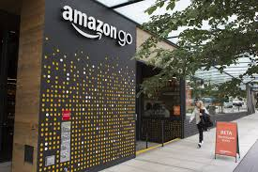
Where it all started? Where are we at today?
Discussed and chose a problem to solve using AI
Motivated by Amazon Go
Found a perfect solution for the school cafeteria
AI Club developed a prototype which
Demonstrate AI based computer vision technology.
Verifies a student ID and detect the items on food tray.
Updates student account and store information to a database.
Seattle
Notes:
At the beginning of this project, we went through problems that a AI can solve, and we choose one of the easier problems because it was our first project.

Slide 4
CafeAI Design
Object Detection and Face Recognition

Slide 5
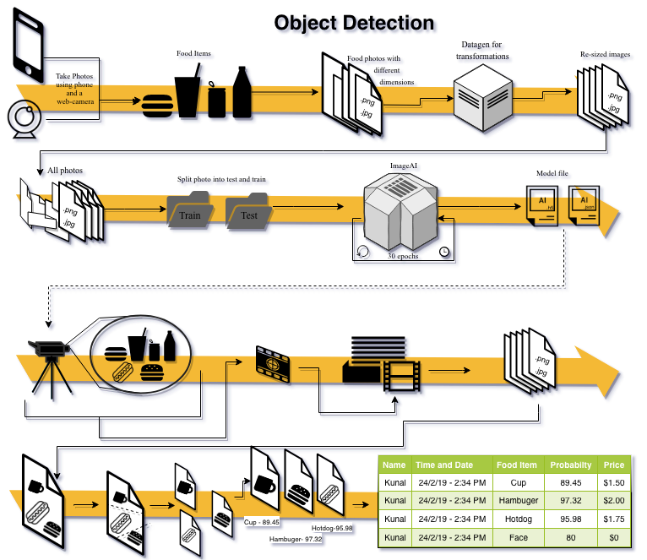
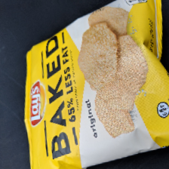
1

Slide 6
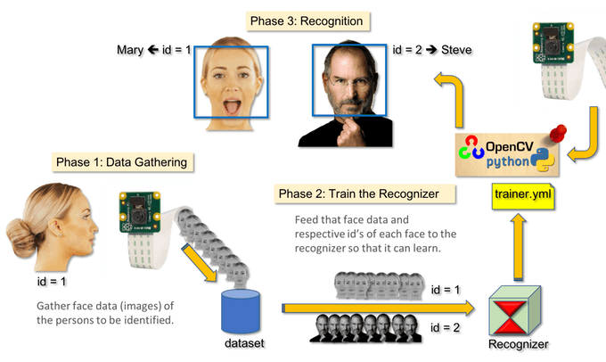
Face Recognition
2

Slide 7
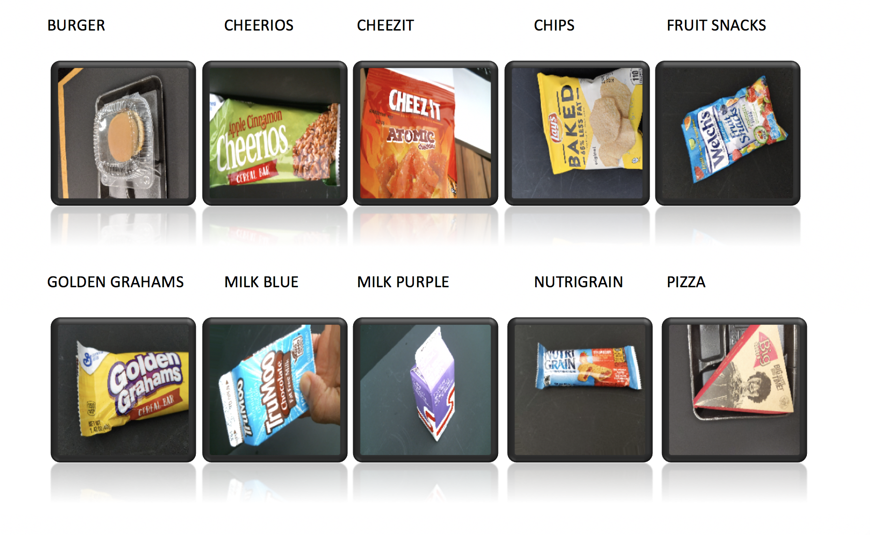
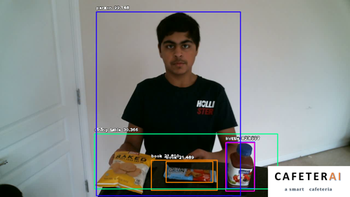
Example of Video Frame Processing
Sample of Food Items
Processed Video Frame

Slide 8
Demo Time

Slide 9
Live demonstration
How to
Walk in frame
Look at camera
Bring plate closer to camera
Leave
Done

Slide 10
Code

Slide 11
Code

Slide 12
Demo

Slide 13
Results
Faces Recognition Issues
Sometimes recognized as another face
Objects Detection Issues
Sometimes detected objects that weren’t there
Current Improvements
Retake Pictures
Try different models and optimize parameters
Ask experts!

Slide 14
Phase II Plan
Fraud control - stop an unrecognized student from taking food from CafeAI.
Auto onboarding process - New student and new food items
Be able to identify duplicate items on the plate
AI self learning system?

Slide 15
Questions?
Improvement Ideas?
Sponsorship & Funding Support?

