Slide 1
Client Resume Matcher - CRM
Connecting Employees to Employers

Slide 2
What does it do
Connects a company to the best possible resume/person. Adapts to multiple resume formats and extracts key entities and main points from resume. Jary is a specific document form with requirements which uses an algorithm which indexes and scores the resumes resulting in the best resume for the specific Jary.

Slide 3


External APIs
Uses GCP cloud platform and their vision, NLP, and entity extraction APIs which support the process of the program
Vision API Uses OCR to convert PDFs to readable files and gives location information about the text - groups
NLP API Extract Basic entities from document
Entity Extraction API Using custom built AI to extract entities for common designs of resumes

Slide 4
Progress to date
Completed code for extracting basic identities from resume → Examples include:
Name
Email
Links
Address
Detecting bold sections in resume and generating a blocks around different sections in resume
Detecting Lines and other key features

Slide 5
Things to do
Build the sheet for the Jary → Exactly what is being asked in a user
Finalize custom AI for special entities
More testing and optimizing for different resume styles
Finishing algorithm for connecting resumes to jary
Finalize and combine everything into one large exe file

Slide 6
Key information
Github
https://github.com/Kunal2341/ClientResumeMatching GCP Credentials - Json files
**check with kunal
Code
**check with kunal
Will be writing a paper on the process and the mathematical formulas used to generate these programs
Already have written research for APIs used
Final Project Presentation - Completion of Internship

Slide 7
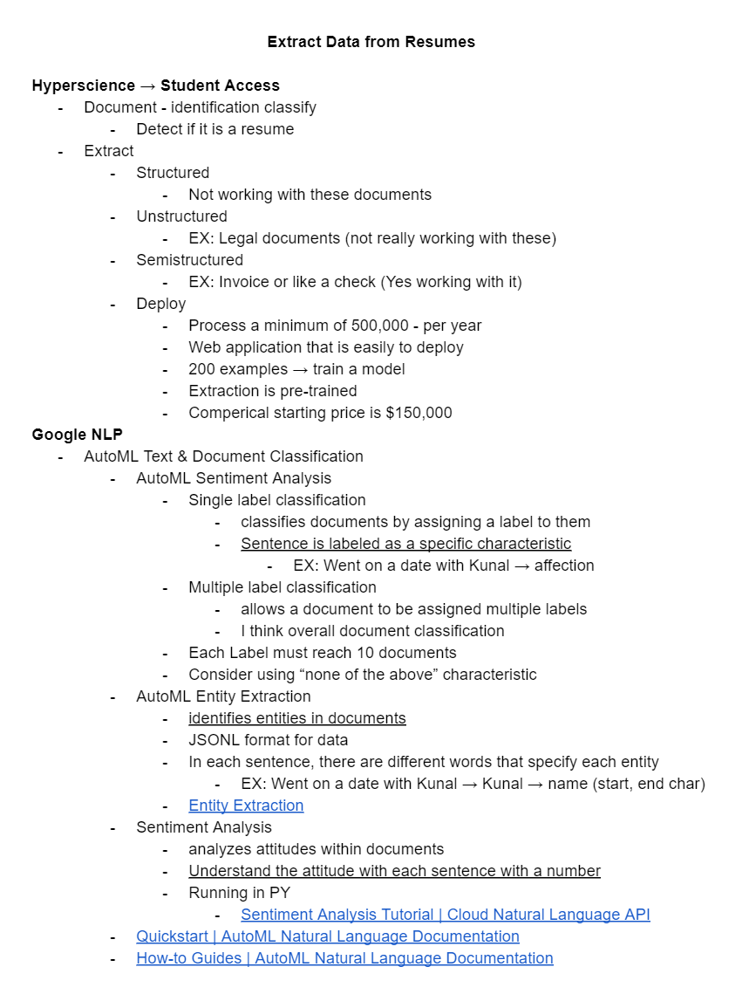
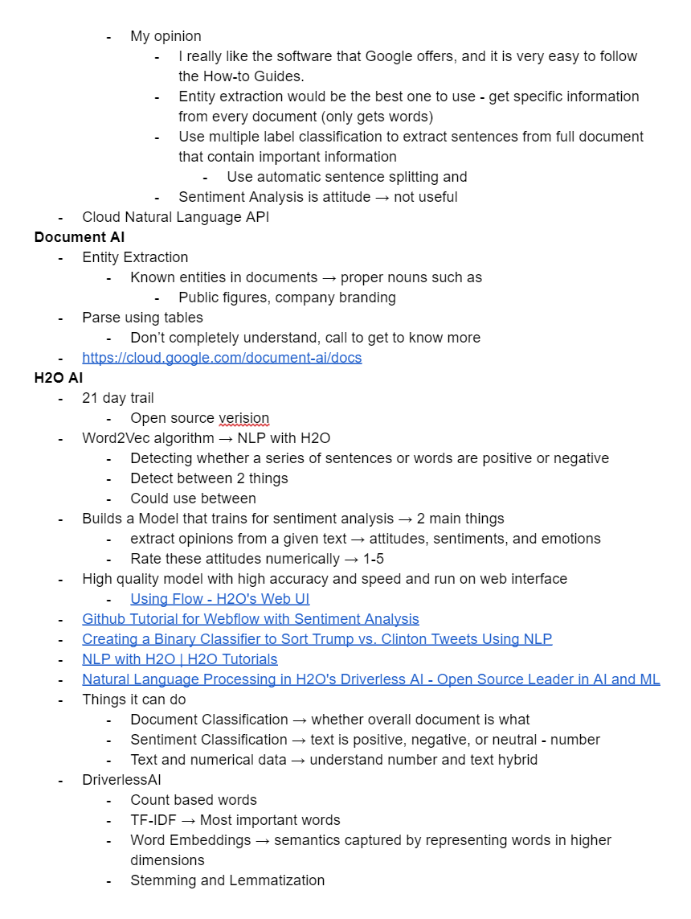
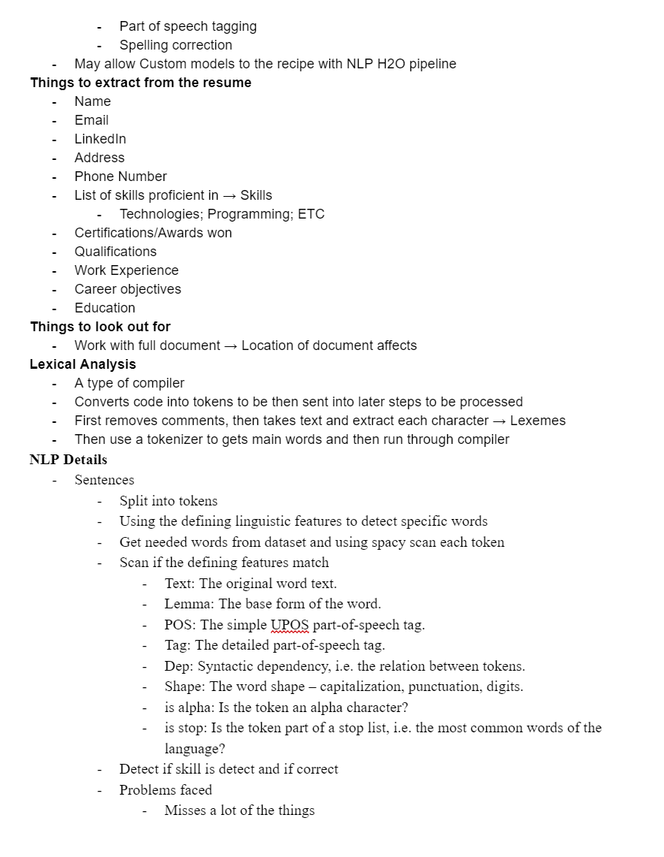
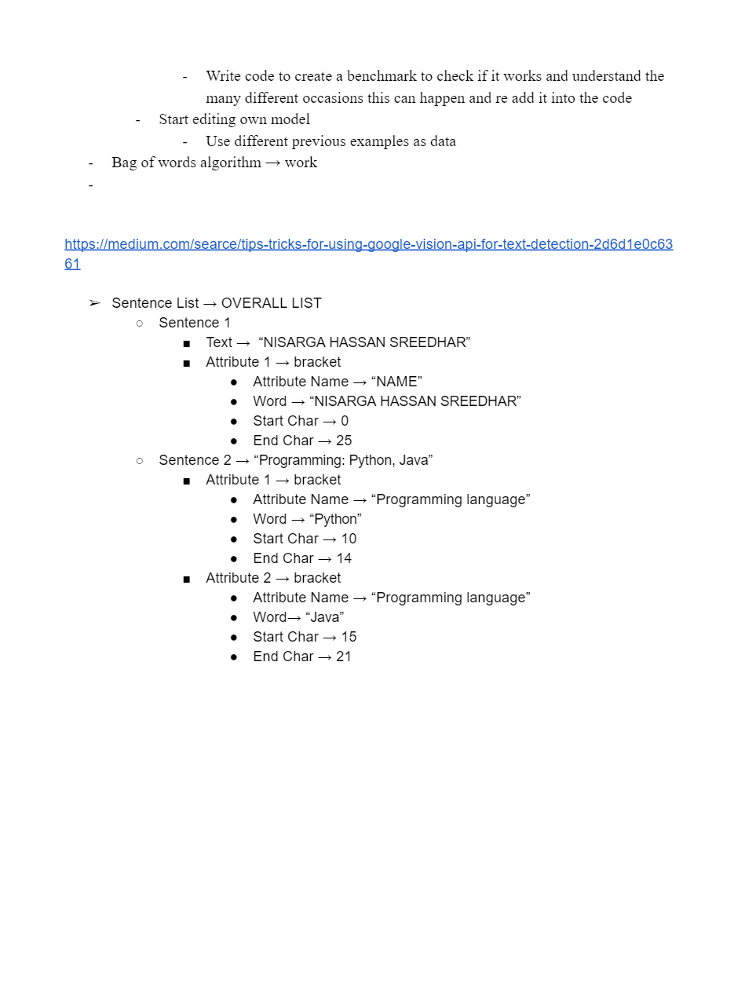
Some of the Previous Reaserch

Slide 8
Key Links
Google Cloud Platform APIs and Credentials
https://console.cloud.google.com/apis/credentials?authuser=1&project=resumematcher
Research Documents
https://docs.google.com/document/d/1WcNx1_2dplGlG5zKhQn-t0U_ilTbXC4HIfVM7ry5CIw/edit
https://docs.google.com/document/d/1uzDd0wPGkx8WSJ2-weVnH_gSyyAIRUa3TLnWHMd_qOE/edit
https://docs.google.com/document/d/1FTp19Qf7Ukechxbycfc6MpQjTLG0T6FRi42OeRwLXX4/edit
Other
Check Google Docs

