Slide 1
Group 24
EL213 Project
CCTV surveillance using Raspberry Pi

Slide 2
Purpose of this project
This project implements the Raspberry Pi CCTV surveillance system over a local network
We also added features such as motion detection, and uploading the data over cloud storage
Thus the main purpose behind this project was replace regular bulky CCTV system with a more efficient and effective system in both financial and productive way.

Slide 3
Hardware Components
Raspberry Pi (Model B) along with a micro-USB power supply
USB camera OR Raspberry Pi camera module (We used USB camera)
Ethernet OR Wi-fi
SD card or microSD card in accordance with the model of Raspberry Pi
A computer for configuration of raspberry pi and to remotely access the final circuit over a wireless network

Slide 4
Software components
Raspbian OS or any other LINUX based operating system
Motiion – for motion detection and other additional features such as setting the framerate, resolution, brightness, output port and other quality control services
Dropbox_uploader – for uploading images or videos on cloud storage(“Dropbox” in our case)
DNS account – With this account, it is possible to stream the video through WAN i.e. over internet. It’s not recommended due to economical reasons.

Slide 5
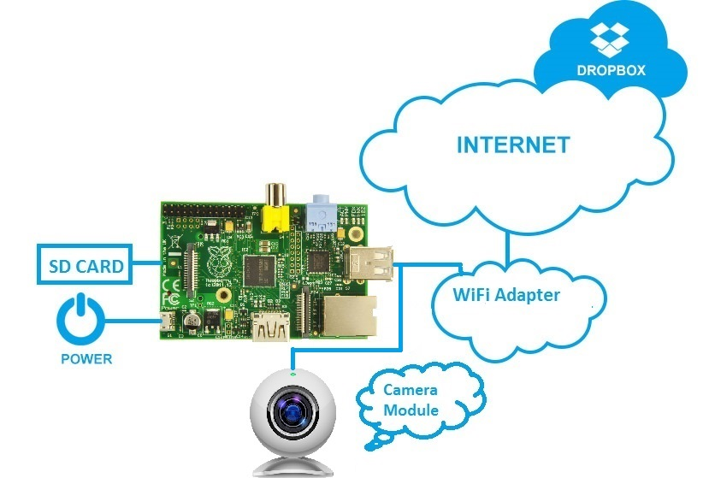

Slide 6
Model functioning
Three main functional components – camera, Raspberry Pi, internet connection
Raspberry Pi holds all the components at a place and checks the proper functioning of the components
The camera is used for primary capturing and the Pi is used for the transfer of data from the camera to the destination source
The internet connection will make the process of transmission possible
The user will be able to configure the system to his own need
The SD card itself contains the operating system and is used to save the images captured by the camera module

Slide 7
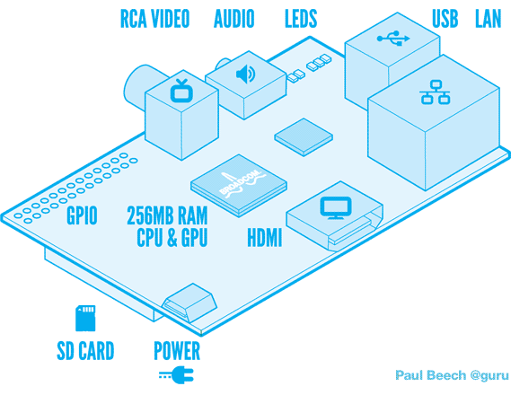
About raspberry pi
2 USB ports
1 Ethernet port
1 HDMI port
1 micro USB port for power
1 SD card slot
Built-in slot for raspberry pi camera module
Raspbian OS(to be installed manually)

Slide 8
workflow

Slide 9
Step 1 installing raspbian os
To make everything work we need a platform on which we can work.
For this we used a LINUX based operating system specially designed for Raspberry Pi – Raspbian OS.
This OS is to be installed on a SD card with minimum storage capacity of 8 GB. For our project a 16 GB memory card is recommended. We used a 16 GB memory card.
Any computer can be used for mounting this OS on memory card.
Now this mini computer needs a monitor to work it’s magic which can be easily done by connecting it with any monitor via HDMI cable.
A set of keyboard and mouse are also to be attached with the Pi via USB cable.

Slide 10
Step 2 updating the pi
It is essential for the Pi to run on latest updates available because the older versions may not support some of the latest features.
For this step the Pi has to be connected to internet either through ethernet or a wireless network.
The sequence of the following command matters.
Following commands are to be typed in terminal to update and upgrade the Pi:
sudo apt-get install update
sudo rpi-update
sudo apt-get upgrade
sudo apt-get update
This commands will update the libraries of the Raspbian OS

Slide 11
Step 3 linking the pi using pUtty
This step is very important for future use of the camera after setting it up.
PuTTY Interface is a software running on Windows which can be used for linking the Pi with any other computer/laptop connected over local network.
For this you’ll need to install PuTTY on your laptop.
To use this feature both the Pi and laptop should be connected over the same local network.
Then by inputting the ip address of Pi we can give commands to the Pi over our computer.
This will prove very helpful for updating or configuring the Pi without ever disassembling it.

Slide 12
Step 4 setting up webcam
Certain libraries have to be installed on Pi to use the connected USB Webcam.
This command will install the software required:
sudo apt-get install fswebcam
Now we will be able to capture images or record videos.
Following command is used to capture images
fswebcam name_of_image.jpg
Following command is used to record videos
avconv -f video4linux2 -r 10 -i /dev/name_of_video.avi
Above commands are for a quick capture. We can give certain parameters to video capturing for changing the resolution or time duration.
For eg..
ffmpeg –f v412 –I /dev/video0 –t 01:00:00 output. For shooting videos of 1 hr.

Slide 13
Step 5 motion sensitivity and live streaming
To use motion detection there is an inbuilt software available on LINUX. Following command will download and install the motion detection software
sudo apt-get install motion
Now this software cannot be used directly. There are certain changes to done in it’s program.
Some of the changes are to turn it on, set the frame-rate, set the output port, change the quality, change the threshold of change between two frames, turn on auto-brightness,etc.
Note that not all of them are recommended because it increases extra processing time and requires extremely fast internet connection. And not all the Pi are fast enough to handle the extra processing time.

Slide 14
To open the file to make changes following command is inputted:
sudo nano /etc/motion/motion.conf
Following are the changes that we made:
daemon on (which was initially off)
width 640 (which was initially 320)
height 480(which was initially 240)
framerate 10(which was initially 2)
stream_localhost off(which was initially on)
Following command will start the live streaming of video:
sudo motion start
The live stream can be observed on :
http://IP_ADDRESS_OF_PI:STREAM_PORT
The device connected to this local network will only be able to live stream this.

Slide 15
Step 6 uploading images over dropbox
Note that the previous step was about live streaming. It doesn’t save photos anywhere.
To save the motion detected photos on SD card “motion” command is used. This command will start saving images on SD card. Now this photos can be uploaded on dropbox.
We’ve made changes so that only images and that too of only “.jpg” format can be uploaded over dropbox. We can make it extend to upload file of any format. Thus making it possible to upload videos too. Now, uploading a video takes too much time so we just kept it to images. After the uploading, the program automatically deletes those file from the local storage and thus cleaning up the space for next files.

Slide 16
Dropbox_uploader.sh is the name of the program.
Following command is used to upload the file over dropbox:
cd home/pi/Dropbox-Uploader./dropbox_uploader.sh upload /home/pi/name_of_upload_file
Now, we cannot directly use this command because first of all we need the program to run it.
Then you need to have a dropbox account.
Then there are 5-6 steps by which you can link the Pi with your dropbox account.
The working of the program is mentioned in the final document that is to be submitted.
Codes are also given in the final document.

Slide 17
The cctv camera is ready

Slide 18
applications
Raspberry Pi CCTV can be installed in any facility such as school, home, industrial areas, etc.
However, it being a mini computer in itself it’s usability increases by many folds over a regular CCTV camera. To mention some of them:
Built-in storage, auto-brightness, contrast adjustments, reshading, changing framerate, resolution and many other image processing functions, motion detection.
Using a microphone with webcam we can record audio along with video using proper commands.
Cost : The camera offering the same features as this one are very expensive and requires high maintenance while this one does not.
Power: Raspberry Pi requires a very low power supply to work and thus making it even more efficient.

Slide 19
Limitations
Not all people require advanced features.
It requires pre-requisite knowledge for setting it up.
Software related malfunctions can become hard to cure.
Hardware failures or damage can become expensive.
Requires a constant internet connection and a failure in it would stop the uploading. process on cloud
Heating issues of Pi.
Limitations specific for us:
We do not have a microphone attached with our Pi. Thus no audio.
The raspberry pi that we used is an older version which is slower. Thus, we weren’t able to use the full potential of extra features that could be provided.

Slide 20
We could not make use of camera module due to it’s faulty hardware. One problem with the camera module is that it’s extremely sensitive and thus is highly likely to get damaged. However it has extra features over a USB camera.
Software related issues are more likely to happen with a camera module..
We could not make a program that captures images and uploads them simultaneously

Slide 21
FIN

