Slide 1
Introduction to Operating System
Structure : Services : Types
Kunal Yadav
A7605221184
B.Tech. CSE [Section -D]

Slide 2
Defining OS
Structure
Services
Applications
System Calls
Evolution of OS
Interface ( CLI/CUI & GUI)
Contents…
Batch OS
Interactive OS
Multiprogramming OS
Time sharing OS
Real Time OS
Multiprocessor System
Distributed System

Slide 3
Operating
System
Software which acts as an interface between the end user and computer hardware
USER / APPLICATION
OPERATING SYSTEM
HARDWARE
Kunal Yadav A7605221184 B.Tech. CSE [Section -D][2021-2025]

Slide 4
OS Structure
Application Programs
System Programs
Software
Hardware
Kunal Yadav A7605221184 B.Tech. CSE [Section -D][2021-2025]

Slide 5
OS
Functions
Running Applications
Providing user interface
Support for built in utility programs
Control to the computer hardware
And few more…
Kunal Yadav A7605221184 B.Tech. CSE [Section -D][2021-2025]

Slide 6
OS-Services
/Components
Program Execution
I/O Operations
File Management
Error Handling
Resource Management
Communication Between Processes
Kunal Yadav A7605221184 B.Tech. CSE [Section -D][2021-2025]

Slide 7
Applications of OS
Managing Input-Output unit : manage its own resources such as memory, monitor, keyboard, printer etc.
Consistent user interface :provides templates, UI components for the working of a computer, easy for user.
Multitasking : good experience as they can perform several tasks on a computer at a time.
Platform for Application programs : help the users to perform a specific task easily.
Security : prevents unauthorized access to programs and data.
Error detecting : various errors during running of processes.
Control over system performance : records delays of requests for service and response from the system.
Kunal Yadav A7605221184 B.Tech. CSE [Section -D][2021-2025]

Slide 8
System Calls
Process Control
Communication
File Management
Information Managment
Device Management
Kunal Yadav A7605221184 B.Tech. CSE [Section -D][2021-2025]

Slide 9
Evolution of OS
SERIAL PROCESSING
PARALLEL PROCESSING
MULTIPROGRAMMING
BATCH PROCESSING
TIME SHARING
DISTRIBUTED SYSTEM
Kunal Yadav A7605221184 B.Tech. CSE [Section -D][2021-2025]

Slide 10
How do we interact?
OS Interface
INTERFACE
When referring to software, an interface is a program that allows a user to interact with the computer or another computer over a network. An interface may also refer to controls used in a program that allow the user to interact with the program
CLI/CUI
Command Line Interface/
Character User Interface
GUI
Graphical User Interface
Kunal Yadav A7605221184 B.Tech. CSE [Section -D][2021-2025]

Slide 11
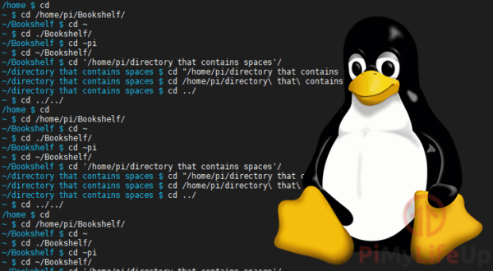
Command
Line
Interface
A command-line interface (CLI) is a text-based user interface (UI) used to run programs, manage computer files and interact with the computer. Command-line interfaces are also called command-line user interfaces, console user interfaces and character user interfaces.
Kunal Yadav A7605221184 B.Tech. CSE [Section -D][2021-2025]

Slide 12
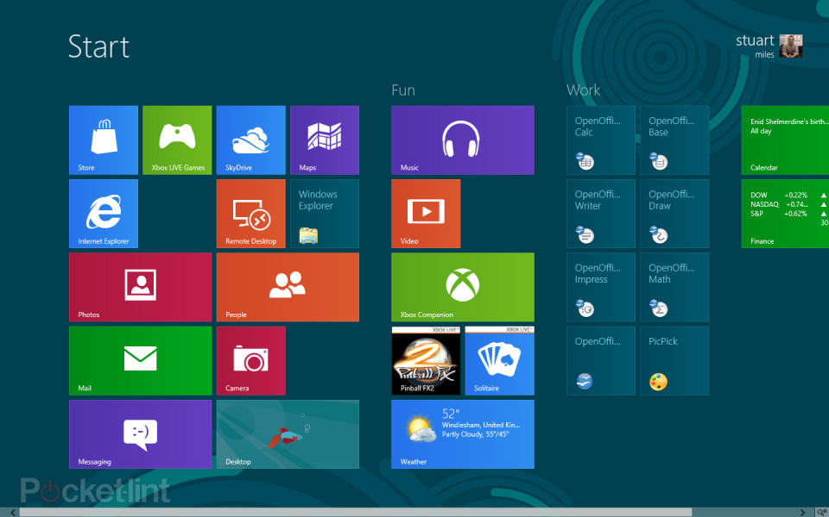
Graphical
User
Interface
A GUI (graphical user interface) is a system of interactive visual components for computer software. A GUI displays objects that convey information, and represent actions that can be taken by the user. The objects change color, size, or visibility when the user interacts with them
Kunal Yadav A7605221184 B.Tech. CSE [Section -D][2021-2025]

Slide 13
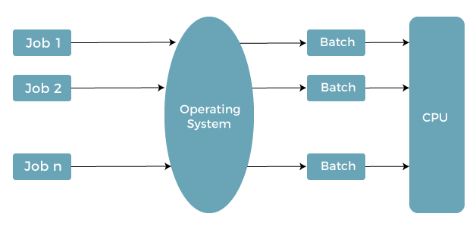
Batch
OS
The operating system keeps the number of jobs in memory and performs them one at a time. Jobs are processed in a first-come, first-served manner. Each job set is defined as a batch. When a task is finished, its memory is freed, and the work's output is transferred into an output spool for later printing or processing.
Kunal Yadav A7605221184 B.Tech. CSE [Section -D][2021-2025]

Slide 14
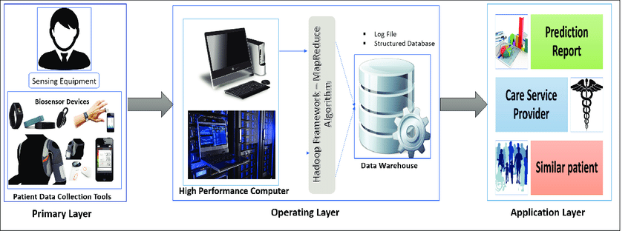
Interactive
OS
An interactive operative system is an operating system that allows the execution of interactive programs. All PC operating systems are interactive operating systems only. An interactive operating system gives permission to the user to interact directly with the computer. Programs that allow users to enter some data or commands are known as Interactive Operating Systems.
Kunal Yadav A7605221184 B.Tech. CSE [Section -D][2021-2025]

Slide 15
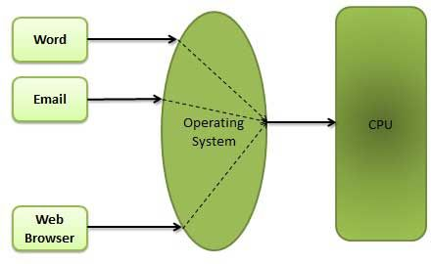
Multiprogramming
OS
A multiprogramming operating system may run many programs on a single processor computer. If one program must wait for an input/output transfer in a multiprogramming operating system, the other programs are ready to use the CPU. As a result, various jobs may share CPU time.
Kunal Yadav A7605221184 B.Tech. CSE [Section -D][2021-2025]

Slide 16
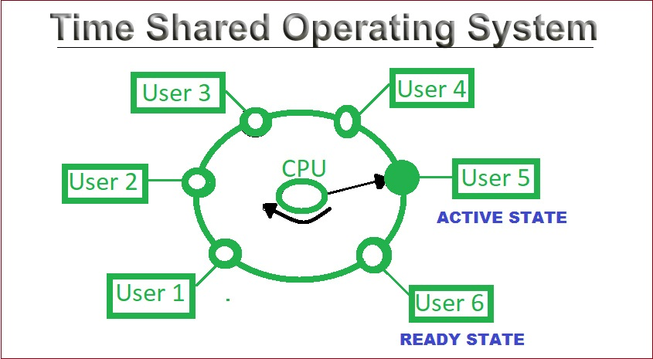
Time
Sharing
OS
Time Shared Operating System is also known as the Multi Tasking Operating System. Time-sharing operating system implements CPU scheduling and multi programming system which to deliver to every users a small piece of operating time. The technique of time sharing system relates with batch processing systems.
Kunal Yadav A7605221184 B.Tech. CSE [Section -D][2021-2025]

Slide 17
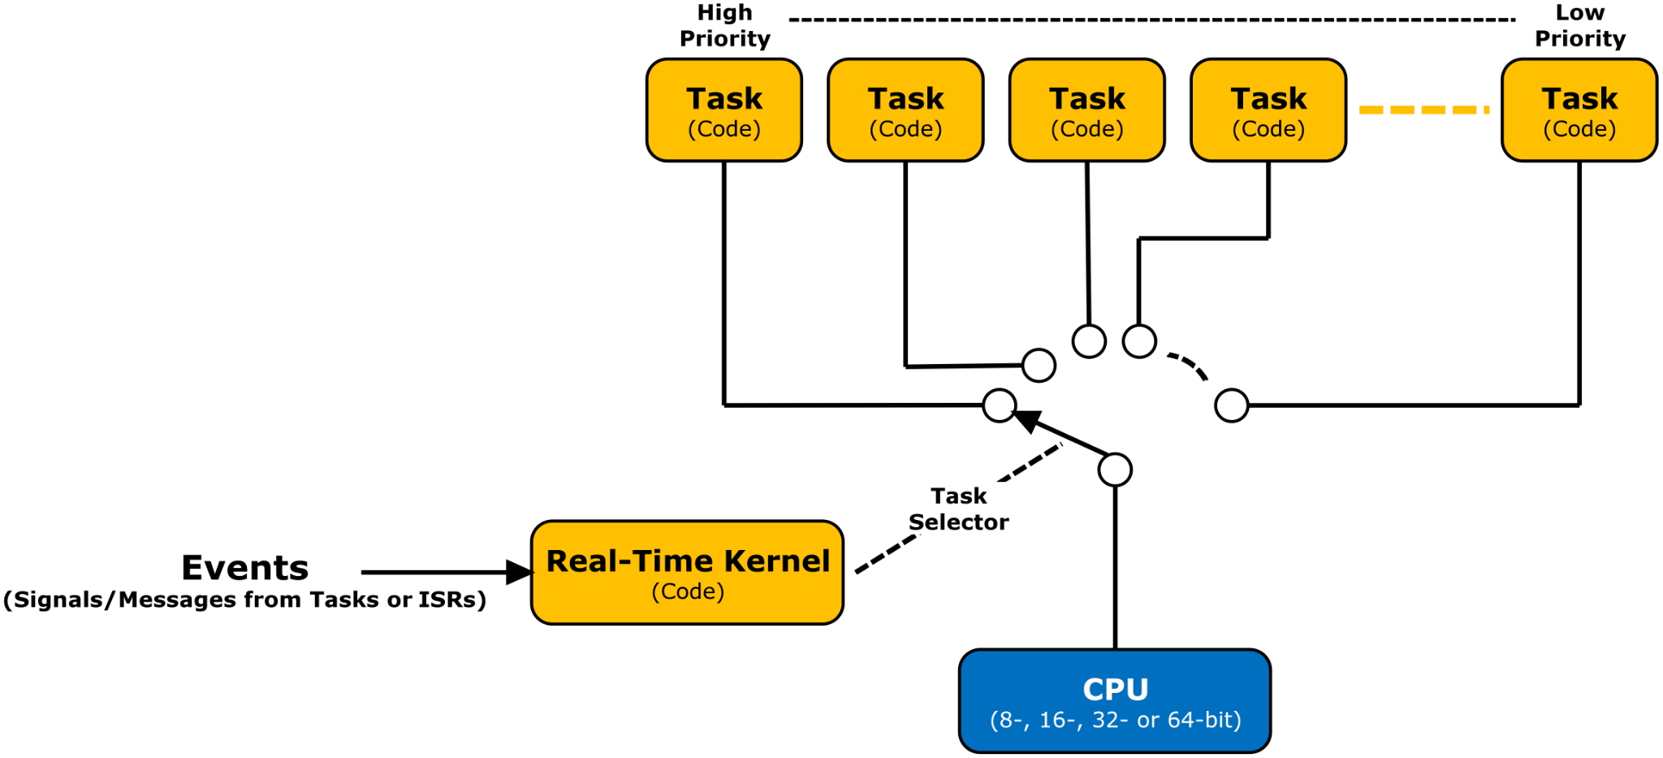
REAL TIME
OS
All real time operating systems are designed to execute their task within a particular time interval, and thus they have to be fast enough to be up to their deadline. Time constraints related with real-time systems simply means that time interval allotted for the response of the ongoing program.
Kunal Yadav A7605221184 B.Tech. CSE [Section -D][2021-2025]

Slide 18
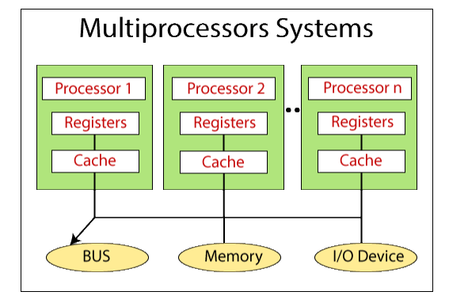
Multiprocessor
Systems
Most computer systems are single processor systems i.e they only have one processor. However, multiprocessor or parallel systems are increasing in importance nowadays. These systems have multiple processors working in parallel that share the computer clock, memory, bus, peripherals etc.
Kunal Yadav A7605221184 B.Tech. CSE [Section -D][2021-2025]

Slide 19
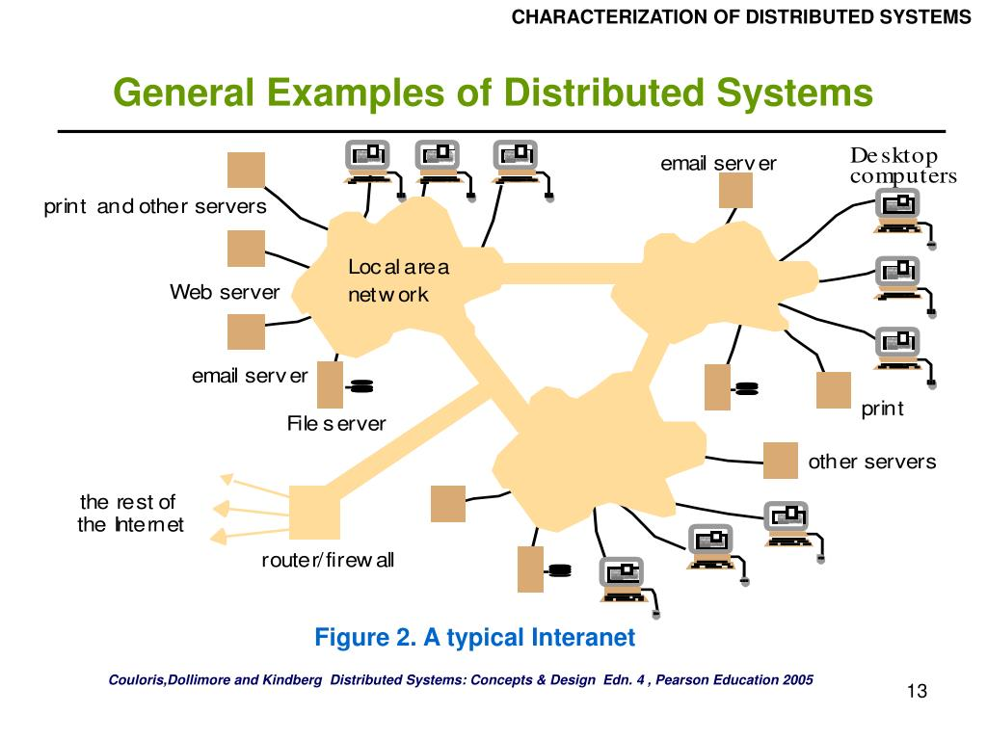
Distributed
System
A distributed system is any network structure that consists of autonomous computers that are connected using a distribution middleware. Distributed systems facilitate sharing different resources and capabilities, to provide users with a single and integrated coherent network.
Kunal Yadav A7605221184 B.Tech. CSE [Section -D][2021-2025]

Slide 20
THANK
YOU
References:
www.javatpoint.com
www.tutorialspoint.com
www.geeksforgeeks.org
Kunal Yadav A7605221184 B.Tech. CSE [Section -D][2021-2025]

