Slide 1

Fake Job Posting Detection
INSTITUTE OF ENGINEERING AND TECHNOLOGY
Lucknow, Uttar Pradesh – 226021
Project Supervisor: Submitted By:
Dr. Promila Bahadur 1. Kavya Agarwal
2. Shambhavi Singh
3. Shivani Kumari

Slide 2

Combating Employment Fraud: Fake Job Posting Detection
Increased reliance on online job platforms for job hunting.
Online platforms are being exploited by scammers creating fake job postings.
Deception leads to financial losses, identity theft, and significant emotional distress for job seekers.
Job seekers often struggle to distinguish between legitimate and fraudulent job postings, leading to wasted time and effort.

Slide 3

The Problem: Exploiting Vulnerable Job Seekers
Targeting Vulnerability: Scammers prey on job seekers desperate for opportunities.
Identity Theft and Fraud: Fake job offers are used to steal personal and financial information.
Emotional and Financial Impact: Victims face monetary losses and psychological stress.
Platform Weaknesses: Insufficient verification mechanisms allow fraudulent postings.
Wasted Resources: Job seekers lose time and effort chasing fake opportunities.

Slide 4

Problem Statement :
Develop a machine learning-based automated system to classify job advertisements as genuine or fraudulent. The solution will enhance the security of online job search platforms, protect users from scams, and foster trust in the digital recruitment ecosystem.

Slide 5

Our Solution: An Automated Detection System
Develop an automated system to detect fake job postings using machine learning.
Analyze job descriptions, company details, contact info, and website data for red flags.
Leverage textual features, company profiles, and job metadata to identify fraudulent patterns
.

Slide 6
Literature Survey :
Authors | Title of Paper | Year of Publication | Findings
T. Sultana, K.A. Sapnaz, F. Sana, J. Najath | Email based Spam Detection. | June 2020 | The research proposes a system for detecting fraudulent or malicious content using Bayes' theorem and the Naive Bayes Classifier, analyzing key features like term frequency and document patterns. This approach helps identify and mitigate harmful content, ensuring greater security and reliability.
S.S. Shaker, D. Alhajim, A.A.T. Al-Khazaali, H.A. Hussein, A.F. Athab | Feature Extraction based Text Classification: A review | May 2022 | Feature extraction techniques play a crucial role in transforming text data into meaningful representations for classifiers such as SVM or deep neural networks. These techniques improve accuracy, specificity, and efficiency, enabling better identification of deceptive content.

Slide 7
Literature Survey :
Authors | Title of Paper | Year of Publication | Findings
S. Qaiser, R. Ali | Text Mining: Use of TF-IDF to Examine the Relevance of Words to Documents | July 2018 | The TF-IDF algorithm is vital in the vectorization process as it identifies and weights the most relevant keywords in textual data, emphasizing unique terms and thus enhancing the accuracy of feature representation. This improves the model’s ability to classify deceptive content more effectively.
Ahmed, H., Traore, I., & Saad | Detection of online fake news using n-gram analysis and machine learning techniques | October 2017 | The study develops a fake news detection model using n-gram analysis, TF-IDF, and machine learning, achieving 92% accuracy with Linear SVM, outperforming existing methods and planned for validation on newer datasets.
Morgan, S. and Menlo Park | Cybercrime Report from the Editors at Cybersecurity Ventures | May 2017 | According to a Cybersecurity Ventures report , the global cost of cybercrime damages trillion annually. Cybercrime is one of the most significant threats facing the world today, posing a risk to both individuals and organizations and causing substantial financial losses.

Slide 8
Literature Survey :
Authors | Title of Paper | Year of Publication | Findings
J.R. Terven, D. M. Cordova-Esparza, A. Ramirez-Pedraza, E.A. Chavez-Urbiola | LOSS FUNCTIONS AND METRICS IN DEEP LEARNING. A REVIEW | July 2023 | The study emphasizes the critical role of loss functions and performance metrics in deep learning across tasks like regression. It also highlights the need to consider dataset characteristics, such as class imbalances and outliers, when designing models, as no single solution fits all tasks. Creating robust loss functions to handle data anomalies and constraints can enhance model performance, advancing deep learning's reliability and effectiveness in modeling complex phenomena.
R. Kumari, S. Srivastava | Machine Learning: A Review on Binary Classification | February 2017 | The use of binary classification in tasks like sock puppet detection and text categorization involves classifying data into predefined categories (e.g., sock puppet or non-sock puppet).

Slide 9
Why Machine Learning?
Adaptability: Addressing Evolving Tactics
Accuracy and Efficiency: Superior Detection
Trust and Security: Building a Safer Job Market
Constantly Evolving Fraud Tactics
Pattern Recognition in Extensive Datasets
Enhanced Trust in Online Recruitment
Fraudsters constantly evolve their tactics.
Analyzes extensive datasets to identify patterns.
Enhances trust in online recruitment platforms.
Limitations of Manual Detection
Improved Accuracy in Fraudulent Postings
Safer Job Search Experience
Manual detection struggles to keep pace.
Predicts fraudulent postings with higher accuracy.
Creates a safer job search experience.
Scalable Machine Learning Solution
Efficiency Gains Over Manual Methods
More Secure Online Job Market
Machine learning offers a scalable, adaptable solution.
Significantly improves efficiency compared to manual methods.
Contributes to a more secure online job market.

Slide 10
Our Methodology: A Step-by-Step Approach
Data Collection
1
.
Data Cleaning and Preprocessing
2
Feature Extraction
3
4
Neural Network Design
5
Model Evaluation and Training
6
Deploying ML Model on a Web Interface

Slide 11
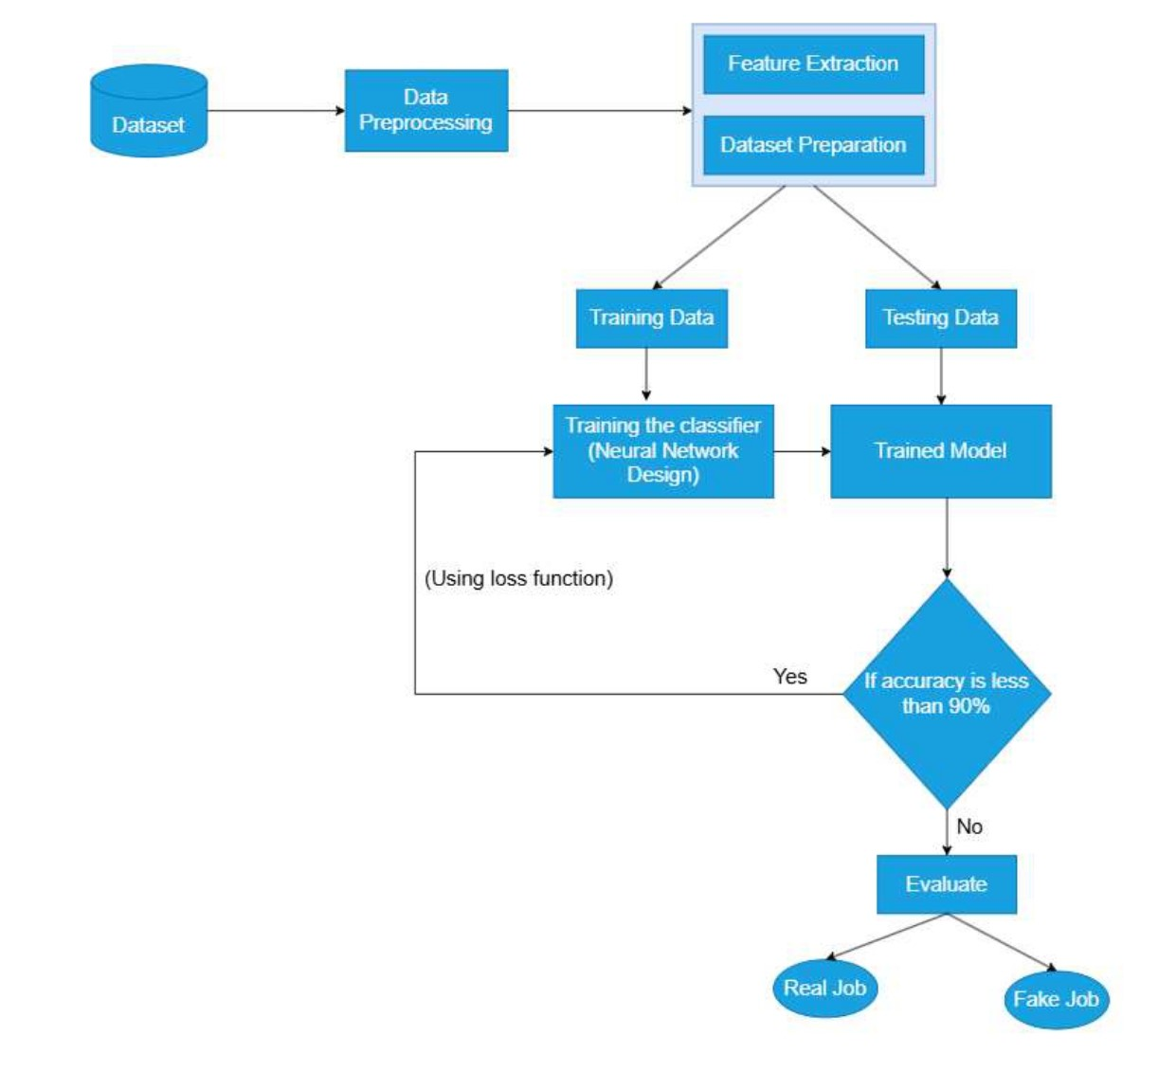
Flowchart for Model Implementation :

Slide 12
How our model will be better than existing models ?
Aspect | Traditional Projects | Our Project
Feature Extraction | Used basic word counts or bag of words methods. | Uses TF-IDF for better word importance analysis.
Training Models | Simple models like Logistic Regression or Naïve Bayes. | Advanced Neural Networks for improved accuracy.
Class Imbalance | Often ignored class imbalance, leading to bias. | Handles imbalance with weighted loss functions.
Dataset Handling | Limited preprocessing and no augmentation. | Improved preprocessing and balanced datasets.
Outcome Accuracy | Lower probability of correct predictions. | Higher probability due to better algorithms.

Slide 13
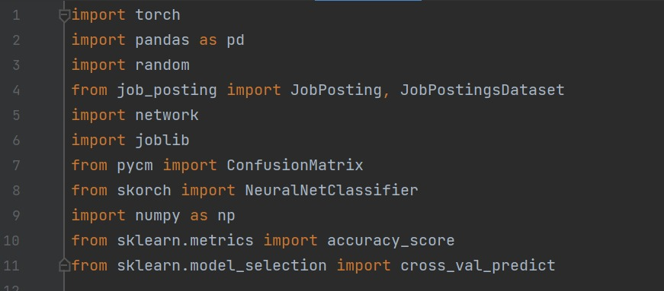
Implementation :
Import Required Libraries :
Essential libraries like PyTorch, Skorch, and scikit-learn are used for model building, training, and evaluation. Pandas handles data processing, while Joblib and Pcym assist with model saving and performance analysis.

Slide 14
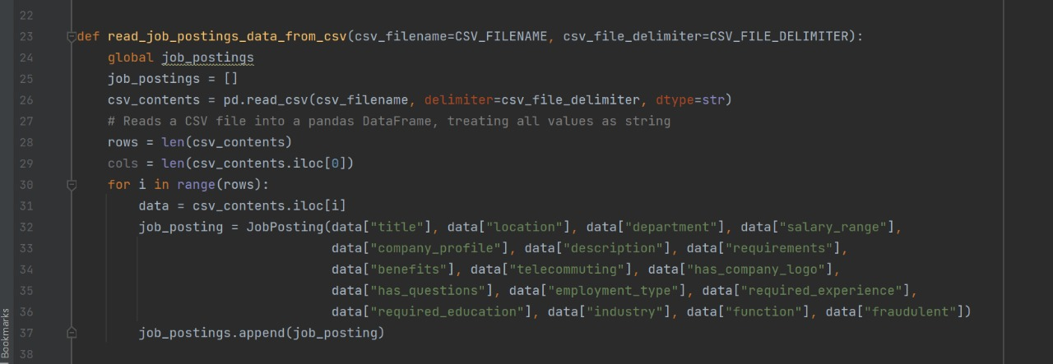
Read Data from CSV :
Reads data from CSV file and coverts CSV contents into a list of job postings (job_postings).

Slide 15
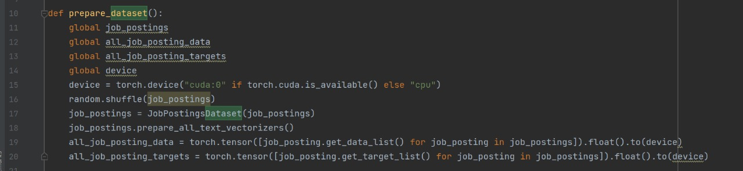
Preparing dataset :
prepare_dataset() shuffles job postings, vectorizes text data, and converts features and labels into
Pytorch tensors, ready for model training on CPU.

Slide 16
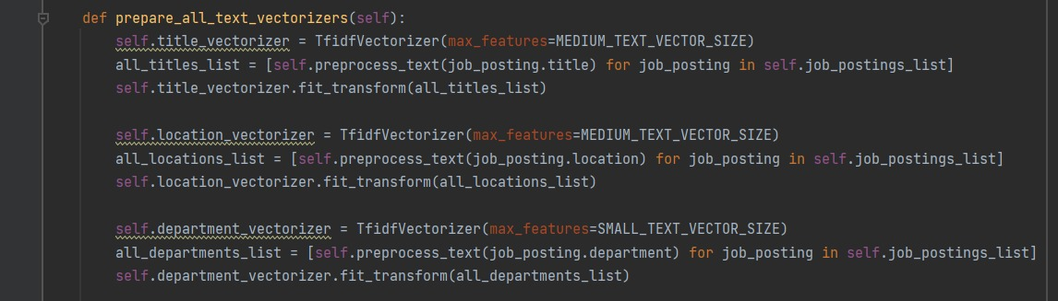
Feature Vectorization using TF-IDF:
TF-IDF vectorization is applied to textual fields like title, description, and company profile to convert them into numerical form. Each field is preprocessed and transformed using size-specific vectorizers, enabling the model to learn from key textual patterns.

Slide 17
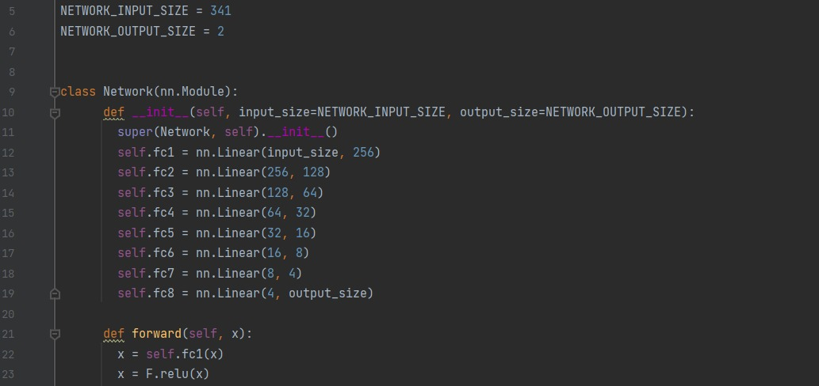
Neural Network Design :
A feedforward neural network is used with ReLU in hidden layers and a sigmoid output for binary classification. Xavier/He initialization ensures stable training, while Binary Cross-Entropy Loss and the Adam optimizer guide learning efficiently.

Slide 18
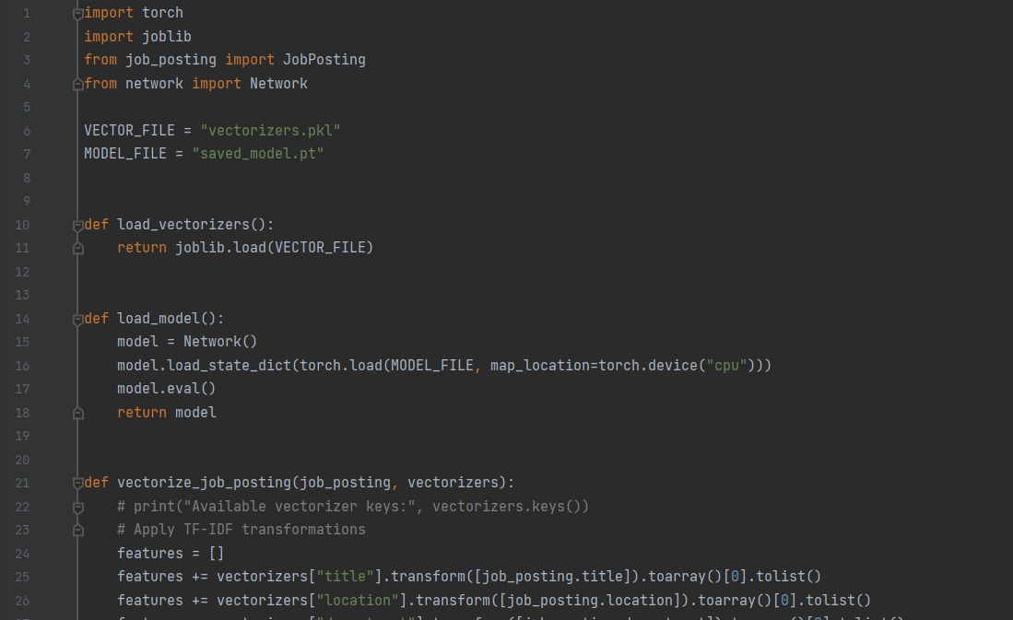
Model Training :
The model is trained using binary cross-entropy loss with Adam optimizer for efficient learning. Cross-validation ensures good generalization, while metrics like accuracy and F1-score monitor performance and prevent overfitting.

Slide 19
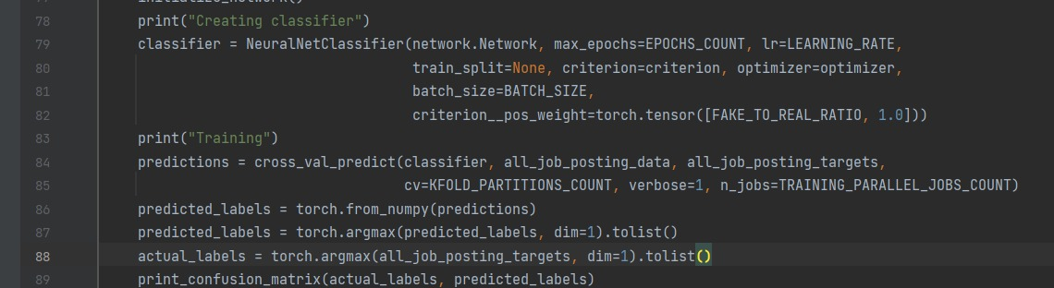
Output for target labels as real or fake :
The model will be evaluated using accuracy, precision, and recall to ensure effective fraud detection and handle class imbalance. Misclassifications will be analyzed to identify weaknesses, guiding fine-tuning for improved real-world performance.

Slide 20
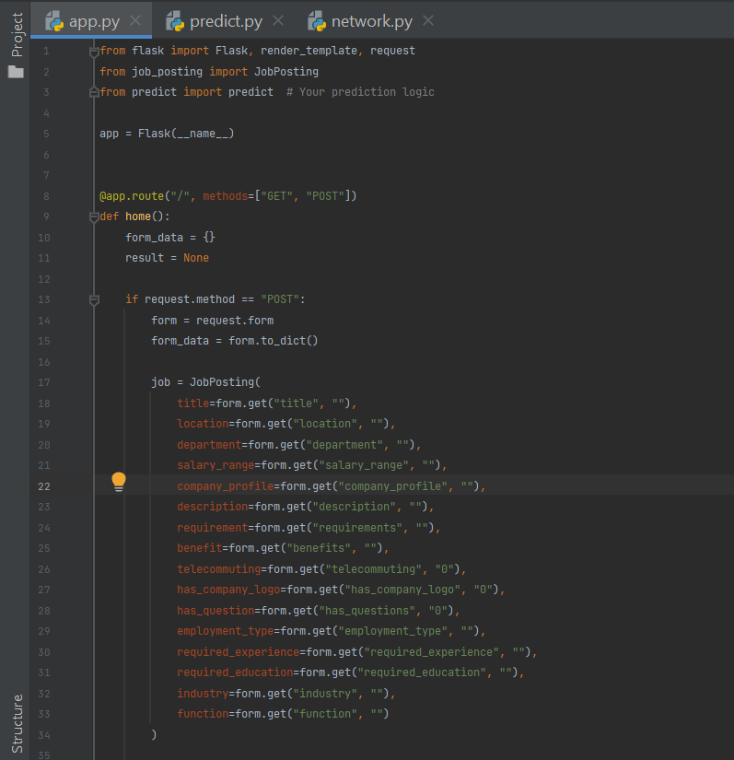
A Web Page Using Flask :
A simple web page was developed using Flask, HTML, and CSS to allow users to input job details and receive instant legitimacy predictions. This interface enables real-time fraud detection and can be integrated into job portals for broader accessibility.

Slide 21
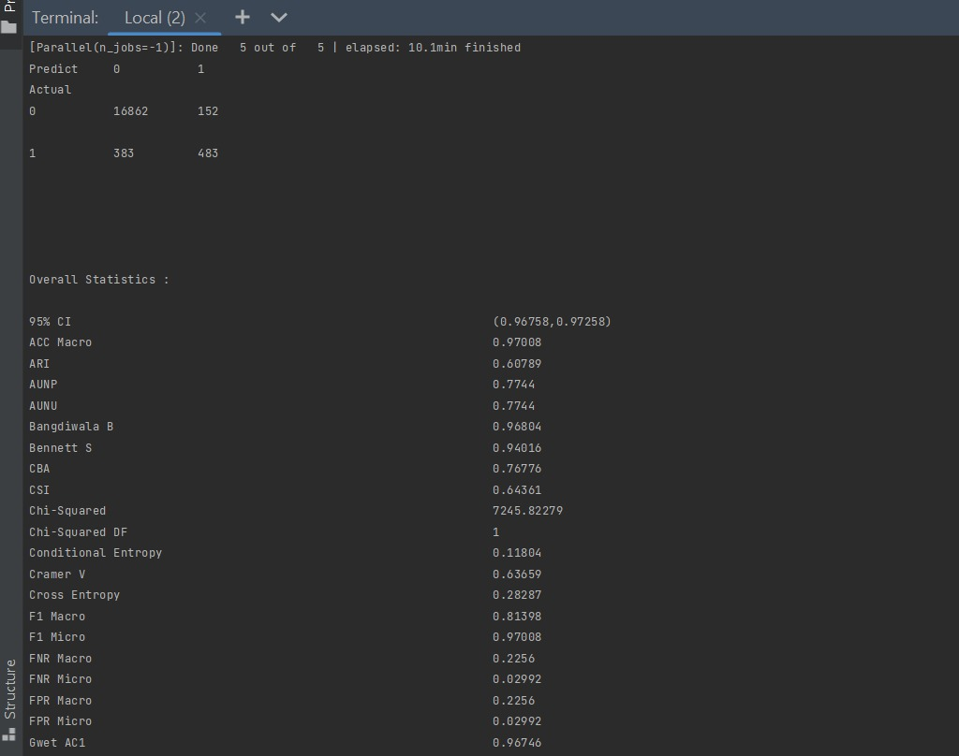
Output of our Trained Model :

Slide 22
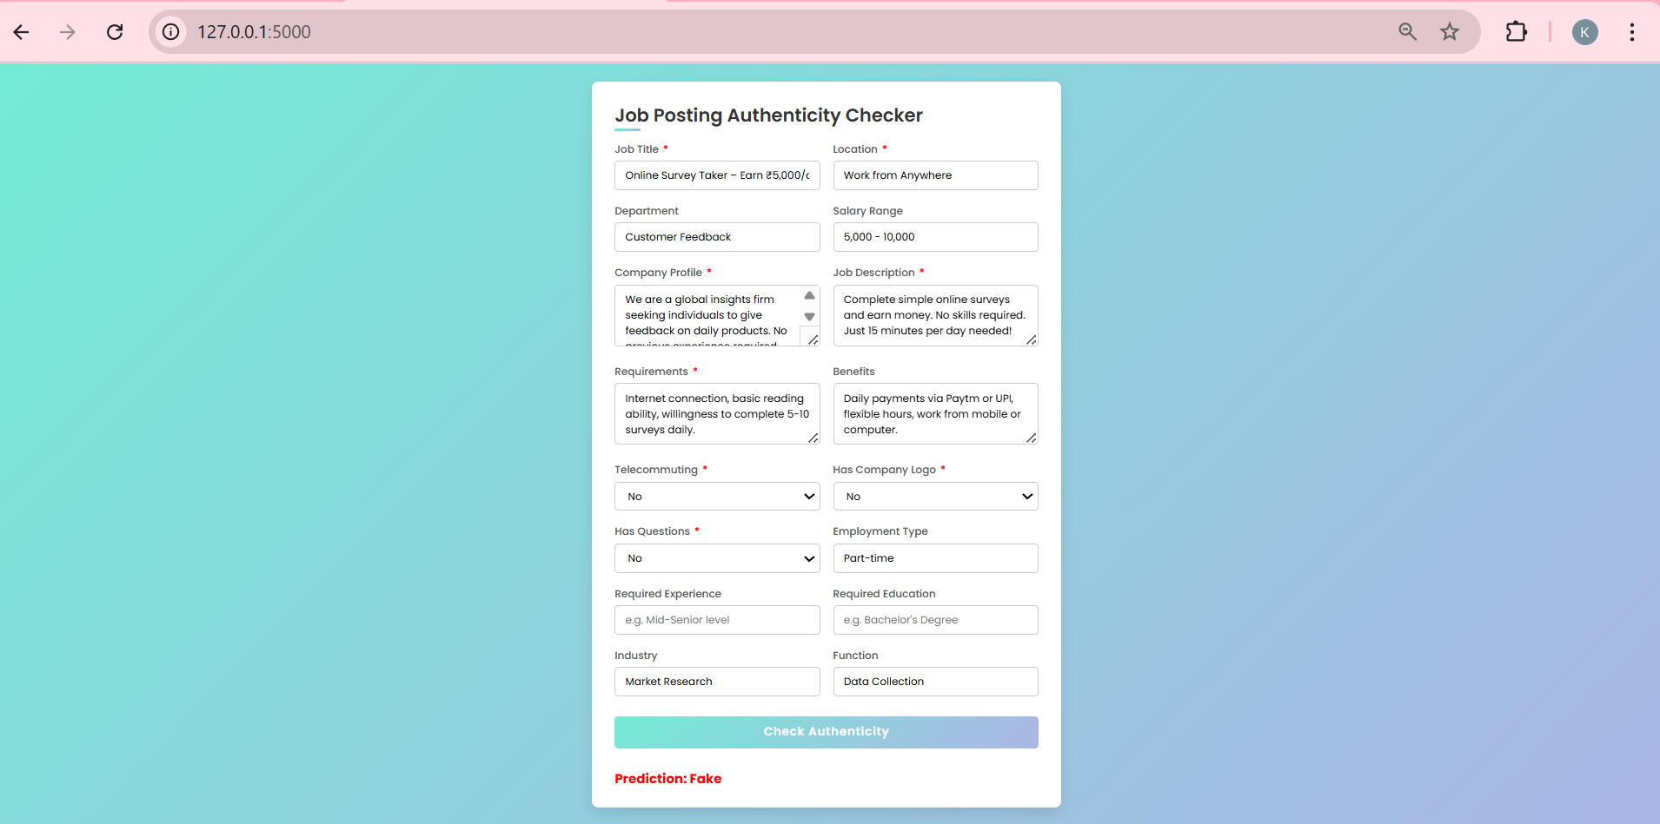
UI of The Web Page :
The UI of our web page features a clean and intuitive form where users can enter job details like title, description, and company profile. Once submitted, the system instantly displays whether the posting is legitimate or fraudulent.

Slide 23

Our automated system will enhance the legitimacy of online recruitment platforms and create a safer environment for job seekers to find legitimate opportunities.
By reducing fraudulent job postings, the system aims to build a more secure and trustworthy job search experience for all.
It will lead to a more efficient job market, saving job seekers time and resources that would otherwise be wasted on scams.
The system contributes to reducing emotional distress and financial losses associated with employment fraud, empowering individuals to engage confidently in the job market.
Our Impact: A Safer Online Job Market

Slide 24
What’s Next :
Webpage Enhancement & Interactivity – A basic web page has been developed to display classification results. It can be improved with interactive dashboards, confidence scores, and feedback options to enhance user experience.
Project Deployment – The model and web app can be deployed on cloud platforms like AWS or Heroku, enabling real-time access and continuous detection of fake job postings across various platform.

Slide 25


