Slide 1
HackerEarth
AI in Capacity Management

Slide 2


TEAM - Opus
THEME:
Kunal Verma ML Scientist - Microsoft Hyderabad B.Tech in EEE, IIT Guwahati
Ashish Verma Senior Data Scientist, Nissan Thiruvendaram BS, MS in Stats – IIT Kanpur
AI in Capacity Management

Slide 3
PROBLEM STATEMENT
Automate the process of matching demand with supply and allocation of resources.
Output a rank and segment-based classification of the resources. The segments for classification are Best Fit (>85% match), Stretched Fit (70% to 85%) and Best Bet (60%-70%)
Recommendation API considering the weightage ranking of the factors – (experience, skills and competency, location, grade/ rank, bench aging and service line)

Slide 4
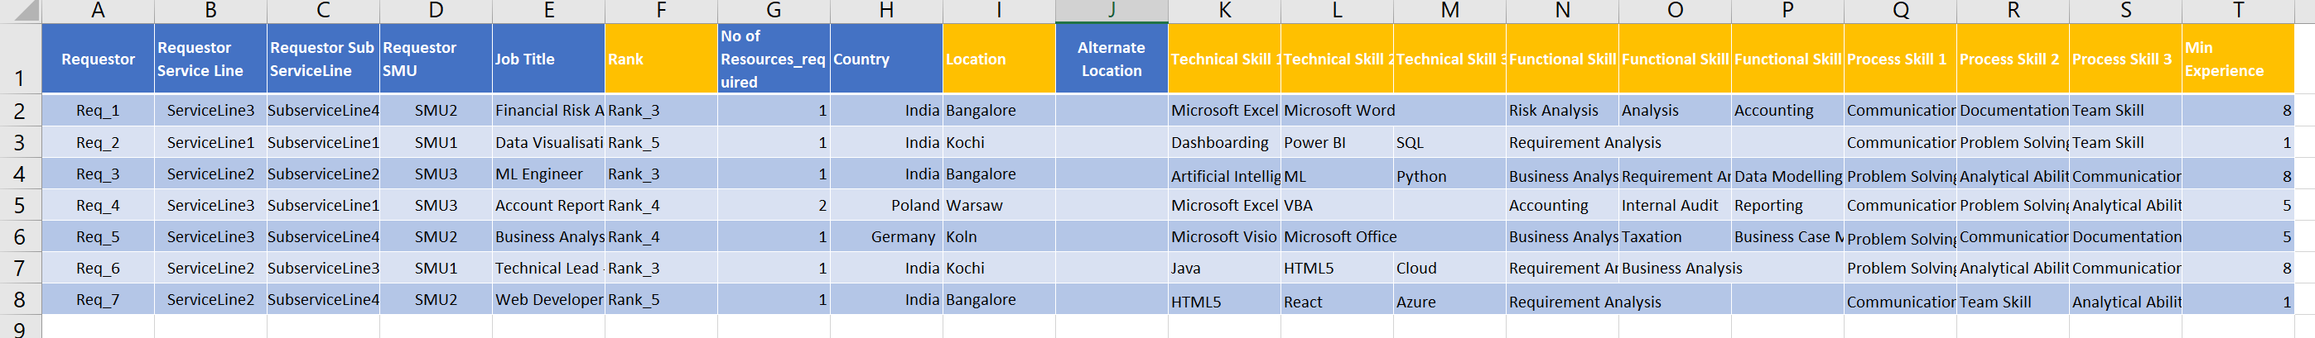
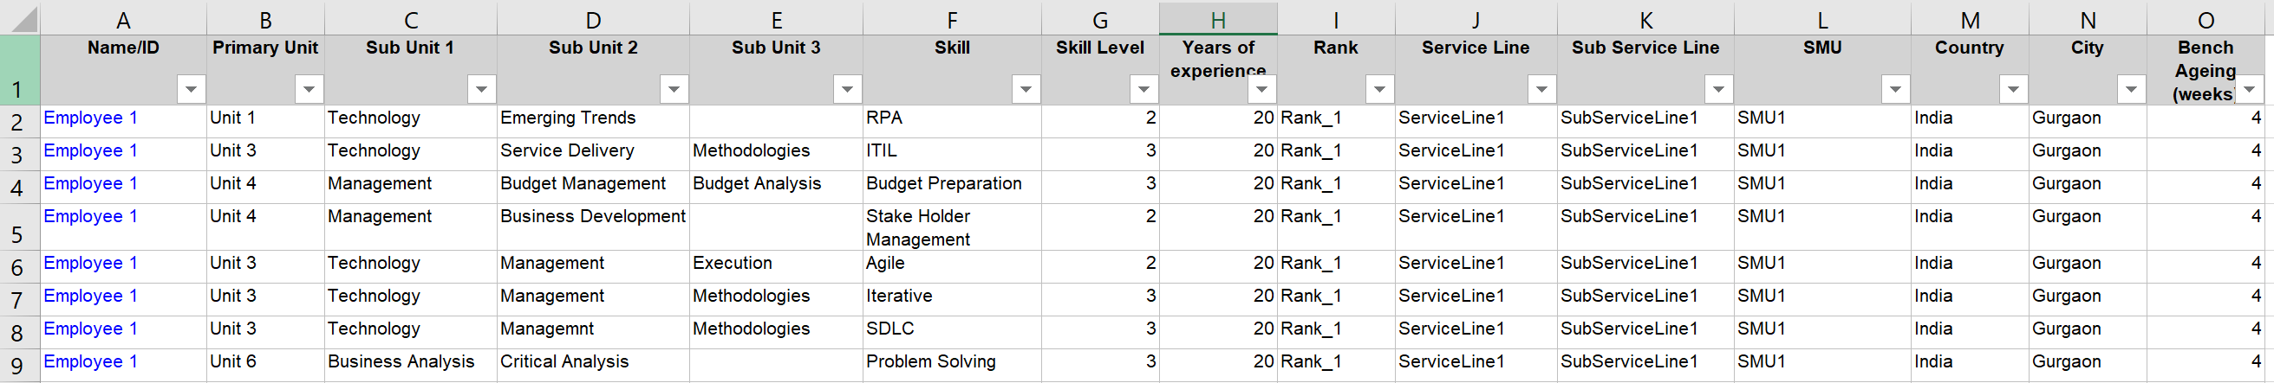
Sample Request Demand Sheet
Sample Supply Employee Sheet

Slide 5
Context Match for Skills
Sample Demand Skills
Advanced Excel, MS Word, Powerpoint
Sample Supply Skill
Keyword Matching
Microsoft Office, Presentation
Word2Vec Spacy
Similarity score = 0.43
Similarity score = 0.79
Contextual Similarity
Spatial Similarity
Rich corpus to learn co-occurrences
Vectorial output easing similarity checks

Slide 6
SOLUTION ARCHITECTURE
2
3
1
Demand Input Excel
SMU, SL & SSL
Demand Skills
Weight – Rank
Recommendations
Supply Tech Skills
Tech Similarity Score
Weight Tech
Weight – Location, WorkEx., Bench Age
Supply Process Skills
Proc Similarity Score
Weight Proc
Cumulative Skills Score
Supply Functional Skills
Func Similarity Score
Weight Func
Word2vec spacy model
Multivariate Optimization

Slide 7

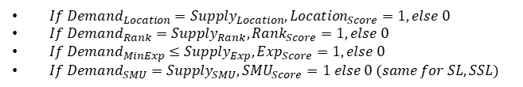
INPUT LAYER
Demand Excel Sheet (Skills, Location, Exp., SMU, SL, SSL, Rank)
OUTPUT LAYER
Weight Technical (w_T), Weight Process (w_P), Weight Functional (w_F), Weight Location (w_L), Weight Rank (w_Rnk), Weight Experience (w_Exp), Weight Bench Ageing (W_Bnch)
$IF\frac{Cum_{Score}}{Max\left(Cum_{Score}\right)}≥0.85,{}_{ }^{′}Best fit′$
$Else If$0.85 > $\frac{Cum_{Score}}{Max\left(Cum_{Score}\right)}$ $≥ 0.7, ‘Stretched Fit’$
$Else If$0.7 > $\frac{Cum_{Score}}{Max\left(Cum_{Score}\right)}$ $≥ 0.6, ‘Best bet’$
$Else ‘No Fit’$
Algorithm
$If Demand_{Location}=Supply_{Location}, Location_{Score}=1, else 0$
$If Demand_{Rank}=Supply_{Rank}, Rank_{Score}=1, else 0$
$If Demand_{MinExp}≤Supply_{Exp}, Exp_{Score}=1, else 0$
$If Demand_{SMU}=Supply_{SMU}, SMU_{Score}=1 else 0 (same for SL, SSL)$
** Returned results are sorted for fitment score against each request
** We multiply w_Exp with ExpScore(0/1) and SupplyExpNorm, where SupplyExpNorm is the min-max normalized Exp. Of employee. We do similar normalization for BenchAge & Rank. This step is done to ensure that total weight of these factors are comparable to that of other factor weights.
**We apply a default weight of 10 for SMU, SSL, SL & SkillLevel because we want to prioritize supply where these factors matches with demand (as asked in the problem)
$Cum_{score}$= [$w_{T}∗\left(SimilarityScore_{Tech}\right)+w_{P}∗\left(SimiliarityScore_{Process}\right)+w_{F}∗\left(SimilarityScore_{Functional}\right)+$ $$w_{L}∗\left(Location_{Score}\right)+ w_{Rnk}∗\left(Rank_{Score}\right)+w_{Exp}∗\left(Exp_{Score}\right)∗\left(Supply_{ExpNorm}\right)+w_{Bnch}∗\left(BenchA_{ScoreNorm}\right)$$ $+10∗\left(SMU_{Score}+SL_{Score}+SSL_{Score}+Supply_{SkillLevel}\right)$]/($w_{T}+w_{P}+w_{F}+w_{L}+w_{Rnk}+w_{Exp}+w_{Bnch}+40$)

Slide 8
WORKING PROTOTYPE
Working demo hosted at - https://kunal93v.pythonanywhere.com/
Easily deployable in Azure Web App Services (flask) – Plug & Play
Robust and Scalable – optimal computation and quick scoring
Open to UI enhancements – Separate HTML/CSS/JS tracks without affecting the core algorithm

Slide 9
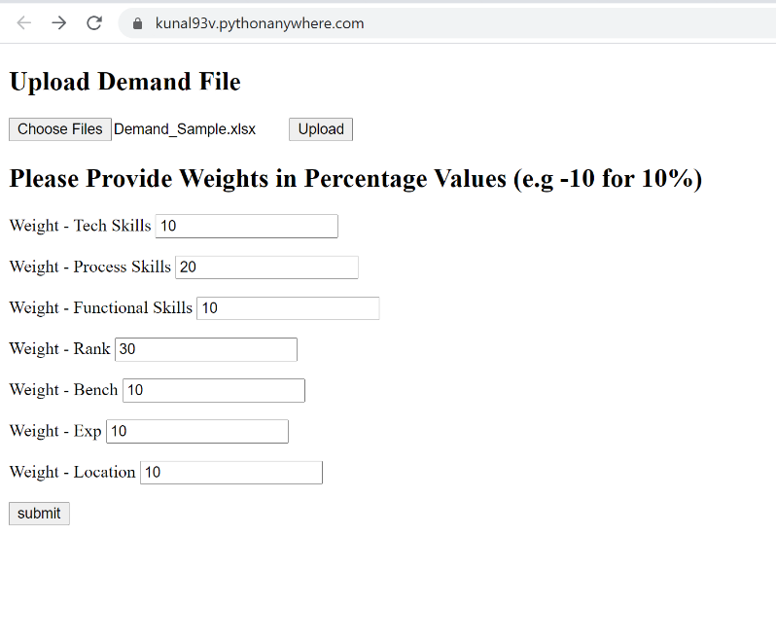
ATTACHMENTS – UI - Input
Upload demand excel sheet for which recommendations are required
Sample Demand Excel Sheet
Weights Input to the Algorithm

Slide 10
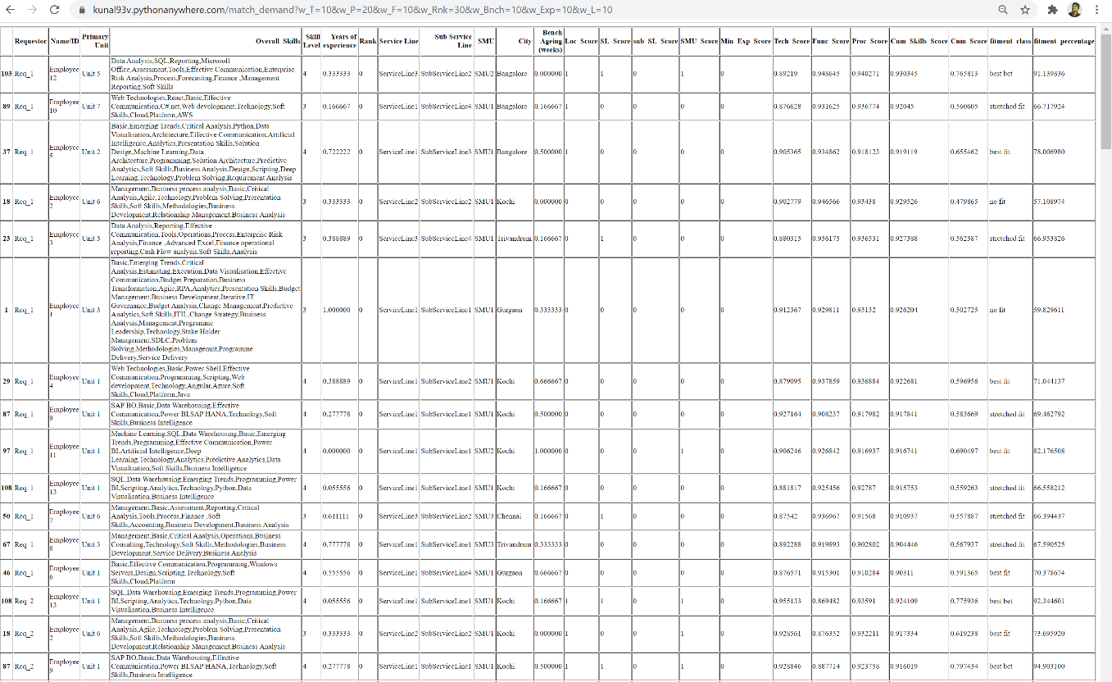
ATTACHMENTS – UI - Output
Sample Output HTML Table Response

Slide 11
THANK YOU

Slide 12
Appendix

Slide 13
We first calculate a similarity score for Technical, Functional, and Process Skills in the Demand
data against the entire corpus of skill set keywords/tags for each employee. This gives a set of
3 scores for each employee. We use Word2Vec Spacy language model to calculate the
similarity score which takes care of the context along with keywords matches.
We use 'en_core_web_sm' pre-trained wordvec model within Spacy which has a proven
corpus for skill-set Corpus data to find the contextual or synonymical similarities. Once we
have these 3 similarity scores, we multiply them with the corresponding weight inputs to
calculate the cumulative skill scores.
We flag Location, Rank, SMU/SSL/SL (synthetic weight = 10 ) as 1 for a perfect match otherwise 0 and then multiply each by their respective weights
We normalize Experience, Bench Age & Skill Level before multiplying them with their corresponding weights.
Finally, we sum up all the weighted scores and normalize them with the total weights to come up with the Cumulative Score. We sort the recommendations in the order Location, Skills, Exp., Skill Level, Bench Aging, SMU, SSL, SL, and Cumulative Score. We calculate the percentage fitment with this Cumulative score as a percentage of the maximum cumulative score. The categories follow - fitment score >= 85% = 'best fit’, fitment score < 85% and fitment score >= 70 % = 'stretched fit’, fitment score < 70% and fitment score >= 60 % = best bet' and fitment score < 60% = 'no fit’. These fitment categories are dynamic and adaptive to changes to weight inputs for the same demand requests.

