Slide 1
HackerEarth
AI in Capacity Management

Slide 2
TEAM - Opus
THEME:
Kunal Verma – ML Scientist, Microsoft Hyderabad Ashish Verma – Senior Data Scientist, Nissan Thiruvendaram
AI in Capacity Management

Slide 3
PROBLEM STATEMENT
Automate the process of matching demand with supply and allocation of resources. The solution should be able to output a rank and segment-based classification of the resources.
The segments for classification are Best Fit (>85% match), Stretched Fit (70% to 85%) and Best Bet (60%-70%)
Recommendation API should also be considering the weightage ranking of the factors – (experience, skills and competency, location, grade/ rank, bench aging and service line)

Slide 4
SOLUTION
Developed a framework to match the demand with supply data
SMU, SL & SSL
Input
Demand Skills
Weight – Rank
Weight Tech
Weight – Location, WorkEx., Bench Age
Recommendations
Supply Tech Skills
Supply Process Skills
Weight Proc
Cumulative Skills Score
Supply Functional Skills
Weight Func
Word2vec spacy model
Multivariate Optimization

Slide 5
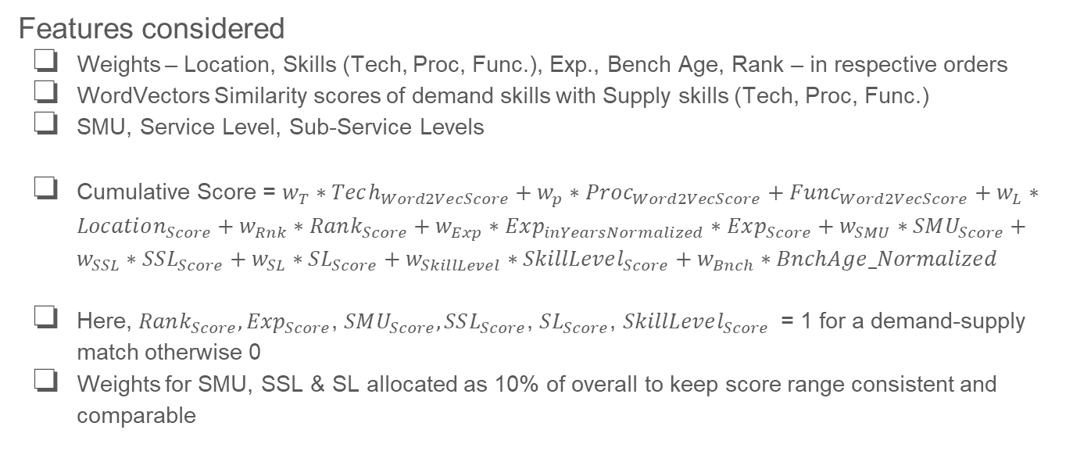
CHECKLIST
Features considered
Weights – Location, Skills (Tech, Proc, Func.), Exp., Bench Age, Rank – in respective orders
WordVectors Similarity scores of demand skills with Supply skills (Tech, Proc, Func.)
SMU, Service Level, Sub-Service Levels
Cumulative Score = $w_{T}∗Tech_{Word2VecScore}+w_{p}∗Proc_{Word2VecScore}+Func_{Word2VecScore}+w_{L}∗Location_{Score}+w_{Rnk}∗Rank_{Score}+w_{Exp}∗Exp_{inYearsNormalized}∗Exp_{Score}+w_{SMU}∗SMU_{Score}+w_{SSL}∗SSL_{Score}+w_{SL}∗SL_{Score}+w_{SkillLevel}∗SkillLevel_{Score}+w_{Bnch}∗BnchAge_Normalized$
Here, $Rank_{Score}, Exp_{Score}$, $SMU_{Score}, SSL_{Score}$, $SL_{Score}$, $SkillLevel_{Score}$ = 1 for a demand-supply match otherwise 0
Weights for SMU, SSL & SL allocated as 10% of overall to keep score range consistent and comparable

Slide 6
WORKING PROTOTYPE
Working demo hosted at - https://kunal93v.pythonanywhere.com/

Slide 7
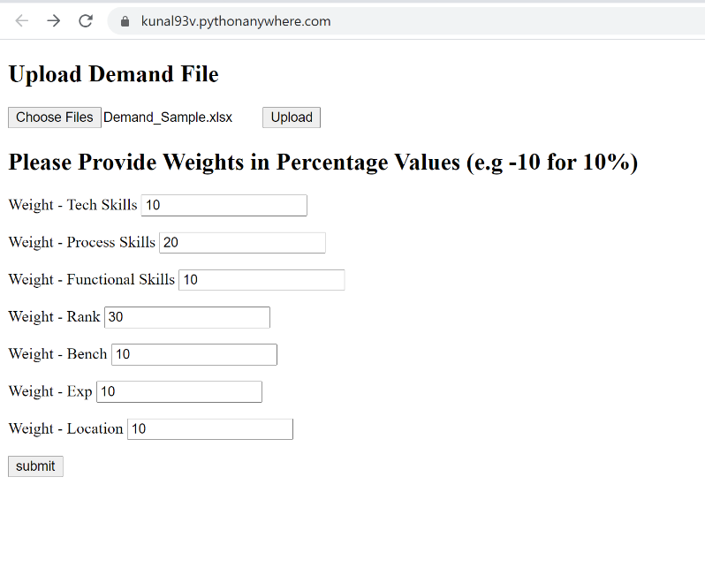
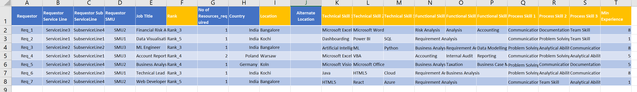
ATTACHMENTS – UI - Input
Upload demand excel sheet for which recommendations are required
Sample Demand Excel Sheet
Weights Input to the Algorithm

Slide 8
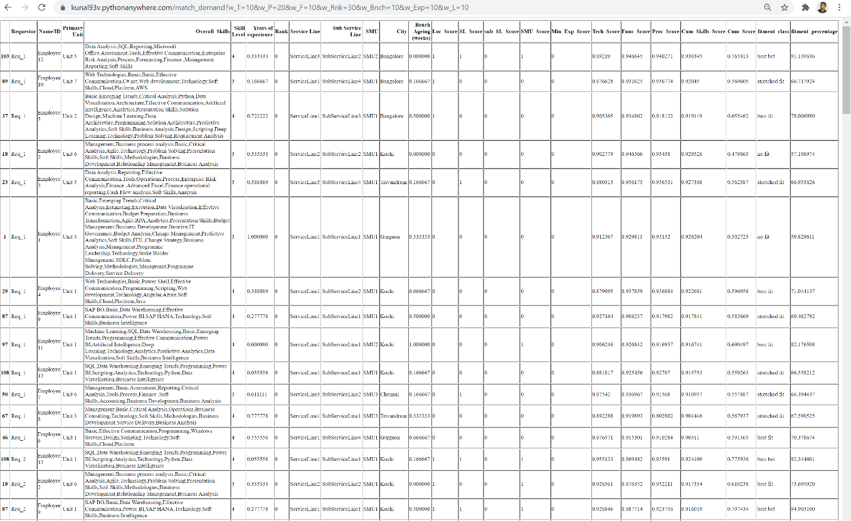
ATTACHMENTS – UI - Output
Sample Output HTML Table Response

Slide 9
THANK YOU

