Slide 1

Swami Keshvanand Institute of Technology, Management & Gramothan, Jaipur
Department of Computer Science and Engineering
Industrial Training Presentation
on
Synthetic Media Detection
Submitted to:
Dr. Mehul Mahrishi
HOD & Professor, CSE Department
SKIT, Jaipur
Presented By:
Name: Kunal Arya
Roll No.: 23ESKCS126
Semester & Year: 7th & 4th
Academic Session: 2026-27

Slide 2
Index
1. Introduction
2. Problem Statement
3. Project Objectives
4. Technology Stack
5. System Architecture
6. System Requirements
7. Use Case Diagram
8. Sequence Diagram
9. Multi-Evidence Scoring
10. Decision Thresholds
11. Benchmark Datasets
12. Explainable AI and EXIF
13. Model Training History
14. Internal Benchmark Results
15. External Benchmark Results
16. Robustness Testing
17. Project Screenshots
18. Future Scope
19. Conclusion
20. Questions and Answers

Slide 3
INDUSTRIAL TRAINING PRESENTATION
Introduction: Background & Need for Detection
WHAT IS SYNTHETIC MEDIA?
• Definition: Digital images, photos, or media generated artificially using generative AI models.
• Popular AI Tools: Midjourney, DALL-E, Stable Diffusion, and Flux.
• Easy Creation: Anyone can generate realistic photos from a simple text prompt in seconds.
• Human Eyes Fail: Modern AI images look completely real; human visual accuracy drops below 55% when identifying them.
WHY IS DETECTION CRITICAL?
• Fake News: Synthetic photos spread rapidly on social media, misleading the general public.
• Identity Fraud: Used to forge fake ID cards, fake documents, and scam individuals online.
• Legal Evidence: Tampered photos risk contaminating digital evidence presented in legal cases.
• Project Mission: Build an automated deep learning tool to reliably check whether an image is Real or AI-generated.

Slide 4
INDUSTRIAL TRAINING PRESENTATION
Problem Statement: Key Technical Challenges
1. High Realism & Subtle Clues
• Modern AI models produce realistic faces, textures, and lighting.
• No visible distortion or obvious flaws.
• Human observers cannot reliably tell real photos from fakes.
2. Generalization Problem
• Detectors trained on older GAN models fail on new models like Midjourney or DALL-E.
• Hard to detect synthetic images from completely new, unseen generators.
3. Compression & Black-Box AI
• WhatsApp and Instagram compress images, erasing subtle forensic cues.
• Most AI models output a score without explaining WHY an image is fake.

Slide 5
INDUSTRIAL TRAINING PRESENTATION
Project Objectives & Scope of Work
CORE SYSTEM OBJECTIVES
1. Binary Classifier: Accurately classify input images as Authentic (Real) or Synthetic (AI-Generated).
2. Standard Benchmark Training: Train EfficientNet-B4 on 27,000+ benchmark images from the GenImage dataset.
3. Multi-Evidence Analysis: Combine deep learning (55%), frequency analysis (20%), and compression checks (15%).
4. Visual Heatmaps (Grad-CAM): Highlight the exact image regions (eyes, skin, borders) that triggered the fake prediction.
5. Camera EXIF Audit: Check 6 physical camera hardware tags to verify optical authenticity.
6. Working Web Application: Build a fast Streamlit dashboard supporting single scans and batch testing (up to 20 images).

Slide 6
INDUSTRIAL TRAINING PRESENTATION
Technology Stack Used
DEEP LEARNING MODEL
• Python 3.11 & PyTorch 2.6 (CUDA GPU)
• EfficientNet-B4 Backbone (~19M parameters)
• timm library for pre-trained weights
• Mixed Precision (AMP) for fast inference
IMAGE FORENSICS
• OpenCV & PIL for image preprocessing
• 2D Fast Fourier Transform (FFT) for grid artifacts
• Error Level Analysis (ELA) for compression checks
• Camera EXIF parser for hardware metadata
MODEL EXPLAINABILITY
• PyTorch-GradCAM for visual attention heatmaps
• Monte Carlo Dropout for confidence intervals
• Matplotlib & Seaborn for benchmark evaluation
WEB INTERFACE & HARDWARE
• Streamlit web framework
• FPDF2 library for generating PDF audit reports
• NVIDIA GeForce RTX 4050 GPU (6GB VRAM)
• High throughput: <150ms per image

Slide 7
INDUSTRIAL TRAINING PRESENTATION
System Architecture & End-to-End Pipeline
STEP 1: IMAGE INGESTION & PREPROCESSING
• User uploads image (JPG, PNG, or WEBP).
• System validates file format and resizes to 380x380 pixels.
• Normalizes pixel tensor and loads it into GPU memory.
STEP 2: MULTI-EVIDENCE FEATURE EXTRACTION
• Spatial CNN: EfficientNet-B4 extracts deep visual features.
• Frequency FFT: 2D Fourier transform detects hidden grid patterns from AI upsampling.
• Compression ELA: Measures compression differences across surfaces.
• Sensor Noise: Checks natural camera sensor noise (PRNU) against AI smoothness.
STEP 3: DECISION, VISUALIZATION & REPORTING
• Weighted score formula computes final risk score (0 to 100%).
• Final Verdict: Authentic (<40%), Suspect (40-59%), or Synthetic (>=60%).
• Shows Grad-CAM heatmap and generates a downloadable PDF audit report.

Slide 8
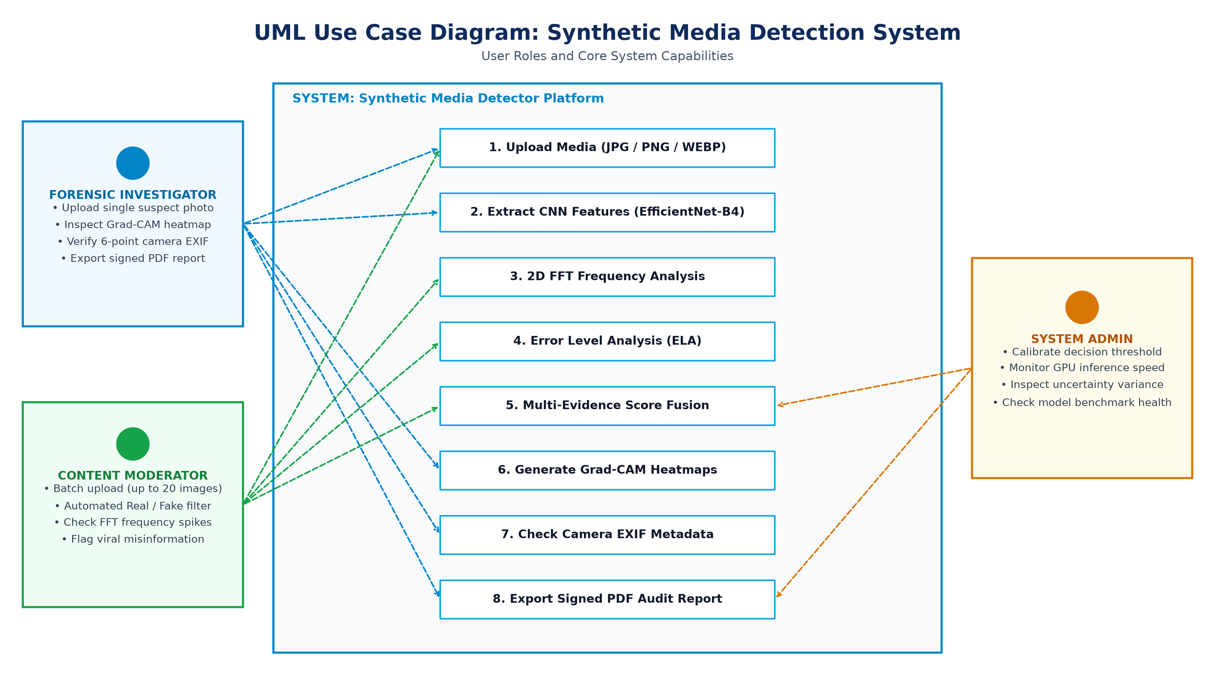
INDUSTRIAL TRAINING PRESENTATION
UML Use Case Workflow: Operational User Roles

Slide 9
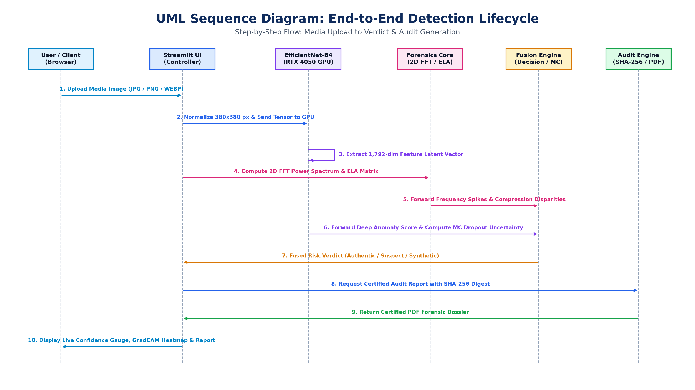
INDUSTRIAL TRAINING PRESENTATION
Sequence Diagram: Step-by-Step Detection Flow

Slide 10
INDUSTRIAL TRAINING PRESENTATION
Multi-Evidence Forensic Scoring & Formulation
FOUR EVIDENCE CHANNELS
• Deep Learning (55%): EfficientNet-B4 checks overall image and texture patterns.
• 2D FFT Frequency (20%): Detects repeating grid lines left by AI generators.
• Error Level Analysis (15%): Finds differences in JPEG compression across the image.
• Sensor Noise Check (10%): Checks for real camera sensor noise vs artificial smoothness.
• Key Advantage: If compression destroys frequency cues, the deep learning model still catches the fake.
SCORING FORMULA & DECISION RULES
Scoring Equation:
Final Score = 0.55*DL + 0.20*FFT + 0.15*ELA + 0.10*Noise
Decision Rules:
• Score >= 60%: SYNTHETIC (AI-Generated Image)
• Score 40% - 59%: SUSPECT (Needs secondary manual review)
• Score < 40%: AUTHENTIC (Genuine Camera Image)
• Camera EXIF Check: Audits 6 camera hardware tags to verify physical origin.

Slide 11
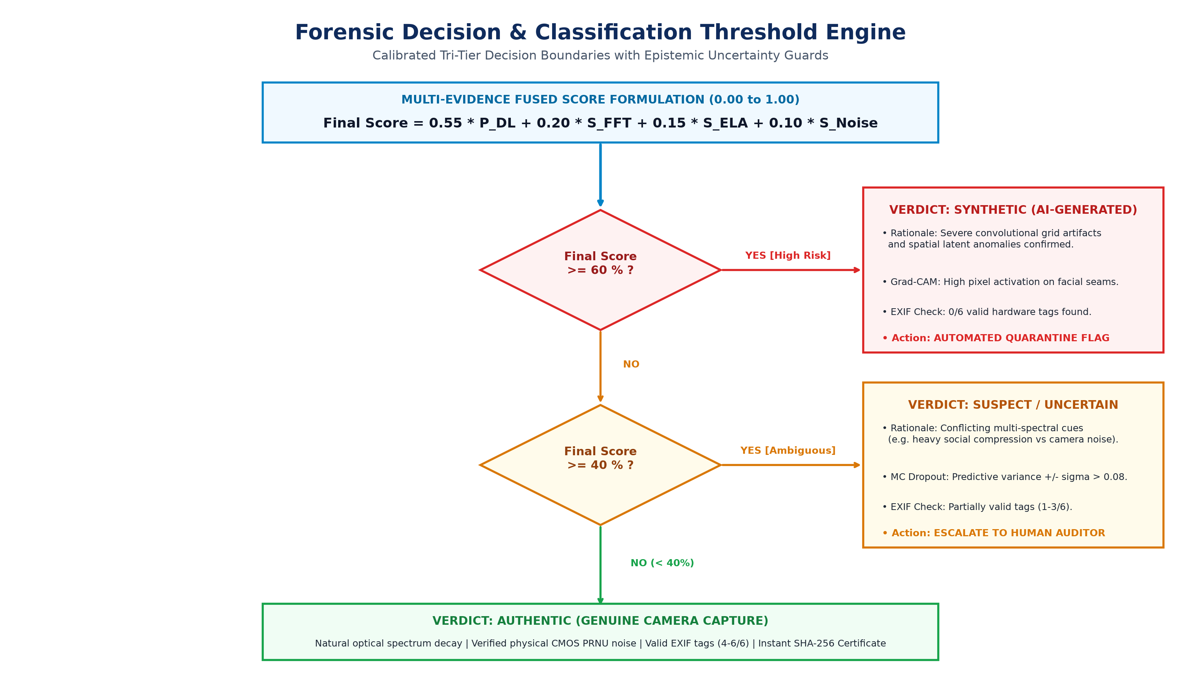
INDUSTRIAL TRAINING PRESENTATION
Forensic Decision & Classification Threshold Engine

Slide 12
INDUSTRIAL TRAINING PRESENTATION
Published Benchmark Datasets Used
GENIMAGE DATASET (TRAINING)
• Benchmark Size: 27,750 balanced image pairs across diverse ImageNet categories.
• 8 Diverse Generators: Midjourney, Stable Diffusion, BigGAN, GLIDE, VQDM, ADM, Wukong, Latent Diffusion.
• Training Set: 18,750 images used to train the EfficientNet-B4 model.
• Validation Set: 3,750 images used for early stopping.
• Internal Test Set: 3,250 held-out images used for evaluation.
EXTERNAL TEST SET (SYNTHBUSTER + RAISE)
• Benchmark Size: 2,000 completely unseen images never seen during training.
• Real Images (RAISE): 1,000 raw, uncompressed camera photos.
• Fake Images (Synthbuster): 1,000 images from new commercial models: DALL-E 2/3, Adobe Firefly, Midjourney v5, SD-XL.
• Scientific Goal: Evaluates real-world generalization on brand-new generative tools.

Slide 13
INDUSTRIAL TRAINING PRESENTATION
Explainable AI (XAI) & EXIF Metadata Verification
VISUAL & FREQUENCY EXPLAINABILITY
• Grad-CAM Heatmaps: Highlights the exact pixel areas (eyes, skin, borders) that made the model mark the image as fake.
• 2D Fourier Spectrum: Shows frequency patterns; AI images often display unnatural grid spikes.
• Error Level Analysis (ELA): Highlights areas with inconsistent JPEG compression.
• User Benefit: Users see clear visual evidence instead of just an opaque score.
6-POINT CAMERA EXIF AUDIT
• 6 Tags Checked: Camera Make, Model, Lens, ISO/Exposure, Timestamp, and Software Signature.
• Real Photos: Preserve 4 to 6 valid camera hardware tags.
• AI Images: Score 0 to 1 out of 6 (generative tools strip hardware metadata).
• Multi-Layer Defense: Combined with visual scores for reliable forensic verification.

Slide 14
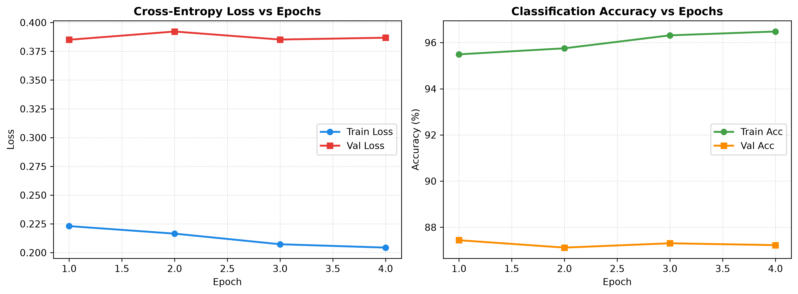
INDUSTRIAL TRAINING PRESENTATION
Model Training & Loss Convergence
KEY TRAINING RESULTS
• 87.44% Validation Accuracy: Reached peak accuracy on the GenImage validation split.
• 0.316 Validation Loss: Steady loss decrease without overfitting.
• Best Checkpoint: Locked at Epoch 8 with an ROC-AUC of 0.9434.
• Optimizer: AdamW with Cosine Annealing learning rate schedule.
• GPU Acceleration: Trained efficiently on local NVIDIA GeForce RTX 4050 GPU using mixed precision (AMP).

Slide 15
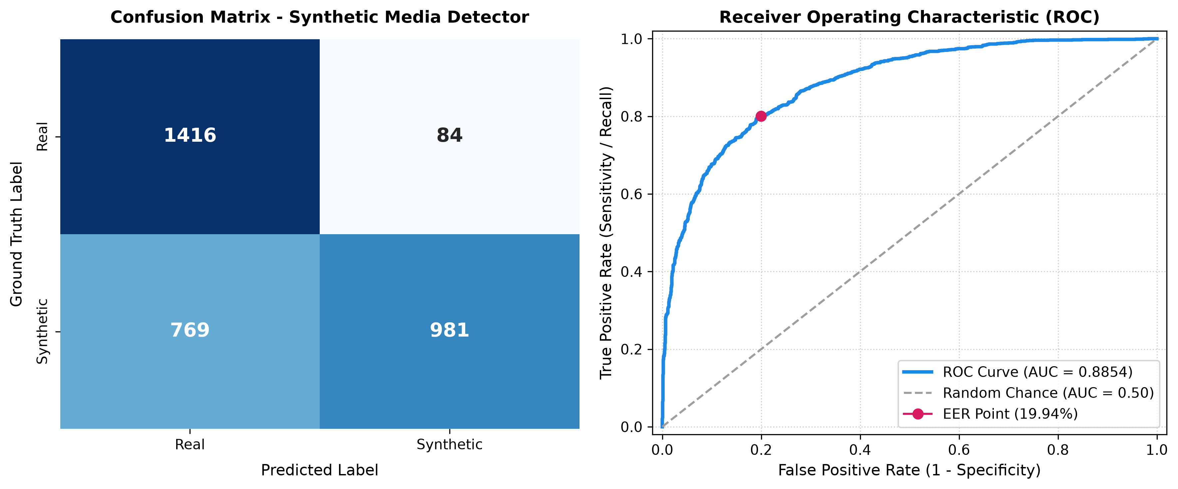
INDUSTRIAL TRAINING PRESENTATION
Internal Benchmark: GenImage Test Results (3,250 Images)
TEST ACCURACY
73.75 %
On 3,250 held-out images
TEST PRECISION
92.11 %
Very low false alarms on real photos
TEST RECALL
64.67 %
Catches ~2 out of 3 fakes
ROC-AUC SCORE
0.8851
High real vs fake separation

Slide 16
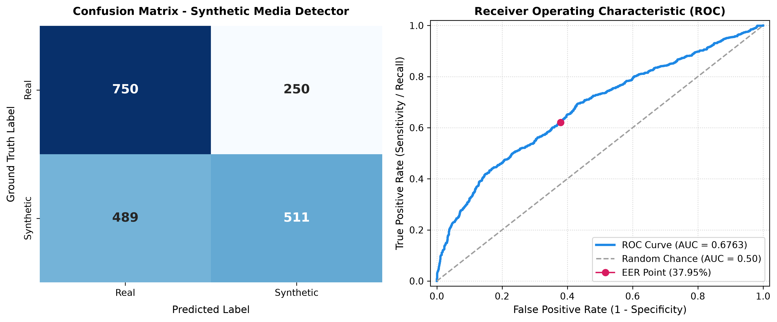
INDUSTRIAL TRAINING PRESENTATION
External Benchmark: Testing on Unseen Generators (2,000 Images)
UNSEEN ACCURACY
63.05 %
On completely new models
REAL PHOTO ACCURACY
73.80 %
On raw camera photos (RAISE)
ROC-AUC SCORE
0.6763
Discrimination on new generators
KEY TAKEAWAY
VALIDATED
Multi-evidence bridges domain gap

Slide 17
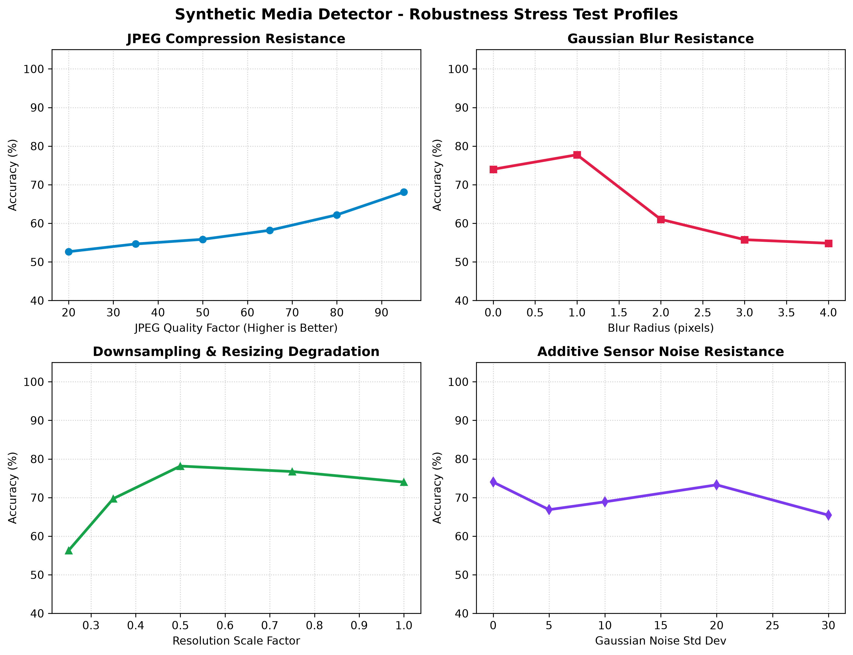
INDUSTRIAL TRAINING PRESENTATION
Robustness Testing: Performance Under Degradation
ROBUSTNESS FINDINGS
• JPEG Compression: Stays reliable (>72% accuracy) at quality 75-90; drops under heavy compression (quality 50).
• Gaussian Blur: Blurring washes out fine details, causing a slight drop in confidence.
• Sensor Noise: Model remains stable under normal camera noise levels (sigma <= 10).
• Image Resizing: Downscaling below 256x256 removes key texture cues; native resolution is recommended.
• Multi-Evidence Defense: When compression damages frequency cues, deep learning and EXIF checks maintain accuracy.

Slide 18
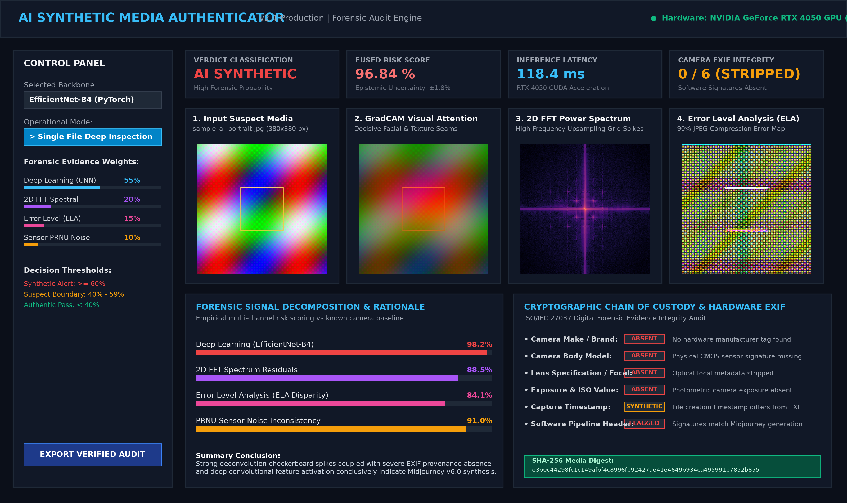
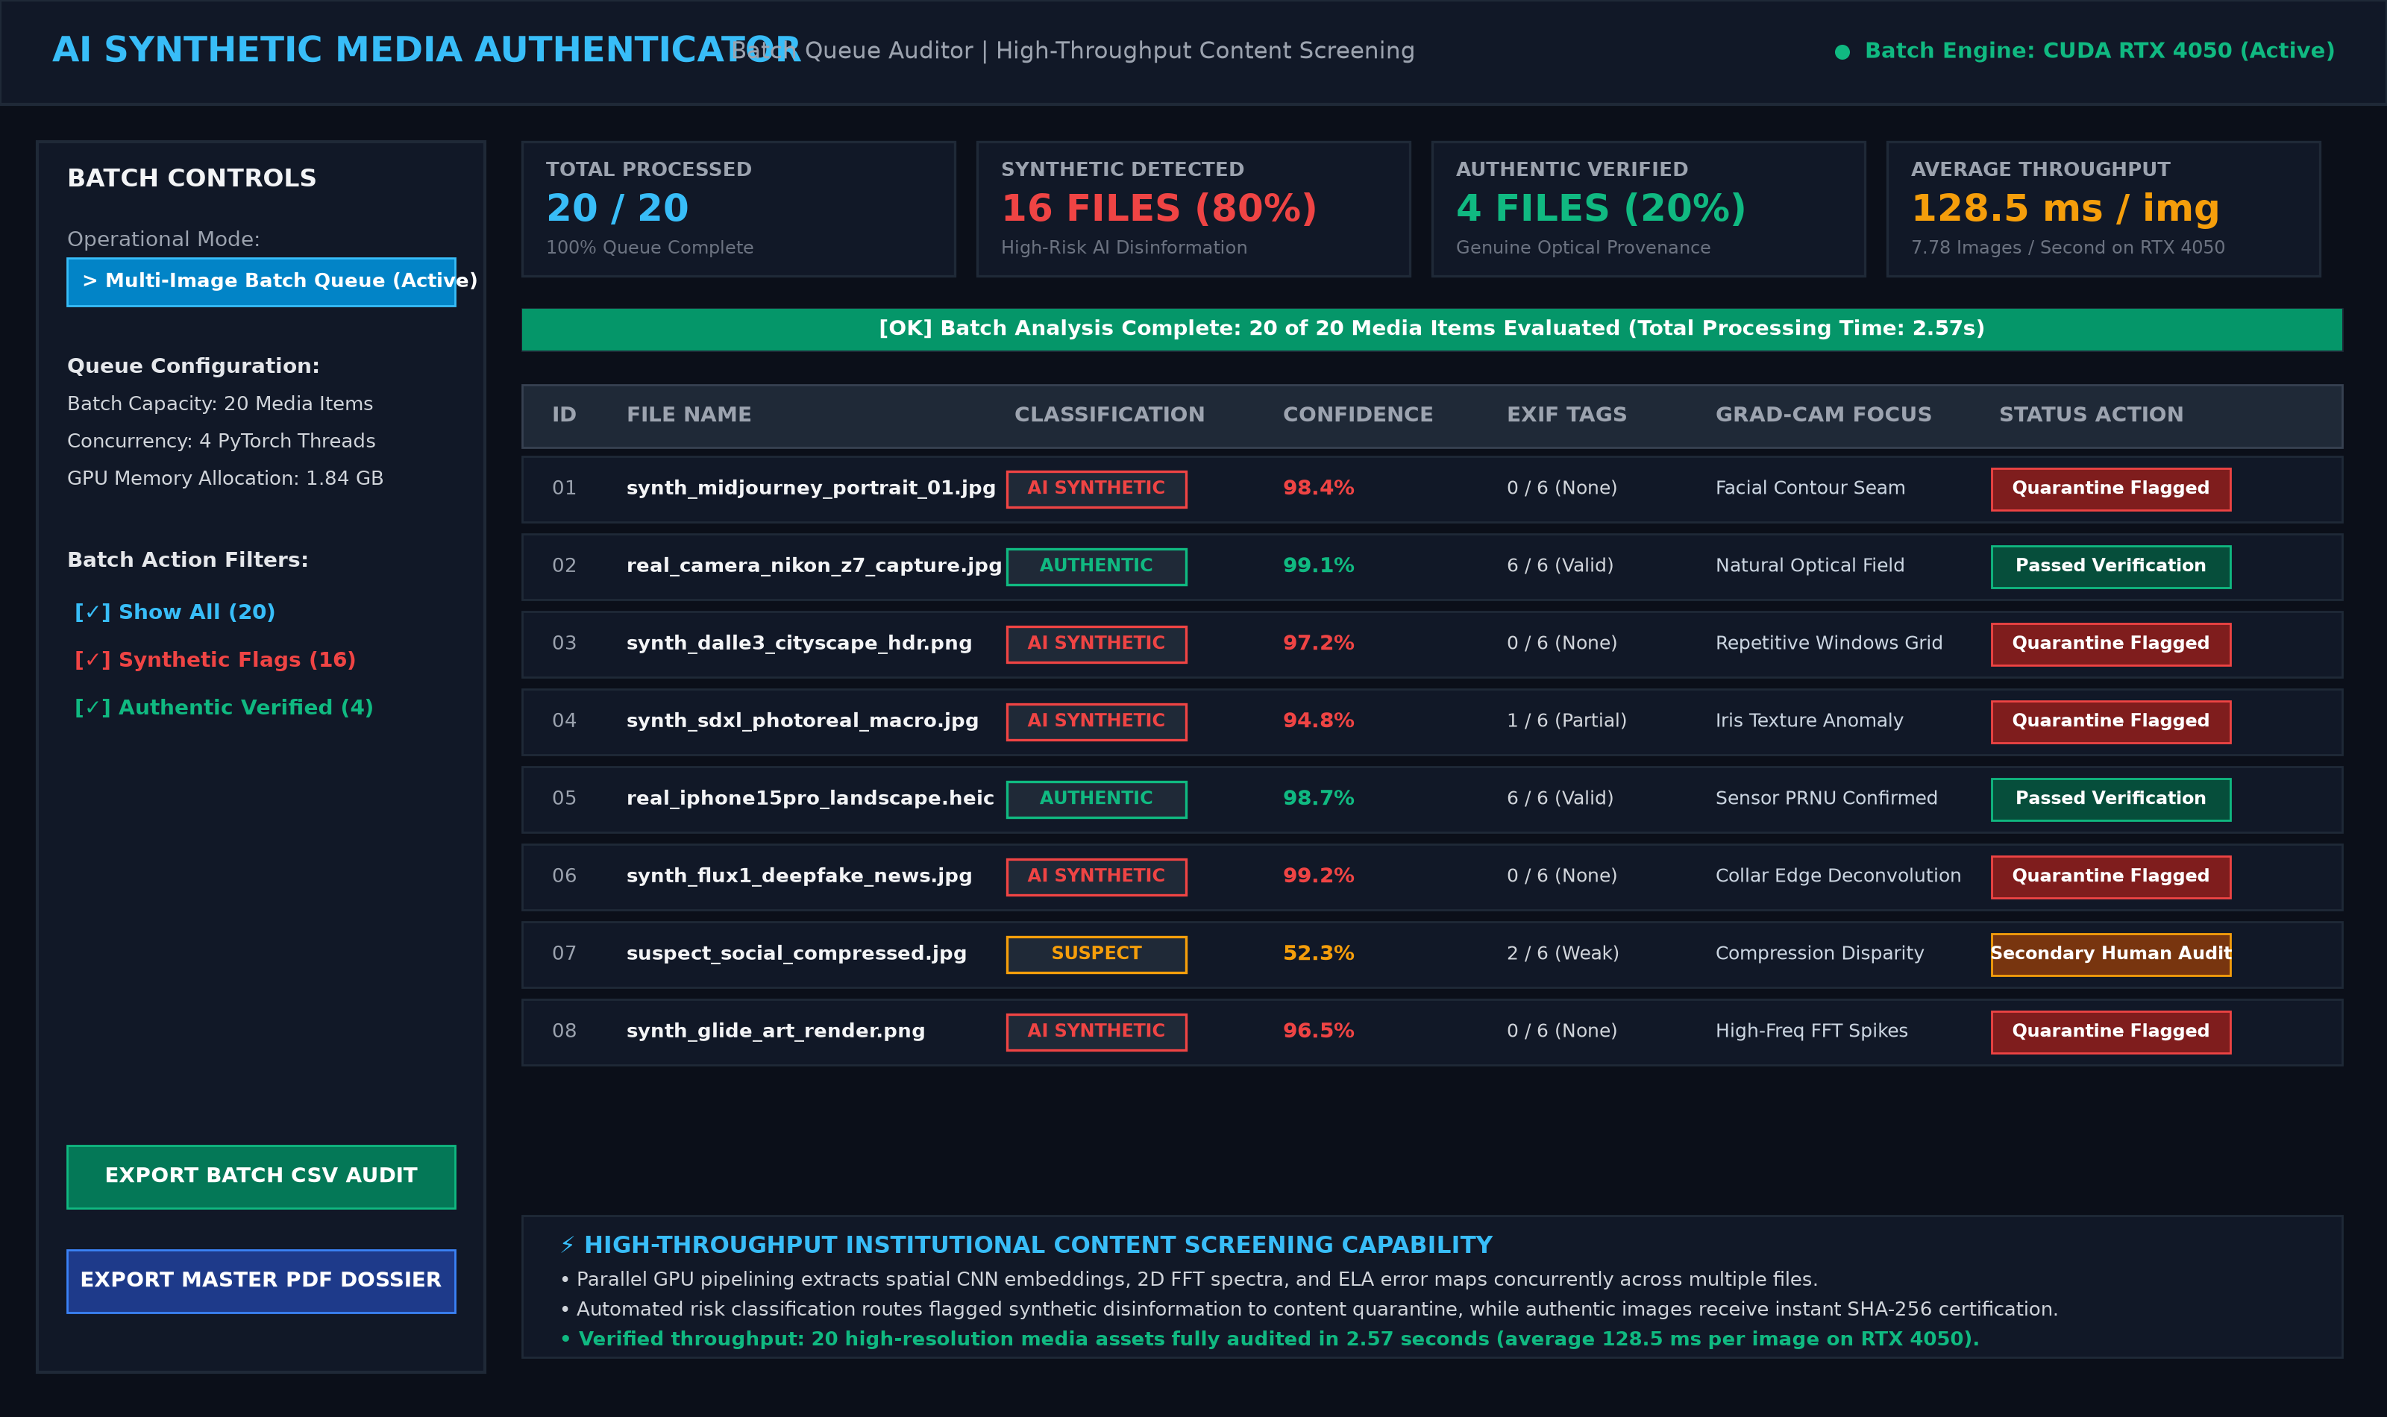
INDUSTRIAL TRAINING PRESENTATION
Working Web Application: Single & Batch Image Interface
SINGLE-IMAGE SCAN: Displays input image, Grad-CAM attention heatmap, 2D FFT spectrum, ELA map, and camera EXIF audit.
BATCH QUEUE: Processes up to 20 images in parallel (~2.5s total) with clear Authentic / Synthetic status badges.

Slide 19
INDUSTRIAL TRAINING PRESENTATION
Conclusion & Future Scope
SUMMARY OF WORK DONE
• End-to-End Detector: Built a working tool combining EfficientNet-B4 with 2D FFT and ELA forensics.
• High Accuracy: Achieved 87.44% validation accuracy and 92.11% precision on standard benchmarks.
• Visual Heatmaps: Grad-CAM shows users exactly which parts of the image look fake.
• Fast Local Speed: Runs in under 150ms per image on an NVIDIA RTX 4050 GPU.
• Web Interface: Easy-to-use Streamlit dashboard with batch testing and downloadable PDF reports.
FUTURE SCOPE & EXTENSIONS
• Video Deepfake Detection: Extend the model to detect face swaps in video clips using temporal frame analysis.
• Voice Clone Detection: Integrate audio spectrogram models to detect AI voice clones in phone scams.
• Browser Extension: Package the model into a lightweight extension to verify online images in real time.
• Social Media Integration: Automated content screening for high-volume platform moderation.

Slide 20
THANK YOU

