Slide 1
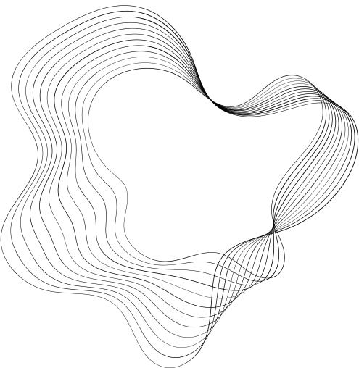
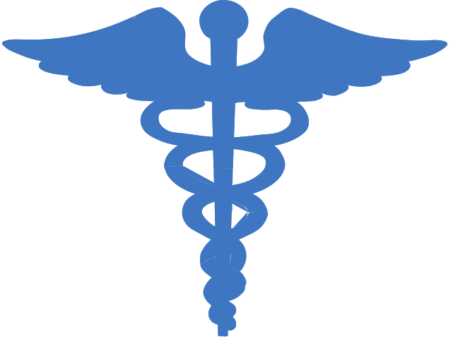

MED+
Disease Detection

Slide 2

CONTENT:
INTRODUCTION
PROJECT ABSTRACT
SYNOPSIS
DIAGRAMS
QUESTIONNAIRE

Slide 3

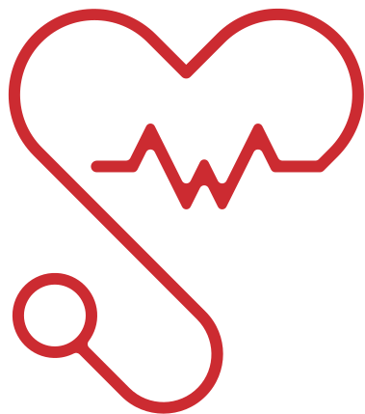
INTRODUCTION
The Disease Prediction System Using AI/ML is a smart healthcare solution designed to predict potential diseases based on user-reported symptoms. By leveraging machine learning algorithms, the system analyzes the given symptoms, calculates the probability of a specific disease, and provides a detailed report. This report includes a severity assessment, suggested home remedies, and recommendations for relevant medical specialists such as neurologists, psychiatrists, or surgeons. The goal is to offer users an accessible, quick, and reliable pre-diagnosis tool that bridges the gap between self-assessment and professional healthcare.

Slide 4

ALL ABOUT MED+
Problem Statement: Traditional healthcare diagnosis requires in-person visits, which can be time-consuming and inaccessible for people in remote areas.
Objective: Develop an AI-powered disease prediction system that provides instant, data-driven health insights.
Technology Used: Machine learning models including Logistic Regression, Random Forest,Support Vector machine(SVM), and Decision Tree.
Functionality:
1) Processes user-input symptoms to predict potential diseases.
2) Provides probability percentages for predicted diseases.
3) Suggests basic home remedies for symptom management.
4) Recommends the appropriate medical specialist for further consultation.
User Experience: Designed to be user-friendly, ensuring accessibility and efficiency in healthcare assessment.

Slide 5



SOFTWARE BLUEPRINTS
Flow chart
UML
Activity Diagram
DFD
Sequence Diagram
Decision Tree
Literature Review

Slide 6

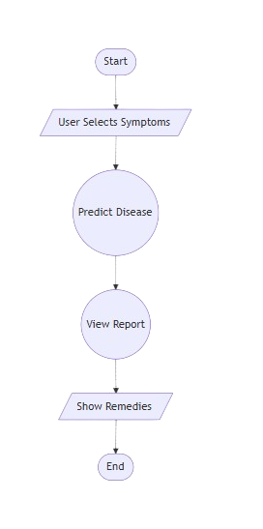
Flow chart

Slide 7

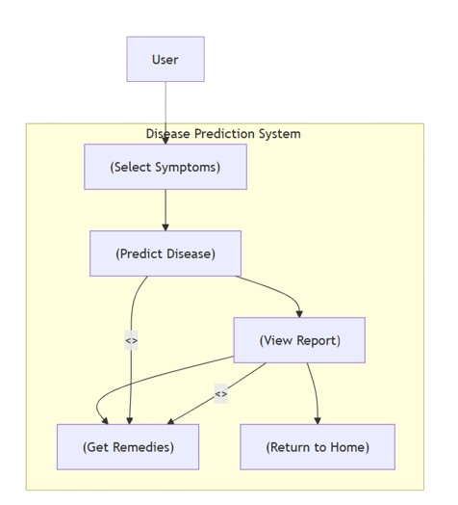
UML

Slide 8

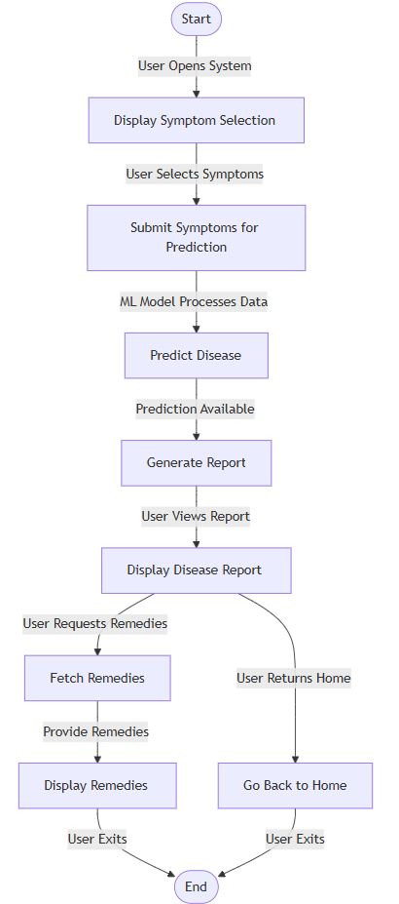
Activity Diagram

Slide 9

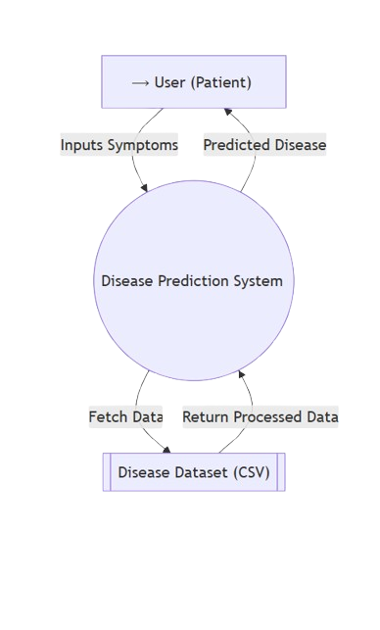
DFD (0-level)

Slide 10
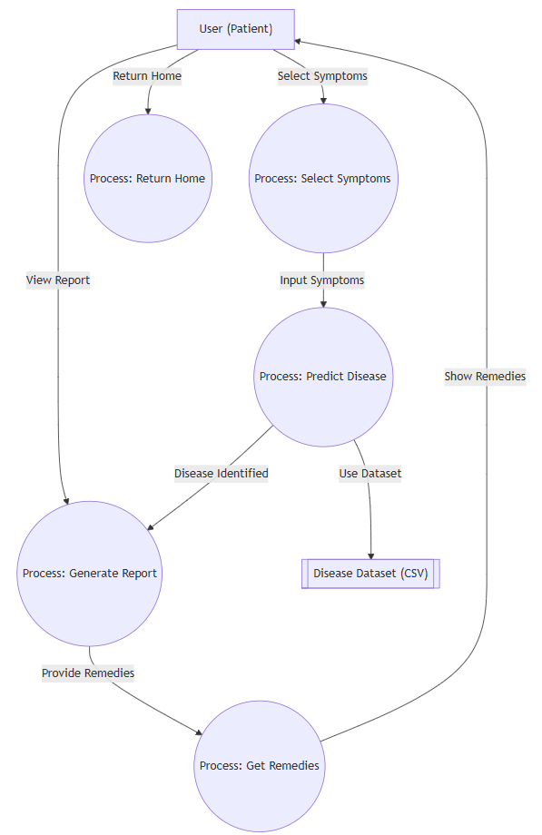
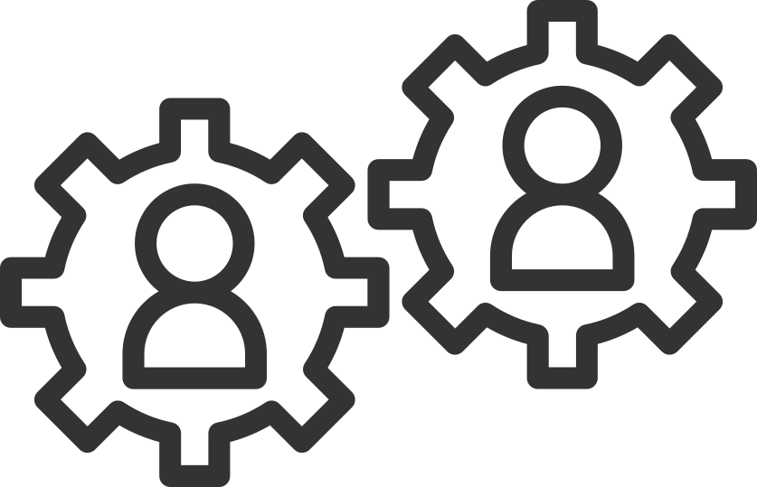
DFD (1-level)

Slide 11

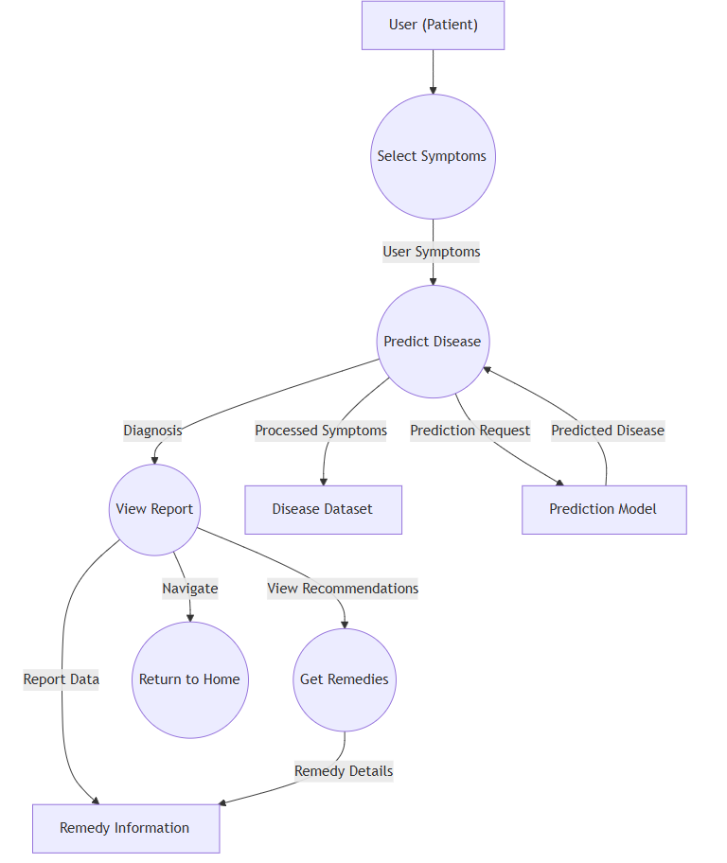
DFD (2-level)

Slide 12

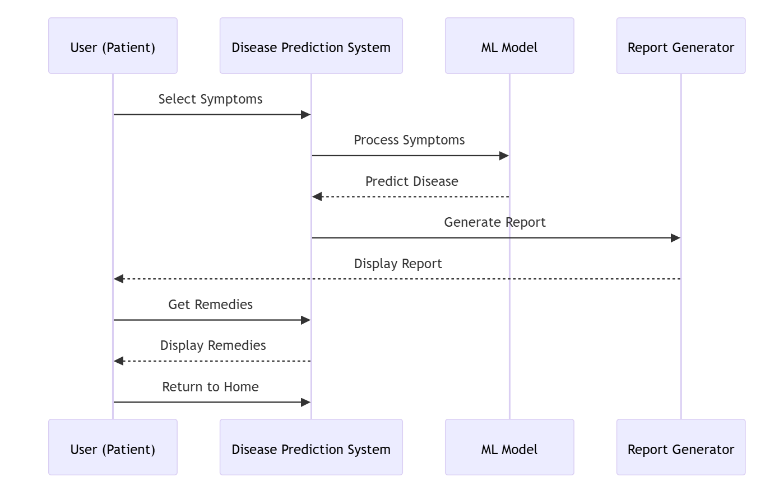
Sequence Diagram

Slide 13

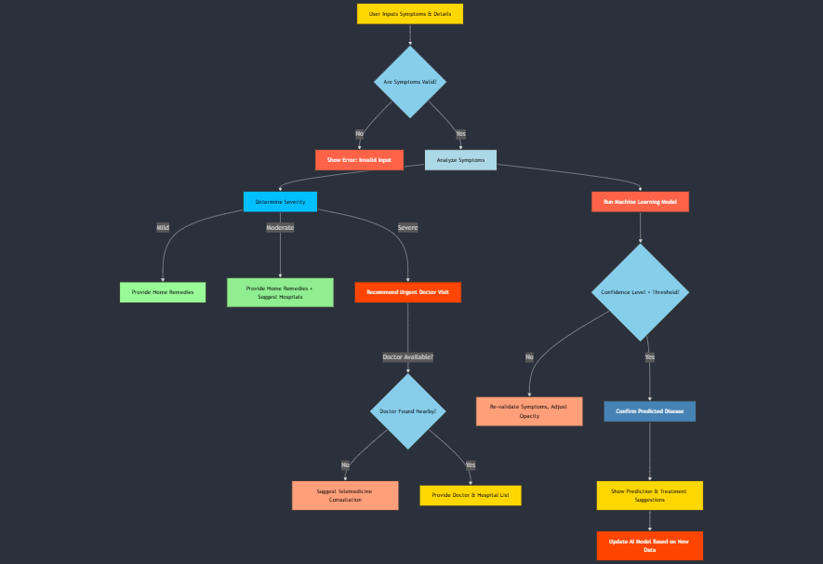
Decision Tree

Slide 14

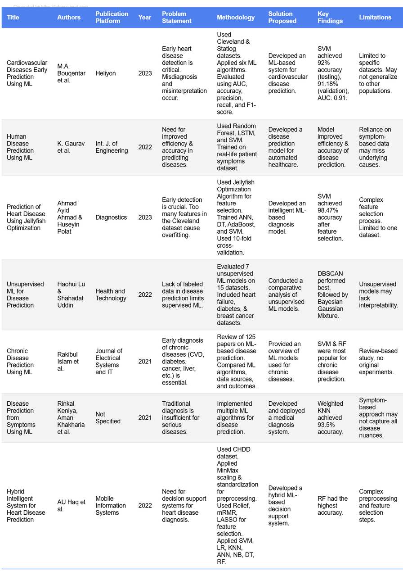
Literature Review

Slide 15

FUTURE SCOPE
Healthcare Integration: Direct doctor appointment booking.
Online Consultations: Virtual healthcare professional access.
Real-time Monitoring: Wearable device health tracking.
Personalized Recommendations: Tailored health insights.
Expanded Database: More diseases for accurate diagnosis.
AI Advancements: Improved prediction precision.
Digital Healthcare Assistant: Fully integrated AI-powered system.

Slide 16
Thank You!!!

