Slide 1


Slide 2
What is PAPAYA and how is it different from traditional FL systems ?
Most Federated Systems are Synchronous which causes 2 main issues of a.heterogeneity in hardware specs and highly imbalanced data causing stragglers and overselection to tackle stranglers causes losing of important data crucial for model b.increasing Concurrency doesn’t always give good updates.
Asynchronous tackles these issues as there are no training rounds and client train their models and send updates to server when they are ready and then server collects model until it reaches its aggregation goal and updates the servers.
So this paper is about PAPAYA a novel asynchronous secure system allowing clients to give updates to the server in a secure manner without waiting for other clients until they are ready for aggregation .

Slide 3
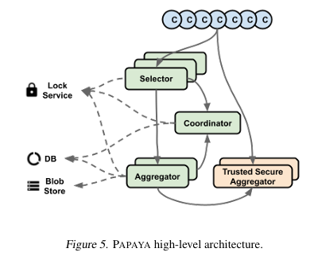
PAPAYA System Design
• PAPAYA has client and server application and in server there are 3 components , coordinator: manages the overall FL process , selector : directly takes with clients about available task and tracks and summarizes client availability to coordinator and aggregator: combines updates from clients to create a new version
• SMPC and TEE are secure aggregation approaches which can’t be used in Asynchronous FL so that they proposed method that rely on TEE and attestation method ensuring TSA is not tampered
•Other aspects of System designs are Client Independence , High Utilization and Fast aggregations

Slide 4
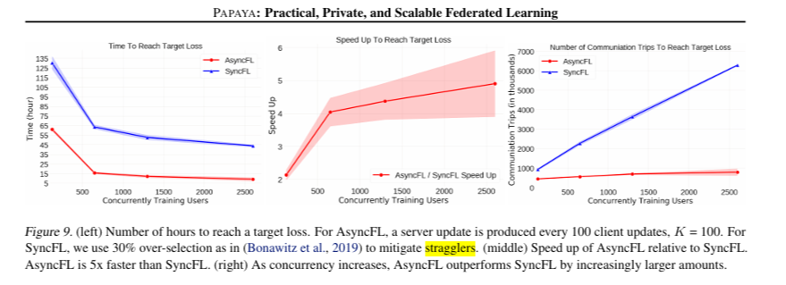
Results
To study performance they trained LSTM on large group of Android phones with both SyncFL and AsyncFL in same environment and found that setting K to be 10-30% of the total number of devices participating at the same time (concurrency) works well in practice.
To study training time performance they measured convergence time and for scalability they compared Async with Sync in terms of their speedup and the number of communication trips with increasing concurrency.Fig.9 shows Async is faster
The aggregation goal (K) tells how many client updates contribute to each server model update as in K is big convergence time increase and when K is small it leads to unstable learning.
In Overselection when slow clients are dropped in SyncFL ,it is found that slow clients often have more data and its crucial for model improvement and they used Kolmogorov test to see distribution of client and AsyncFL has similar distribution that of ground truth and Sync had skewed distribution which shows AsyncFL has better model quality that SyncFL

Slide 5
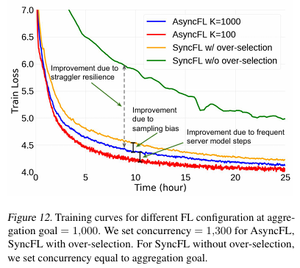
Advantages of AsyncFL and Conclusion
AsyncFL has two main advantages over SyncFL: better scalability because of more frequent model steps and straggler resilience without adding sampling bias.
Figure 12 shows how well the training process works for three different setups: one using SyncFL with over-selection (orange line) and two using AsyncFL with different settings for K (red and blue lines). All three setups involve 1,300 devices working together at the same time.
SyncFL with OS deal with slow devices by adding more devices than needed AsyncFL with K = 100 here server model is updated after receiving updates from 100 devices which is 4.3 times faster than SyncFL with OS and Async with K =1000 updates sever model after receiving updates form 1000 models which is 3.4 times better than Sync with OS
So we can conclude that PAPAYA is a production asynchronous FL system for training at scale which is faster and stranglers resilient , provides better quality model and it is flexible to support both AsyncFL and SyncFL

Slide 6
Key Contributions and findings
Contributions
So the paper is about PAPAYA is a production asynchronous FL system for training at scale which is faster and stranglers resilient , provides better quality model and it is flexible to support both AsyncFL and SyncFL.
Paper address the problem of Scalability and Data and System heterogeneity which leads to model being biased and wrongly trained
To study performance they trained LSTM on large group of Android phones with both SyncFL and AsyncFL in same environment and found Convergence time is less in AsyncFL and overall communication efficiency gain of AsyncFL increases from 2 to 8 as concurrency increases. The evaluation results shows that AsyncFL handles the system heterogeneity and scalability challenges more effectively than SyncFL
The work in paper advances the current system by providing Enhanced privacy , Improved Scalablity , Efficient communication and Robustness to Stragglers.
Findings
According to the paper PAPAYA is 5 times faster speed up and conserves nearly 8times more resources than synchronous.
In Test perplexity (lower is better) after 1 million client updates. We partition clients into percentiles, based on the training data volume and used SyncFL ,SyncFL with OS and AsyncFL methods and AsyncFL outperformed other methods with better accuracy and less time.
In Practical Application its ability to handle large-scale deployments, improve training efficiency, and maintain high model quality makes it a more desirable method for federated learning.

Slide 7
Insights and thoughts on the Potential Applications
Insights
AsyncFL addresses key challenges in federated learning, such as scalability, communication efficiency, straggler resilience, and model quality, making it a more practical and effective solution for real-world applications.
AysncFL has shown some Promising results like Speedup in training time , avoiding Bias , Highly scalable, Aggregation Goal Tradeoff
Potential Application
In Large-Scale Federated Learning Systems, AsyncFL's ability to efficiently handle large numbers of clients (e.g., 100 million Android phones) and manage system heterogeneity makes it ideal for large-scale federated learning
In Healthcare Monitoring Systems , AsyncFL can ensure timely and accurate model updates, which is critical in medical applications where delays or biases could affect patient outcomes.
For Smart City and IoT Applications ,AsyncFL's scalability and communication efficiency can support the fast and reliable aggregation of data from heterogeneous sources, leading to better decision-making and resource management.

Slide 8
Future work.
Future research could integrate advanced privacy-preserving techniques, such as differential privacy and secure aggregation, into AsyncFL to further enhance its privacy guarantees.
The frequency of server updates in AsyncFL is limited by the system's write bandwidth. Future work could focus on overcoming these limitations to further enhance AsyncFL's performance.

Slide 9
THANK YOU

