Slide 1
Expancify
AI Powered Expense Tracker
Submitted By
Submitted To
Kunal Choudhary
Dinesh Kumar Bhayal
EN23IT301064

Slide 2
Introduction
Expancify is a smart expense tracking web application that helps users manage their daily expenses in an organized and efficient way. Users can manually add, update, and track their expenses through a simple interface. The system also supports sharing and managing expenses with roommates, making it easier to handle group spending and balance distribution. Additionally, Expancify includes an AI dashboard that analyzes expense data to generate reports, identify unnecessary expenses, and provide smart suggestions to improve financial habits.
The application uses AI to analyze spending patterns and identify unnecessary expenses, helping users improve their financial habits.

Slide 3

Objectives
To develop a user-friendly platform for managing daily expenses efficiently.
To enable users to manually add, update, and track their expenses.
To provide a system for sharing and managing expenses with roommates.
To ensure accurate calculation and distribution of group expenses.
To integrate an AI dashboard for generating expense reports and insights.
To identify unnecessary expenses and provide smart financial suggestions.
To improve users’ financial awareness and decision-making skills.

Slide 4
Key Points
Expense Management
Users can manually add, edit, and track their daily expenses.
Edit existing expense details.
Track daily spending efficiently.
Roommate Expense Sharing.
Supports splitting and managing shared expenses among roommates.
Manage shared payments easily.
Maintain accurate balance distribution

Slide 5
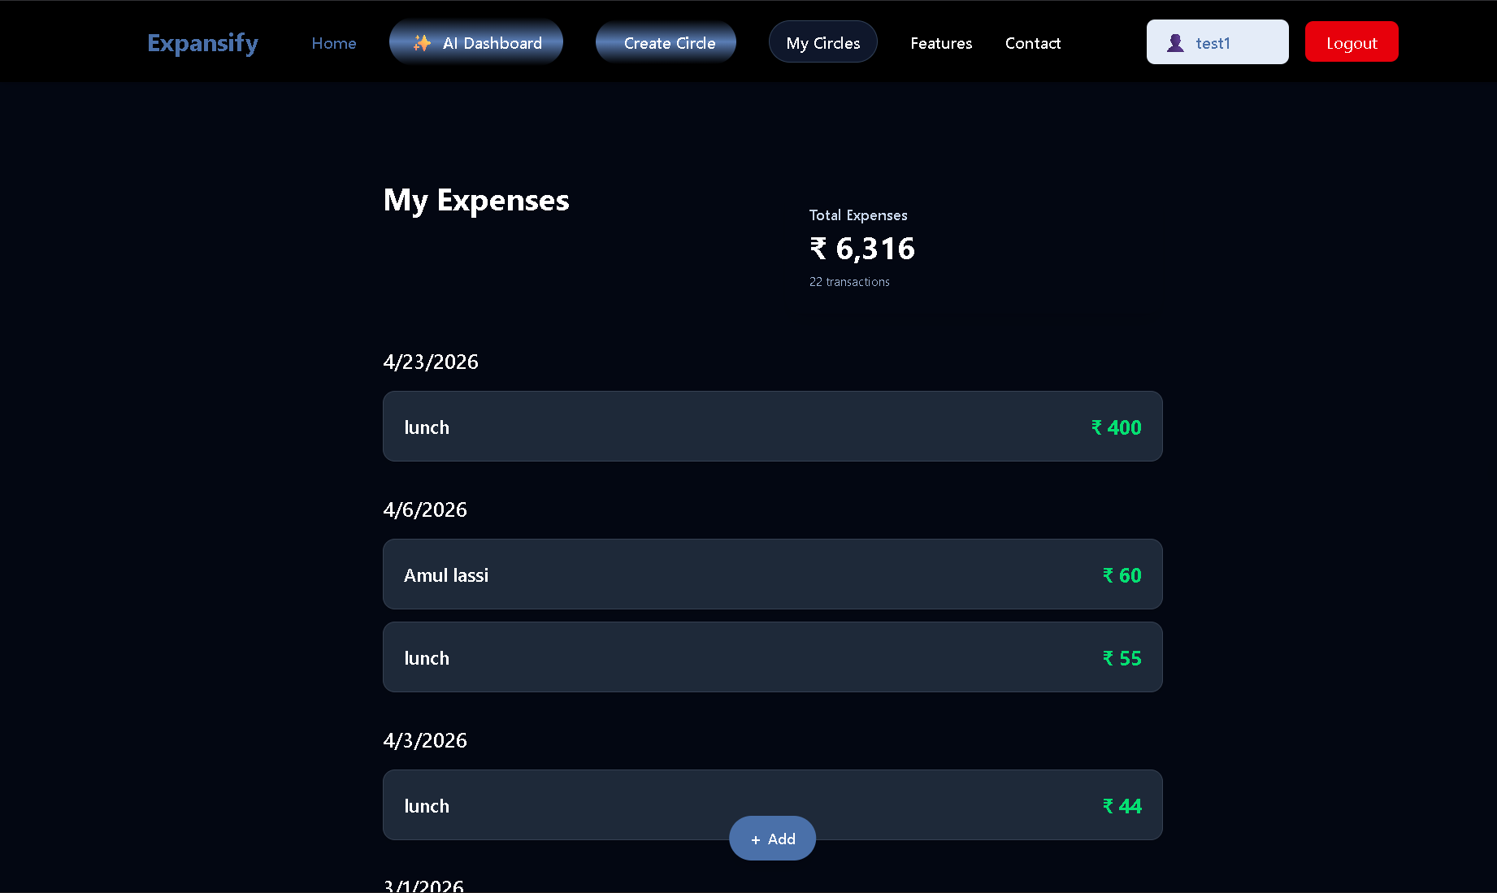

Slide 6
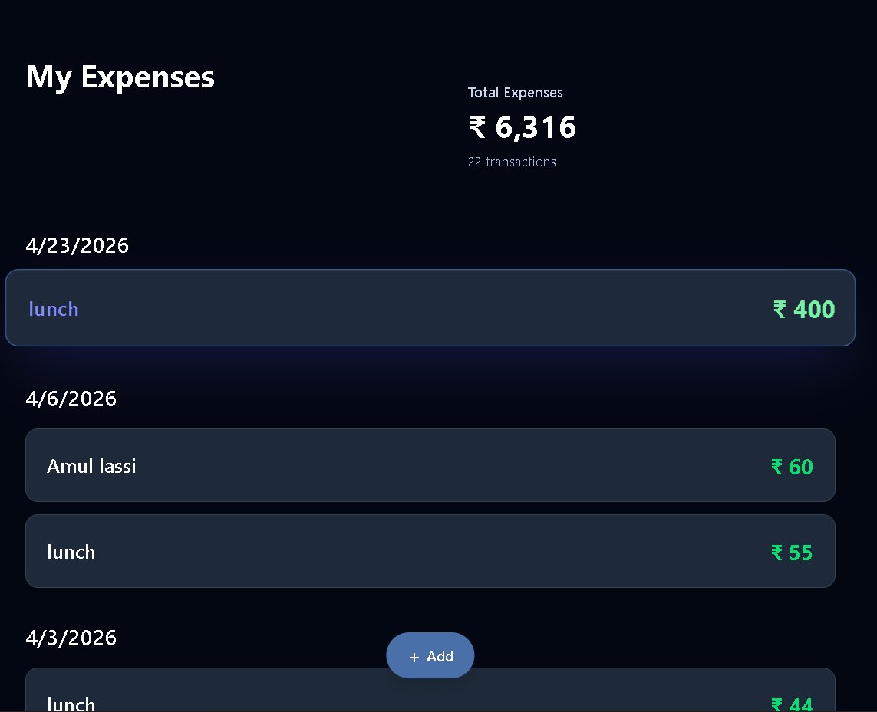
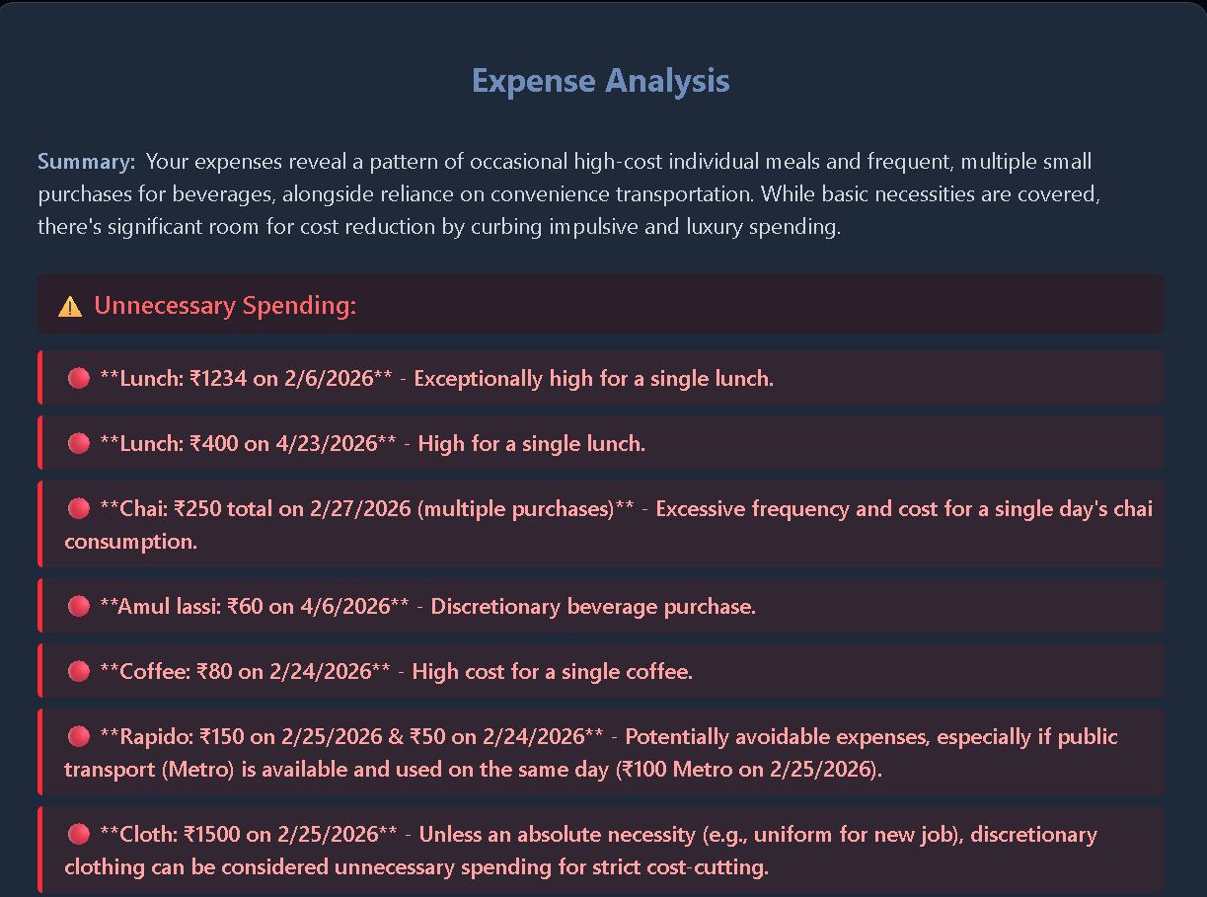
Visual Overview
Expense View
Generated Report

Slide 7
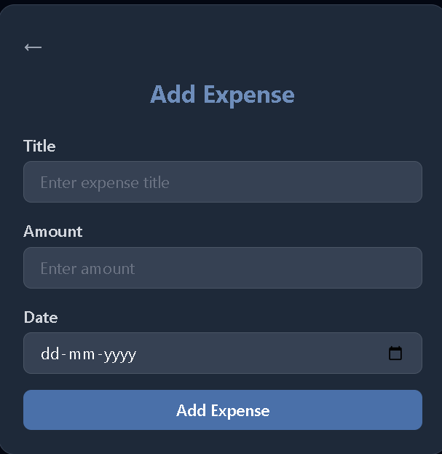
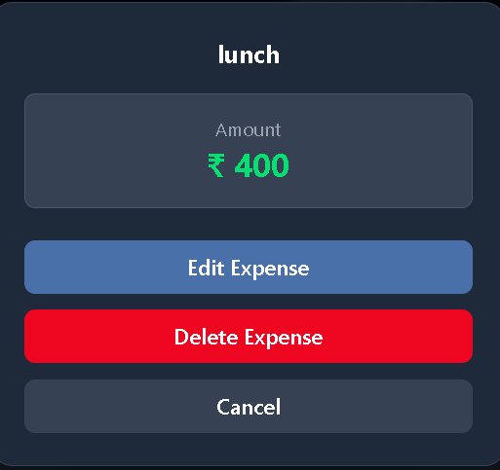
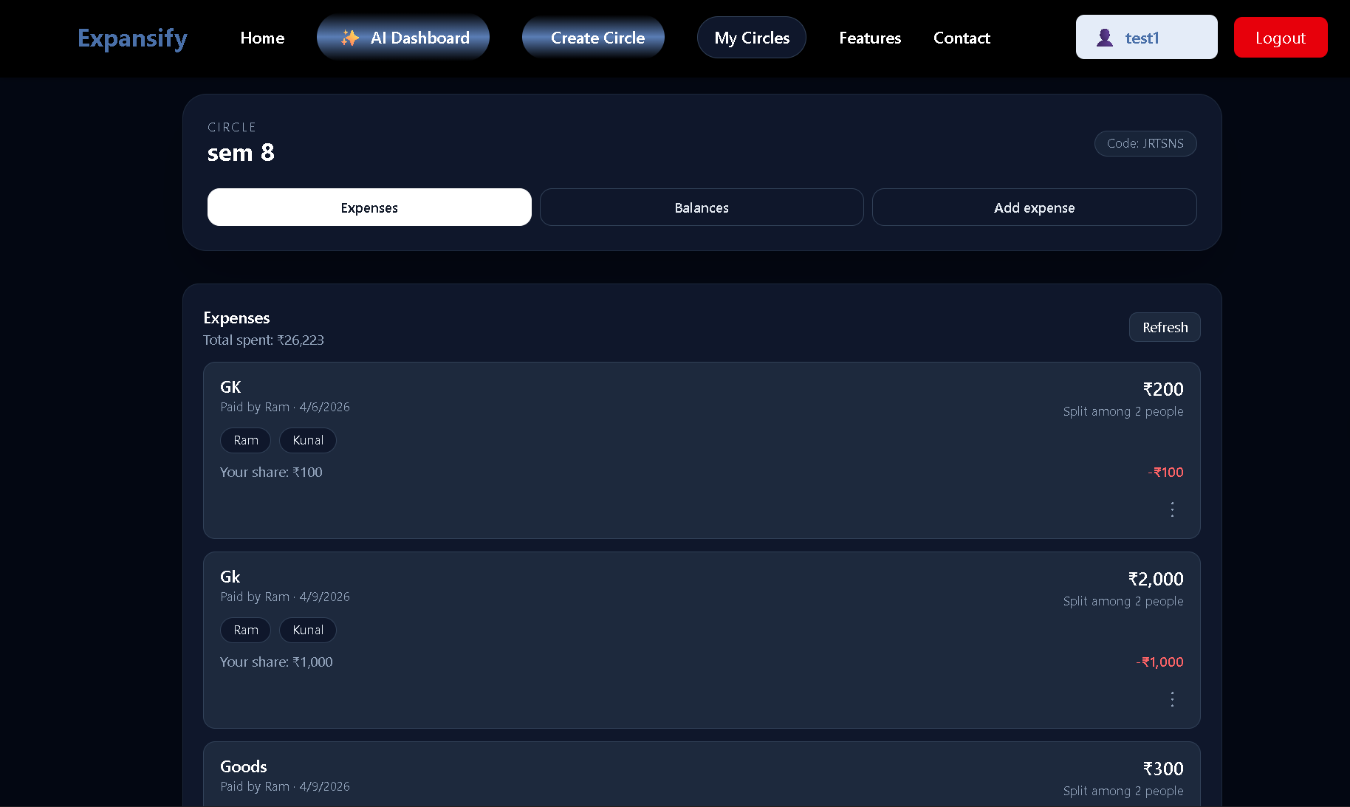
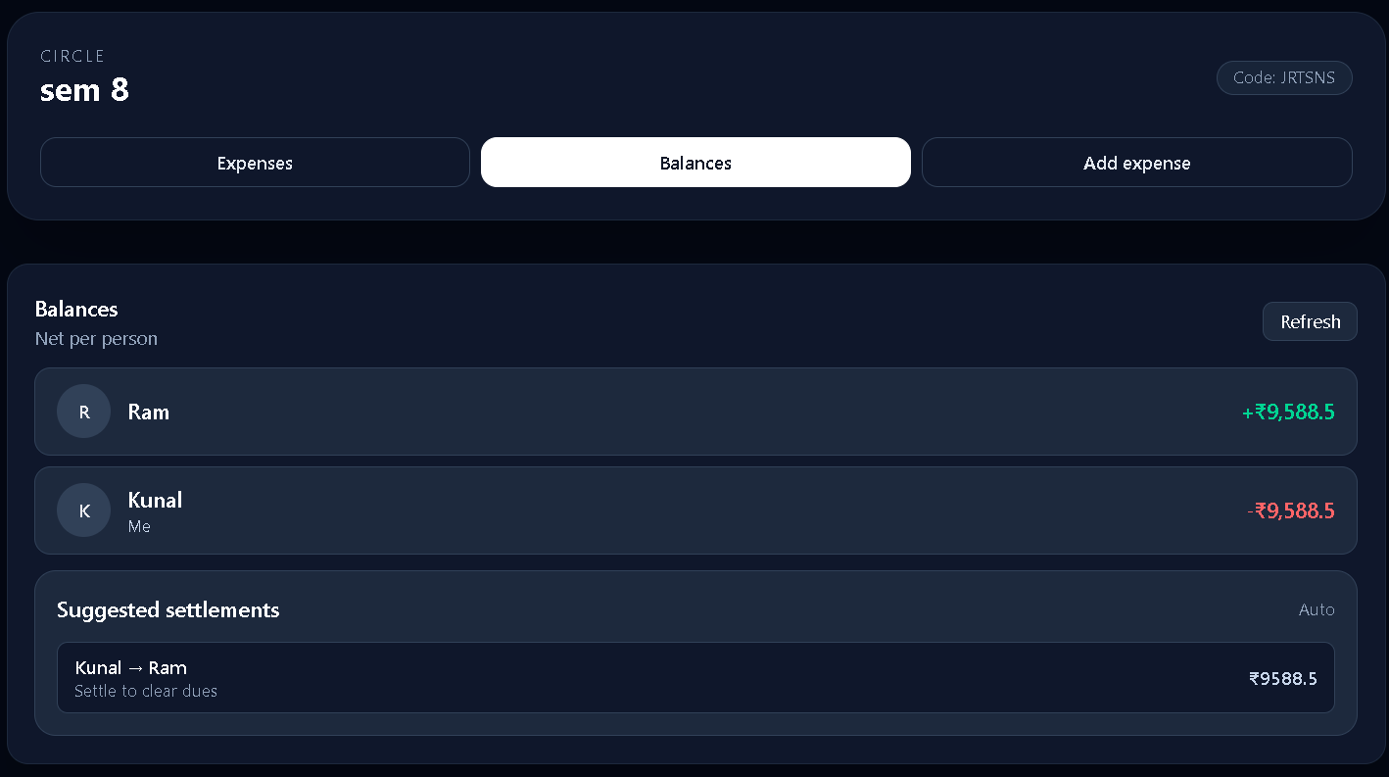
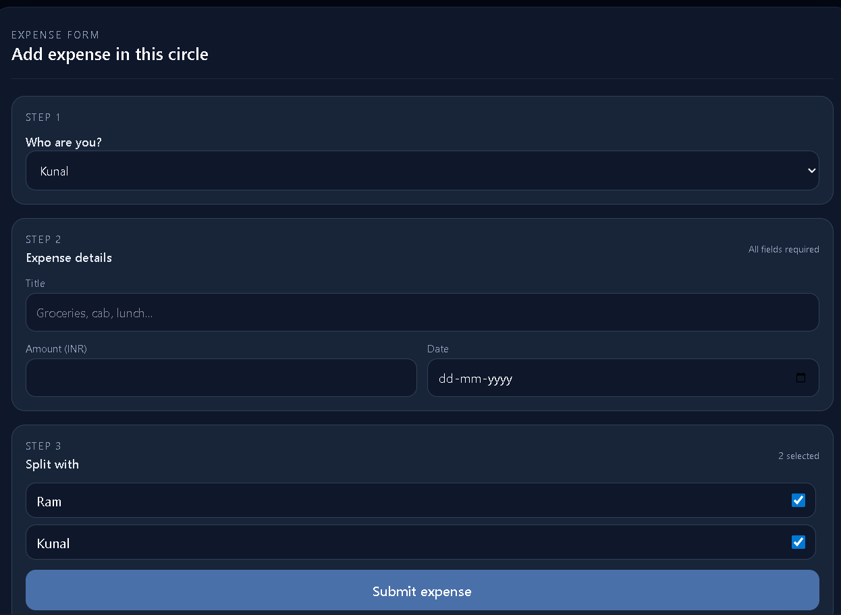
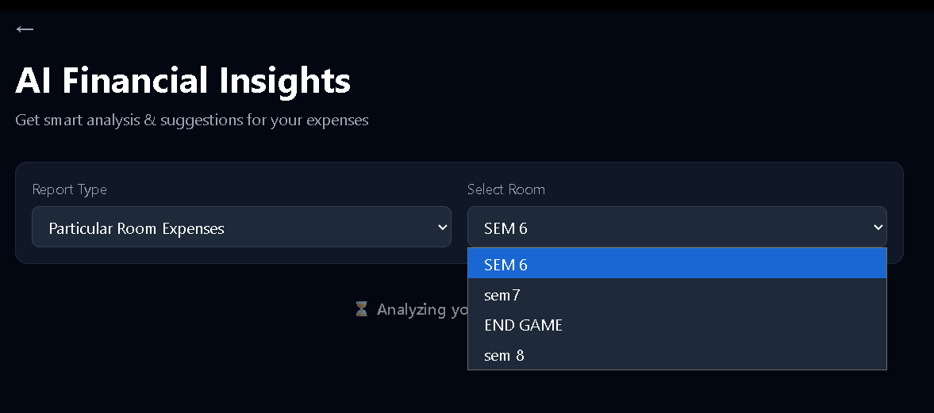
Features Overview

Slide 8
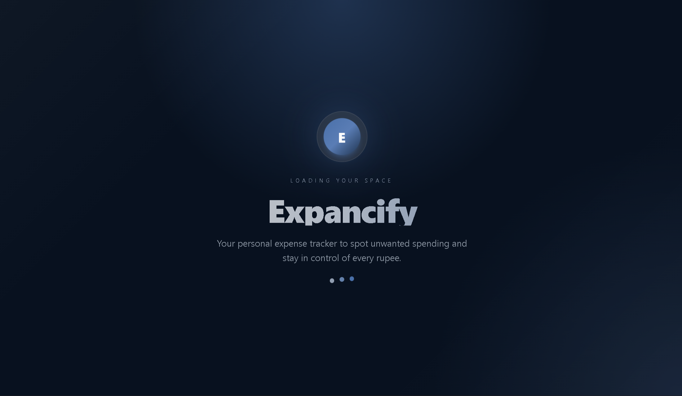
Detailed Explanation
Loading Screen
CRUD Operation
Expancify provides a complete solution for managing both personal and shared expenses in a simple and efficient way. Users can manually record their daily expenses and update them whenever needed. The application also allows users to manage shared expenses with roommates, ensuring proper balance calculation and fair distribution. In addition to basic expense tracking, Expancify includes an AI dashboard that analyzes spending data to generate meaningful reports. This helps users identify unnecessary expenses and receive smart suggestions, ultimately improving their financial management and decision-making.

Slide 9
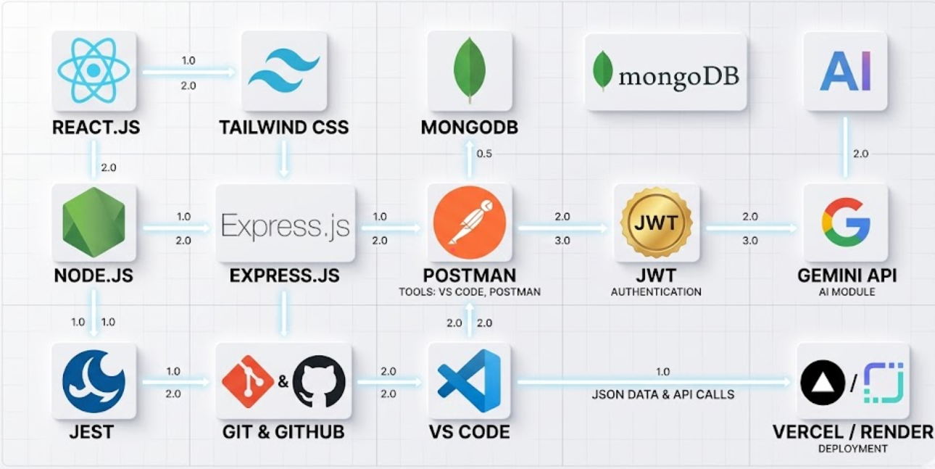
Tech-Stack
Room creation
Frontend: React.js, Tailwind CSS.
Backend: Node.js, Express.js
Database: MongoDB.
Authentication: JWT.
AI Module: Gemini API.
Testing: Jest
Version Control: Git & GitHub
Tools: VS Code, Postman

Slide 10
Comparison Table
Factor | Traditional Method | Expancify
Expense Tracking | Manual (notebooks / memory) | Digital and organized
Accuracy | Prone to errors | High accuracy
Time Consumption | Time-consuming | Fast and efficient
Expense Sharing | Difficult to manage | Easy roommate sharing
Insights | No analysis | AI-based reports & suggestions
Accessibility | Limited | Accessible anytime
Data Security | Data may loss | Secure and safe

Slide 11
Flowchart
Expense Management
Roommate Sharing
AI Analysis

Slide 12
Pie chart

Slide 13
Thank You!
For any query/suggestions pls mail us at
en23it301064@medicaps.ac.in

