Slide 1
Apt-tech solutions

Slide 2
agenda
Blood Relations
Direction Sense

Slide 3
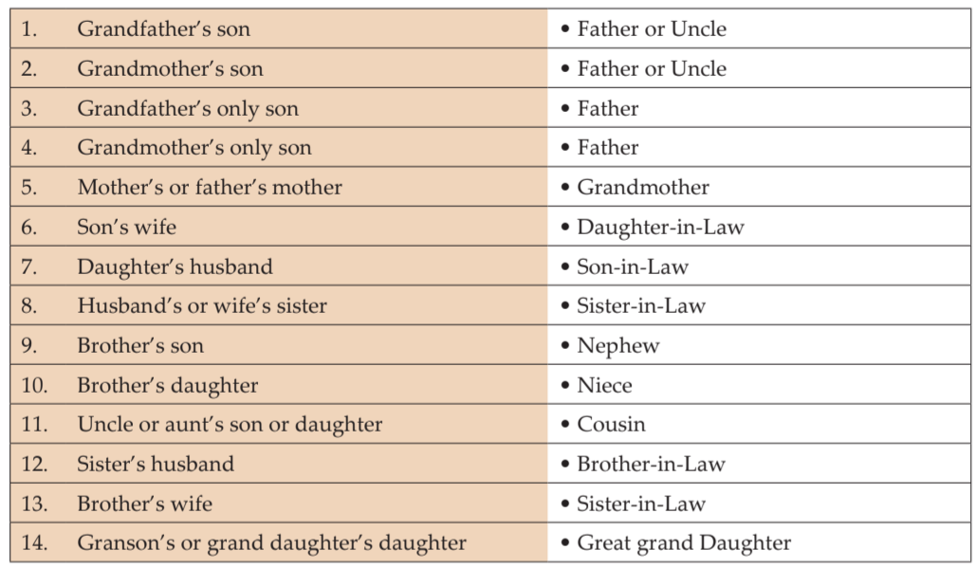
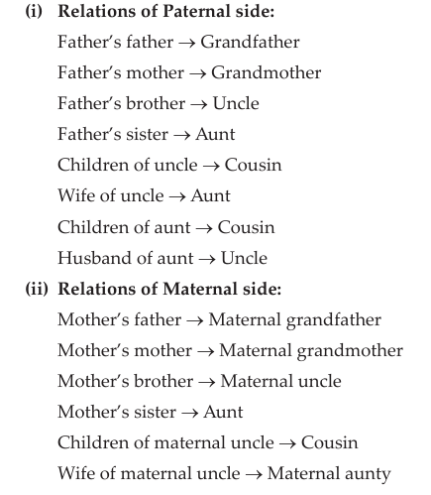
Blood relations

Slide 4
Q.
A family consists of 6 members P, Q, R, X, Y & Z. Q is the son of R but R is not mother, P and R are married couple. Y is the brother of R, X is daughter of P. Z is brother of P.
How many males are in the family?
How many females are in the family?
How P is related to Y?
How Y is related to P?
How X is related to Y?
How Y is related to X?

Slide 5
Q.
A is mother of B; B is sister of C; D is son of C; E is brother of D; F is mother of E; G is grand-daughter of A; H has only two children B & C.
Who is mother of G?
How F is related to H?
How H is related to F?
How E is related to H?
How E is related to B?

Slide 6
Q.
M has a son Q and daughter R. He has no other children. E is the mother of P and daughter in law of M. How P is related to M?
(a)Grandson (b)Grandchild (c)Grand daughter (d)CBD

Slide 7
Q.
P, Q, R, S and T are related and belong to the same family. P is brother of S; Q is wife of P. R and T are children of siblings P and S respectively. Which of the following must necessarily false.
(a) S is sister in law of Q
(b) S is brother of P
(c) S is aunt of T
(d) S is aunt of R

Slide 8
Q.
A is B’s daughter, B is C’s mother. D is C’s brother. How is D related to A?
(a) Father (b) Grandfather (c) Brother (d) Son

Slide 9
Q.
P is Q’s brother. R is Q’s mother. S is R’s father. T is S’s mother. How is P related to T?
(a) Grand-daughter (b) Great grandson (c) Grandson (d) Grandmother

Slide 10
Q.
A is B’s brother. C is D’s father. E is B’s mother. A and D are brothers. How is E related to C?
(a) Sister (b) Sister-in-law (c) Niece (d) Wife

Slide 11
Q.
A is the sister of B. B is the brother of C. C is the son of D. How is D related to A?
(a) Mother (b) Daughter (c) Son (d) Uncle

Slide 12
Q.
B is the brother of A. whose only sister is mother of C. D is maternal grandmother of C. How is A related to D?
(a) Daughter-in-law (b) Daughter (c) Aunt (d) Nephew

Slide 13
Q.
A and B are sisters. R and S are brothers. A’s daughter is R’s sister. What is B’s relation to S?
(a) Mother (b) Grandmother (c) Sister (d) Aunt

Slide 14
Q.
E is the sister of B. A is the father of C. B is the son of C. How is A related to E?
(a) Grandfather (b) Grand-daughter (c) Father (d) Great-grandfather

Slide 15
Q.
Given that:
A is the mother of B.
C is the son of A.
D is the brother of E.
E is the daughter of B.
Who is grandmother of D?
(a) A (b) B (c) C (d) D

Slide 16
Q.
A is D’ brother. D is B’s father. B and C are sisters. How is A related to C?
(a) Son (b) Grandson (c) Father (d) Uncle

Slide 17
Q.
A is B’s sister, C is B’s mother, D is C’s father, E is D’s mother, then how A is related to D?
(a) Grandfather (b) Daughter (c) Grandmother (d) Granddaughter

Slide 18
Single Person Blood Relation
Direct
Indirect

Slide 19
Q.
Suresh introduces a man as “He is the son of the woman who is the mother of the husband of my mother”. How is Suresh related to the man?
(a) Uncle (b) Son (c) Cousin (d) Grandson

Slide 20
Q.
Pointing to a lady in a photograph. Meera said. “Her father’s only son’s wife is my mother-in-law” . How is Meera’s husband related to that lady in the photo?
(a) Nephew (b) Uncle (c) Son (d) Father

Slide 21
Q.
Pointing to a photograph Vikas said “She is the daughter of my grandfather’s only son”. How is
lady in the photograph related to Vikas in the photograph?
(a) Father (b) Brother (c) Sister (d) Mother

Slide 22
Q.
Suresh’s sister is the wife of Ram. Ram is Rani’s brother. Ram’s father is Madhur. Sheetal is Ram’s
grandmother. Rema is Sheetal is daughter-in-law. Rohit is Rani’s brother’s son. Who is Rohit to
Suresh?
(a) Brother-in-law (b) Son (c) Brother (d) Nephew

Slide 23
Q.
Vinod introduces Vishal as the son of the only brother of his father’s wife. How is Vinod related
to Vishal?
(a) Cousin (b) Brother (c) Son (d) Uncle

Slide 24
Direction sense & Distance
Main directions – East, West, South, North
Cardinal directions – E, SE, S, SW, W, NW, N, NE
Angle of movement – Clockwise and Anticlockwise (360^0)
Shadow - at the time of sunrise and sunset
Shortest distance

Slide 25
Example 1:
Ravi walks 8 km North-East and then 6 km South-East. Find the total distance as well as shortest distance between starting and end points.
14 km, 12 km
14 km, 10 km
10 km, 8 km
8 km, 6 km

Slide 26
Q.
Based on Final Direction
Suman walks 15 km towards North. She turns right and walks another 15 km. She turns right and walks another 15 km. In which direction is she from the starting point?
A. North B. South C. East D. West

Slide 27
Q.
After starting from a point, a man walks 4 km towards West, then turning to his right he moves 4 km. After this, he again turns right and moves 4 km. Which choice given below indicates the correct direction in which he is from his starting point?
A. North B. East C. South D. West

Slide 28
Q.
If South-West becomes North, then what will North-East be?
A. North B. South-East C. South D. East

Slide 29
Q.
A clock is so placed that at 12 noon its minute hand points towards North-East. In which direction does its hour hand point at 1:30 pm?
A. North B. South C. East D. West

Slide 30
Q.
A girl is facing North. She turns 180° in the anti-clockwise direction and then 225° in the clockwise direction. Which direction is she facing now?
A. West B. North-East C. South-West D. East E. North-West

Slide 31
Q.
A person walks towards his house at 8:00 am and observes his shadow to his right. In which direction he is walking?
A. North B. South C. East D. west

Slide 32
Q.
Based on Displacement
Vijay travelled 12 km Southward, then turned right and travelled 10 km, then turned right and travelled 12 km. How far was Vijay from the starting point?
A. 22 km B. 44 km C. 12 km D. 10 km

Slide 33
Q.
A person starts from a point A and travels 3 km Eastwards to B and then turns left and travels thrice that distance to reach C. He again turns left and travels five times the distance he covered between A and B and reaches his destination D. The shortest distance between the starting point and the destination is
A. 12 km B. 15 km C. 16 km D. 18 km

Slide 34
Q.
Based on Direction and Displacement
Shyam, goes 5 km in the North from his school. Now, turning to the left, he goes to 10 km and again turns to left and goes to 5 km. How far he is from his school and in which direction?
10 km, South from school B. 10 km, North from school
C. 10km, West from school D. 10 km, East from school

Slide 35
Q.
X and Y start from the same point X walks 40 m North, then turns West and walks 80 m, then turns to his right and walks 50 m. At the same time, Y walks 90 m North. Where is Y now with respect to the position of X?
Y is 30 m to the East of X B. Y is 80 m to the West of X
C. Y is 30 m to the west of X D. Y is 80 m to the East of X

Slide 36
Q.
Examples
Rahul put his timepiece on the table in such a way that at 6 P.M. hour hand points to North. In which direction the minute hand will point at 9.15 P.M. ? A. South-East B. South C. North D. West

Slide 37
Q.
One evening before sunset Rekha and Hema were talking to each other face to face. If Hema's shadow was exactly to the right of Hema, which direction was Rekha facing?
A. North B. South C. East D. Data is inadequate

Slide 38
Q.
Y is in the East of X which is in the North of Z. If P is in the South of Z, then in which direction of Y, is P?
A. North B. South C. South-East D. None of these

Slide 39
Q.
One morning Udai and Vishal were talking to each other face to face at a crossing. If Vishal's shadow was exactly to the left of Udai, which direction was Udai facing?
A. East B. West C. North D. South

Slide 40
Q.
A man walks 5 km toward south and then turns to the right. After walking 3 km he turns to the left and walks 5 km. Now in which direction is he from the starting place?
A. West B. South C. North-East D. South-West

Slide 41
Q.
If South-East becomes North, North-East becomes West and so on. What will West become?
A. North-East B. North-West C. South-East D. South-West

Slide 42
Q.
K is 40 m South-West of L. If M is 40 m South-East of L, then M is in which direction of K?
A. East B. West C. North-East D. South

Slide 43
Q.
Some boys are sitting in three rows all facing North such that A is in the middle row. P is just to the right of A but in the same row. Q is just behind of P while R is in the North of A. In which direction of R is Q?
A. South B. South-West C. North-East D. South-East

Slide 44
Q.
A boy rode his bicycle Northward, then turned left and rode 1 km and again turned left and rode 2 km. He found himself 1 km west of his starting point. How far did he ride northward initially?
A. 1 km B. 2 km C. 3 km D. 5 km

Slide 45
Q.
Rasika walked 20 m towards north. Then he turned right and walks 30 m. Then he turns right and walks 35 m. Then he turns left and walks 15 m. Finally, he turns left and walks 15 m. In which direction and how many meters is he from the starting position?
A. 15 m West B. 30 m East C. 30 m West D. 45 m East

Slide 46
Thank you
Any doubts ?

