Slide 1

Job Hunter
Fabfour:
Kunal Joshi
Priyanka Dayanand Pandit
Shreyas Madapura Chandraiah
Thulasi Amaraneni

Slide 2
Agenda
Problem Description
Data Exploration
Data Preprocessing and Representation
Learning Models Used
Model Performance and Results
System Architecture/Demo

Slide 3
Problem Description
Evaluating the candidate’s profile with the company’s job requirement is a crucial element before applying to a particular job.
Generally, candidates tend to apply to jobs where their profiles do not completely meet with companies' job requirements resulting in profile refusal.
Candidate’s profile matching with companies’ job requirements depends on several factors such as Education, Discipline, Required Skills, Desired Skills, and Years of Experience.
The main motivation of our project is to develop a platform where a candidate can evaluate his/her job profile by inputting the required fields, thereby mitigating the time and effort spent on applying for jobs.
By checking the calculated scores, the candidate can then decide whether to apply or not.

Slide 4
Data Exploration
The dataset is collected from various sources such as Kaggle, Glassdoor, LinkedIn, Indeed in CSV format.
The dataset is manually merged from different datasets to avoid redundant attributes and null values.
We could not find a reliable dataset that could cater to our project's requirements, so we created a dataset by merging datasets from various sources.

Slide 5
Data Preprocessing and Representation
Dataset has total of 1600 records and 9 attributes.
Attributes in dataset are namely company name, job title, job category, job location, education, discipline, required skills, desired skills, years of experience.
Dataset has job postings from Amazon, Apple, Facebook, Google, Microsoft, SpaceX and others.
Feature Selection
Data discretion
Null value reduction
Removal of duplicate records
Maintaining data consistency

Slide 6
Data Preprocessing and Representation

Slide 7
Data Preprocessing and Representation

Slide 8
Data Preprocessing and Representation

Slide 9
Data Preprocessing and Representation

Slide 10
Learning Models Used:
Inverted Index
For filtering Jobs.
Vector Space Model
For ranking the documents(Jobs).
Eclipse Windowbuilder
For designing a GUI application.

Slide 11
Inverted Index:
After reading the dataset Inverted Index is performed.
Inverted Index is performed on education attribute to achieve filtering based on job’s education requirement.
It lists the terms and its corresponding record indexes for the attribute education.
As we intended to keep key technical terms in our dataset, we neither used stop words nor performed stemming.
Case folding was performed.

Slide 12
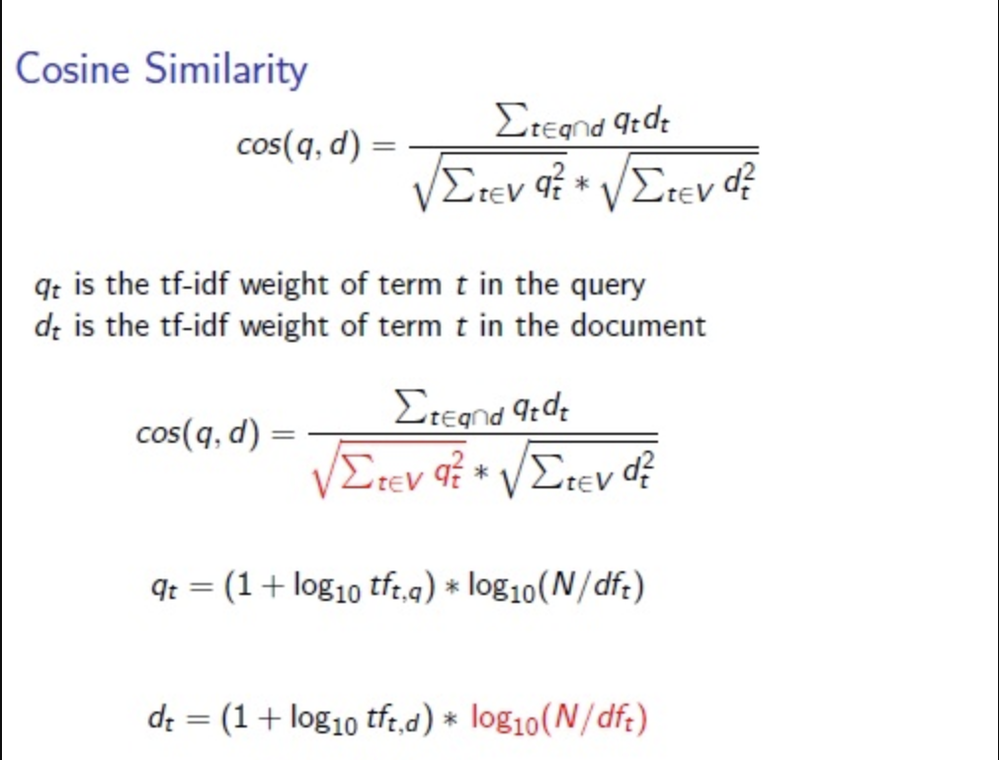
Vector Space Model:
https://i.stack.imgur.com/NXDSI.jpg
VSM which is an algebraic model was used for filtering our records based on their rankings.
It helps us to display the top documents/index records for an user query.
It is performed for required skills and desired skills.
It is achieved by performing cosine similarity based on which score was calculated.
Score ranges from [0,1].
Fig [1]
[1] https://i.stack.imgur.com/NXDSI.jpg

Slide 13
Score Calculation:
score = ((disscore*.15)+(reqscore*0.5) + (desscore*0.2) + (YE.YEscore.get(i)*0.15))*100
Education index must match with that of discipline query, if the discipline is Matching or if it is ‘Any’ for the particular records in the dataset the score is given as ‘1’ if not ‘0’. The weightage given in the score is 15%.
We calculate the score for required skills and desired skills using cosine similarity. The weightage given in the score for required skills is 50% and 20% for desired skills.
If the user given query is matching or greater than required the score is given as ‘1’ else if it is less the score is calculated as (1/(required YOE) - (Given users YOE)). The weightage given in the score is 15%.
The final score is calculated and displayed to the users in the order of top matching jobs.

Slide 14
Eclipse Windowbuilder:
Windowbuilder is a plugin to Eclipse.
Built effective GUI application.
With the help of visual designer and the layout tools designed an UI.
Event handlers are written to customize the controls the way we want for our system performance.
Added filters and performed action handling to sort the results in an categorized manner.

Slide 15
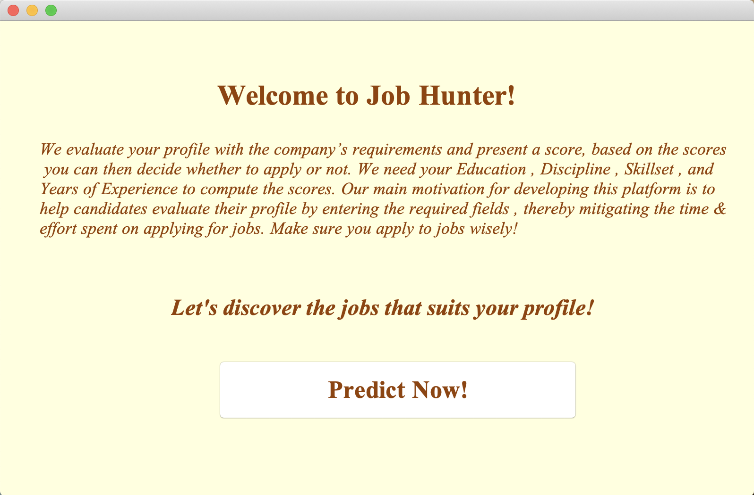
Demo: Home Page

Slide 16
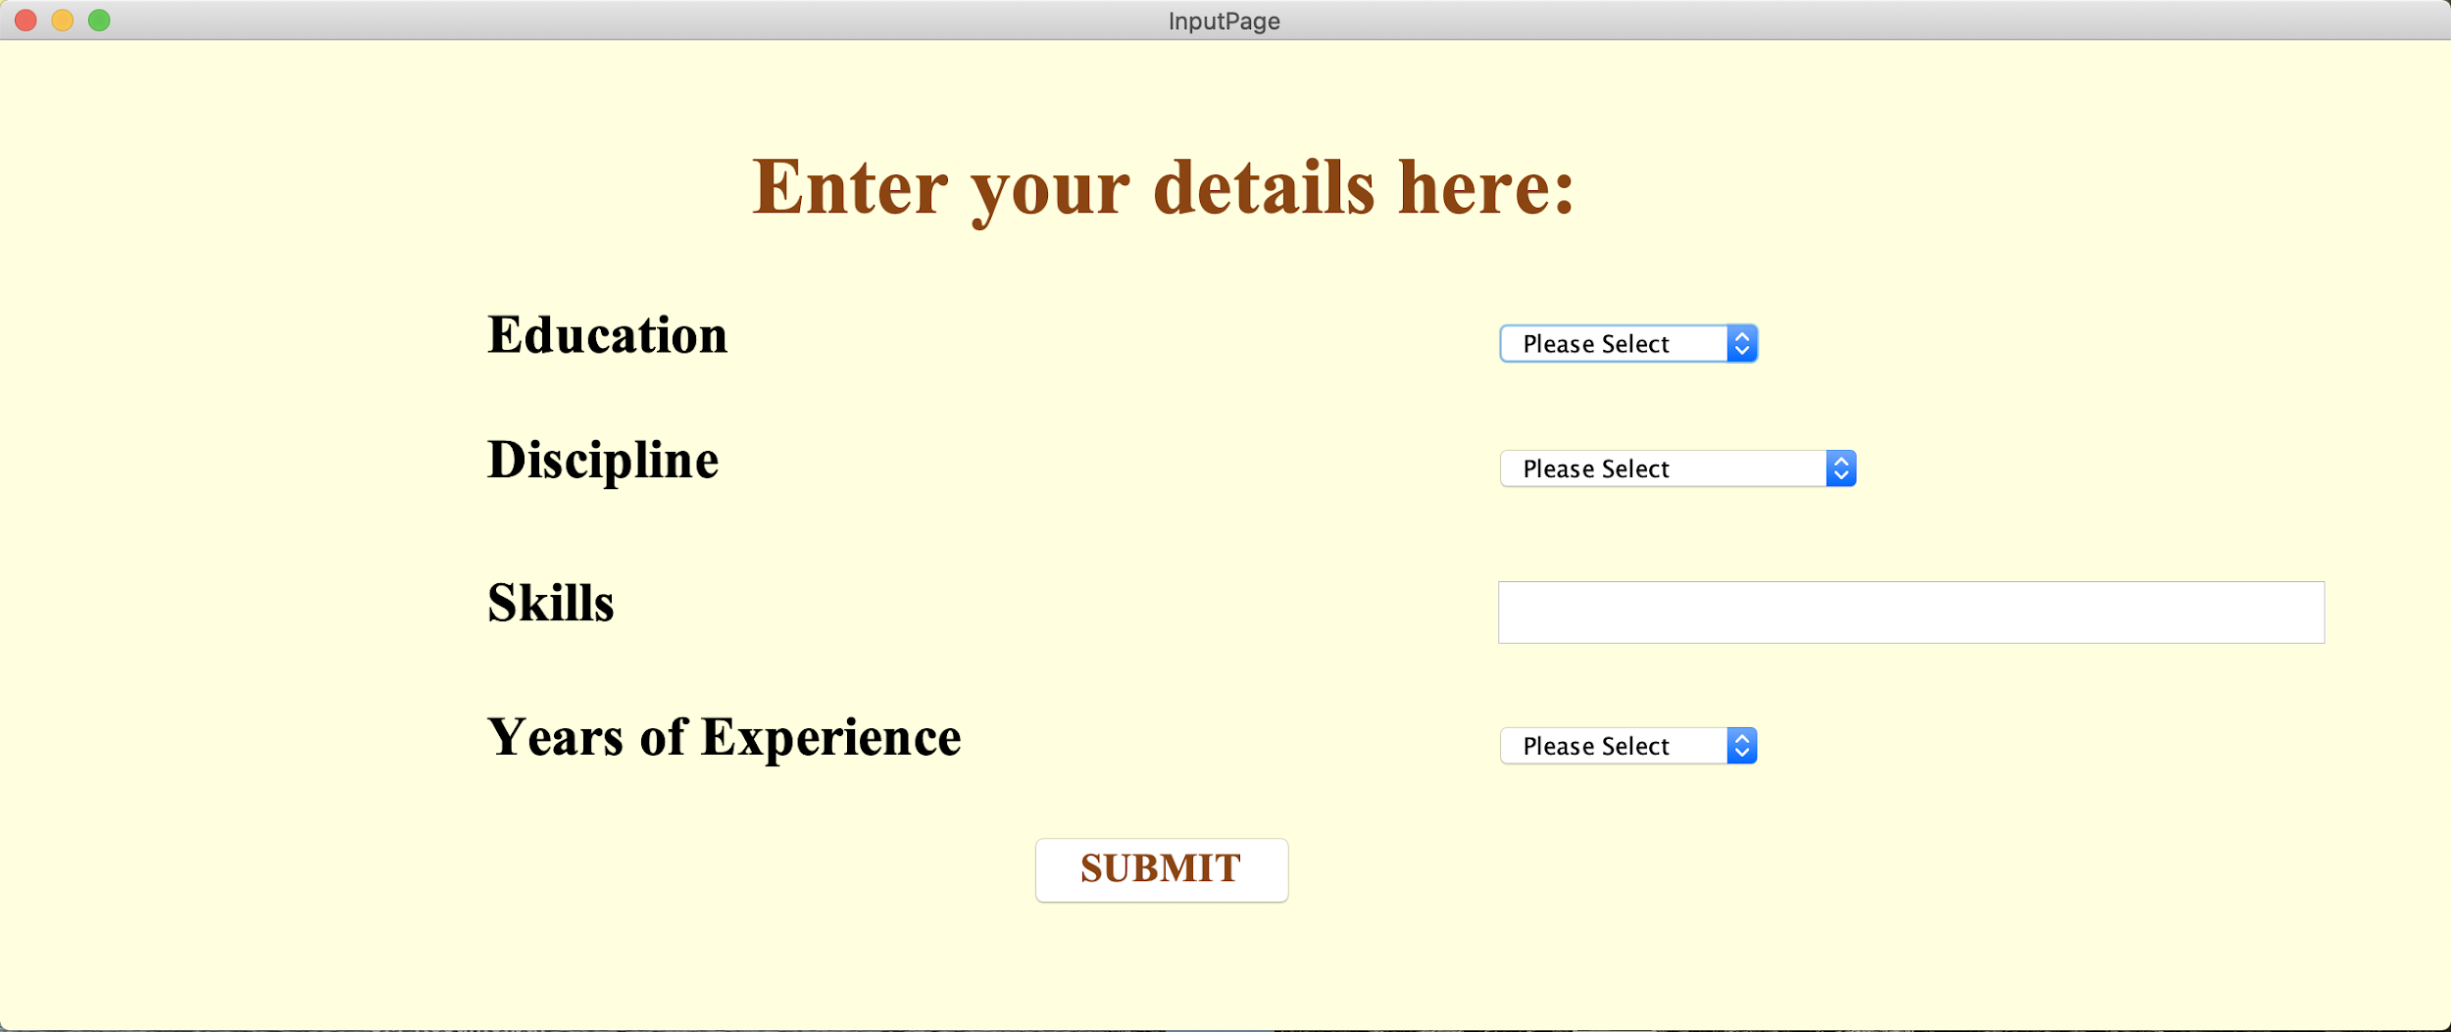
Demo: Input Page

Slide 17
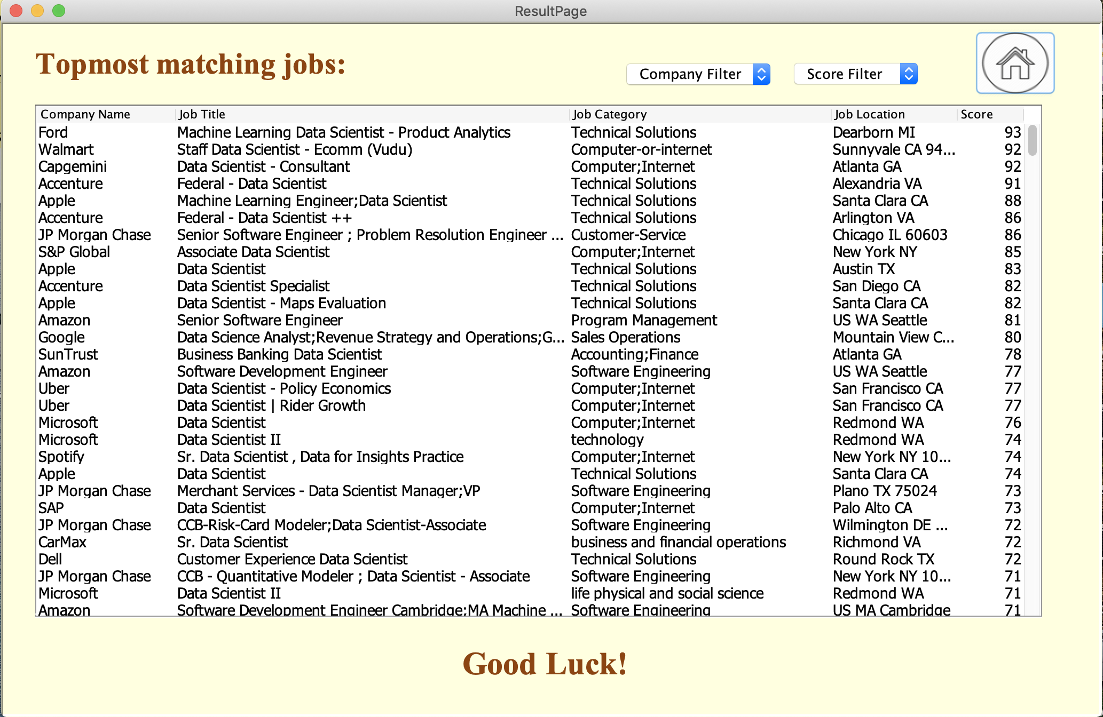
Demo: Result Page

Slide 18
Model Performance and Results:
We have modified the cosine similarity formula to benefit our platform. There were few circumstances where if a candidate inputs a set of extra skills other than the job requirements, eventually the score for that particular job would decline. To handle such cases, we have calculated the query length vector for each job in the dataset. This implementation will produce a desired cosine similarity score even the candidate possesses extra skills.

Slide 19
Model Performance and Results:
Before
Candidate's Inputs,
Education: BS
Discipline: Applied Mathematics
Skills: Python,R,SQL,MapReduce,C,C++,Java,Interpersonal Skills,Communication Skills,Presentation Skills
Years of Experience: 3
Precision: 0.34
Recall: 1

Slide 20
Model Performance and Results:
After
Candidate's Inputs,
Education: BS
Discipline: Applied Mathematics
Skills: Python,R,SQL,MapReduce,C,C++,Java,Interpersonal Skills,Communication Skills,Presentation Skills
Years of Experience: 3
Precision: 1
Recall: 1

