Slide 1
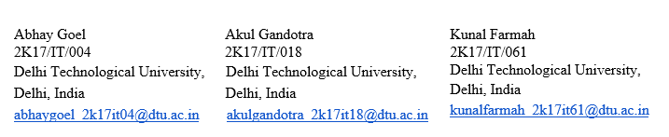
REMOTE COVID-19 PATIENT MONITORING SYSTEM USING PHOTOPLETHYSMOGRAPHY
IT 401 B.TECH PROJECT-I
A PROJECT REPORT SUBMITTED IN PARTIAL FULFILMENT OF THE REQUIREMENTS FOR THE AWARD OF THE DEGREE OF BACHELOR OF TECHNOLOGY IN INFORMATION TECHNOLOGY
Submitted By:
Under the Supervision of:
Ms. Anamika Chauhan
Dept. of Information Technology
Delhi Technological University

Slide 2
CONTENTS
INTRODUCTION
LITERATURE REVIEW
INTERNET OF MEDICAL THINGS (IOMT)
PHOTOPLETHYSMOGRAPHY
What is Photoplethysmography
A typical PPG Waveform (Simplified Version)
Uses of PPG
PPG in wearable devices
Limitations of PPG
THE CURRENT COVID-19 SITATION IN INDIA
CURRENT EXISTING SOLUTION

Slide 3
OUR PROPOSED MODEL AND ITS IMPLEMENTATION SO FAR
SMARTHPONE PHOTOPLETHYSMOGRAPHY
WORKING OF SMARTPHONE PPG
VITAL SIGNS MEASUREMENT MODES IN OUR APP
ADVANTAGES OF OUR APPROACH
HOW THE APP WORKS TOWARDS MONITORING AND WARNING USERS
HOW DOCTORS CAN MONITOR THEIR PATIENTS
MODE 1: MEASUREMENT USING PPG IN ACTION
MODE 2: MEASUREMENT USING PULSE OXIMETER
OUR EXPERIMENTS AND RESULTS
RESULTS OF SMARTPHONE PPG MEASUREMENT
RESULTS OF TESTING THE MAX30100 PULSE OXIMETER CONNECTED TO NODE MCU ON SERIAL OUTPUT
FUTURE WORK IN MAJOR 2

Slide 4
introduction
The Covid-19 pandemic has hit the nation hard and brought the economy to its knees.
Many businesses are failing due to non compatibility with work from home.
India stands at the second place in the total number of reported cases after USA, not to ignore the massive Under reporting happening due to shortage of personnel, equipment and testing labs, even with large efforts by the government.
No efficient framework exists for monitoring of patients and everything is dependent on user input without a trace of automation..

Slide 5
Thus, there has been a demand for low cost, simple and portable technology for the primary care and community based clinical settings to monitor patients.
This also brings light to the fact that there has to be a patient monitoring system in order to notify the authorities of the vitals of Covid-19 patients.
Here we will be focussing on providing a cost efficient, easily available remote patient monitoring system that harnesses the power of Photoplethysmography and IOT for monitoring vital signs like Heart Rate and Oxygen Saturation (SPO2) of the Covid-19 patients

Slide 6
LITERATURE REVIEW
INTERNET OF MEDICAL THINGS (IOMT)
Internet of Medical Things can be considered as a combination of medical devices and applications that
can connect using network technologies.
The global IOMT market is expected to reach $72.02 billion in 2021 at a AGR of 26.2%.
The market of medical devices consisting of IOMT comprises of smart devices such as wearables, and
vital monitors strictly for aiding healthcare with associated real time location, telehealth, and other
services.
IOMT is driven by an increase in the number of connected medical devices that are able
to generate, collect, analyze or transmit health data or images and connect to healthcare provider
networks, transmitting data to either a cloud repository or internal servers.

Slide 7
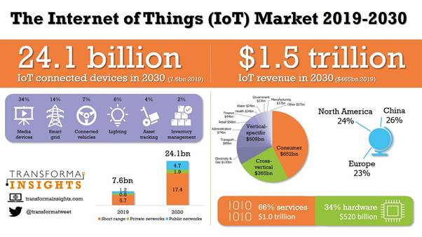
Ultimately, this connectivity between medical devices and sensors is streamlining clinical workflow management and leads to an overall improvement in patient care, both inside care facility walls and in remote locations.
Our project uses IOMT in a wide spectrum and helps patients to monitor their vitals at home at a cheap cost.

Slide 8
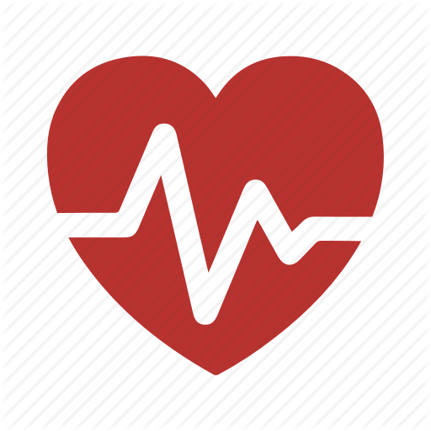
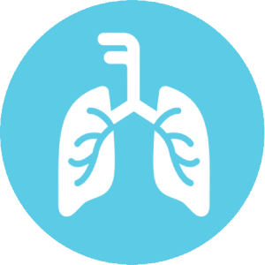
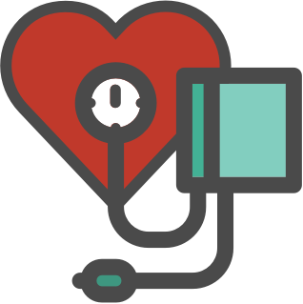
What is Photoplethysmography?
Photoplethysmography (PPG) is a simple optical technique used to detect volumetric changes in blood in peripheral circulation.
It is a low cost and non-invasive method that makes measurements at the surface of the skin.
The technique provides valuable information related to our cardiovascular system

Slide 9
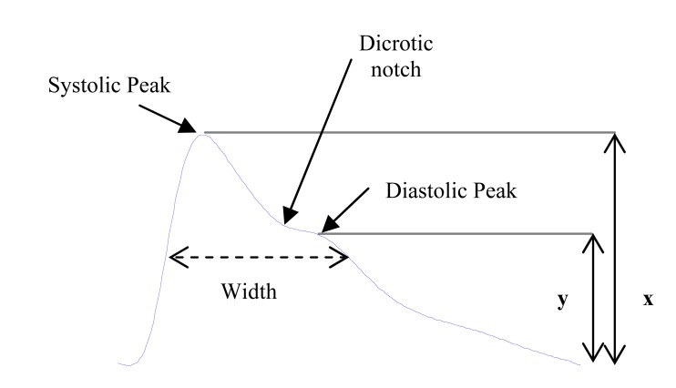
A typical ppg waveform (simplified version)

Slide 10
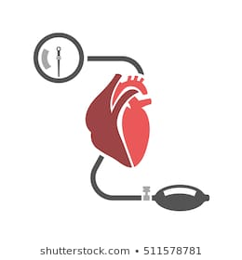
Uses of PPG
Medical devices based on PPG technology are widely used in various applications in the clinical set up.
Some of them are:
Clinical physiological monitoring
Blood oxygen saturation
Blood pressure
Cardiac output
Heart rate
Respiration

Slide 11
The most common application of ppg: Wearable Devices
Using this technology, wearable pulse rate monitors have been developed.
Important design requirements for these systems include miniaturization, robustness and user-friendliness.
These devices have a sensor that monitors minor variations in the intensity of light transmitted through or reflected from the tissue.
These intensity changes are associated with changes in blood flow through the tissue and provide vital cardiovascular information such as the pulse rate.

Slide 12
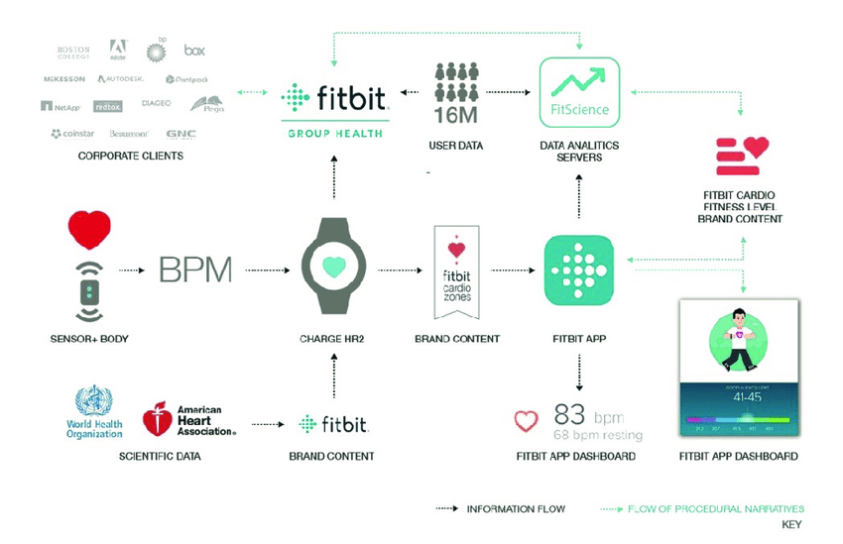
So as a typical use case, we can look a fitbit or an mi-band.
Everyone would have noticed a flashing light on the back panel that touches the wrist. That is the IR light that is used to perform PPG and give us an accurate estimate of the vital signs.

Slide 13
Limitations of ppg
Despite PPG’s wide range of applications, there are several significant drawbacks that may limit the usefulness and evolution of conventional PPG:
Spot Measurement: A PPG sensor can only monitor the dynamic change of the blood volume at one site/point per probe.
Contact Measurement: For accurate measurements, the conventional PPG sensor should be attached firmly to the skin, which constrains its practicality in situations such as wound diagnostics (burn/ulcer/trauma) and skin healing evaluation or when free movement is required
Motion artifact corruption: PPG is susceptible to motion-induced signal corruption.

Slide 14
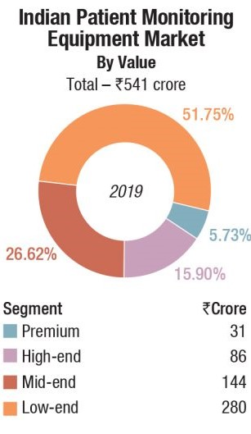
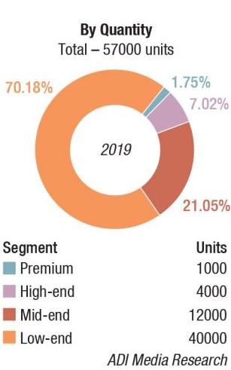
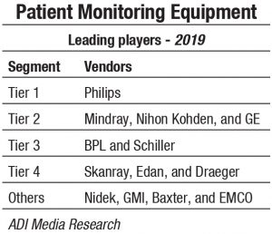
The current covid-19 situation in india
Fig
Our nation India current stands at 2nd place in terms of tally of the number of infected people with USA ahead of us.
Daily new cases rose up to a maximum of 97,400 on September 10th, there is a need of new and efficient patient monitoring systems in the healthcare system.
The capital of India, Delhi is also hard struck with daily cases rising to nearly 8600. Even though the government has taken significant steps to curb the pandemic, still there are many people suffering because of the lack of proper systems installed by the government.

Slide 15
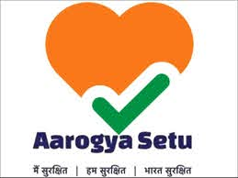
Current existing solution
The Aarogya Setu App
Slightly effective in contact tracing, completely ineffective in monitoring of any kind as the app is dependent on user input.
There is a serious need for an effective, inexpensive solution to track and monitor the patients and at the same time generate valuable data for the researchers and doctors to study how each patient reacts differently to the virus.

Slide 16
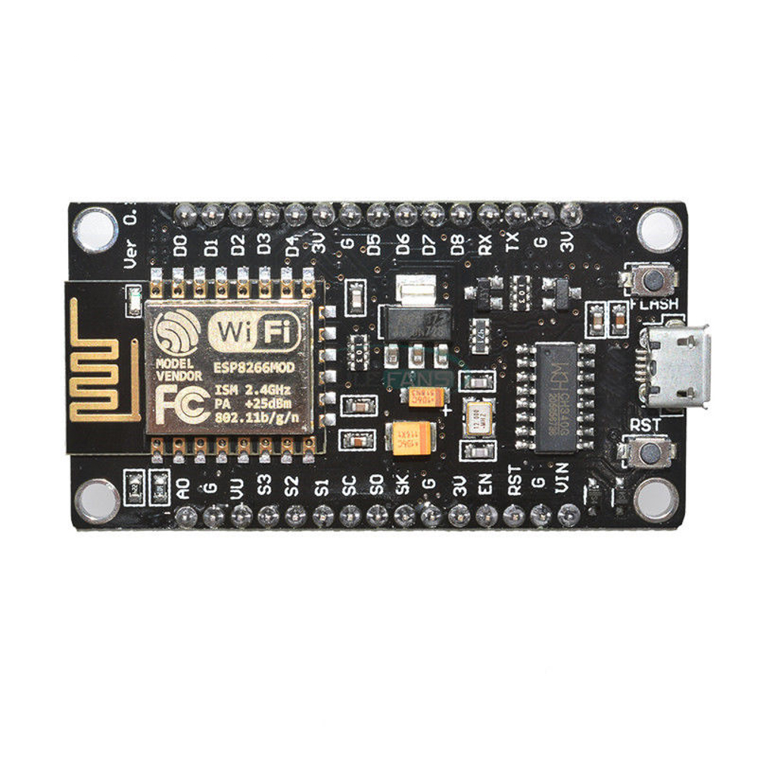
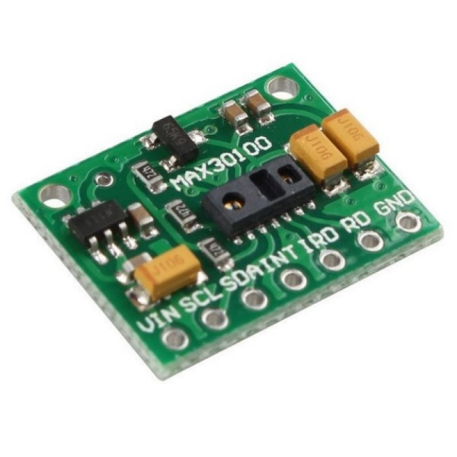
OUR PROPOSED MODEL AND ITS IMPLEMENTATION SO FAR
Node MCU Module
We have proposed an Android App uses both PPG and IOT to measure vital signs of the users so they can track their health and recovery.
Using just the smartphone camera and flash to measure the Heart Rate and Oxygen Saturation that is available on every decent android device, it is easily available to everyone.
A simple pulse oximeter costs as much as Rs. 1100 in the market, our app uses the same technique it uses under the hood at no extra cost.
MAX 30100 Pulse Oximeter Module

Slide 17
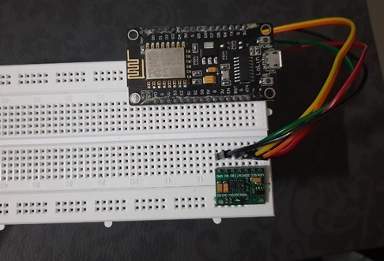
Yes it is not 100% accurate, but it is enough to warn a person about deteriorating health, especially if he is an active patient in recovery phase.
It allows doctors to register and track their patients’ progress by having the information about the most recent vital sign measurement of that patient.
Patients can book appointments with the registered doctors and chat with them if needed.
The complete device with MAX 30100 Pulse
Oximeter connected to Node MCU module

Slide 18
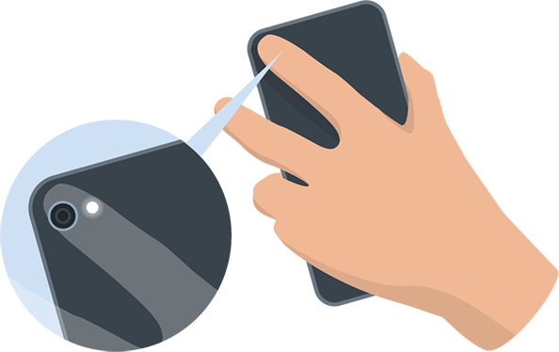
smartphone Photoplethysmography
As PPG uses IR light of almost any spectrum and involves image processing to some extent, the smartphone camera can provide as an alternate resource for measuring all the parameters using PPG that is available with all.

Slide 19
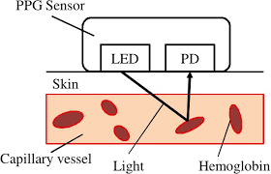
Working of ppg using smartphone
So what we do is we put our finger on the phone camera with flash on.
The camera shoots a short video of the light reflecting back from the blood vessels inside the finger.
Then it uses Complex Mathematical and CV methods and performs image processing to take out the features that a normal fitness band analyses and gives an estimate about the vital signs.

Slide 20
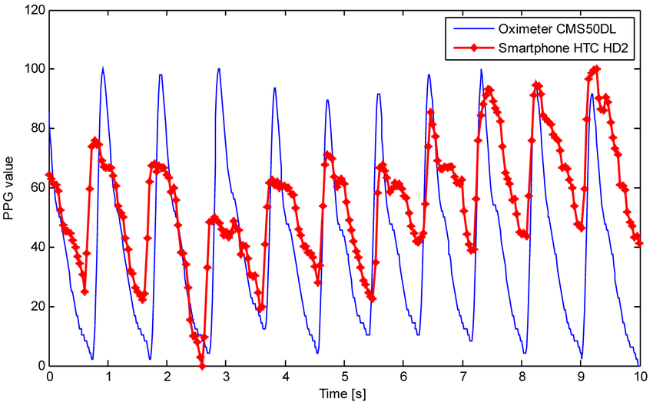
Comparison between the photoplethysmograms obtained by the smartphone HTC HD2 and the oximeter.
The peaks and the valleys of both signals correspond.
https://www.researchgate.net/figure/Comparison-between-the-photoplethysmograms-obtained-by-the-smartphone-HTC-HD2-and-the_fig16_233776340

Slide 21
VITAL SIGNS MEASUREMENT MODES IN OUR APP
We offer 2 modes of Heart Rate and SPO2 measurement:
1) Using PPG that uses the camera module, image processing and complex mathematical formulae devised by the researchers over the decades.
2) Using MAX Pulse Oximeter sensor module connected to an Arduino Enabled Node MCU. The app will connect to the Arduino device and receive the measurements taken by the oximeter sensor via wifi.
Measurement using PPG
Complete Set up comprising of Node MCU and MAX 30100 Pulse Oximeter

Slide 22
Advantages of our approach
Easily available, low cost, efficient platform to monitor Covid-19 patients.
Monitoring can be done remotely without any need of contact with the patients.
The Complete Sensor module only costs less than Rs.500 as compared to the market cost of Rs. 800 – 2100.
Cost Breakup: Node MCU Rs.200, MAX Pulse Oximeter Rs.200, Breadboard and jumper cables around Rs. 80-100.
Multiple sensors can be used with the same Node MCU board. So all you need is one Node MCU board and multiple sensors, separate for each patient and just plug in and plug out your sensor module, connect the device to the app and receive the measurement results in less than a minute.

Slide 23
There is very less local patient vitals data available currently due to heavy load on the hospitals and doctors especially with over 8000 cases getting registered daily.
With our solution implemented on a large scale such as hospitals, there will be loads of patient vitals data generated that will be accurate as well if the Arduino method is used for measurement which will cost a mere fraction of what the government is spending for importing expensive apparatus from other countries.
That data can be helpful for the local researchers and doctors to find out how every patient reacts differently to the virus and how measurement of vitals can help in early detection of infections and asymptomatic cases.

Slide 24
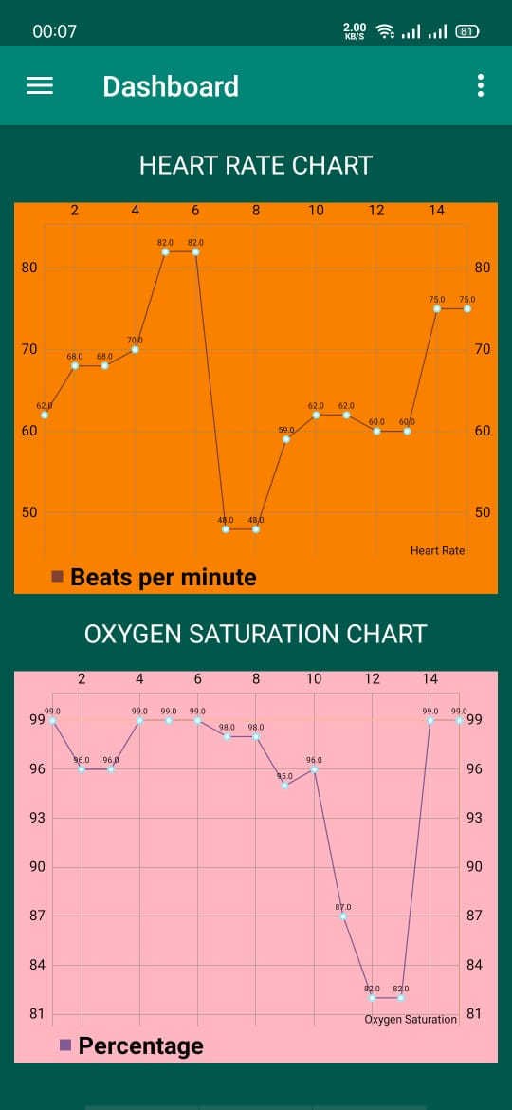
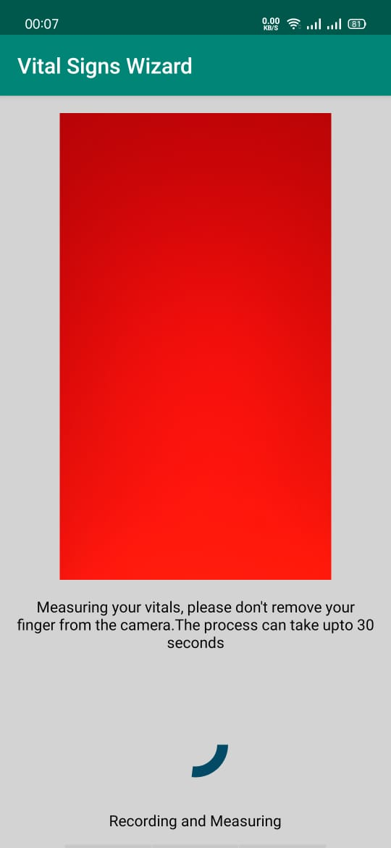
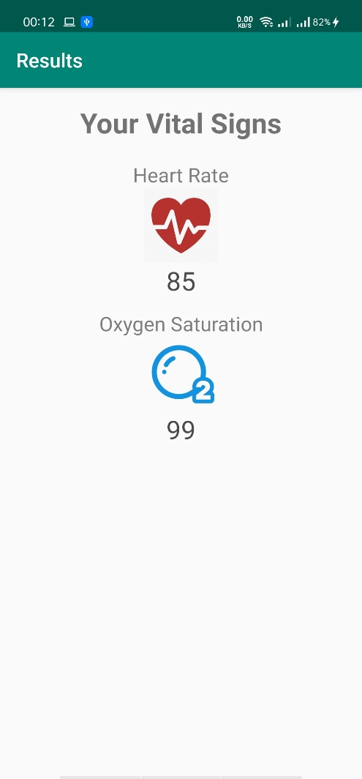
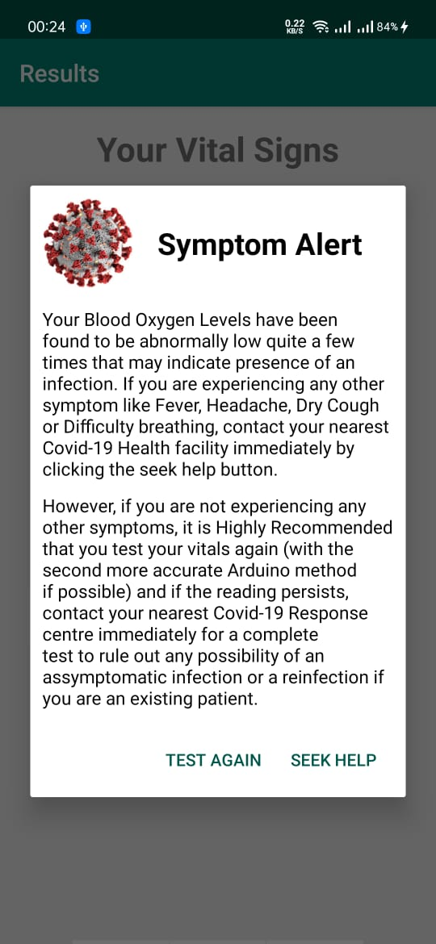
HOW THE APP WORKS TOWARDS MONITORING AND WARNING USERS

Slide 25
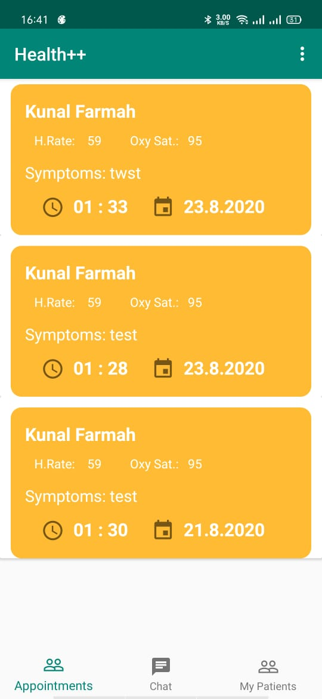
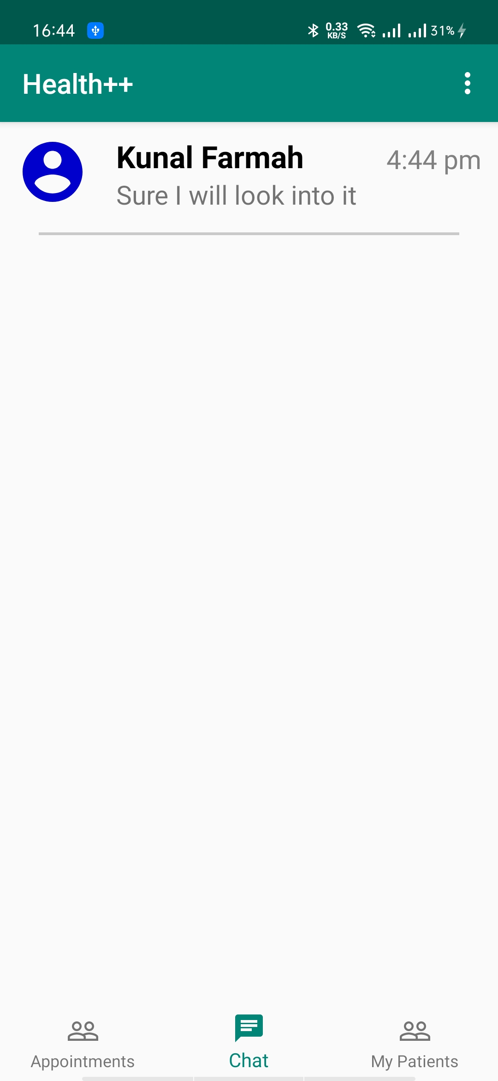
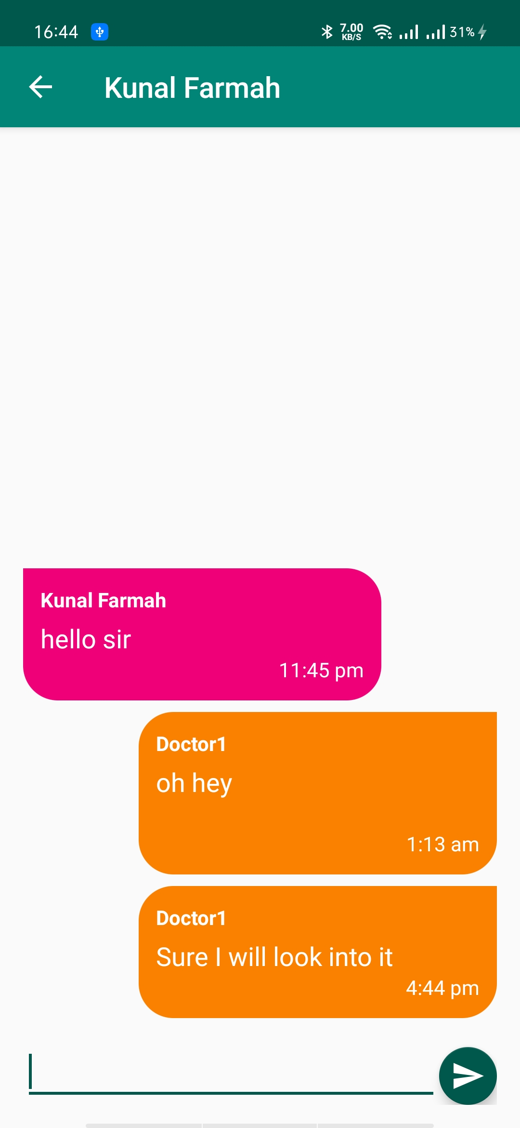
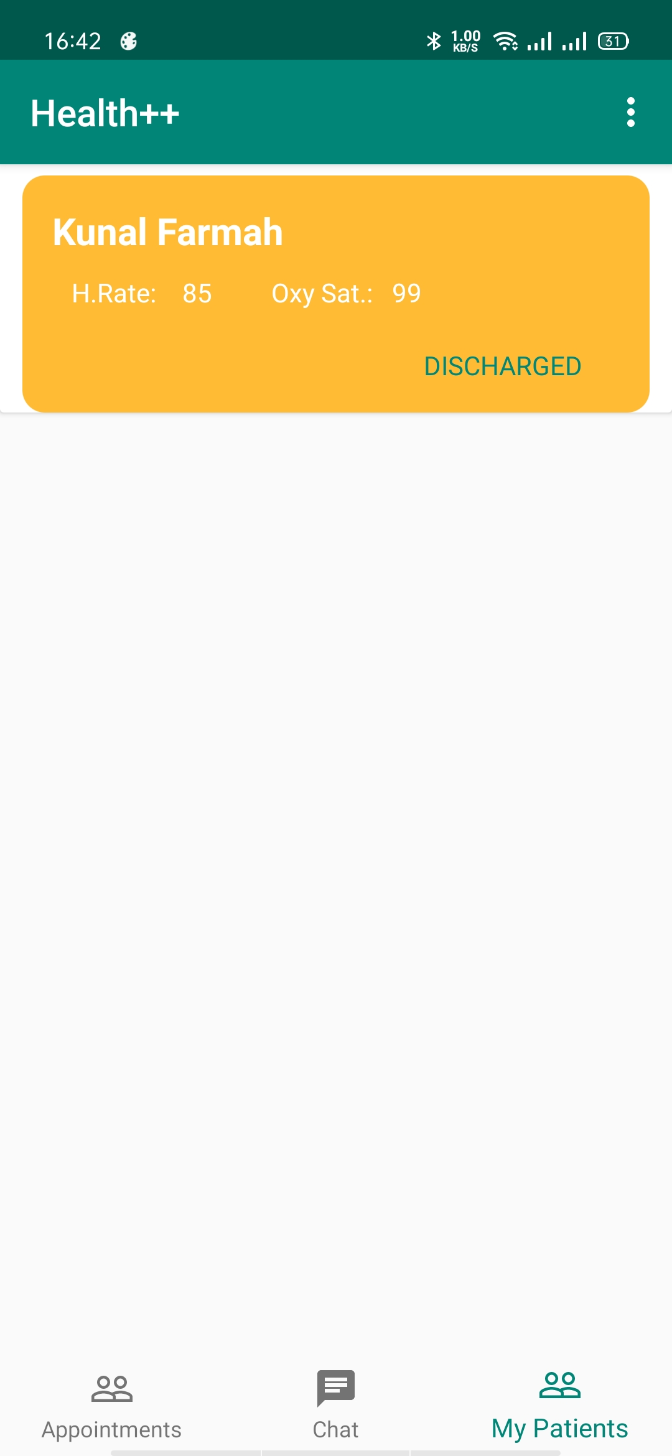
How doctors can monitor their patients

Slide 26

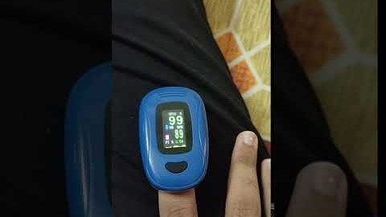
Mode 1: measurement using ppg in action
Results obtained by a Rs. 2000 Pulse Oximeter
at the same time.
Measuring Vital signs using smartphone PPG

Slide 27
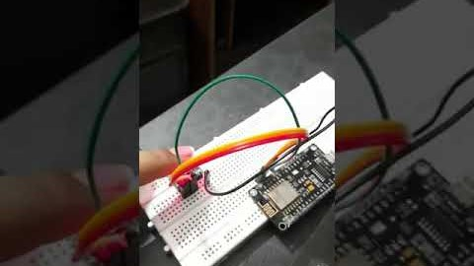
Mode 2: measurement using pulse oximeter (implementation so far limited to serial output)
Testing the MAX30010 Pulse Oximeter Sensor connected to Node MCU on serial output

Slide 28
Our experiments and results
We have successfully tested the PPG method of vital signs measurement by both adhering to and violating the constraints related to the technique and got promising results.
The first mode of measurement, though not completely accurate is enough to serve as a way to warn people about asymptomatic infections signs of deteriorating health in case of active patients.
We have also finished setting up the apparatus for the second mode, that is Node MCU + MAX Pulse oximeter sensor module and it gives 100% accurate results.

Slide 29
Entry Id | Heart Rate | Oxygen Saturation | Timestamp
MHC_p1vy4xS_990Iy7Y | 62 | 99 | 1.600103326072E+12
MHDH86Py__wjXlQwxpE | 68 | 96 | 1.600114954175E+12
MHDHCn5Y-0CywaUImg5 | 68 | 96 | 1.600114973355E+12
MHDHMIzvWA6TdTBFUKe | 70 | 99 | 1.600115012324E+12
MHFB-hsa_ki6ObOgvmX | 82 | 99 | 1.600146901491E+12
MHFB1ud-29ebfS0rEls | 82 | 99 | 1.600146910500E+12
MHSLzL9meJhfI8HGxim | 48 | 98 | 1.600367882815E+12
MHSM30NbcGi8qius5il | 48 | 98 | 1.600367901965E+12
MHgfsDCLCefpvv_PhLP | 59 | 95 | 1.600625016869E+12
MI_dDJDZsKG1blU18uz | 62 | 96 | 1.601580621645E+12
MI_dnATOZFJPb9QE-J4 | 62 | 87 | 1.601580772665E+12
MJOFwMeWjam5ZkF_els | 75 | 99 | 1.602446672893E+12
MJOG7UchMH8Q_15uHRu | 75 | 99 | 1.602446722555E+12
Entry Id | Heart Rate | Oxygen Saturation | Timestamp
MHQd9GL7GlfV-0wGxqm | 73 | 99 | 1.600339093947E+12
MHRC_je0evM3OnJDM8s | 61 | 99 | 1.600348642913E+12
MHRCaCRt2-WEpmXu8VD | 61 | 99 | 1.600348644819E+12
MHRCwwNWg090AsLyeLg | 59 | 99 | 1.600348737928E+12
MHRgvNHtpFOhVGiE5fH | 47 | 99 | 1.600356858018E+12
MHWeC7a6nAvmdVLh433 | 75 | 99 | 1.600440028931E+12
PPG measurements of Abhay Goel
PPG Measurements of Kunal Farmah
Entry Id | Heart Rate | Oxygen Saturation | TimeStamp
MHCMlLDt40uxopVRtLH | 70 | 99 | 1.600099652815E+12
MHCMmtPIBiOAiK1UueQ | 70 | 99 | 1.600099659163E+12
MHCNnhhbydnlcxuqTr9 | 63 | 99 | 1.600099924988E+12
MHCNs4propaV9aJngo5 | 63 | 98 | 1.600099942916E+12
MHCO-fYDQznKDXgWDR4 | 59 | 99 | 1.600099978098E+12
MHCO3GXA_ZzhDa7NJ0s | 59 | 99 | 1.600099992817E+12
MHCYBkNM-hQ__gRgG3W | 64 | 99 | 1.600102649464E+12
MHCnf1X2Yybh2_i1C_0 | 52 | 99 | 1.600106967500E+12
MHFCxrjGoYkc9eMb2Ap | 52 | 99 | 1.600147414511E+12
MHFCyD87rGQSOAWgPPw | 52 | 98 | 1.600147415945E+12
MHHGWrJuVE0ReIvWU95 | 84 | 99 | 1.600181902862E+12
MHHGaZvNxgDTNOvbIg3 | 84 | 99 | 1.600181922165E+12
MHHGoAQgfkaAfbMj6aX | 64 | 99 | 1.600181977878E+12
MHQeNpm34ZJuhULiP9K | 57 | 99 | 1.600339414935E+12
MHQfSX1ZRsQPbWiIuQB | 57 | 99 | 1.600339696400E+12
MHQf_uWRbKtFiirURU2 | 99 | 98 | 1.600339730735E+12
MHQgMdjl4kLeFuQ8ADq | 99 | 99 | 1.600339934461E+12
MHR0Fc3im4sgtuDBsOc | 60 | 97 | 1.600345410155E+12
MHWGzHiztquDmociH3j | 64 | 99 | 1.600433680641E+12
PPG measurements of
Akul Gandotra

Slide 30
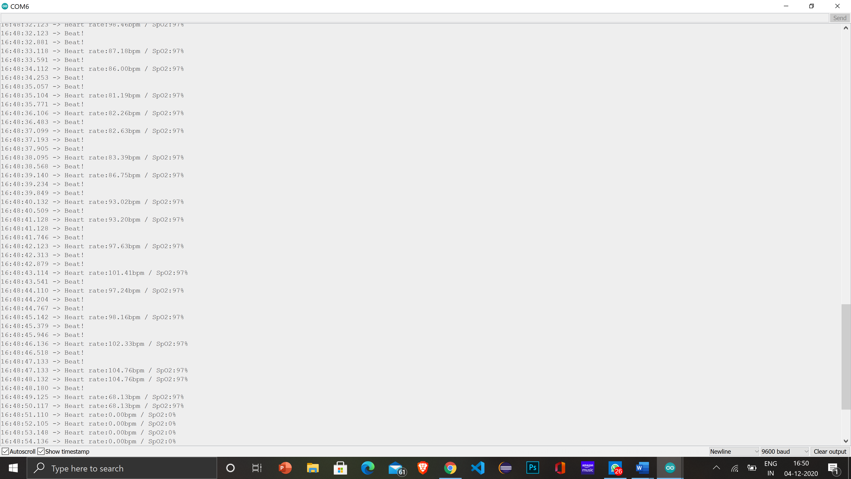
Our experiments on the MAX 30100 pulse
Oximeter connected to Node MCU giving
Output to a serial monitor.
Finger removed at this point.
The device produced two
erroneous readings after which,
the readings turned to 0.

Slide 31
FURTHER Work in major 2
The app will be improved to be more precise in case of PPG.
Successful connection to Arduino and receiving results directly via wifi.
The Node MCU module would be able to connect to more devices like an ECG sensor among others.
Users would be able to use more than one type of sensors with their Node MCU module which has 8 outputs and currently only 2 are used.
An in depth comparison between our smartphone measurements and actual market oximeter readings.

Slide 32
THANK YOU

