Slide 1
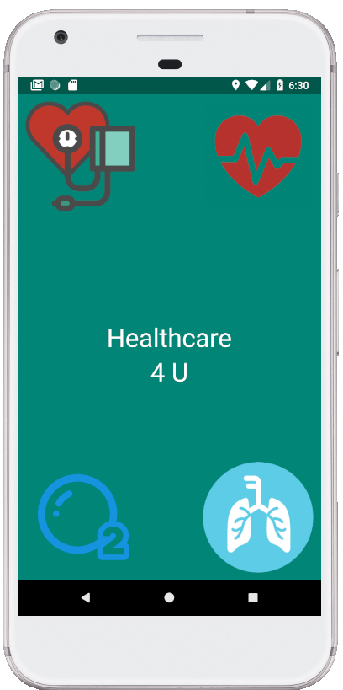
Health++ A PPG based vital signs testing Android App
SacredHacks
Nikhil Sachdeva, Namrata Jha, Aheli Ghosh, Kunal Farmah

Slide 2
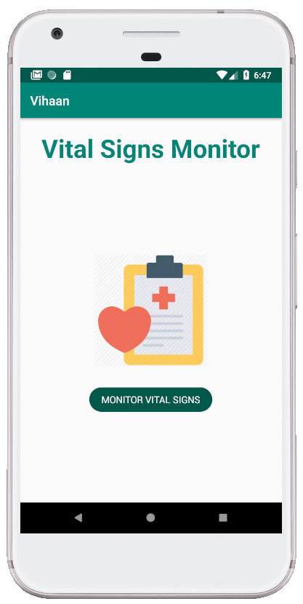
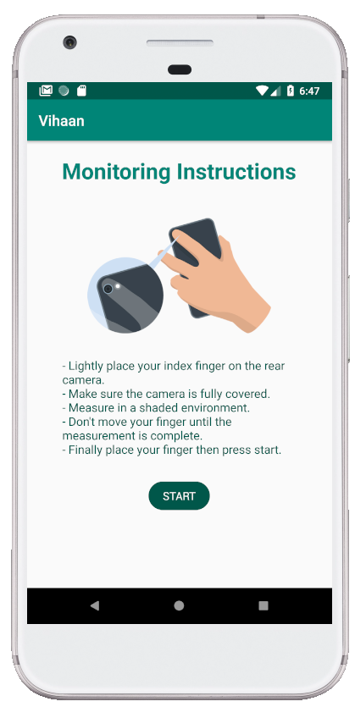
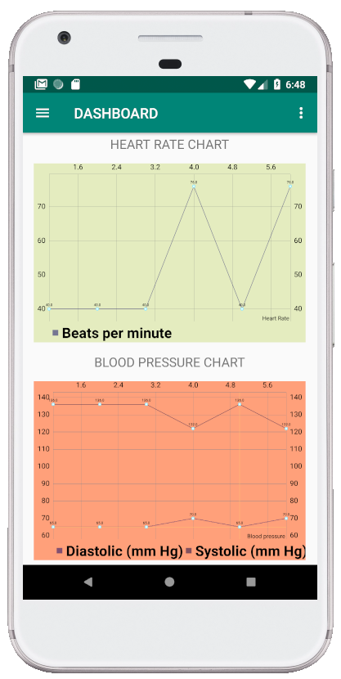
Monitor your Vitals from your Smartphone!

Slide 3
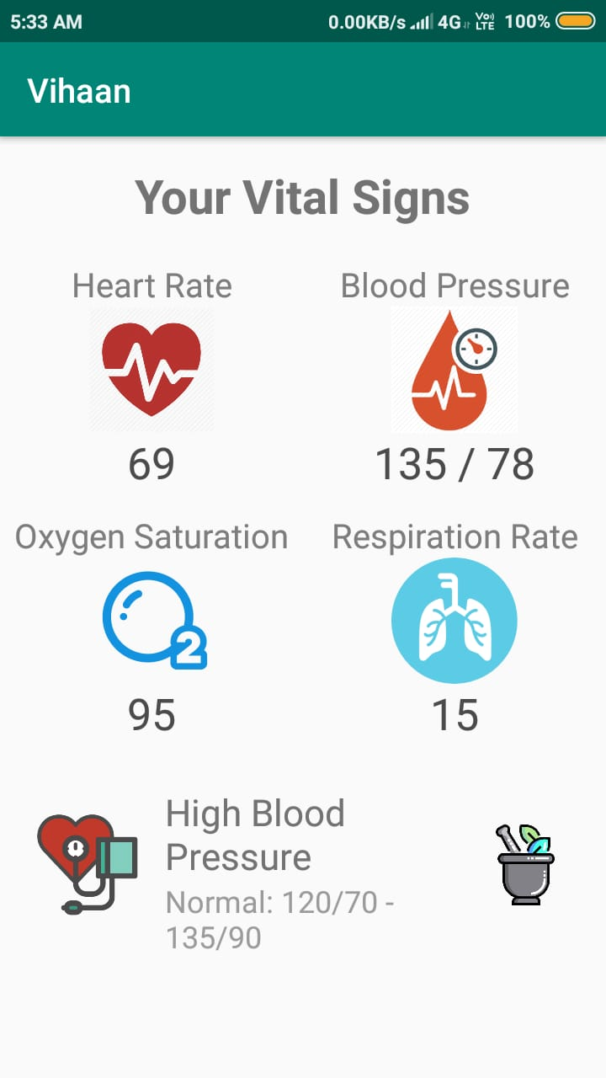
Vital Signs Measurement using Photoplethysmography
Photoplethysmography (PPG) is a simple and low-cost optical technique that can be used to detect blood volume changes in the microvascular bed of tissue. It is often used non-invasively to make measurements at the skin surface.
This Android application uses this concept to measure the vital signs of the body namely Blood Pressure, Heart Rate, Oxygen Saturation and Respiration Rate with the help of the Camera and Flash.
It shoots a video of 30 seconds, then analyses it frame by frame to match the perfect orientation of the images and selects the best image and calculates the required results using Image Processing, Bessel function and Fast Fourier Transform and much more complex functions.

Slide 4
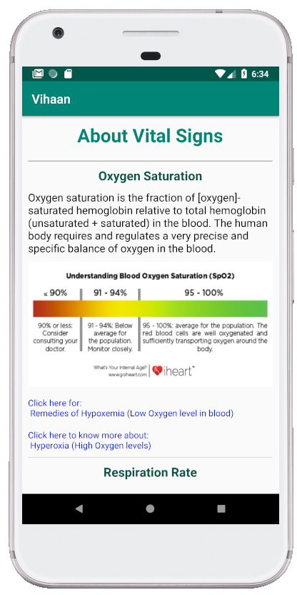
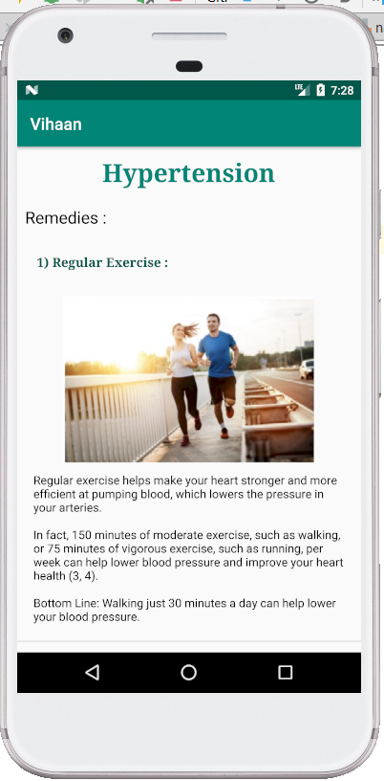
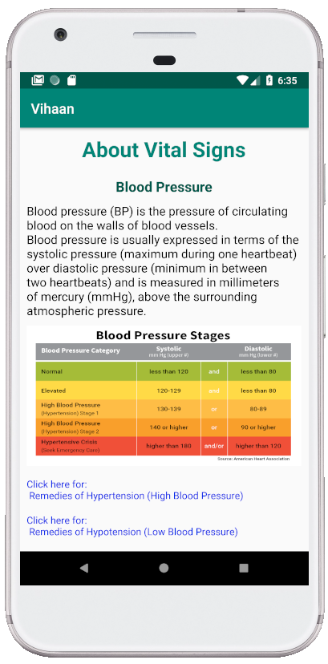
Remedies as a first Suggestion
You can learn about heart rate, blood pressure, respiration rate and oxygen saturation.
In case any of them are out of range on testing, you can check up on remedies as corrective measures.
Of course, then surely check up with a doctor by booking an appointment in person, or on chat.

Slide 5
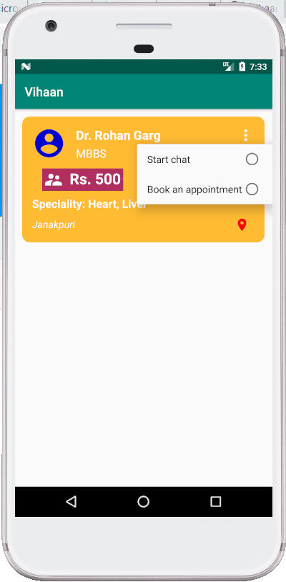
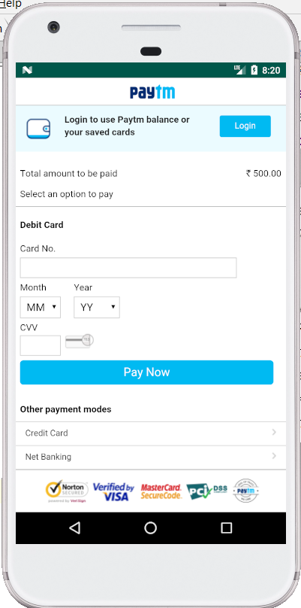
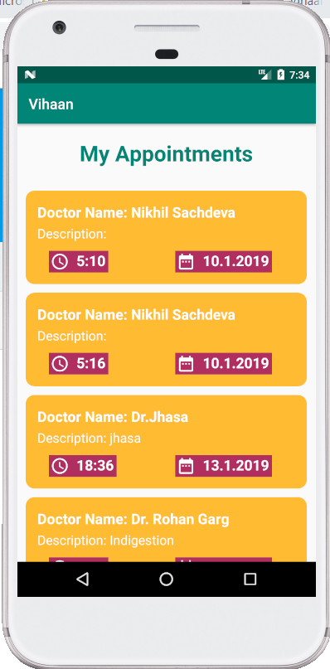
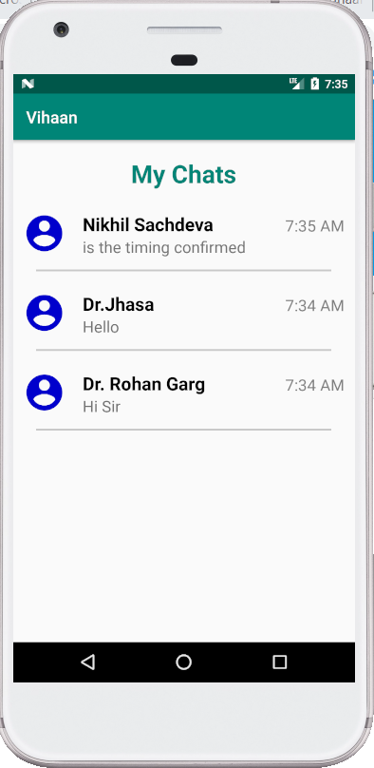
Chat or Book an Appointment with Registered Doctors with payments via Paytm Gateway

Slide 6
Competitors
Fitness Bands using PPG.
Practo.
Why are we better?
Most renowned Fitness Bands are expensive.
You have to buy it first to take advantage of its features while everyone nowadays has a smartphone.
Moreover we provide a chat support ☺
Practo provides chat support as well as Appointment booking but it doesn’t let users test their vital signs
Moreover, for people with problems of blood pressure, heart rate, etc who have to test their bp or heart rate levels daily, our app provides an easier and comfortable way to test the vital signs than using those hefty gadgets (machines) and give adequate remedies along with an option to chat with doctors and book appointments

