Slide 1
PortProof
Making IBM Db2 prove its own SQL migration.
A migration is only done when the engine says so.
Solo entry · Db2 Community Edition 12.1.5.0 · PostgreSQL 17 · MySQL 8.4

Slide 2
THE PROBLEM
Every migration tool tells you it translated.
None of them tells you whether the answer is still correct.
I gave IBM's own PostgreSQL-to-Db2 translator 38 statements drawn from real migration work.
It reported zero errors.
Db2 then rejected 14 of them outright. More compiled cleanly and returned different rows than the source engine.
38
statements, translated with no error reported
14
rejected by Db2 the moment it tried to compile
7
compiled, and silently returned the wrong rows
PortProof · Db2Hack 2026 · IBM Db2 TechX Summit
2

Slide 3
WHY IT MATTERS
A silent failure is the expensive kind.
A migration that errors is annoying. One that succeeds and returns different numbers is a finance report nobody questions.
Nothing complains. The translator reports success, the query compiles, rows come back. There is no error to triage and no alert to fire.
It is found downstream, or never. A wrong GROUP BY or a case-insensitive join surfaces as a number that looks plausible. The cost is paid in decisions, not in stack traces.
Testing it by hand does not scale. Thirty eight statements is a demonstration. A real estate is thousands, and each needs the same question answered: same SQL, same answer?
PortProof · Db2Hack 2026 · IBM Db2 TechX Summit
3

Slide 4
THE SOLUTION
Db2 is the authority, not the store.
PortProof refuses to decide anything itself. Every claim it makes is produced by the engine and can be re-derived from evidence it shows you.
1 Compile proof. Db2 PREPARE with DeferredPrepare=0, so the SQLCODE is a real server-side compile and not a client's guess. That is what catches the 14.
2 Semantic proof. The original runs on a real PostgreSQL or MySQL, the translation runs on Db2, over six datasets built to break translations. Differences come back as a counterexample you can check, with a strength score, because two empty results agreeing is not evidence.
3 An agent that cannot approve itself. A language model proposes each repair, grounded in past repairs recalled from a vector column inside Db2. Every candidate is checked read-only and then compiled by Db2. The loop can only exit through the engine.
PortProof · Db2Hack 2026 · IBM Db2 TechX Summit
4

Slide 5
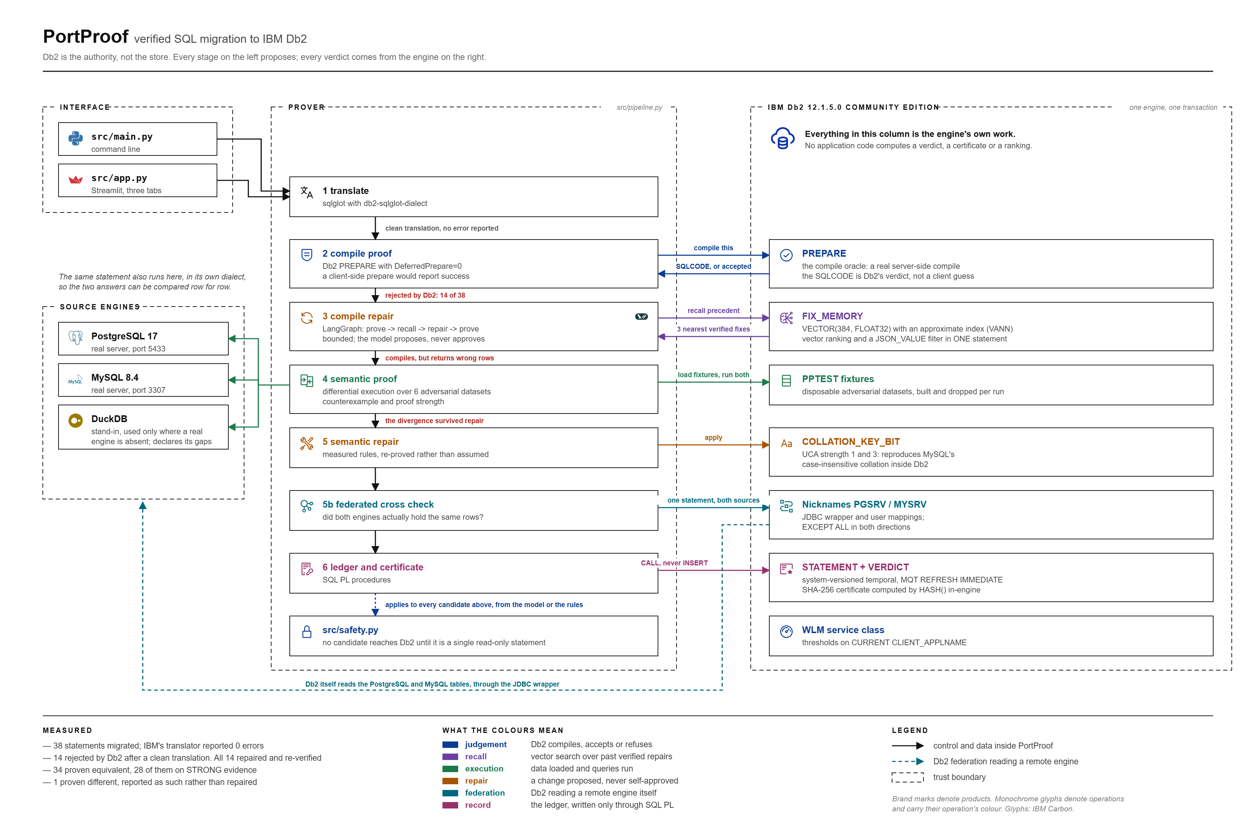
ARCHITECTURE
Work on the left. Judgement on the right.
PortProof · Db2Hack 2026 · IBM Db2 TechX Summit
5

Slide 6
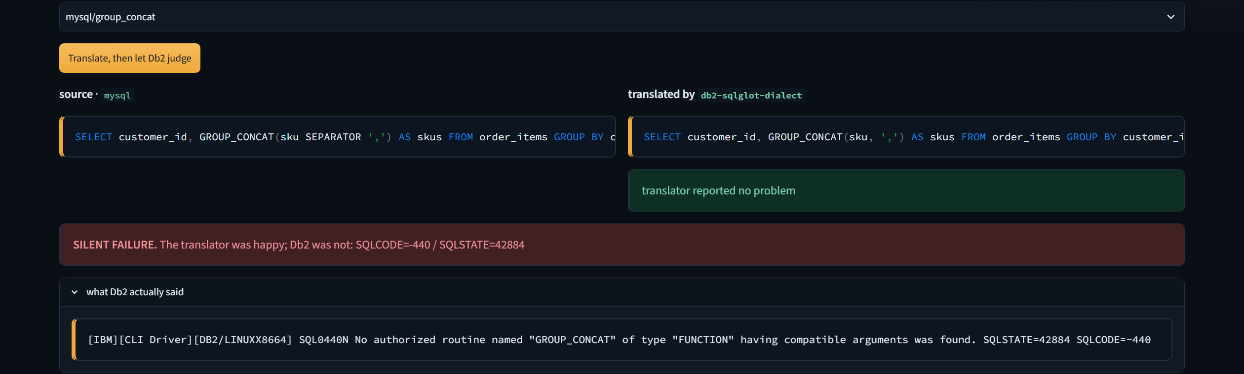
CAUGHT LIVE · TAB 1
The translator is silent. Db2 is not.
mysql/group_concat translated with no error reported. Db2 answered SQLCODE -440: no authorized routine named GROUP_CONCAT.
PortProof · Db2Hack 2026 · IBM Db2 TechX Summit
6

Slide 7
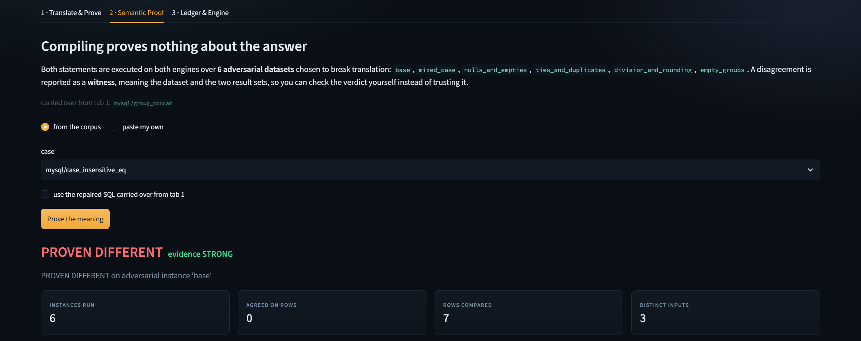
THE PART NOTHING ELSE CATCHES · TAB 2
Compiling proves nothing about the answer.
This statement compiles on Db2 perfectly well. MySQL's default collation is case-insensitive and Db2's is not, so the two return different rows. Here is the witness.
PortProof · Db2Hack 2026 · IBM Db2 TechX Summit
7

Slide 8
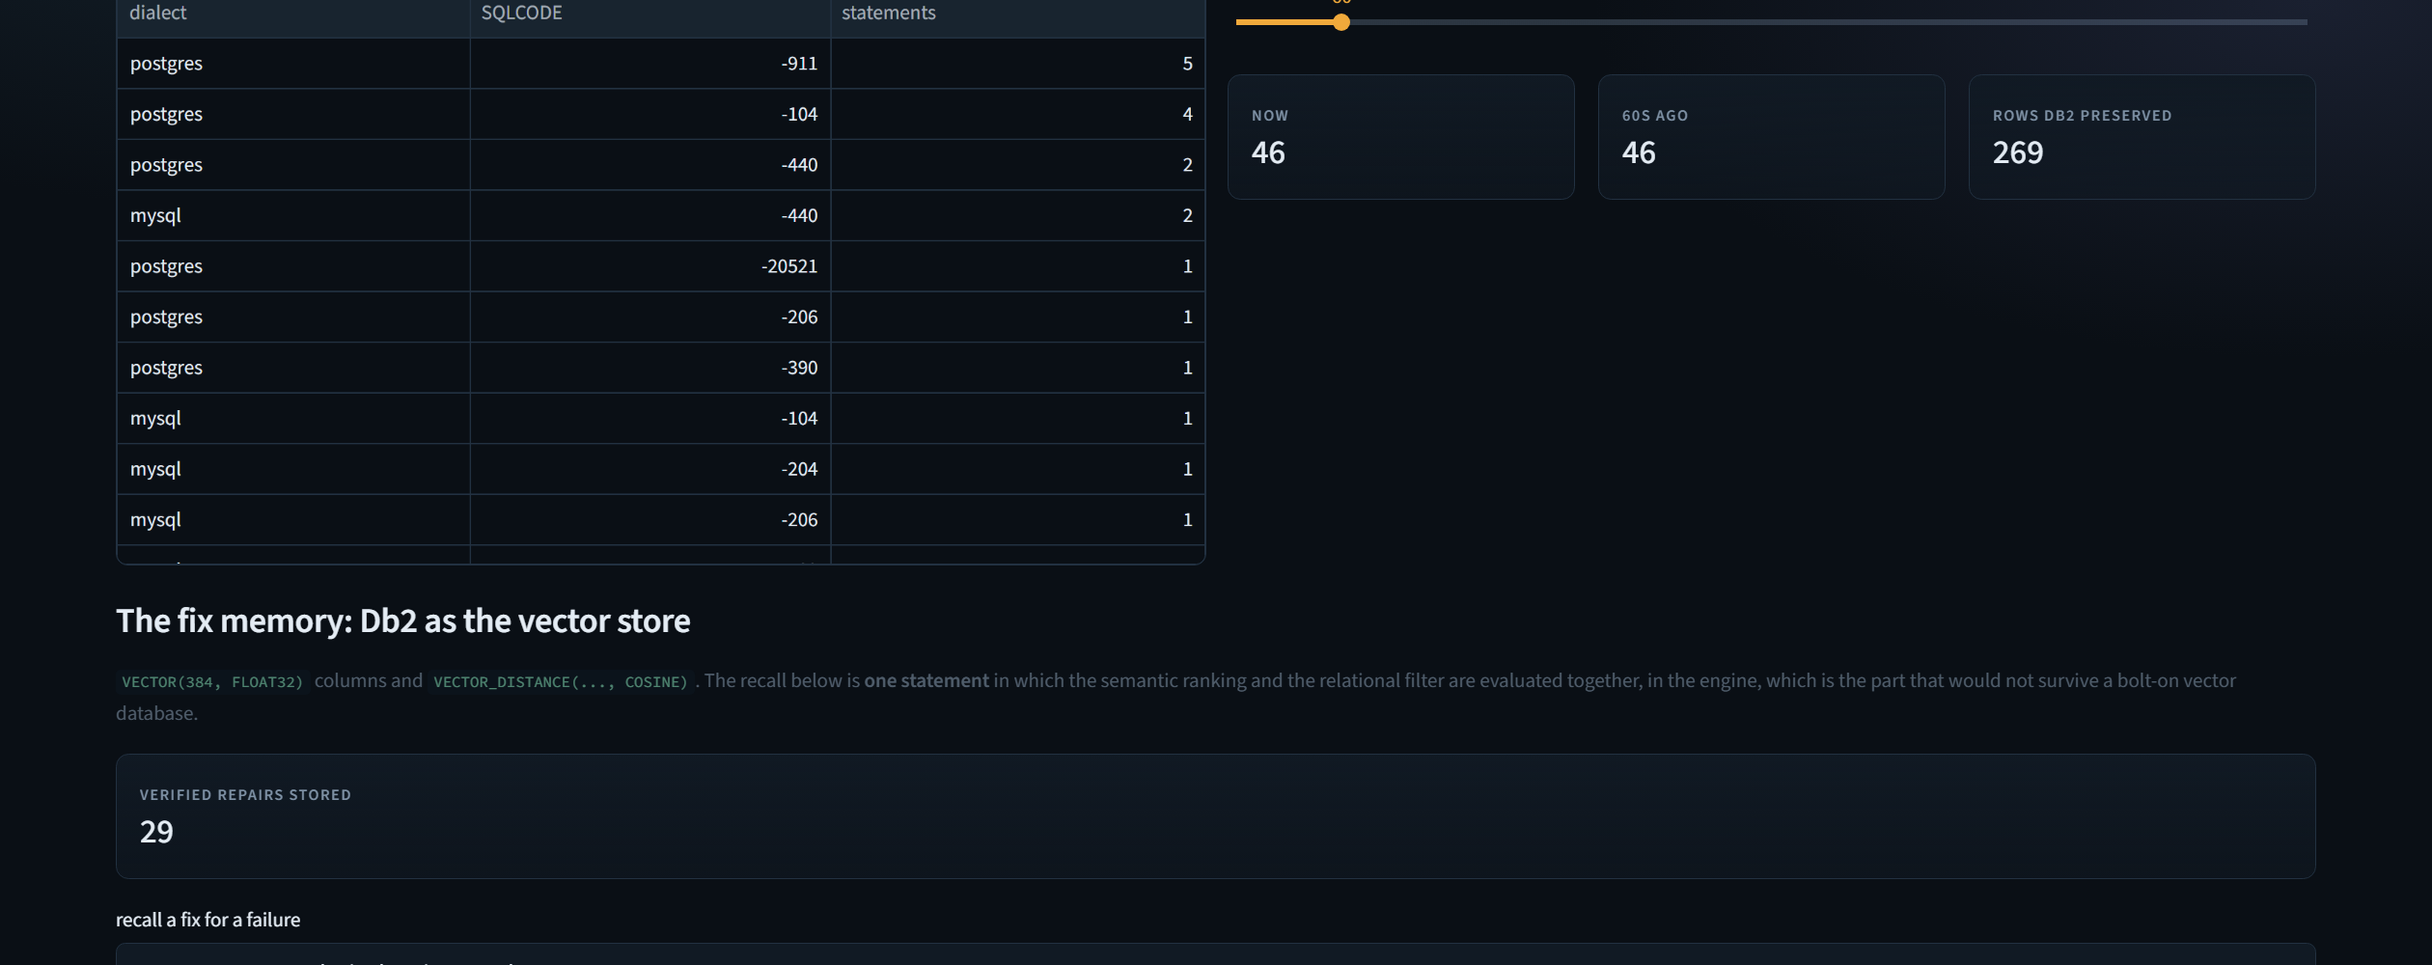
WHY DB2, AND NOT DB2 PLUS SOMETHING ELSE
One engine, one transaction, one set of permissions.
The fix memory is a VECTOR(384, FLOAT32) column with an approximate index. The semantic ranking and the relational filter are planned together, by the same optimiser, in a single statement.
PortProof · Db2Hack 2026 · IBM Db2 TechX Summit
8

Slide 9
WHAT THE ENGINE IS ACTUALLY DOING
21 Db2 capabilities, each load-bearing.
Nothing here is used to be able to say it was used. Remove any one and a claim the project makes stops being provable.
PROOF
— PREPARE as a compile oracle, DeferredPrepare=0
— SQL PL procedures; MERGE upsert, CONTINUE HANDLER
— HASH(...,2) SHA-256 certificates, computed in-engine
— System-versioned temporal tables, FOR SYSTEM_TIME AS OF
— MQT with REFRESH IMMEDIATE MAINTAINED BY SYSTEM
— Two-identity least privilege, enforced by GRANT
— WLM service class and thresholds on CLIENT_APPLNAME
AI AND DATA
— VECTOR(384, FLOAT32) columns
— CREATE VECTOR INDEX ... WITH DISTANCE COSINE (VANN)
— VECTOR_DISTANCE with FETCH APPROX FIRST
— Hybrid vector + relational recall in one statement
— JSON_VALUE(... RETURNING ...) typed extraction
— COLLATION_KEY_BIT at UCA strength 1 and 3
— Federation: JDBC wrapper, nicknames, EXCEPT ALL
PortProof · Db2Hack 2026 · IBM Db2 TechX Summit
9

Slide 10
MEASURED, NOT ASSERTED
Every number here is reproducible.
python -m src.main, against a live Db2. 151 tests pass. The default repair engine needs no API key, so a judge gets these same figures.
14 / 14
34
1
63.4%
silent compile failures repaired and re-verified by Db2
statements proven equivalent, 28 on STRONG evidence
proven different, reported rather than repaired
fewer pages, by Db2's own administrative function
Cross-checked by Db2 itself. Federation nicknames over both source engines let one Db2 statement compute the symmetric difference in both directions, confirming the engines disagreed about the answer while holding identical rows.
PortProof · Db2Hack 2026 · IBM Db2 TechX Summit
10

Slide 11
WHAT IT DOES NOT DO
A prover that oversells itself is the thing this argues against.
These are in the README, because a limitation found by a judge is worth less than one the project already named.
It proves statements, not schemas. No DDL migration, no constraint or trigger translation.
Equivalence is empirical, not formal. Six adversarial datasets are evidence, not a proof over all inputs. That is exactly why every verdict carries a strength score, and why two empty result sets agreeing is reported as weak.
One divergence remains unrepaired. postgres/column_division. It is a real difference between PostgreSQL and Db2 decimal division, so the report names it and says why, rather than papering over it.
PortProof · Db2Hack 2026 · IBM Db2 TechX Summit
11

Slide 12
The model proposes.
Db2 decides.
github.com/ZENODIUM/IBM_Db2_TechX_Project_Submission · submissions/portproof
Db2Hack 2026 · IBM Db2 TechX Summit

