Slide 1
ML
IBM DB2 TECHX SUMMIT 2026 • SUBMISSION
MasteryLoop
Bloom-Mastery Adaptive AI Classroom Powered by
IBM Db2 LUW Recursive Graph Analytics & Grounded RAG
IBM DB2 LUW
OPEN-WEB + AI KB RAG
NON-REPEATING MCQS
VERIFIED QUALITY
13 Tables • Recursive CTE
DuckDuckGo · PDF · Gemini
Chunk Rotation + 2-Pass Audit
38 / 38 Pytest Passing
Author: Suryakanth (@Suryakanth25)
Slug: submissions/mastree | MIT License
Notes:
Welcome judges! I'm Suryakanth, solo creator of MasteryLoop (slug: mastree). MasteryLoop brings Benjamin Bloom's mastery-learning pedagogy to life using IBM Db2 LUW recursive prerequisite graph analytics, open-internet and AI Knowledge Base RAG, and grounded dual-format teaching.

Slide 2
01 / PROBLEM & IMPACT
02 / 10
Why Learners Hit Plateaus in Existing Platforms
Memorizing repeated questions hides foundational gaps—and naive LLM tutors hallucinate without audit trails.
PROBLEM 01
PROBLEM 02
PROBLEM 03
Repetitive Quizzes
Blind Remediation
Black-Box AI Tutors
• Same chunks, same MCQs: Learners see recycled questions and obvious wrong distractors after failing once.
• No chunk rotation: Missed material never drives exploration of deeper subsections of a topic.
• Zero rigor verification: Options aren't checked against factual passages, eroding student trust.
• Symptom over root cause: Failing Window Functions or JOINs is often caused by weak WHERE or SELECT basics.
• Flat LMS trackers: Percentage dashboards can't traverse prerequisite dependency trees automatically.
• One-style explanations: Repeating identical text fails students who need worked examples or analogies.
• External hallucination: Chatbots invent facts outside the learner's notes or textbook material.
• No enterprise persistence: Prompt responses, mastery velocity, and failure diagnosis aren't stored relationally.
• Unexplained routing: Teachers & students cannot inspect why the system recommended backtracking.
THE MASTERYLOOP IMPACT — BLOOM'S 2-SIGMA GUARANTEE IN SOFTWARE
Learners only advance when they prove mastery >= 80% across >= 5 attempts and >= 2 difficulty tiers—grounded strictly in their own Db2-stored chunks, with deterministic IBM Db2 recursive CTE root-cause diagnosis when stuck.
MasteryLoop (mastree) | IBM Db2 TechX Summit 2026 | Suryakanth (@Suryakanth25)
FastAPI + Vanilla JS + IBM Db2 LUW
Notes:
Slide 2 frames the three core bottlenecks: repetitive quizzes, blind prerequisite failures, and black-box hallucinating chatbots. MasteryLoop solves all three with deterministic gating and Db2 recursive graph traversal.

Slide 3
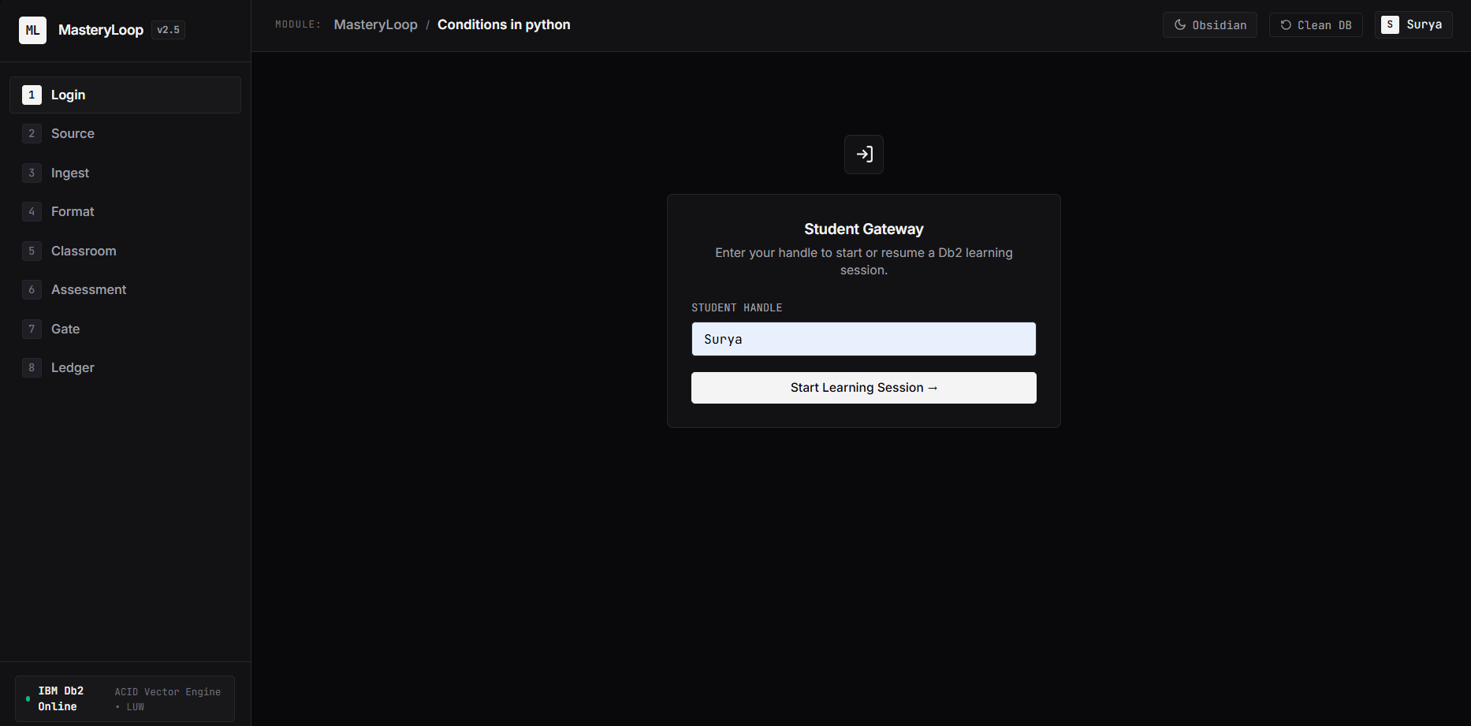
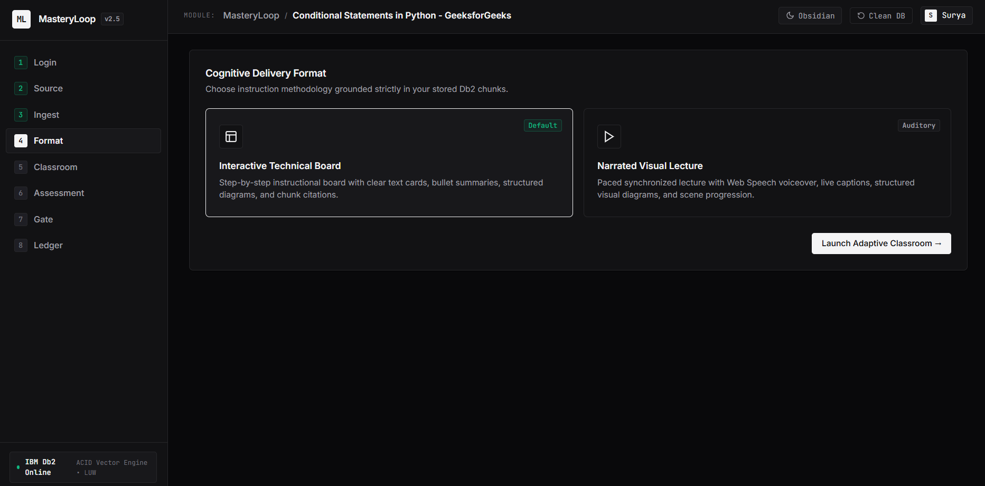
02 / SOLUTION OVERVIEW
03 / 10
The 8-Step Adaptive MasteryLoop Classroom
From open-internet discovery or personal notes to recursive Db2 remediation in one cohesive FastAPI SPA.
LIVE OBSIDIAN UI CAPTURE (STEPS 01 & 04)
01
02
03
04
Login
→
Source
→
Ingest
→
Format
Passwordless handle stored in DB2.STUDENTS
Open Web, URL/PDF, AI KB, or Upload
~120w chunks + batch embed into DB2.CHUNKS
Board Deck or 16:9 Narrated Visual Lecture
05
06
07
08
Classroom
→
Assess
→
Gate + CTE
→
Ledger
5-6 scenes citing exact Chunk IDs
5 non-repeating audited MCQs
80% rule + Recursive CTE diagnosis
Trajectory chart + Why-This SQL audit
CLOSED ADAPTIVE REMEDIATION LOOP (MAX 3 PASSES)
• Fail Gate → Diagnose Ancestor: Db2 Recursive CTE identifies weakest prerequisite (< 80% mastery).
• Style Shift on Reteach: Rotates overview -> worked example -> analogy -> step-by-step on unseen chunks.
MasteryLoop (mastree) | IBM Db2 TechX Summit 2026 | Suryakanth (@Suryakanth25)
FastAPI + Vanilla JS + IBM Db2 LUW
Notes:
Walk judges through the 8-step lifecycle shown on screen, noting the real Obsidian UI screenshots on the right: clean login without demo clutter and format choice between Technical Board and Narrated Visual Lecture.

Slide 4
03 / IBM DB2 INTEGRATION (30% WEIGHT)
04 / 10
Db2 LUW as the Transactional & Graph Brain
Deep native ibm_db engineering: 13 normalized tables, recursive CTE analytics, ACID updates, BLOB storage, and auditability.
Relational & RAG Schema Highlights (src/schema.sql)
SQL0345N-COMPLIANT RECURSIVE CTE
• 13 Core Tables + 12 Indexes: students, concepts, concept_prereqs, documents, chunks, lessons, questions, attempts, mastery, mastery_history, loop_events, llm_cache, lesson_images.
• Db2 Dialect Strictness: IDENTITY_VAL_LOCAL(), FETCH FIRST n ROWS ONLY, SYSCAT.TABLES / SYSCAT.COLUMNS idempotent migrations, and ? markers everywhere.
• Atomic ACID Transactions: record_attempt_and_update_mastery disables autocommit to insert attempt, upsert mastery, and append mastery_history atomically.
• SHA-256 Cache & BLOB Store: llm_cache stores prompts & batched embeddings; lesson_images persists BLOB(5M) lesson illustrations.
• Analytics View (v_student_progress): Cross-joins students x concepts with mastery to compute live is_mastered gate status across the cohort.
• Zero Seed Clutter Option: init_db.py initializes clean empty tables by default (--seed optional; --clean resets all 13 tables in 1 click).
WITH prereq_tree (concept_id, prereq_id, depth) AS (
SELECT cp.concept_id, cp.prereq_id, 1
FROM concept_prereqs cp WHERE cp.concept_id = ?
UNION ALL
SELECT pt.concept_id, cp2.prereq_id, pt.depth + 1
FROM prereq_tree pt, concept_prereqs cp2
WHERE pt.prereq_id = cp2.concept_id
)
SELECT c.concept_id, c.name,
MIN(pt.depth) AS min_depth,
COALESCE(m.mastery_score, 0.0) AS mastery_score
FROM prereq_tree pt
JOIN concepts c ON pt.prereq_id = c.concept_id
LEFT JOIN mastery m ON m.student_id=? AND m.concept_id=c.concept_id
GROUP BY c.concept_id, c.name, m.mastery_score
ORDER BY mastery_score ASC, min_depth DESC;
FULL EXPLAINABILITY: "WHY THIS?" AUDIT LOGGING
Every gate evaluation persists the exact SQL query and prerequisite rows inside DB2.LOOP_EVENTS (GET /api/why/{event_id}), so judges and educators can verify why Db2 chose a specific root-cause ancestor.
MasteryLoop (mastree) | IBM Db2 TechX Summit 2026 | Suryakanth (@Suryakanth25)
FastAPI + Vanilla JS + IBM Db2 LUW
Notes:
Emphasize that Db2 accounts for 30% of the rubric and here Db2 drives core intelligence: no 'RECURSIVE' keyword, comma-join in the recursive member for SQL0345N compliance, transactional atomicity, and SYSCAT migrations.

Slide 5
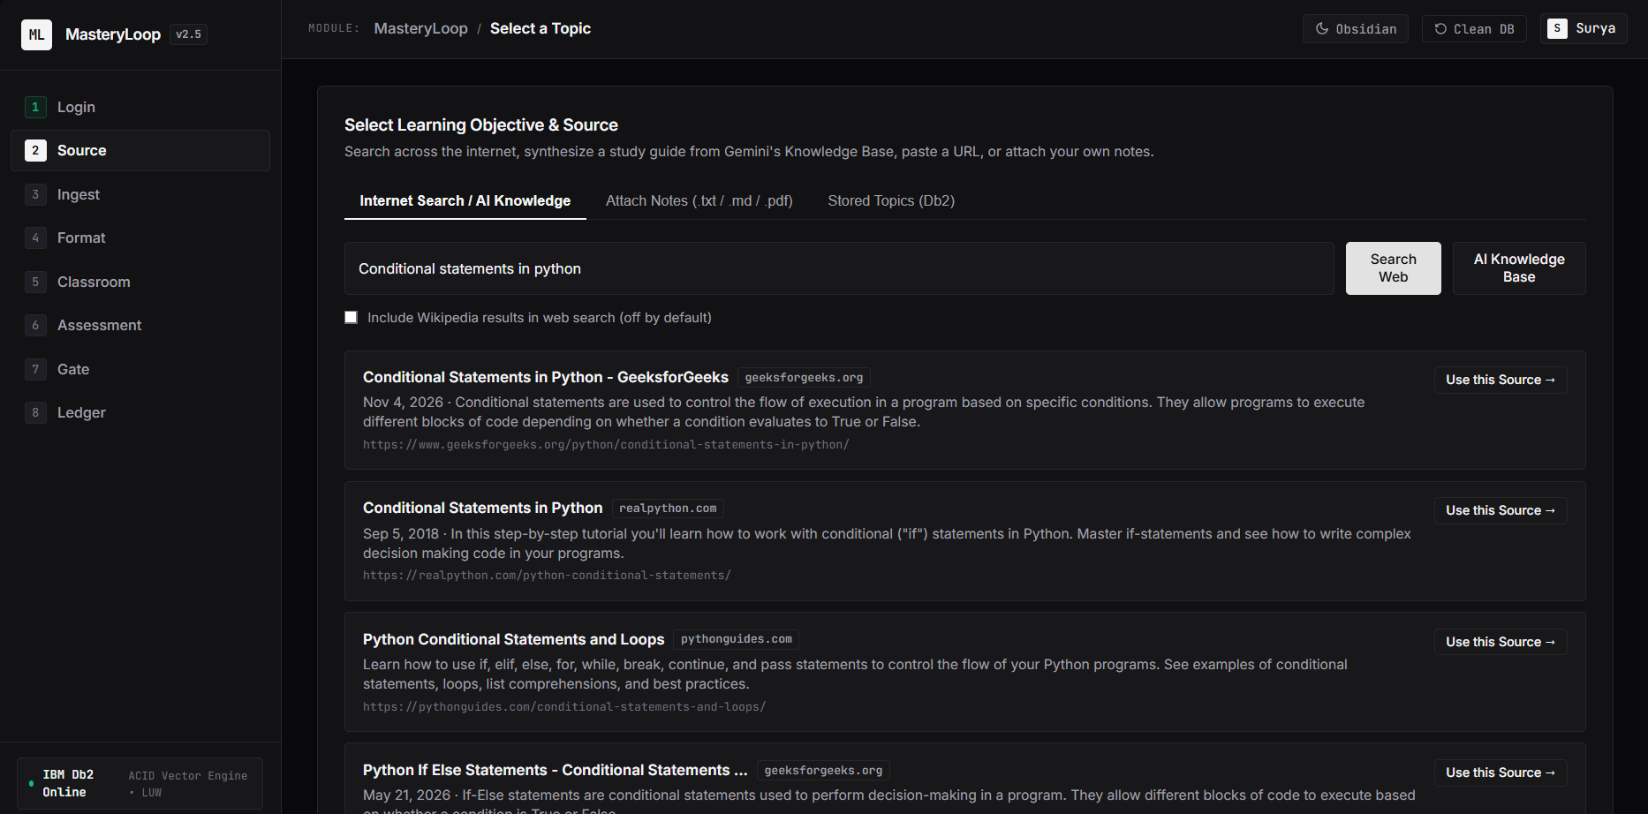
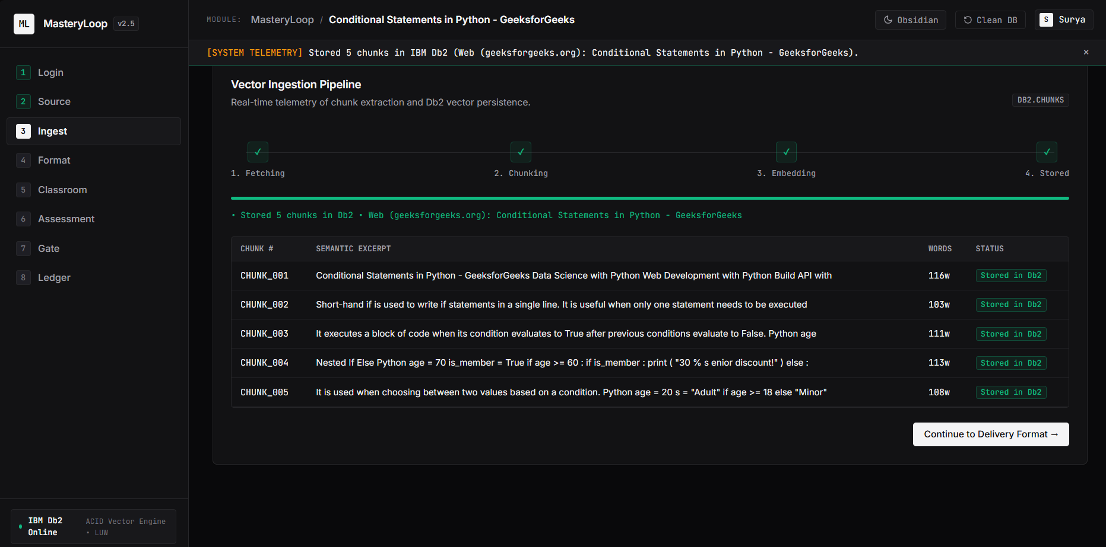
04 / AI & RAG ARCHITECTURE (20% WEIGHT)
05 / 10
Diverse Non-Wikipedia RAG & Resilient Gemini Failover
Custom zero-LangChain pipeline combining multi-provider internet search, pooled Db2 embeddings, and grounded generation.
Open Internet Search
Gemini AI Knowledge Base
Direct URL / PDF Import
Personal Notes & SQL Seed
src/web_search.py queries DuckDuckGo (ddgs), HN Algolia, StackExchange, OpenAlex—excluding Wikipedia unless toggled.
Synthesizes a 5-section study guide (800-1,100 words) when no external article or upload is provided.
Strips <nav>/<script> boilerplate via HTMLParser + pypdf with 10s timeouts and 3,000-word / 25-chunk caps.
Drag-and-drop .txt / .md / .pdf + prerequisite linking so custom topics participate in Recursive CTE tracing.
REAL INGESTION TELEMETRY (OPEN WEB -> DB2.CHUNKS)
Production Reliability Upgrades (src/ai.py)
• Model Failover Chain: Starts on gemini-3.5-flash-lite with automatic failover across 3.5-flash, 3.6-flash, and 3.8-flash on 404/503/504/timeout (25s HttpOptions).
• Pooled Batch Embeddings: 1 batch API call per ingestion (gemini-embedding-001) reusing ONE Db2 connection for cache lookup/write, plus BM25 fallback.
• Strict Schema Grounding: 1 Gemini call synthesizes 5-6 scenes across 8 safe visual schemas (flow, cycle, compare, hierarchy, timeline, concept_map, equation, bullets) citing chunk IDs.
• Offline Resilience: DEMO_MODE=1 + SHA-256 llm_cache + topic-agnostic fallbacks guarantee demo continuity even under rate limits.
MasteryLoop (mastree) | IBM Db2 TechX Summit 2026 | Suryakanth (@Suryakanth25)
FastAPI + Vanilla JS + IBM Db2 LUW
Notes:
Highlight two major engineering decisions: first, we do NOT use LangChain—every retriever, chunker, and validator is transparent Python on ibm_db and google-genai. Second, notice the real GeeksforGeeks search and live 5-chunk DB2 persistence screenshots.

Slide 6
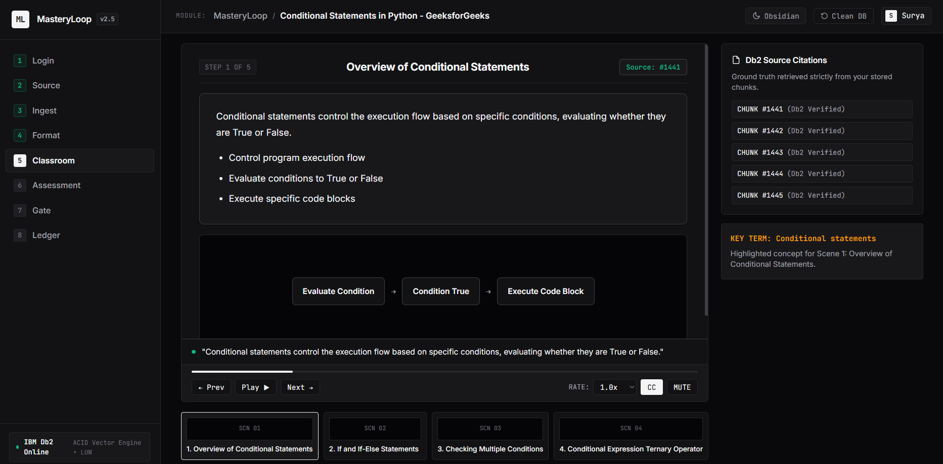
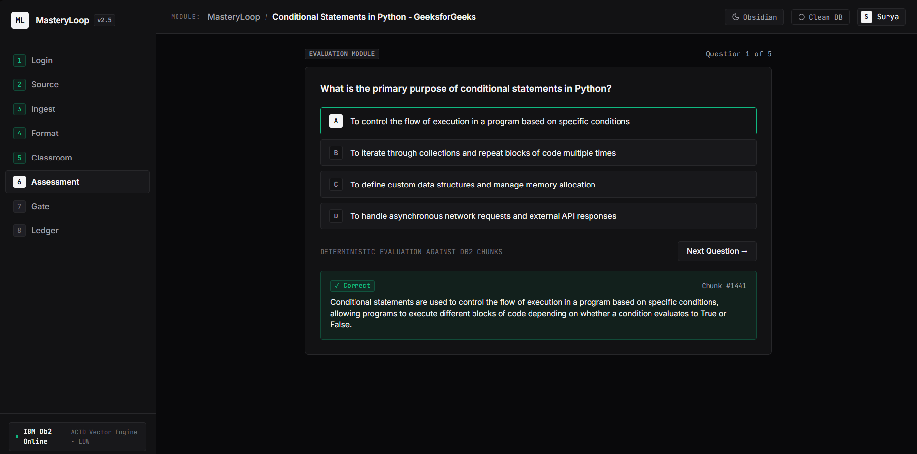
05 / TEACHING & VERIFIED ASSESSMENT
06 / 10
Grounded Classroom + Non-Repeating 2-Pass MCQs
Eliminates repeated questions and canned distractors by rotating untested chunks and auditing answer keys.
GROUNDED CLASSROOM (SCREEN 5)
2-PASS AUDITED QUIZ (SCREEN 6)
• Board & Video Modes: Interactive high-contrast Technical Board or 16:9 Narrated Visual Lecture (Web Speech API, 0.75x-1.5x, CC/Mute).
• Chunk-Level Grounding: Every scene (<=45 narration words) cites exact chunk IDs and rotates teaching styles across remediation loops.
• Unseen-Chunk Rotation: /api/quiz/generate selects untested chunks first across loops and excludes prior stems to stop repetition.
• Strict Verification & Instant Grade: 1-call batch audit verifies keys against chunk text; /api/quiz/answer grades deterministically with chunk feedback.
MasteryLoop (mastree) | IBM Db2 TechX Summit 2026 | Suryakanth (@Suryakanth25)
FastAPI + Vanilla JS + IBM Db2 LUW
Notes:
Show judges the actual screenshots from the app: clean high-contrast Board cards with flow diagrams on the left, and chunk-cited MCQs with diverse distractors and deterministic instant feedback on the right.

Slide 7
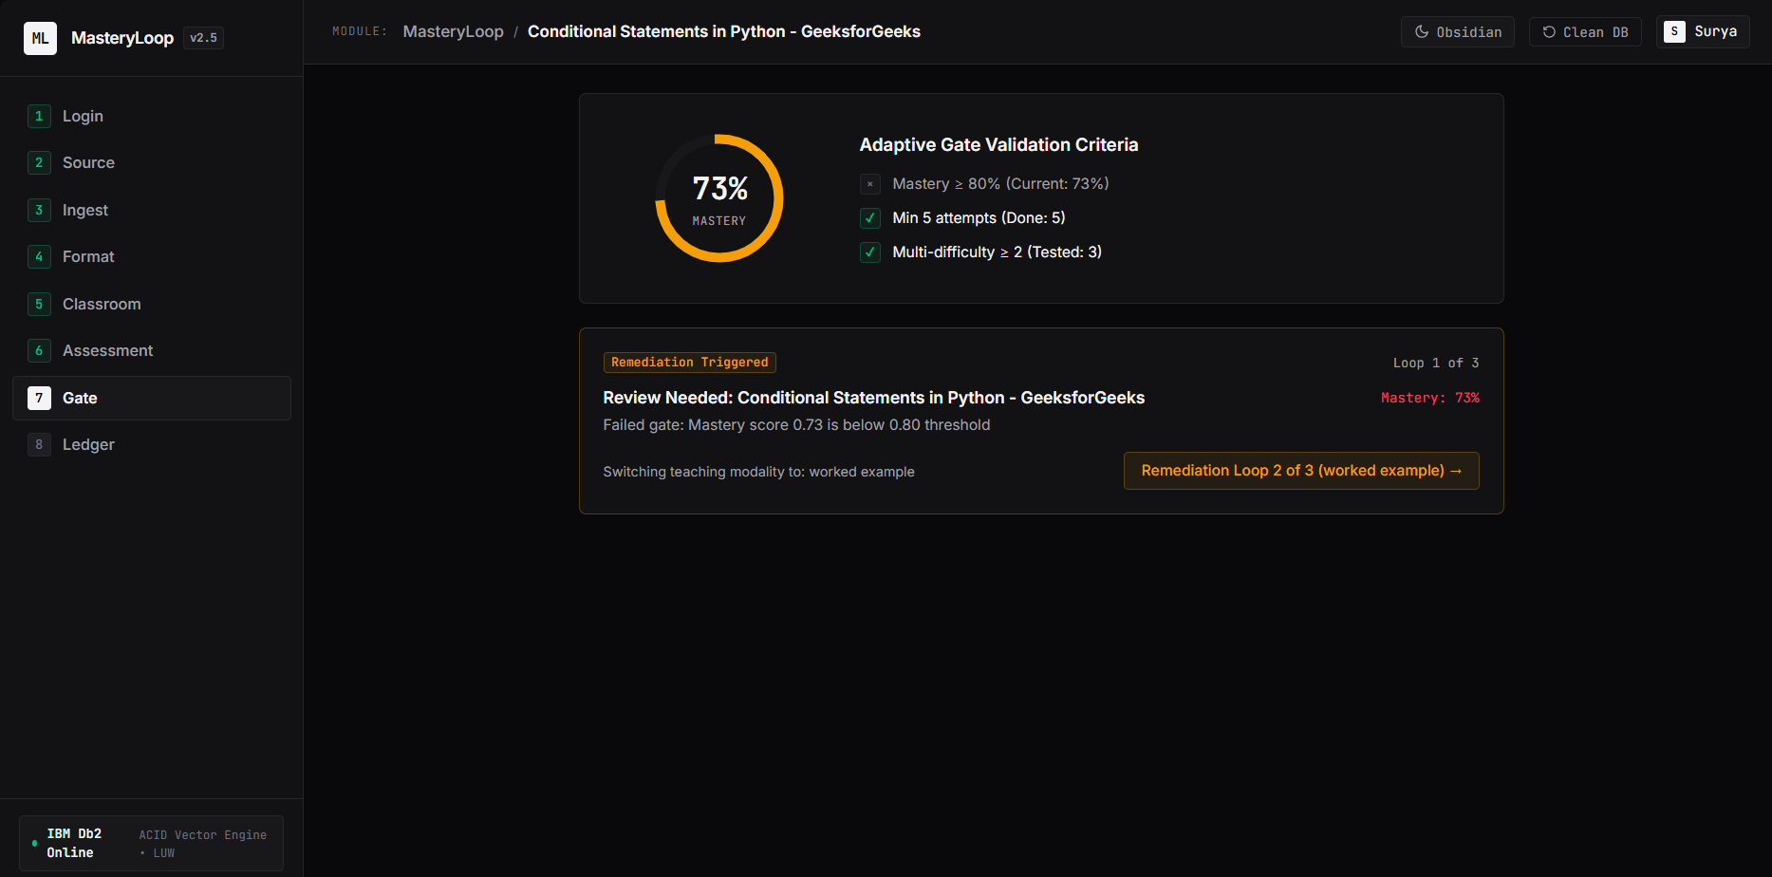
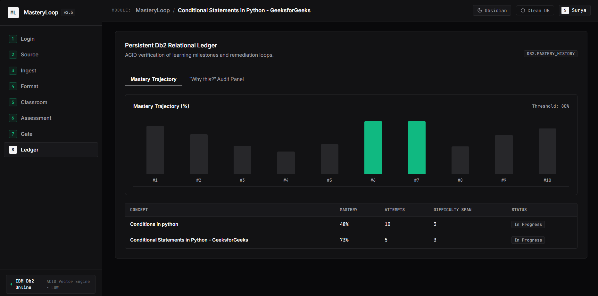
06 / MASTERY GATE & ANALYTICS
07 / 10
Deterministic Gating & Persistent Db2 Audit Ledger
Weighted recency scoring + multi-factor gate + SQL VIEW analytics make every learning decision inspectable.
DETERMINISTIC SCORING FORMULA & GATE RULE
Mastery = Sum(correct_i * w_diff * 0.85^age_i) / Sum(w_diff * 0.85^age_i) | Gate Pass = Mastery >= 0.80 AND Attempts >= 5 AND Difficulties >= 2
Screen 7: Gate Evaluation & Remediation Trigger
Screen 8: Relational Ledger (v_student_progress)
Below 80%: auto-triggers Loop 2 in 'worked example' style targeting fresh chunks; escalates to 'Needs Human Help' after 3 loops.
Queries DB2.MASTERY_HISTORY and VIEW v_student_progress for live progress charts plus a 'Why this?' SQL tab.
MasteryLoop (mastree) | IBM Db2 TechX Summit 2026 | Suryakanth (@Suryakanth25)
FastAPI + Vanilla JS + IBM Db2 LUW
Notes:
Point to the actual 73% Gate remediation capture on the left and the Mastery Trajectory + v_student_progress matrix on the right. Every attempt and loop event is an immutable record in IBM Db2.

Slide 8
07 / ENGINEERING & REPRODUCIBILITY (15% WEIGHT)
08 / 10
Tested, Secure & Reproducible Out of the Box
Clean separation of API, Db2 logic, and AI orchestration with automated tests and zero committed secrets.
38 / 38 AUTOMATED TESTS
14 DOCUMENTED REST ENDPOINTS
• Unit Verification: Mastery formula decay/weighting, gate boundaries, sentence chunking, visual JSON schema bounds, fallback quiz diversity.
• Live Db2 & API Integration: Db2 server check, Recursive CTE execution, transactional mastery/history, v_student_progress, and E2E TestClient workflow.
• FastAPI + OpenAPI (/docs): Structured Pydantic validation, uniform {error, detail} JSON responses, and background INGESTION_JOBS polling.
• Zero-Framework Vanilla SPA: Served directly at / via StaticFiles—no npm build step needed to run locally.
CLEAN-WORKSPACE REPRODUCIBILITY
SECURITY & SUBMISSION HYGIENE
• Idempotent Setup: python src/init_db.py initializes clean tables cleanly (--seed for optional SQL graph; --clean to wipe all 13 tables).
• Cross-Platform Config: Verified on Python 3.12 + IBM Db2 LUW 12.1; .env.example uses dummy placeholders only.
• SQL Injection Immunity: Every Db2 query uses parameterized ? markers via ibm_db.prepare / execute.
• Secrets & Scope Isolation: .env ignored by .gitignore; all work isolated strictly inside submissions/mastree/ under MIT License.
MasteryLoop (mastree) | IBM Db2 TechX Summit 2026 | Suryakanth (@Suryakanth25)
FastAPI + Vanilla JS + IBM Db2 LUW
Notes:
Slide 8 addresses the 15% Reproducibility & Code Quality criteria directly: 38 passing pytest tests, FastAPI /docs, zero npm build overhead, clean init_db.py lifecycle, and strict secrets hygiene.

Slide 9
08 / EVOLUTION & ROADMAP
09 / 10
Hard-Won Engineering Fixes & Future Roadmap
How real debugging against IBM Db2 LUW and live LLM APIs hardened MasteryLoop.
Key Challenges Diagnosed & Solved
Post-Hackathon Roadmap
• Db2 Dialect Constraints: Eliminated RECURSIVE keyword and used comma-join syntax inside the recursive CTE to satisfy Db2 SQL0345N.
• Connection Latency Optimization: Replaced ~75 sequential Db2 connects in batch_embed_texts with a single shared connection/transaction.
• Silent Gemini 404 Failover: Diagnosed retired 2.5-flash failures falling into static fallbacks; upgraded to gemini-3.5-flash-lite failover + distinct fallback distractors.
• Async Ingestion UX: Moved chunking/embedding into background threads with polling + structured progress previews so UI never freezes.
• Native Db2 VECTOR Similarity: Upgrade embedding column from CLOB cosine scoring to native Db2 v12.1.2+ VECTOR(n, FLOAT32) & VECTOR_DISTANCE.
• Cinematic Studio Audio & Video: Pair scenes JSON with neural TTS (edge-tts / Kokoro) word timestamps + Remotion/FFmpeg MP4 export for shareable explainers.
• Live Sandboxed Db2 SQL Lab: Let learners execute real SQL queries against ephemeral read-only Db2 schemas inside the Technical Board.
• Instructor Cohort Dashboards: Aggregate v_student_progress and loop_events across classrooms using Db2 OLAP window functions.
MasteryLoop (mastree) | IBM Db2 TechX Summit 2026 | Suryakanth (@Suryakanth25)
FastAPI + Vanilla JS + IBM Db2 LUW
Notes:
Judges appreciate concrete engineering battle scars: solving Db2 SQL0345N, pooling Db2 cache connections, diagnosing silent LLM fallback failures, and having a clear path to native Db2 VECTOR datatypes and exported video explainers.

Slide 10
READY FOR LIVE DEMO & REVIEW
Inspectable Db2 Analytics.
Verified Conceptual Mastery.
REPRODUCE LOCALLY IN 3 STEPS
cd submissions/mastree
pip install -r requirements.txt && python src/init_db.py
cd src && uvicorn api:app --port 8000 # App: http://localhost:8000 | Docs: /docs
pytest tests/ -v # 38/38 tests passing against IBM Db2 LUW
Thank You! Questions & Live Walkthrough
Suryakanth (@Suryakanth25) • Inspired by DeepTutor (HKUDS/DeepTutor, Apache-2.0; all code written from scratch) • MIT License
Notes:
Close cleanly with reproducible quick-start commands and offer to show the live running app on localhost:8000 and the Db2 Recursive CTE in the 'Why this?' panel.

