Slide 1
BLUESTOCK FINTECH
Mutual Fund Analytics — Capstone Project
Final Presentation
40
51K+
32K+
10
7
Schemes Analysed
NAV Data Points
Transactions
Raw Datasets
Analysis Days
Prepared by: Kunal Gupta | July 2026
Internship @ Bluestock Fintech | AI/ML Data Analytics Track

Slide 2
Problem Statement & Objectives
Why this project matters
Key Problems
Project Objectives
▸ Data Fragmentation: NAV, AUM, SIP data scattered across sources
▸ No unified performance comparison across 40+ schemes
▸ Missing benchmark tracking (Nifty 50/100/BSE SmallCap)
▸ Investor behavior blindspot (32K+ transactions unexplored)
▸ Static reporting — no interactive dashboards for stakeholders
▸ Build end-to-end ETL pipeline with SQLite star schema
▸ Compute risk-adjusted metrics (Sharpe, Sortino, Alpha, VaR)
▸ Generate 15+ EDA visualizations with business insights
▸ Create 4-page interactive Power BI dashboard
▸ Implement rule-based fund recommendation engine

Slide 3
Data Sources & Datasets
10 structured CSV datasets | AMFI India + mfapi.in
01 Fund Master
06 Folio Count
40 schemes, AMC, category, plan type
Industry folio growth (24 months)
02 NAV History
07 Scheme Performance
51,400+ daily NAV records (2020-2025)
Sharpe, Sortino, Alpha, Beta, VaR
03 AUM by Fund House
08 Investor Transactions
140 AMCs × monthly AUM data
32,780 SIP/redemption records
04 Monthly SIP Inflows
09 Portfolio Holdings
60 months of industry SIP data
323 stock-level equity holdings
05 Category Inflows
10 Benchmark Indices
Inflow by fund category per month
NIFTY 50/100/SENSEX daily OHLCV
Sources: AMFI India · mfapi.in REST API · NSE/BSE public data | Total: ~5.5 MB

Slide 4
System Architecture & ETL Pipeline
Extract → Transform → Load → Analyze → Visualize
EXTRACT
TRANSFORM
LOAD
ANALYZE
VISUALIZE
mfapi.in REST + 10 CSVs
Pandas clean FFill + Dedup
SQLite DB Star Schema
Metrics + EDA + Risk
Power BI + Reports
Star Schema Database (8 Tables)
dim_fund
dim_date
fact_nav
fact_aum
fact_sip
fact_transactions
fact_performance
fact_portfolio

Slide 5
EDA Highlights
15 visualizations | 10 business insights
01.
SIP inflows grew 3x: ₹11K Cr (Jan'23) to ₹31K Cr (Dec'25)
06.
Pharma & Banking sectors dominate equity fund holdings
02.
T30 cities = 67% volume | B30 growing faster at +18% YoY
07.
Redemptions spike in Jan/Apr (tax planning) and Oct (corrections)
03.
36-45 age group = highest SIP investors (32% of volume)
08.
UPI is now the dominant payment mode at 42% of transactions
04.
Female investors show higher SIP continuity despite lower avg amount
09.
Folio count grew 18% YoY — reflecting market participation surge
05.
Large Cap NAV correlation > 0.92 | Small Cap more idiosyncratic
10.
December is consistently the highest SIP inflow month

Slide 6
Fund Performance Analytics
Composite scorecard | Risk-adjusted returns
24.6%
0.94
1.0%
94.8
5
40
Top 3yr CAGR (Small Cap)
Best Sharpe (SBI Small Cap)
Avg Expense Direct Plans
Top Composite Score
Metrics in Scorecard
Funds Ranked
Composite Score = 30% CAGR + 25% Sharpe + 20% Alpha + 15% Expense(inv) + 10% MaxDD(inv)
▸ SBI Small Cap Direct is the #1 ranked fund (Composite Score: 94.8)
▸ All top-10 funds by Sharpe Ratio are either Small Cap or Flexi Cap
▸ Direct plans outperform Regular plans by 0.6-0.9% annually (expense drag)
▸ Max Drawdown range: -10% (Low Risk) to -25% (Very High Risk)
▸ Alpha > 1% for 18 out of 40 funds — indicating active management value

Slide 7
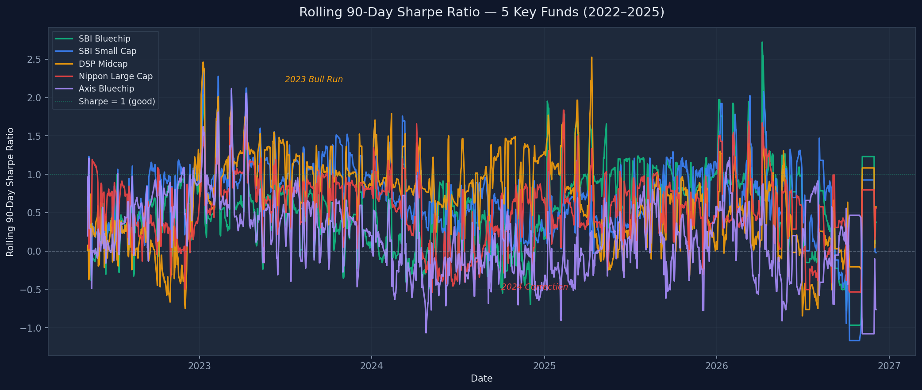
Advanced Risk Metrics
VaR, CVaR, Rolling Sharpe, HHI Concentration
Key Risk Findings
▸ VaR 95%: Small Cap = -1.8% to -2.2% daily
▸ VaR 95%: Large Cap = -0.9% to -1.1% daily
▸ CVaR shows 40% worse loss on the worst 5% of days
▸ Rolling Sharpe peaked at 2.5+ in mid-2023 bull run
▸ 38.2% of SIP investors are 'at-risk' (gap > 35 days)
▸ HHI: Concentration does NOT predict higher returns
▸ Most diversified fund: Nippon India Large Cap (HHI=0.08)

Slide 8
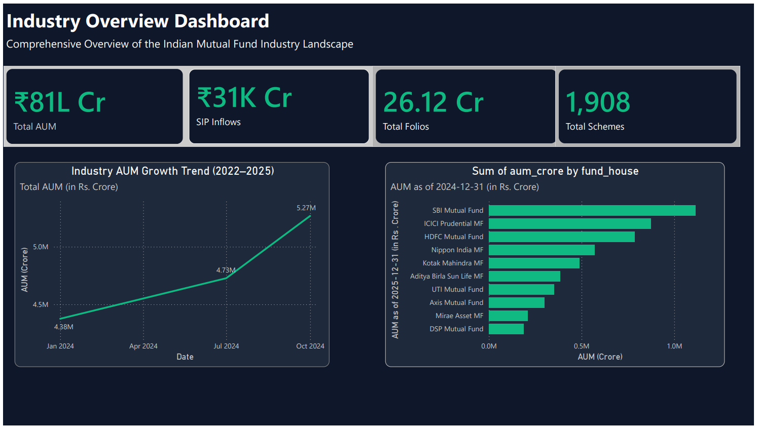
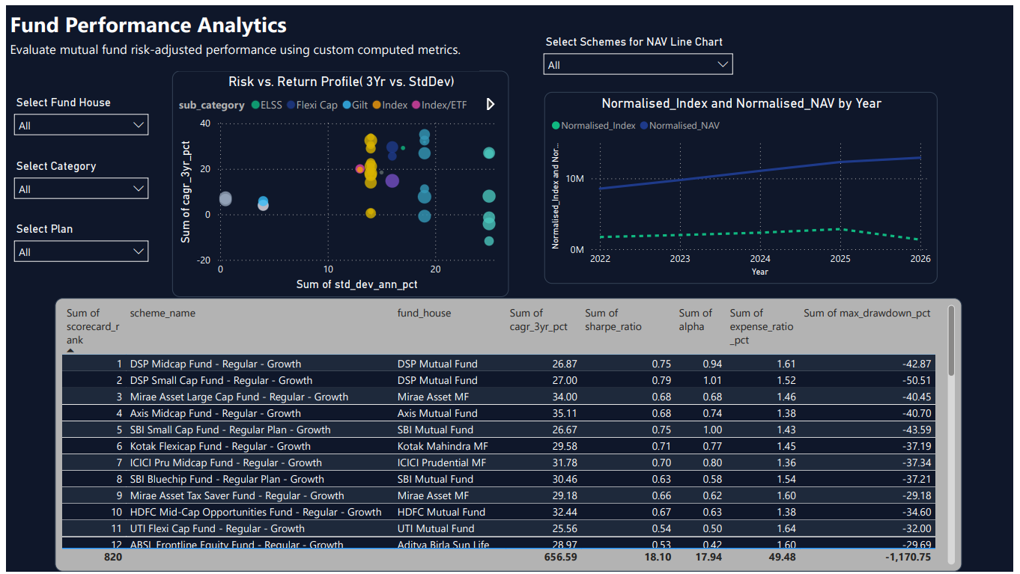
Power BI Dashboard — Market & Performance
Pages 1-2: Industry overview, AUM trends, fund scorecard
Page 1: AUM trend, Top AMCs, SIP inflow, Folio growth
Page 2: Risk-return scatter, NAV trends, Performance table
Technology: Power BI Desktop | DAX Measures | Star Schema | Slicers + Drill-through

Slide 9
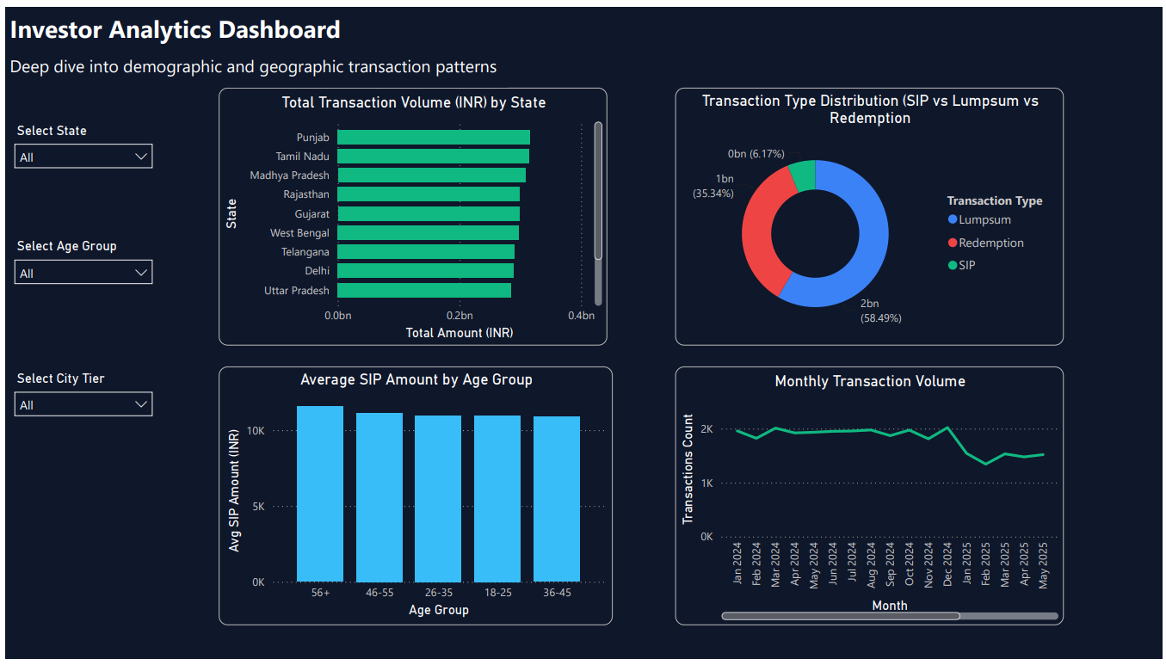
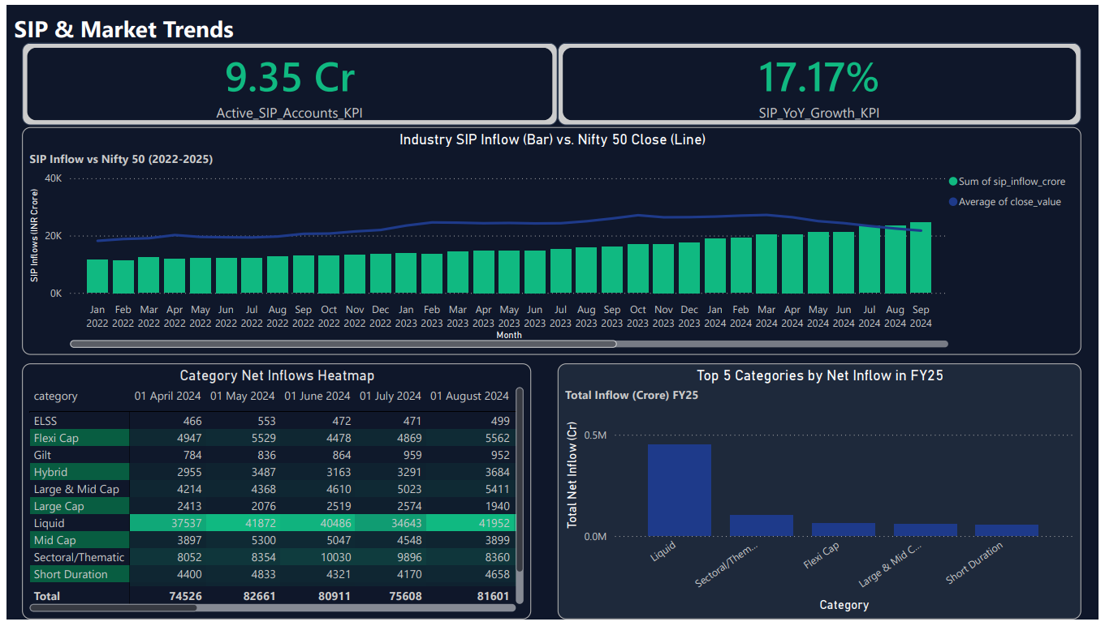
Power BI Dashboard — Investor & Benchmark
Pages 3-4: Demographics, geographic heatmap, benchmark comparison
Page 3: Age/Gender splits, Geo heatmap, City tier analysis
Page 4: NAV vs Index, Category flows, Sector HHI
Consistent fintech blue/purple theme | Slicers on every page | Interactive tooltips

Slide 10
Fund Recommender & Cohort Analysis
Rule-based engine + investor behavior insights
Recommendation Engine
Investor Cohort Insights
▸ Maps risk appetite → compatible fund risk grades
▸ Ranks candidates by Sharpe Ratio (top-3)
▸ Low: Low risk → Bond/Debt funds
▸ Moderate: Moderate + Moderately High → Flexi/Large Cap
▸ High: High + Very High → Small Cap/Mid Cap
▸ CLI: python scripts/recommender.py --risk Moderate
▸ 2022 cohort: Highest avg SIP at ₹8,200+/month
▸ 38.2% of 6+ SIP investors are 'at-risk' (gap >35 days)
▸ Under-30 investors: Fastest growing segment (+28% YoY)
▸ Tier-2 cities: Lower churn (32%) vs Tier-1 (40%)
▸ Jan/Apr: Peak discontinuation months (tax season effect)
▸ HHI analysis: Concentration ≠ better returns

Slide 11
Strategic Recommendations
Data-driven insights for AMCs, distributors & investors
For Investors
For Fund Managers
For Bluestock Fintech
▸ SIP investors in 2022 cohort benefited most — stay invested through cycles
▸ Small Cap: High returns (24% CAGR) but requires 3+ year horizon
▸ Prefer Direct Plans: Save 0.7-1.0% annually over Regular Plans
▸ SIP retention: 38% at-risk investors need proactive outreach
▸ Expense ratio reduction in Regular plans improves competitiveness
▸ Diversified portfolios (low HHI) delivered comparable risk-adjusted returns
▸ Productionize recommender as a REST API endpoint
▸ Rolling Sharpe monitoring for fund-of-funds rebalancing
▸ Cohort analysis powers personalized investor communication

Slide 12
Thank You
Bluestock Fintech | Mutual Fund Analytics Capstone
✓
10 raw datasets → cleaned, modelled, and loaded into SQLite star schema
✓
15 EDA visualizations with 10 actionable business insights
✓
40 funds scored on 5 performance dimensions (CAGR, Sharpe, Alpha, Expense, MaxDD)
✓
4-page interactive Power BI dashboard with DAX-driven KPI cards
✓
Advanced risk analytics: VaR, CVaR, Rolling Sharpe, HHI, Cohort, SIP Continuity
✓
Rule-based fund recommendation engine with CLI interface
✓
Comprehensive 15–20 page final report + this 12-slide presentation
Kunal Gupta | Internship @ Bluestock Fintech | July 2026

