Slide 1
SEASONAL AGRICULTURE
PERFORMANCE ANALYSIS
Major Project | VOIS AICTE Batch 1 2026–2027
Student Name: Kunal Joon
College Name: Sushant Univertrsity
AICTE STU ID: STU6a05644eb11611778738254
Data Analytics Project

Slide 2
Problem Statement
• Agricultural performance varies with seasonal environmental conditions, farming practices, resource availability and market conditions.
• Raw agricultural data does not clearly explain how performance changes across seasons.
• This project analyzes seasonal differences, trends, relationships and variations in agricultural performance.
• The findings are intended to support evidence-based agricultural planning.

Slide 3
Project Description
• The dataset contains 4,000 agricultural records and 28 variables.
• It covers 3 seasons, 8 crop categories and 8 states.
• The workflow includes data cleaning, exploratory analysis, seasonal comparison, statistical testing and visualization.
• Performance is evaluated using yield, production, revenue, cost, profit, water usage and pest/disease risk.
• A Random Forest model can additionally be used to identify variables associated with crop yield.

Slide 4
Who Are the End Users?
• Farmers — compare seasonal performance and resource requirements.
• Agricultural planners — support evidence-based seasonal planning.
• Agribusinesses — understand crop profitability and market outcomes.
• Agricultural analysts — identify trends, relationships and unusual patterns.
• Researchers and students — perform data-driven agricultural studies.

Slide 5
Technology Used
• Python — core programming and analysis
• Pandas & NumPy — data cleaning and numerical analysis
• Matplotlib & Seaborn — data visualization
• SciPy — statistical analysis and ANOVA
• Scikit-learn — Random Forest regression
• Jupyter Notebook — project documentation and reproducible analysis

Slide 6
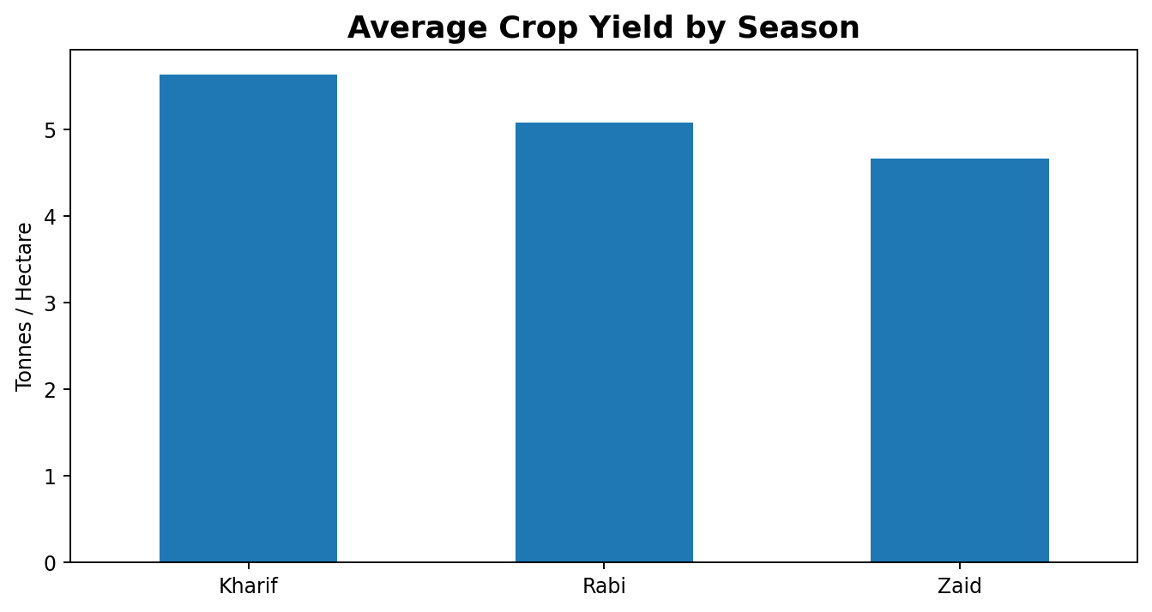
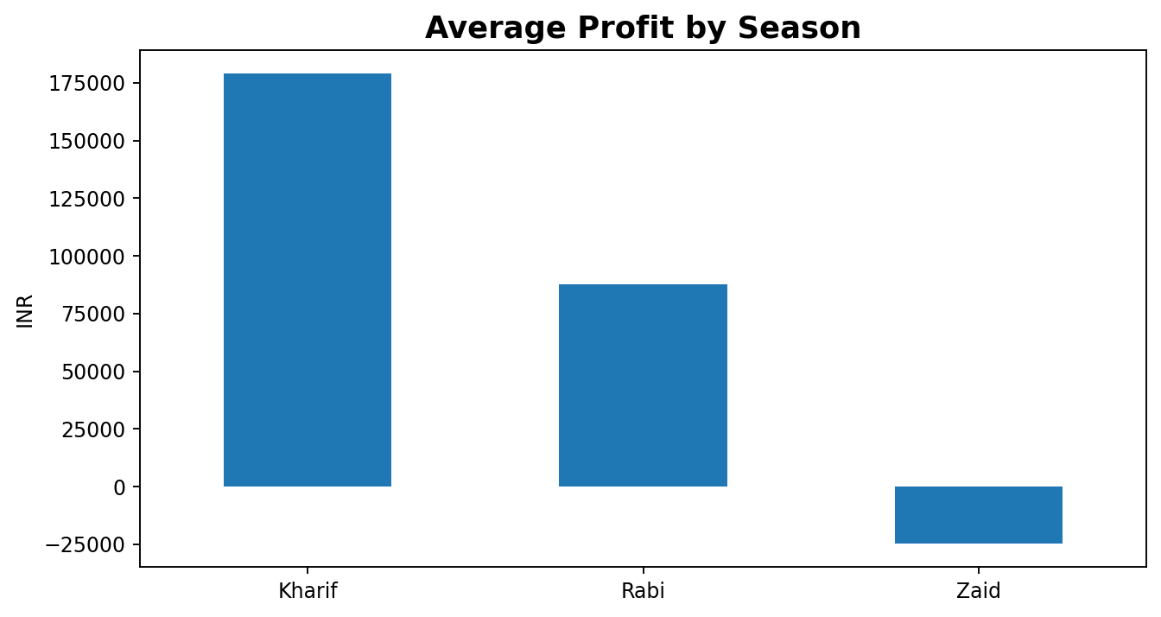
Results — Seasonal Performance
Highest average yield: Kharif — 5.64 t/ha
Highest average profit: Kharif — ₹178,915

Slide 7
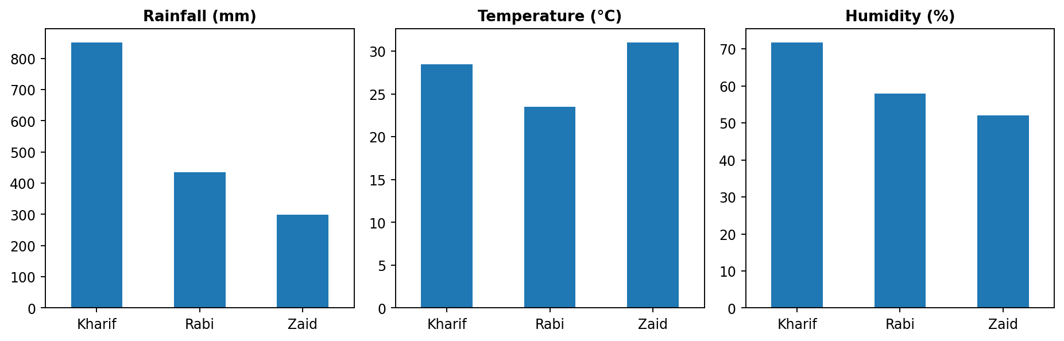
Results — Environmental Conditions
Seasonal differences in rainfall, temperature and humidity provide context for changes in crop performance and agricultural risk.

Slide 8
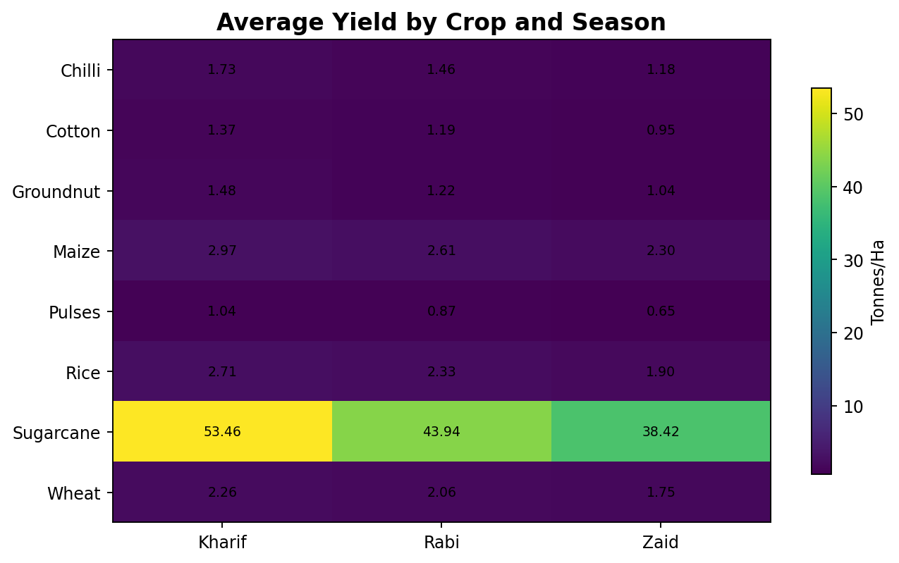
Results — Crop & Season Comparison
• Highest average-yield crop: Sugarcane (46.94 t/ha).
• Crop performance changes across seasons.
• The crop-season comparison identifies stronger and weaker combinations.
• These patterns can support more targeted crop and seasonal planning.

Slide 9
Results — Water Efficiency & Pest Risk
• Best average water efficiency: Kharif (5.89 t per 1000 m³).
• Highest average disease/pest risk: Kharif (54.47%).
• Highest average water use occurs in Zaid (6,420 m³).
• Water efficiency and pest risk should be evaluated together with yield and profitability.

Slide 10
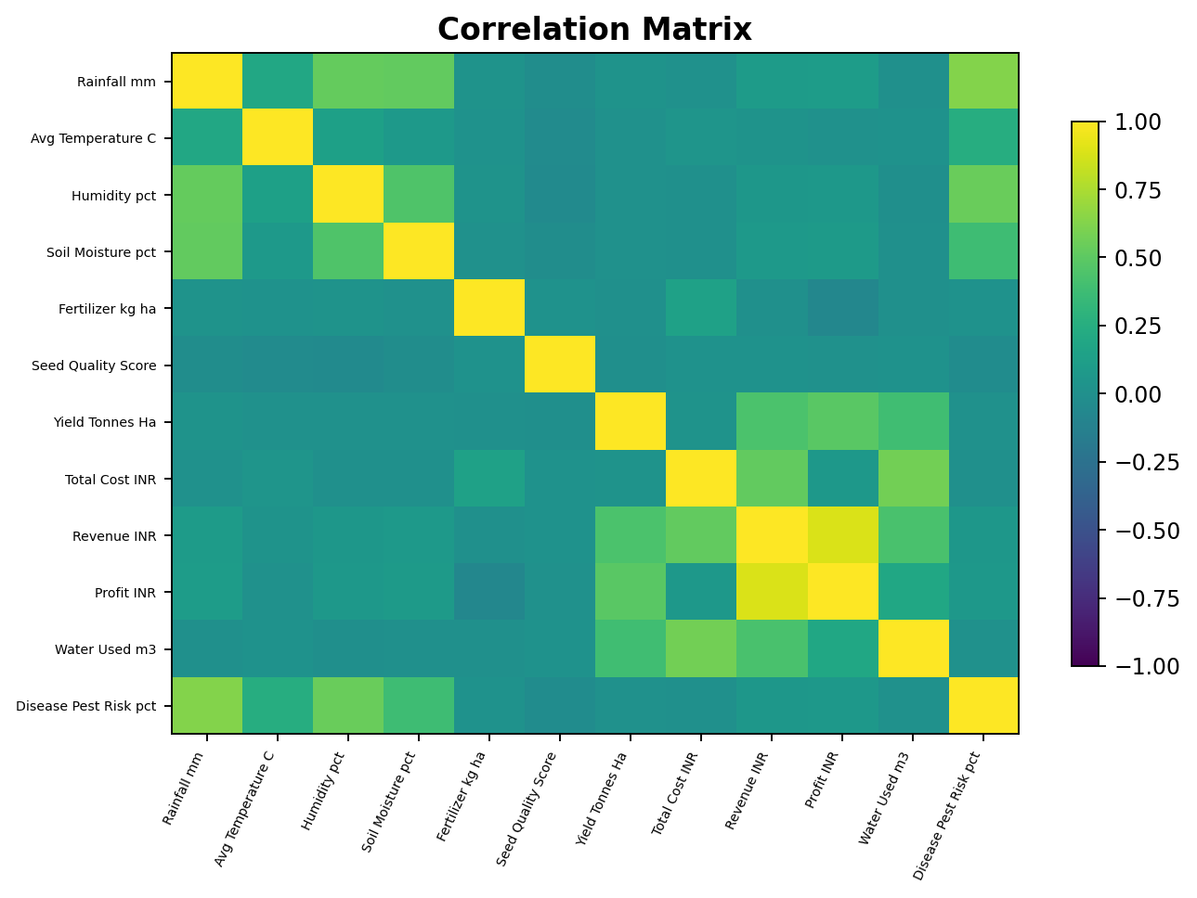
Results — Relationships & Statistical Analysis
• Yield ANOVA p-value: nan.
• A p-value below 0.05 indicates statistically significant differences in mean yield between seasons.
• Profit ANOVA p-value: 1.712e-15.
• Correlation shows association between variables; it does not by itself prove causation.

Slide 11
Future Scope
• Build an interactive dashboard for seasonal and regional monitoring.
• Add multi-year historical data for long-term trend analysis.
• Integrate live weather and market-price information.
• Develop crop-specific recommendation systems.
• Use advanced machine learning for yield, profit and pest-risk prediction.
• Add GIS maps for state- and district-level agricultural planning.

Slide 12
GitHub Link
Project Repository
https://github.com/KunalJoon/Seasonal_Agriculture_Performance_Analysis
Repository should contain:
• Jupyter Notebook
• Dataset / data source information
• README with project description
• Results and visualizations

Slide 13

VOIS Course Completion Certificate
Course name: Data Visualization

Slide 14
THANK YOU
Seasonal Agriculture Performance Analysis
Questions & Discussion

