Slide 1

"Market Street Wine: A Comprehensive Case Study.“
“An Exploration of Trends, Challenges, and Strategic Opportunities."
"R was employed for the initial data cleaning, streamlining the preparation phase for analysis."
Prepared By: Group B
Deepika Rohra(XA24005)
Kunal Kaushal(XA24007)
Diwakar Sharma(XA24006)
Mayank Rathod(XA24008)

Slide 2
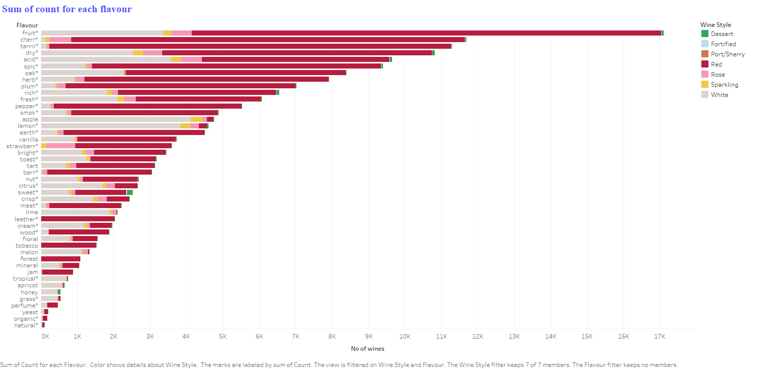
To begin the analysis, we used flavors as our primary focus and starting point
SR.NO | TOP FLAVOUR | Count | AVG PRICE | TOP WINE STYLE
1 | Fruit | 17101 | 45.16 | Red
2 | cherry | 11681 | 49.96 | White
3 | tanni | 11295 | 53.29 | Rose
“Here, the flavors present in the highest number of wines could be a deciding factor. We have identified the wine styles in which these flavors are found. The recommended wine styles are: Red, White, and Rosé.”

Slide 3
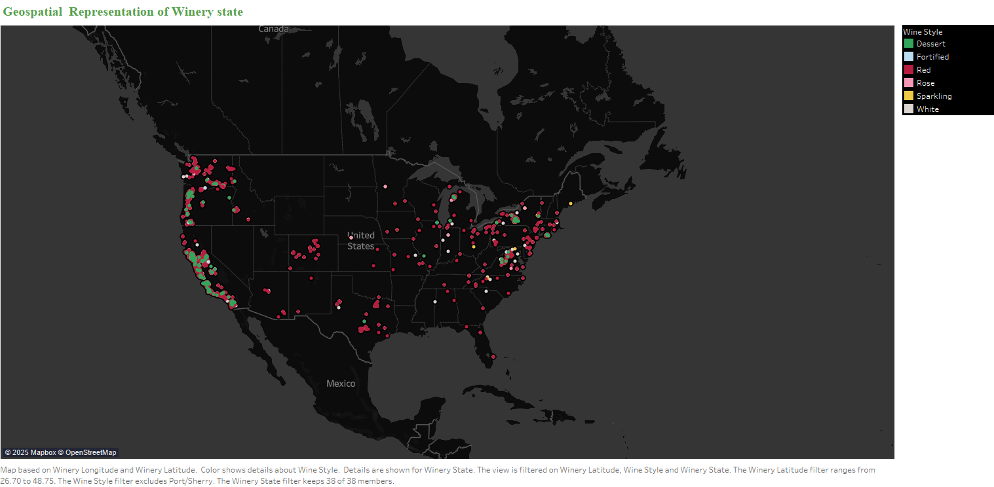
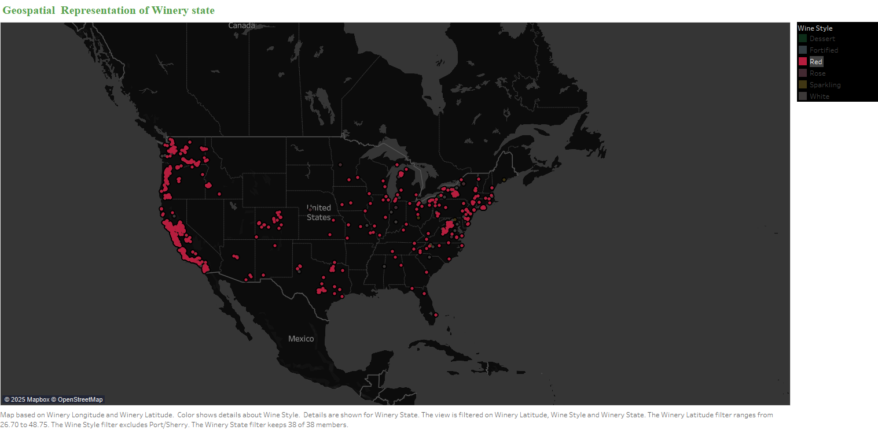
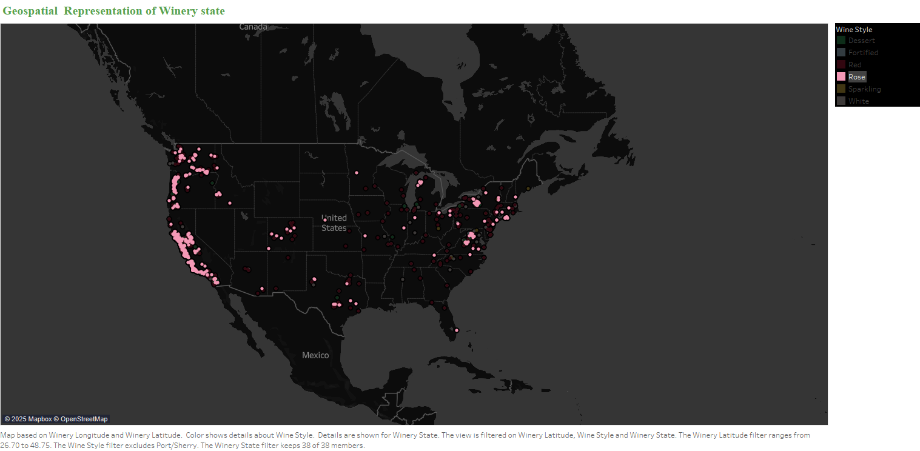
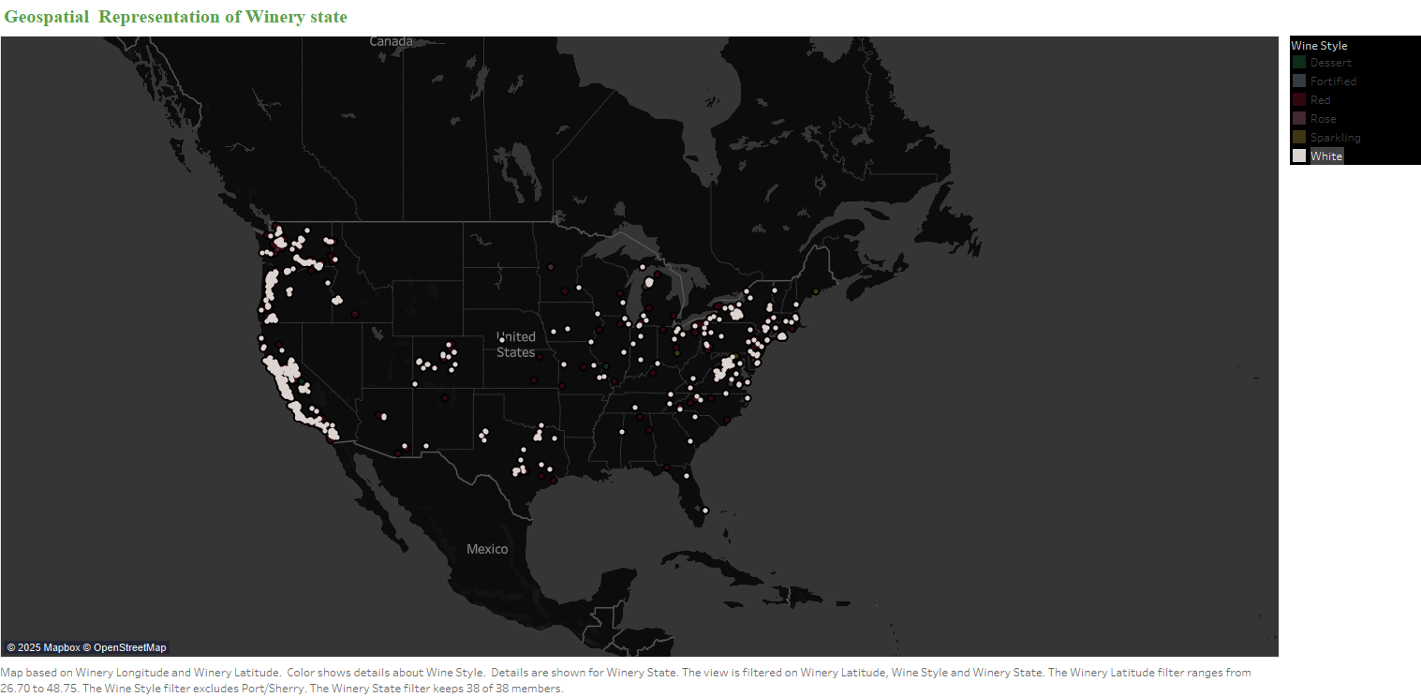
Q2-Were there wine producing regions more easily available in United States that wine drinkers might be interested in?---"YES"
The graphs show that a high number of wineries producing Rosé, Red, and White wines are in the western and north-eastern regions of the U.S., making them easily accessible.

Slide 4
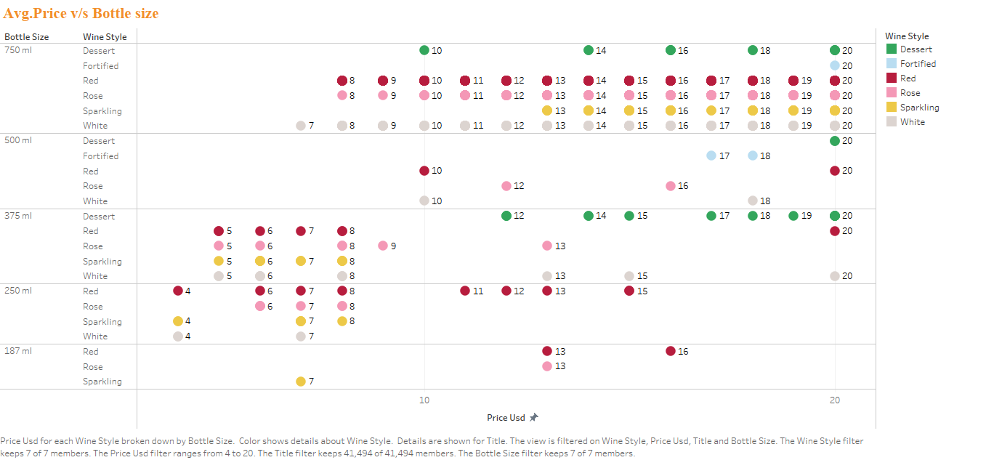
Q3 -Could Richard find good ones that hit popular price point of under $20?---”YES”
Graph: Average Price vs. Bottle Size and Wine Style (Price Filter: Up to $20)
Red, Rosé, and White wines offer the most options across multiple categories.
Among bottle sizes, 750 ml is the most recommended as it covers all wine styles and offers the lowest unit price, making it the most cost-effective choice.
For the 750 ml size, White wine is available across the widest price range, while Red and Rosé wines fall within slightly narrower price ranges.

Slide 5
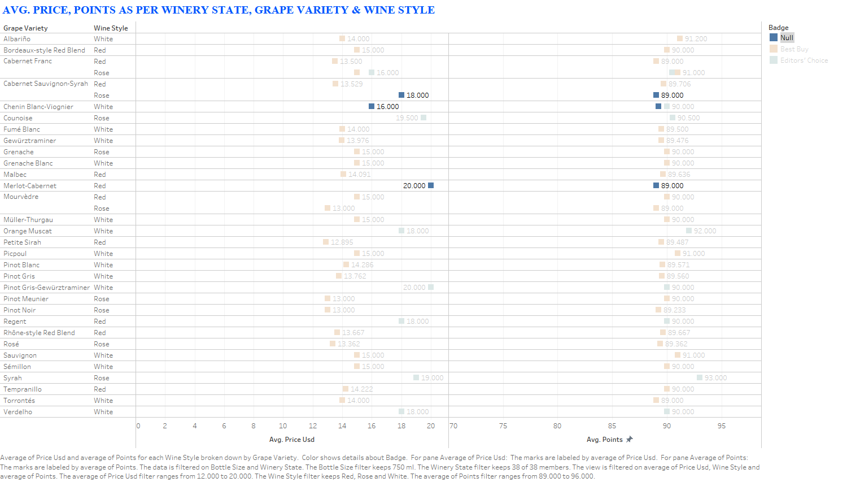
With classic wines such as the traditional French and Italian labels being more difficult to obtain, what alternatives might consumers be open to trying? Did they need to think about additional strategies to entice millennials?
We have analyzed wines in the White, Red, and Rosé categories, priced at $20 or less for a 750 ml bottle.
These wines have been further segmented based on the badges they have received. Wines with no badges (NULL) can be prioritized for market penetration, starting with those that have the highest ratings, as they may offer untapped potential despite lacking formal recognition.

Slide 6
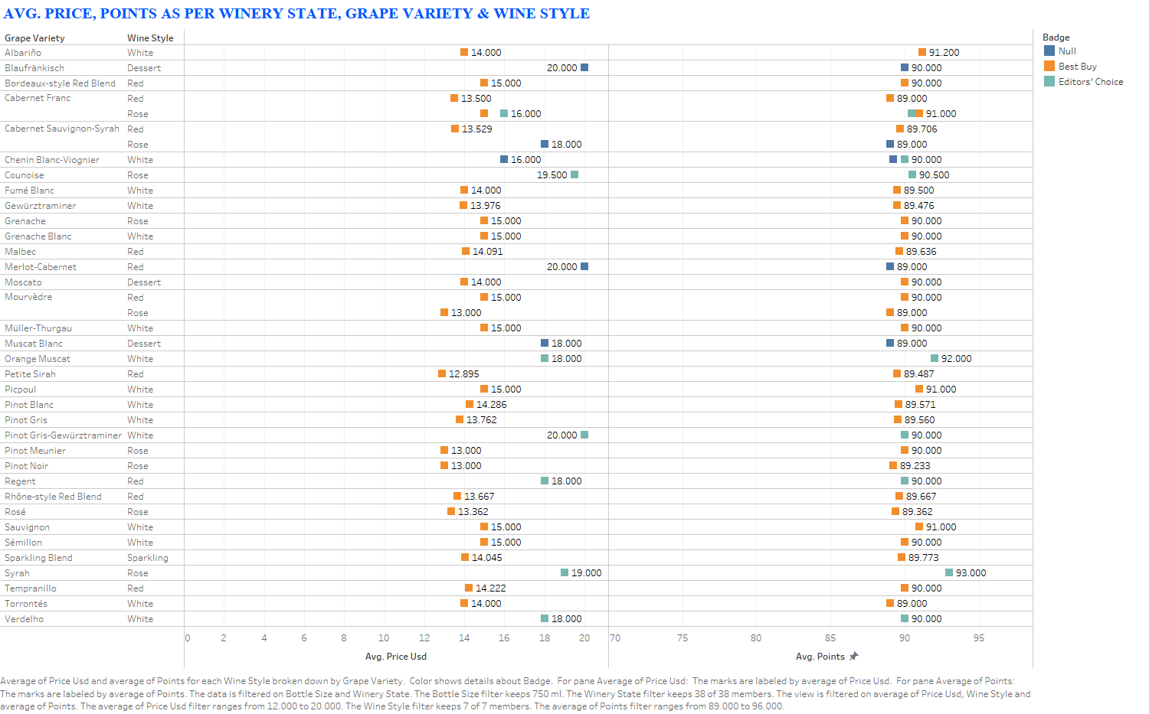
Initial graph of previous recommendations, where filters has been applied on wine style-(RED,ROSE,WHITE), Bottle Size- 750 ml, Avg. Price <=20$

Slide 7
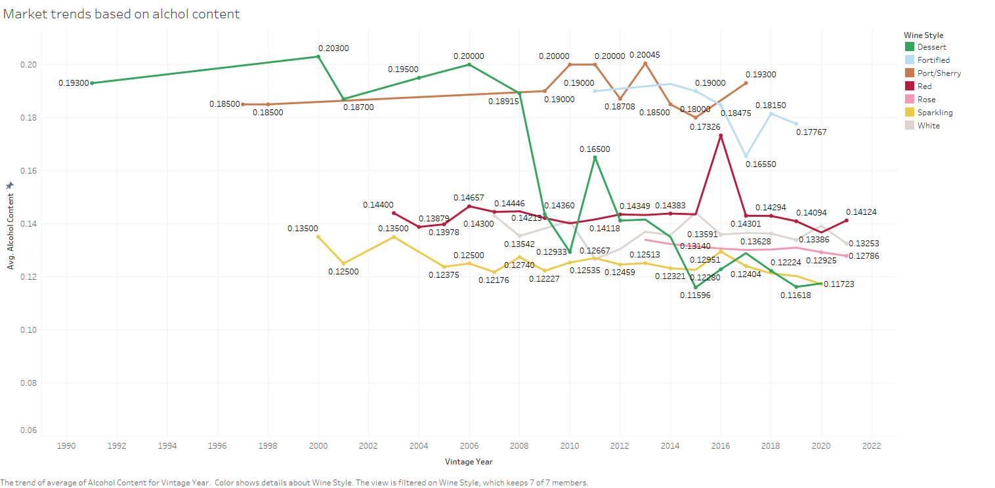
Q-5 What other wine trends would it be beneficial to consider?
Market Trend: Over the past two decades, Red wine has maintained a consistent alcohol content, whereas White and Rosé wines have shown a gradual decrease in alcohol content over the years.

Slide 8
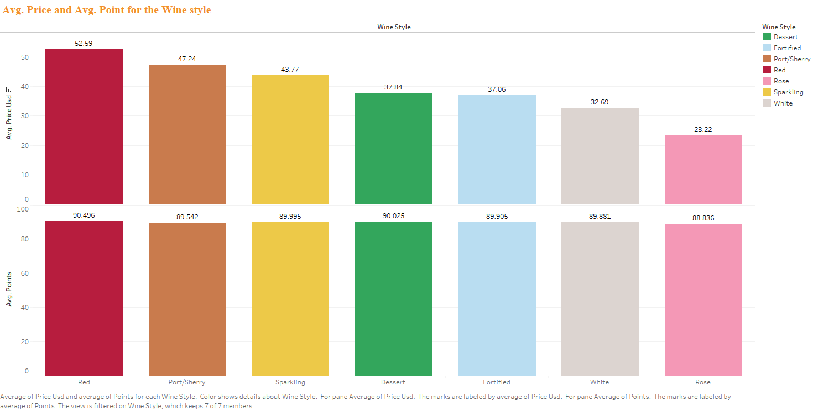
From the last graph, we focused on four wine styles.
Based on the average price point, the preferred wine styles are Rosé, White, and Red.
Although Red wines are priced higher, they are still worth considering due to the wider variety of available flavors, which may indicate higher market demand.
We are not considering Dessert, Fortified, and Port wines as they have limited flavor availability.
(Since sales data is not available, we are using flavor variety as a proxy for market demand.)

Slide 9
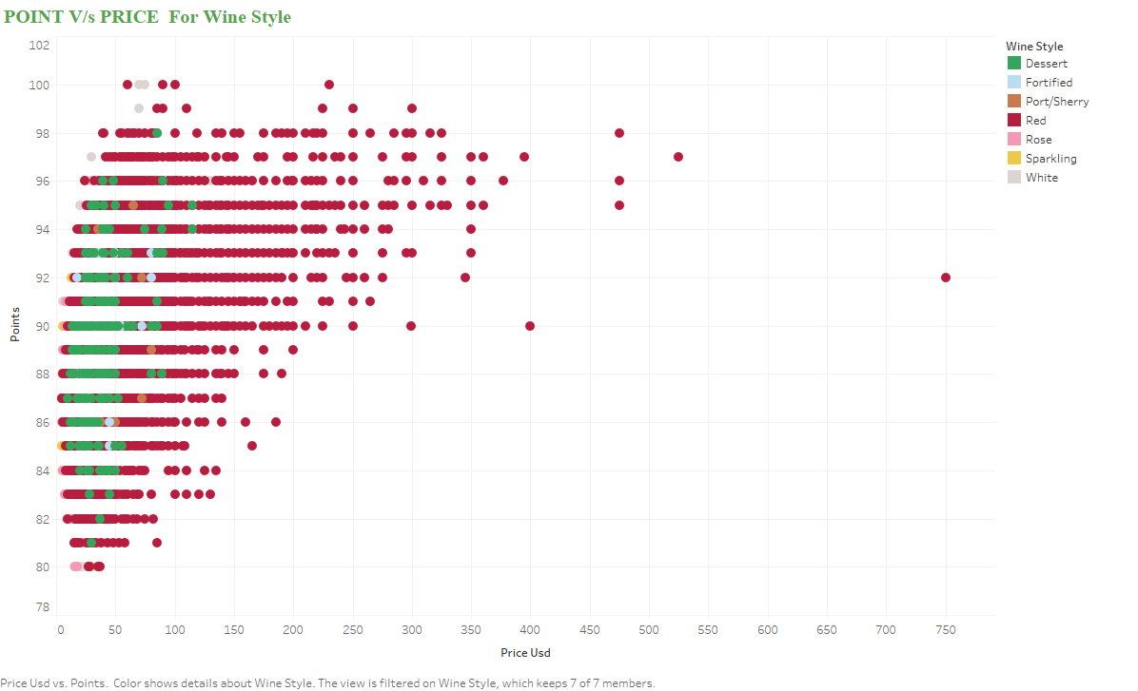
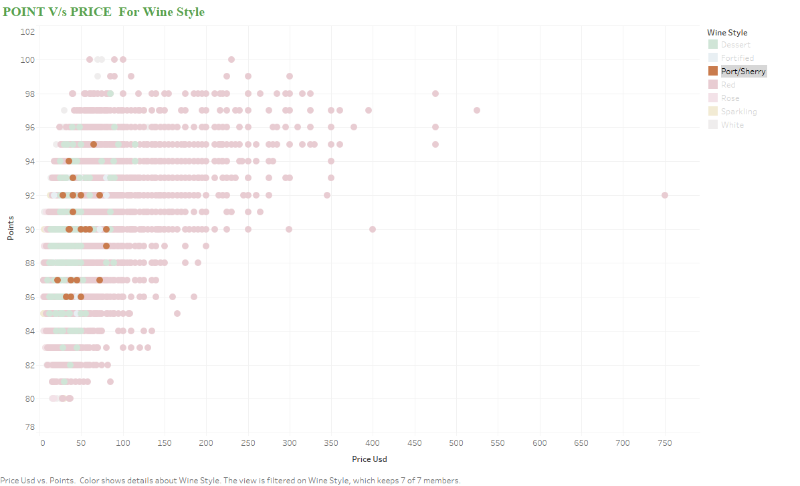
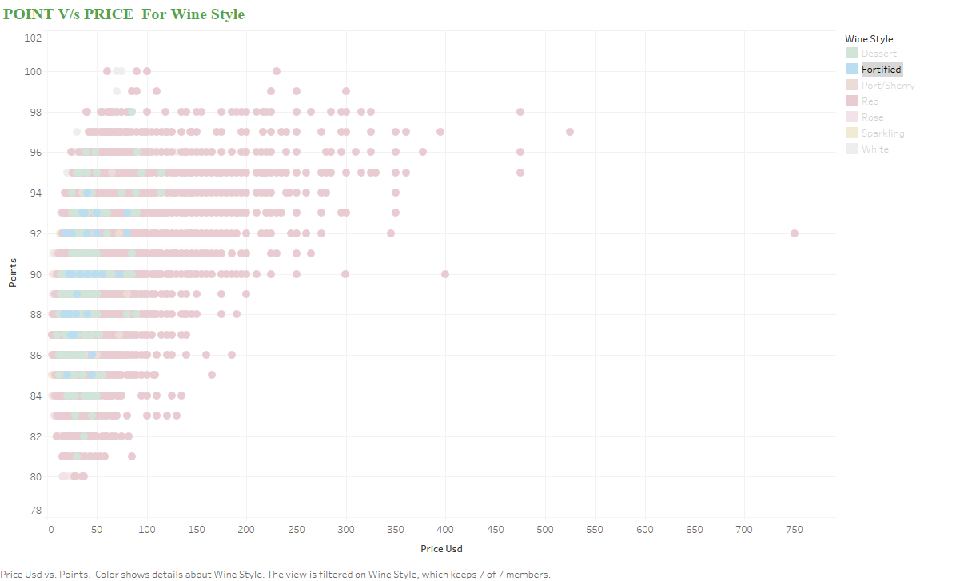
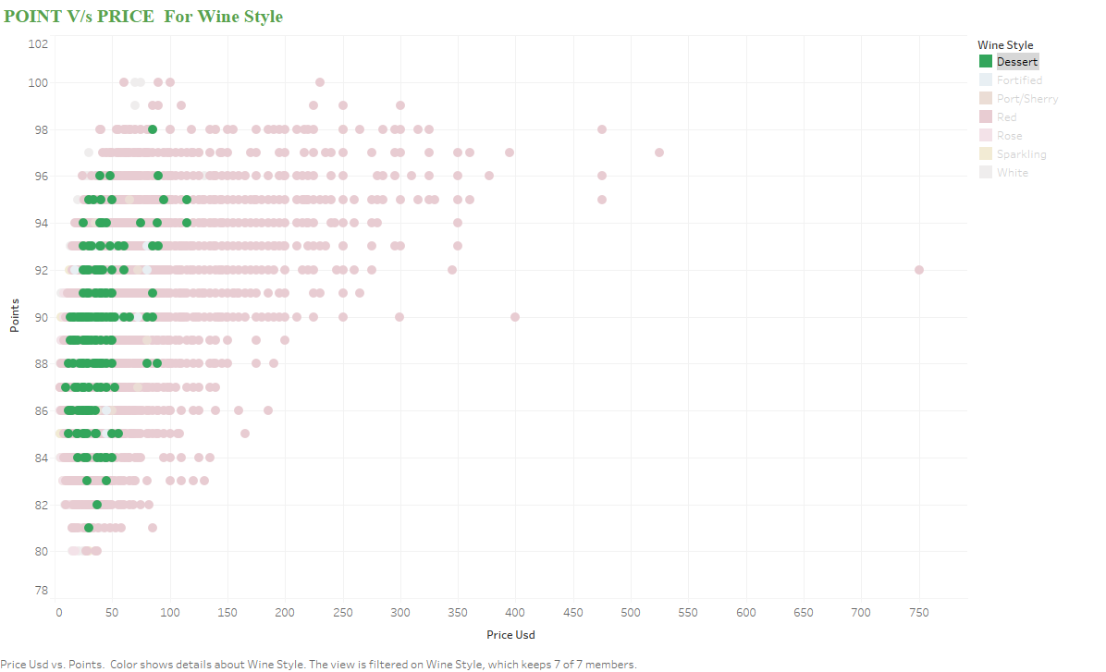
From this, it is evident that wines with lower prices and higher ratings are available, offering good value options. Red wine dominates the market share and is available across all price points, making it a versatile choice for consumers.
Additionally, wines with higher ratings tend to be priced higher, indicating a correlation between quality perception and pricing.

Slide 10
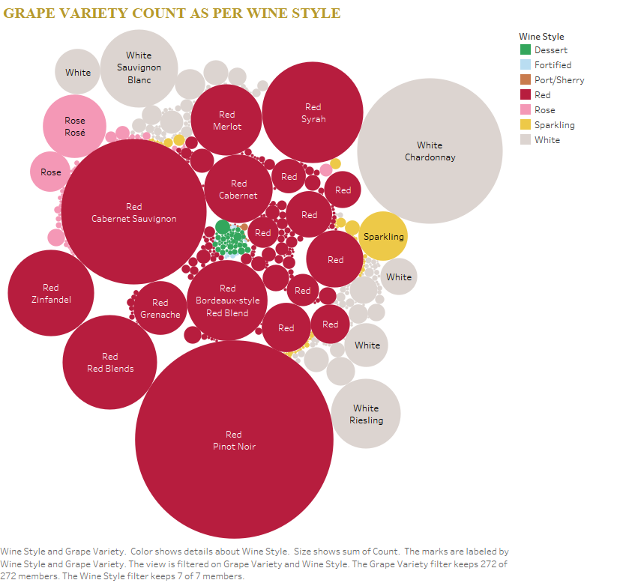
Bubble Graph: Wine Style
Based on grape varieties, Red, White, and Rosé wines remain the most prominent styles. Among them, Pinot Noir (Red) and Chardonnay (White) are the top contributors in their respective categories.

Slide 11
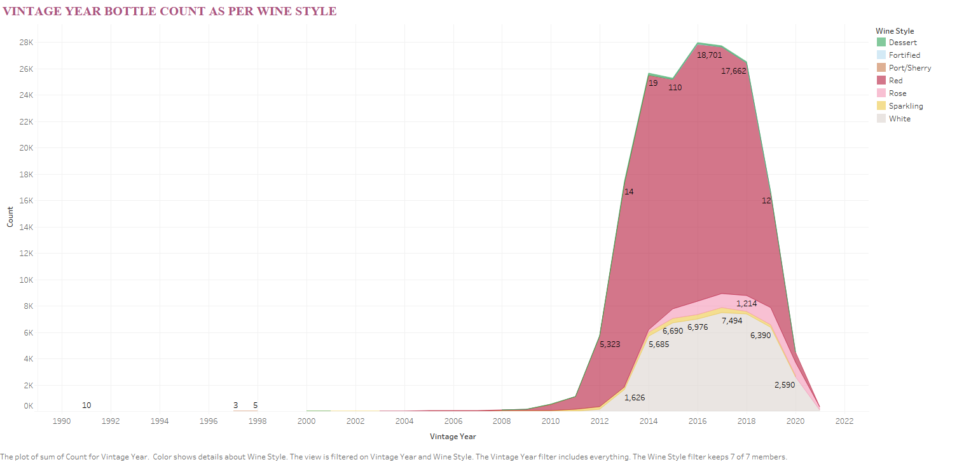
Vintage Year Bottle Count as per Wine Style
Since 2008, there has been a noticeable increase in the preservation of Red wine.
Around 2017 and 2018, all wine types saw the highest number of bottles preserved, followed by a decline in 2020.
This drop could be attributed to various factors such as geographical conditions, transportation challenges, or other market disruptions.

Slide 12
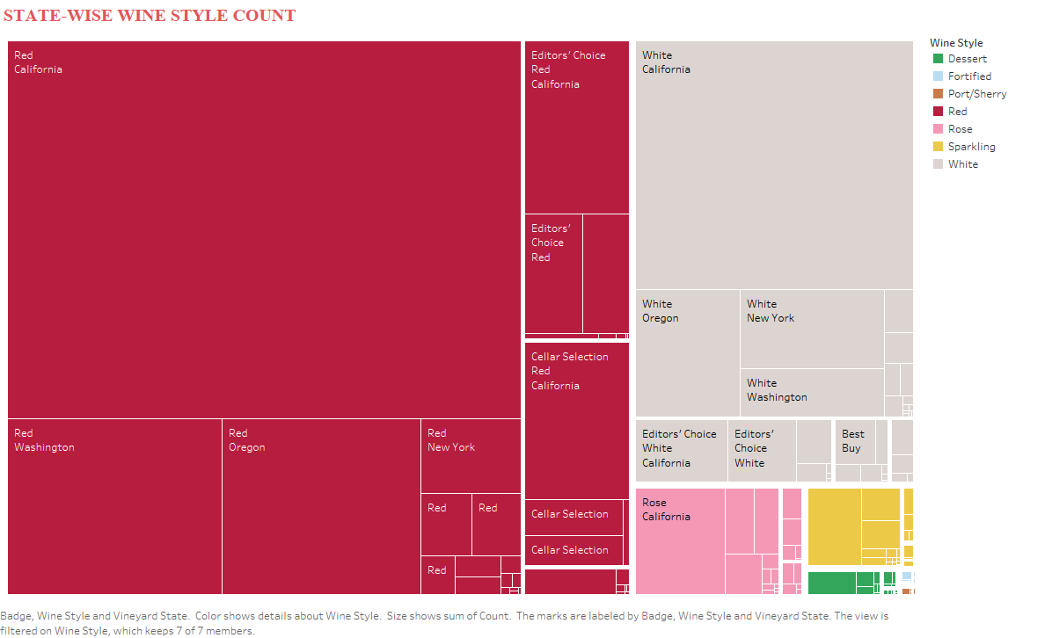
California is the largest producer across all wine styles, with Red wine being the most produced, followed by White and Rosé.
Washington and Oregon hold the second and third positions, respectively, in overall wine production.

