Slide 1

RAZORPAY AI BUILDATHON 2026 • TRACK 2: AI RISK MANAGER
IntentLock
Zero-Trust Policy Gate for High-Risk Payouts
A defense-grade policy gate intercepting deepfake voice notes, urgent social engineering, and unauthorized recipient tampering before instructions reach RazorpayX rails.
403 Passing Tests • 0 Unsafe Handoffs • 3 Hard Authority Lanes • MIT Open Source
Builder: Kunal Kumar Mehta • Repository: github.com/KunalKumarMehta/razorpay

Slide 2

RAZORPAY AI BUILDATHON 2026 • TRACK 2: AI RISK MANAGER
The Threat Landscape: Deepfakes, Urgency & Autonomous LLM Risks
1. Weaponized Voice Clones
• Rapid Voice Synthesis:
Executive voices cloned in 30 seconds via generative audio tools.
• Urgent WhatsApp Voice Notes:
'Clear ₹4.25L tooling deposit to vendor account before 5 PM.'
• Psychological Vulnerability:
Urgency induces operators to bypass slow bank registry verification.
• Irreversible Rails:
Indian rails (IMPS/UPI) have zero recall: no Ctrl+Z once dispatched.
2. The Autonomous Agent Trap
• The Industry Hype:
Startups giving LLMs direct API keys to move company treasury.
• The Core Fallacy:
LLMs hallucinate, suffer prompt injection, and misunderstand edge cases.
• Catastrophic Financial Impact:
In enterprise payments, a 1% failure rate is an existential disaster.
• IntentLock Thesis:
Never let an LLM touch the financial trigger.
3. The Maker-Checker Blind Spot
• Existing Protection:
RazorpayX provides robust internal Maker-Checker queues.
• The Upstream Hole:
Spoofed instructions enter the queue as 'Maker Drafts' without origin validation.
• Fatigued Reviewers:
Approvers click 'Confirm' assuming the desk verified the counterparty.
• The Solution:
A zero-trust cryptographic gate BEFORE instructions enter RazorpayX.

Slide 3
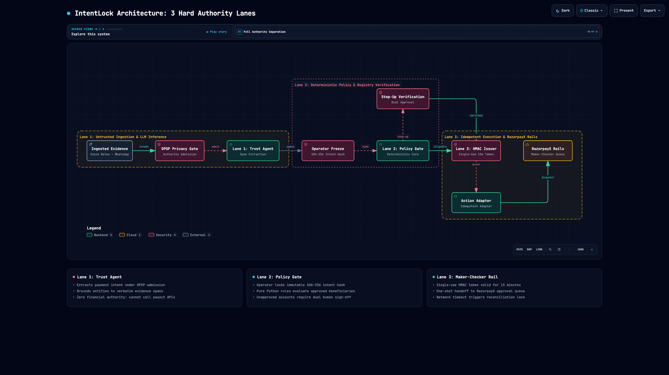
RAZORPAY AI BUILDATHON 2026 • TRACK 2: AI RISK MANAGER
System Architecture: 3 Hard-Bounded Authority Lanes
Authority Separation Architecture
• Lane 1: Trust Agent (Read-Only LLM)
Ingests audio/images under DPDP admission rules. Extracts intent & links exact evidence spans. Zero money authority.
• Lane 2: Deterministic Policy Gate
Operator freezes SHA-256 intent hash. Deterministic Python core evaluates limits & approved counterparty registry.
• Lane 3: Maker-Checker Rail
Issues single-use 15-minute HMAC-SHA256 grant. Dispatches exactly one pending item to RazorpayX queue.
• Cryptographic Integrity Invariant:
Any edit to amount or account breaks the intent hash and instantly cancels the handoff grant.

Slide 4
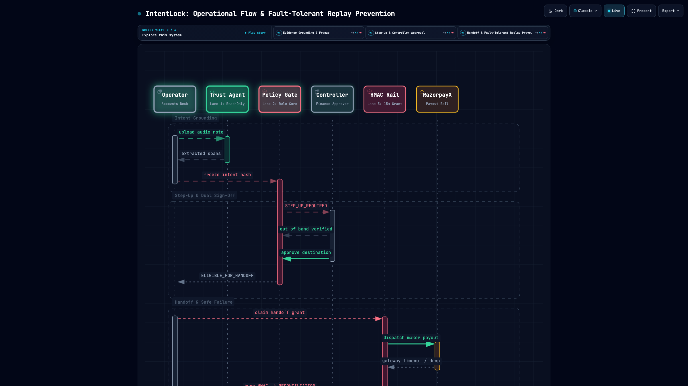
RAZORPAY AI BUILDATHON 2026 • TRACK 2: AI RISK MANAGER
Operational Flow: 3 Human Gestures & Fault-Tolerant Replay Prevention
Operational Gating & Fault Tolerance
• Gesture 1: Freeze Intent
Operator verifies extracted spans. Freezes immutable SHA-256 Intent Hash into audit ledger.
• Policy Step-Up: STEP_UP_REQUIRED
Unapproved destination! Gate halts execution; requires independent callback + separate controller sign-off.
• Gestures 2 & 3: Out-of-Band & Approval
Controller approves destination -> Case transitions to ELIGIBLE. Operator freshly initiates handoff to RazorpayX.
• Uncertainty Never Becomes Permission:
Gateway timeouts enter RECONCILIATION_REQUIRED. Single-use HMAC burned; blind retries rejected.

Slide 5
RAZORPAY AI BUILDATHON 2026 • TRACK 2: AI RISK MANAGER
Zero-Trust Cryptographic Ledger & Data Privacy Gates
Authoritative Hash Chain
• Dedicated Audit Store:
audit_events table is the sole authoritative audit store; chained via SHA-256.
• Tip Integrity Verification:
Verified tip checkpoints signed with HMAC-SHA256 secret keys.
• Tamper Detection:
Any row modification, deletion, or truncation causes immediate AuditLedgerIntegrityError.
• Zero Mutable Leakage:
State mutations never bypass cryptographic chain.
DPDP Privacy & Admission
• Processing Authority Records:
Mandatory admission record required before risk case creation.
• Data Classification:
Validates classification, submitter role, and retention schedules.
• Admission Rejection:
Invalid or unauthorized evidence triggers immediate Admission Rejection.
• Defense-Only Architecture:
Strictly zero offensive tooling; strictly zero PII leaks to disk.
Single-Use HMAC Grants
• Single-Use HMAC Tokens:
HMAC-SHA256 handoff grants valid for exactly 15 minutes.
• Cryptographic Pinning:
Bound strictly to case_id, case_version, and exact frozen intent_hash.
• Atomic Claiming:
Executed with SQLite BEGIN IMMEDIATE transactions to prevent race conditions.
• Anti-Replay Guarantee:
Tokens cannot be reused or replayed across sessions.

Slide 6
RAZORPAY AI BUILDATHON 2026 • TRACK 2: AI RISK MANAGER
Engineering Rigor: 403 Passing Tests & Disclosed Invariants
Evaluation Harness & Safety Suites
• 45-Case Development Policy Harness:
Validates span extraction, intent freezing, and basic registry checks.
• 90-Case Sealed Policy Plumbing Suite:
Covers edge cases: multi-currency, unapproved vendors, split amounts, ambiguous notes, and timeout forks.
• 81-Execution Critical Safety Harness (27 base x 3 repetitions):
Rigorous verification of zero Unsafe Handoffs, replay rejections, and grant expiration.
• 403 Automated Unit & Integration Tests passing 100% in GitHub Actions CI.
Honest Engineering Disclosure
• The Golden Rule of Hackathons: Never fake production metrics.
• Explicit Benchmarking Declaration:
Current benchmarks verify deterministic policy plumbing and safety boundary invariants against synthetic datasets.
• Held-Out Production Targets (Declared as Targets):
- Unsafe Handoffs: 0 (Zero Tolerance - Verified in Invariant Suite)
- 3-Action Correctness Target: >= 90.0%
- Protective Intervention Recall Target: >= 95.0%
- Operator Interaction Reduction Target: >= 30.0%
• Live Whisper / ASR models staged for Design Partner phase.

Slide 7
RAZORPAY AI BUILDATHON 2026 • TRACK 2: AI RISK MANAGER
Startup Thesis: Defensible Wedge for RazorpayX Payouts
1. Beachhead & Ideal Buyer
• Target Buyer:
Finance Control Owners, CFOs, & Heads of Treasury.
• Target Segment:
Indian growth & mid-market enterprises running on RazorpayX.
• Urgent Wedge:
Gating high-urgency, out-of-band payout exceptions.
• Solves the #1 Threat:
CEO deepfake audio inducing unauthorized wire transfers.
2. 90-Day Design Partner Pilot
• Staged 3-Partner Pilot:
Validate in live shadowing with 3 Indian mid-market businesses.
• Measured Success Criteria:
- 0 Unsafe Handoffs during live shadowing.
- >= 30% reduction in manual operator triage time.
- 100% catch rate on modified destination bank details.
• Disciplined Expansion:
Only expand into vendor onboarding if 2 of 3 partners commit.
3. Defensible Moat
• Models are Commodities:
Foundation models (Whisper, Gemini, Llama) get swapped constantly.
• The Durable Moat:
- Counterparty trust graph & approved beneficiary registry.
- Tamper-evident cryptographic audit ledger.
- Deep workflow embedding into RazorpayX Maker-Checker rails.
- Provable safety invariant compliance.

Slide 8
SUMMARY & NEXT STEPS
Why IntentLock Wins Track 2: AI Risk Manager
Production-Grade Delivery
• 403 passing unit & integration tests.
• GitHub Actions CI 100% Green (lint, tests, evals, Docker).
• CycloneDX & SPDX SBOM generator.
• Pinned multi-stage Docker build.
• Full FastAPI backend + Vite React Operator Console.
• MIT Open Source License.
Strategic Razorpay Alignment
• Native extension for RazorpayX Payouts & Vendor Payments.
• Protects Razorpay merchants from modern deepfake threats.
• Embeds seamlessly into existing Maker-Checker approval flows.
• Strictly defense-only: 100% compliant with Track 2 rules.
The Ask to Judges
• Architectural Grilling:
Evaluate IntentLock on its disclosed safety invariants, code architecture, and honest metrics.
• Razorpay Ecosystem Integration:
Introductions to 3 RazorpayX design partners to validate in live shadowing.
Repository:
github.com/KunalKumarMehta/razorpay

