Slide 1
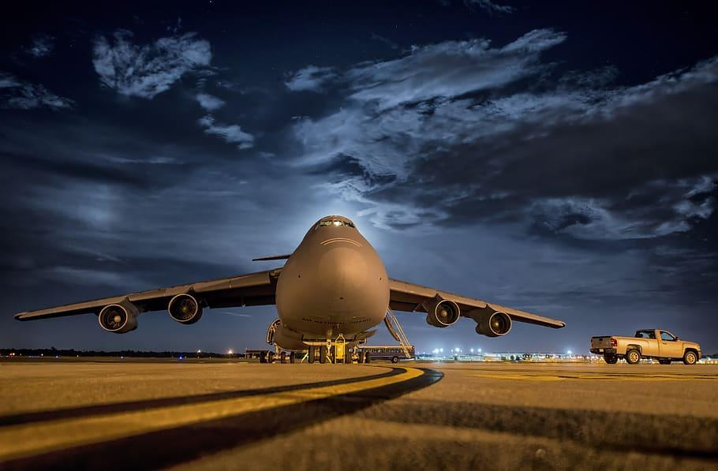
Detailed Project Report

Slide 2
Detailed Project Report (DPR)
Predictive Maintenance - NASA Turbofan Jet Engine RUL Prediction
Predictive Maintenance RUL Prediction
Author : Kunal Lokhande February 2025
iNeuron Internship

Slide 3
Contents
1 Objective 2 Problem Statement
3 Benefits
4 Data Sharing Agreement
5 Dataset Description
6 Model Building
7 Architecture
8 Insights
9 Conclusion
10 Q & A

Slide 4
1 Objective
1. Accurate RUL Prediction: Develop a machine learning model to forecast turbofan jet engine Remaining Useful Life (RUL) enhancing maintenance precision.
2. Cost Reduction: Minimize unplanned downtime and optimize servicing schedules to cut airline maintenance costs.
3. User-Centric Interface: Build an intuitive web dashboard for real-time RUL monitoring and actionable maintenance alerts.
4. Scalable Deployment: Design a modular system deployable on cloud or local servers, ensuring adaptability across airline fleets.

Slide 5
2 Problem Statement
1. Unplanned Downtime: Current reactive maintenance leads to costly engine failures, disrupting flight schedules and safety.
2. Inefficient Servicing: Lack of accurate RUL predictions results in unnecessary maintenance, increasing operational expenses.
3. Data Underutilization: Vast volumes of sensor data remain untapped, missing critical opportunities for predictive insights and proactive maintenance.

Slide 6
3 Benefits
1. Cost Savings: Reduce maintenance expenses through optimized, data-driven servicing schedules.
2. Enhanced Safety: Minimize in-flight engine failures with early RUL alerts, improving passenger and crew safety.
3. Operational Efficiency: Cut unplanned downtime by ensuring smoother airline operations and higher fleet availability.
4. Sustainability Impact: Extend engine lifespan by reducing waste and carbon footprint through optimized part replacement cycles.

Slide 7
4 Data Saving Agreement
● Base Dataset for training and validation
● Sample file name
● Length of dataset
● Number of columns
● Column names
● Column relevance
● Column data types

Slide 8
5 Dataset Description
1. Source: NASA C-MAPSS (Commercial Modular Aero-Propulsion System Simulation) benchmark dataset.
2. Content: Multivariate time-series data from turbofan jet engines, tracking 21 sensor readings (temperature, pressure, RPM) and 3 operational settings.
3. Scope: Simulated run-to-failure cycles (20,631 records) under varying conditions (sea level, altitude, fault modes).
4. Preprocessing: Normalized using Robust Scaling (median/IQR) to handle sensor outliers and noise.

Slide 9
5 Dataset Description
5. Key Sensors: Focus on critical degradation indicators (e.g., Sensor 7: exhaust temperature, Sensor 12: fuel flow).
6. Data Splits:
- Training Data: 100 engines with full run-to-failure cycles (21 sensors × 20,631 cycles)
- Testing Data: 100 engines with partial cycles + final RUL values for validation
- RUL Labels: Provided separately for each engine in testing set

Slide 10
6 Model Building
1. Data Ingestion
- Loads NASA C-MAPSS dataset (CSV) from Kaggle/local storage
- Checks file integrity, converts to Pandas DataFrame.
2. Data Preprocessing
- Applies Robust Scaling (IQR) to minimize outlier impact
- Imputes missing values (median), extracts cyclical trends
3. Data Transformation
- Converts raw sensor data into time-sequenced inputs
- Creates degradation trend features for RUL patterns

Slide 11
6 Model Training
4. Model Training
- Trains SVM, Random Forest, XGBoost with hyperparameter tuning
- Balances accuracy (MAE) and overfitting (5-fold cross-validation)
5. Model Evaluation
- Validates MAE, RMSE, R² on held-out test set
- Compares against NASA's baseline models
6. Model Deployment
- Flask app at localhost:5001 with Plotly Dash visualizations
7. User Interaction
- Dashboard with RUL Prediction system.

Slide 12
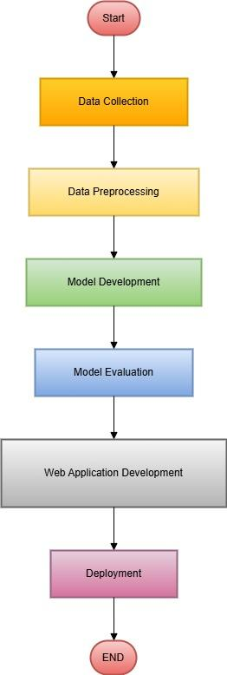
7 Architecture
- workflow
diagram

Slide 13
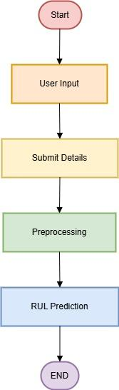
7 Architecture
- User I/O
diagram

Slide 14
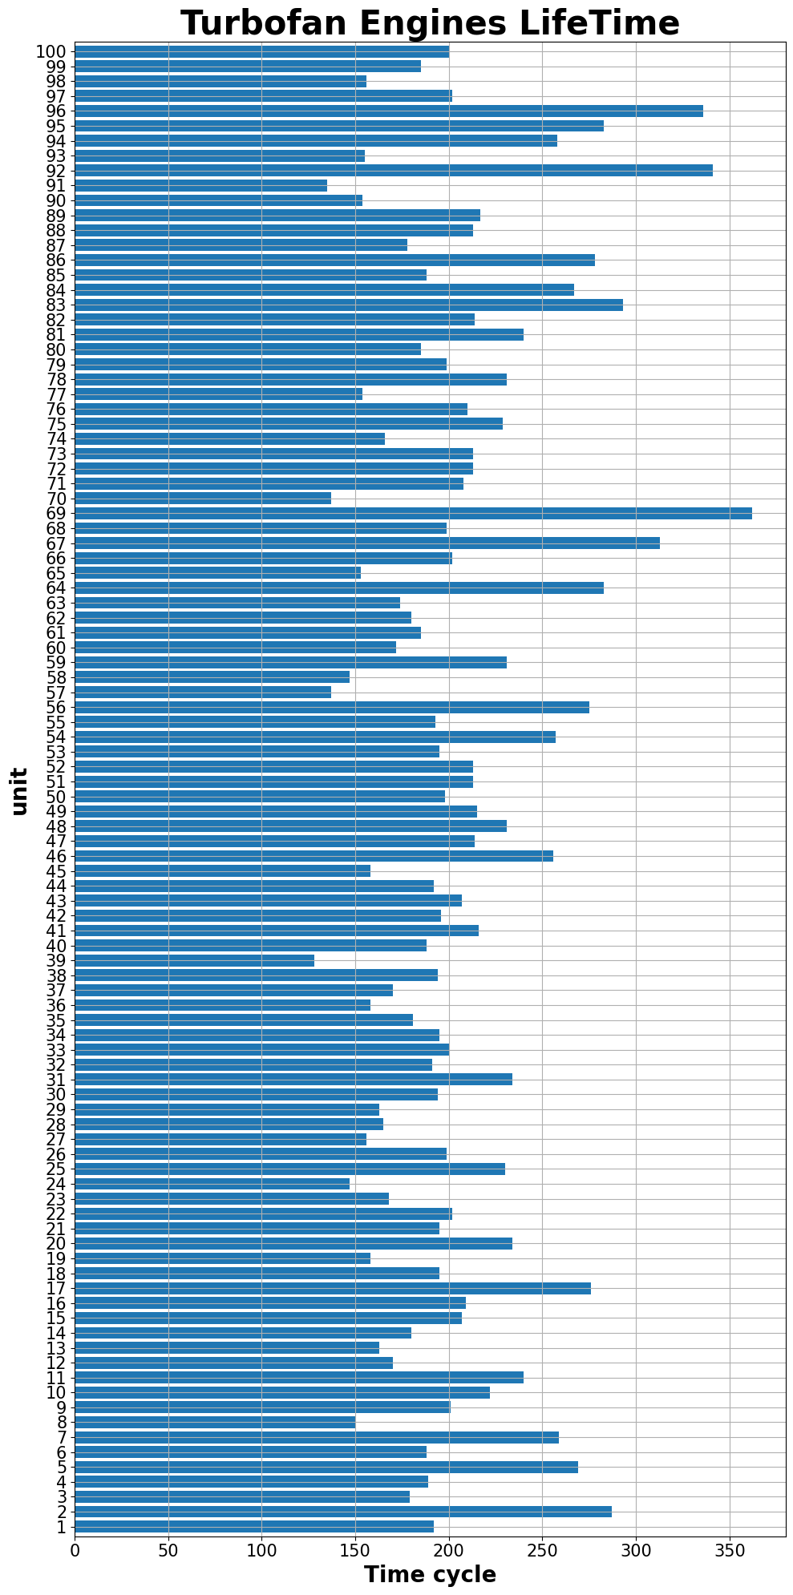
8 Insights

Slide 15
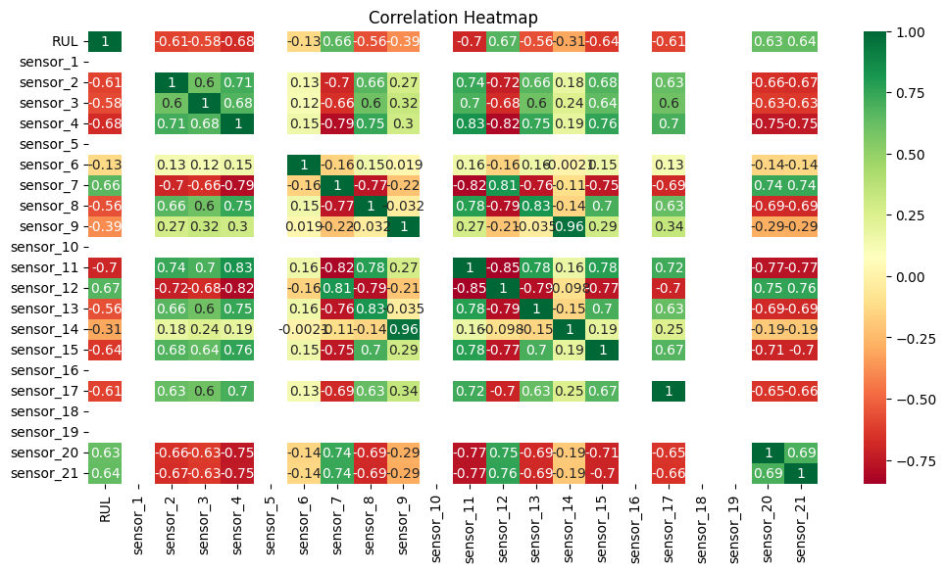
8 Insights

Slide 16
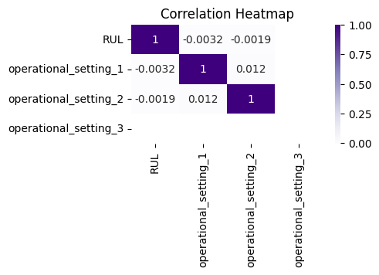
8 Insights

Slide 17
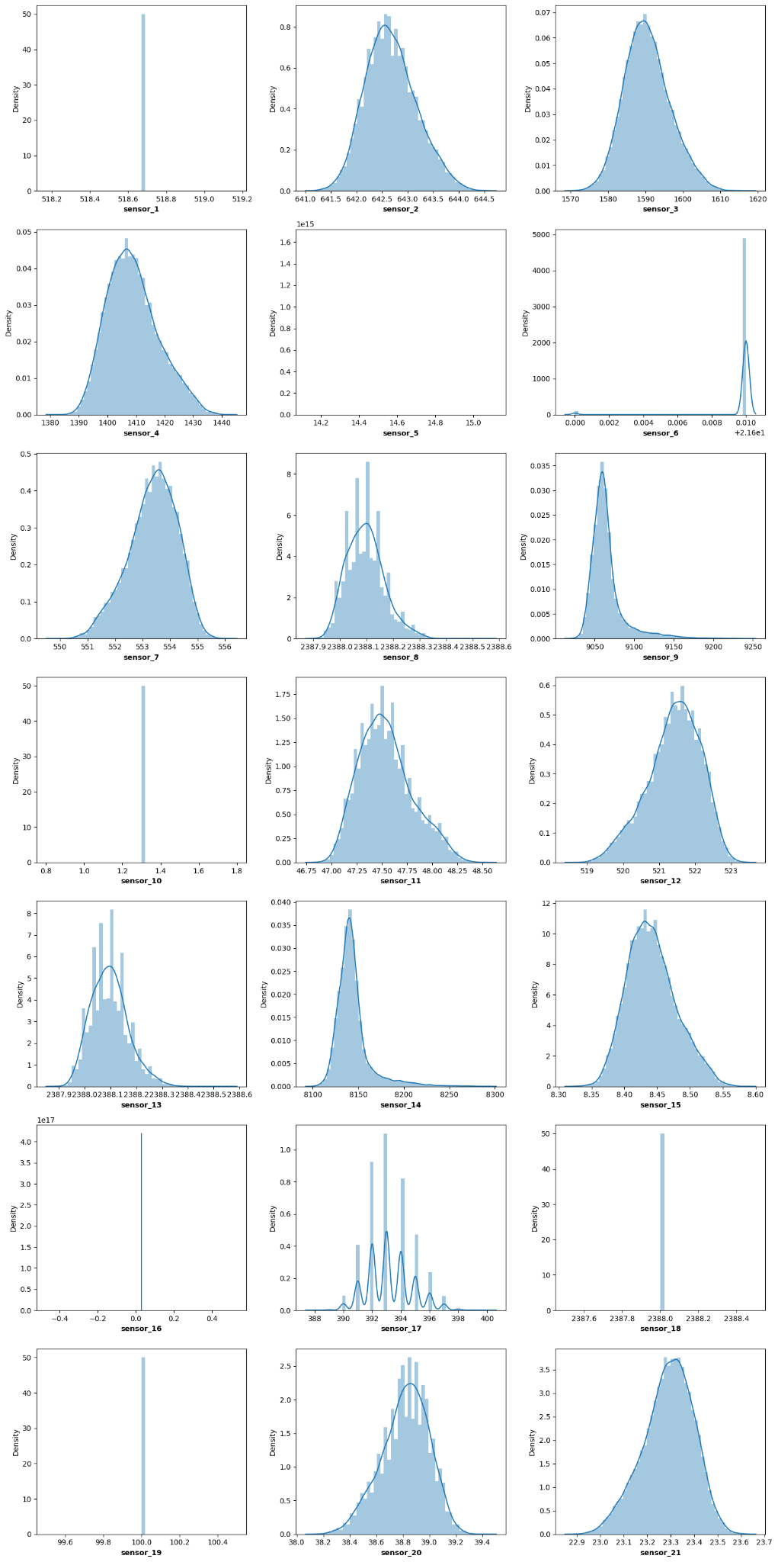
8 Insights
Distribution of sensor data

Slide 18
9 Conclusion
1. The project successfully developed a machine learning system to predict aircraft engine remaining useful life.
2. The solution enables proactive maintenance planning through accurate degradation monitoring.
3. The modular design supports both local and cloud deployment for flexible implementation.
4. This approach demonstrates how predictive analytics can transform aviation maintenance operations.

Slide 19
10. Q and A
Q1) What’s the source of data?
Ans: The data for training is provided by Ineuron (kaggle dataset)
.
Q 2) What was the type of data?
Ans: The data has purely numerical values.
Q 3) What’s the complete flow you followed in this Project?
Ans: End to End project flow from scratch to deployment.
Q 4) What techniques were you using for data pre-processing?
Ans: Checking for nulls, duplicates in data. Removing Outliers if present.
Q5) How are logs managed?
Ans: Logs manages with the help of pipeline and logger functions

Slide 20
Thank you

Slide 21
iNeuron internship
Predictive Maintenance

