Slide 1
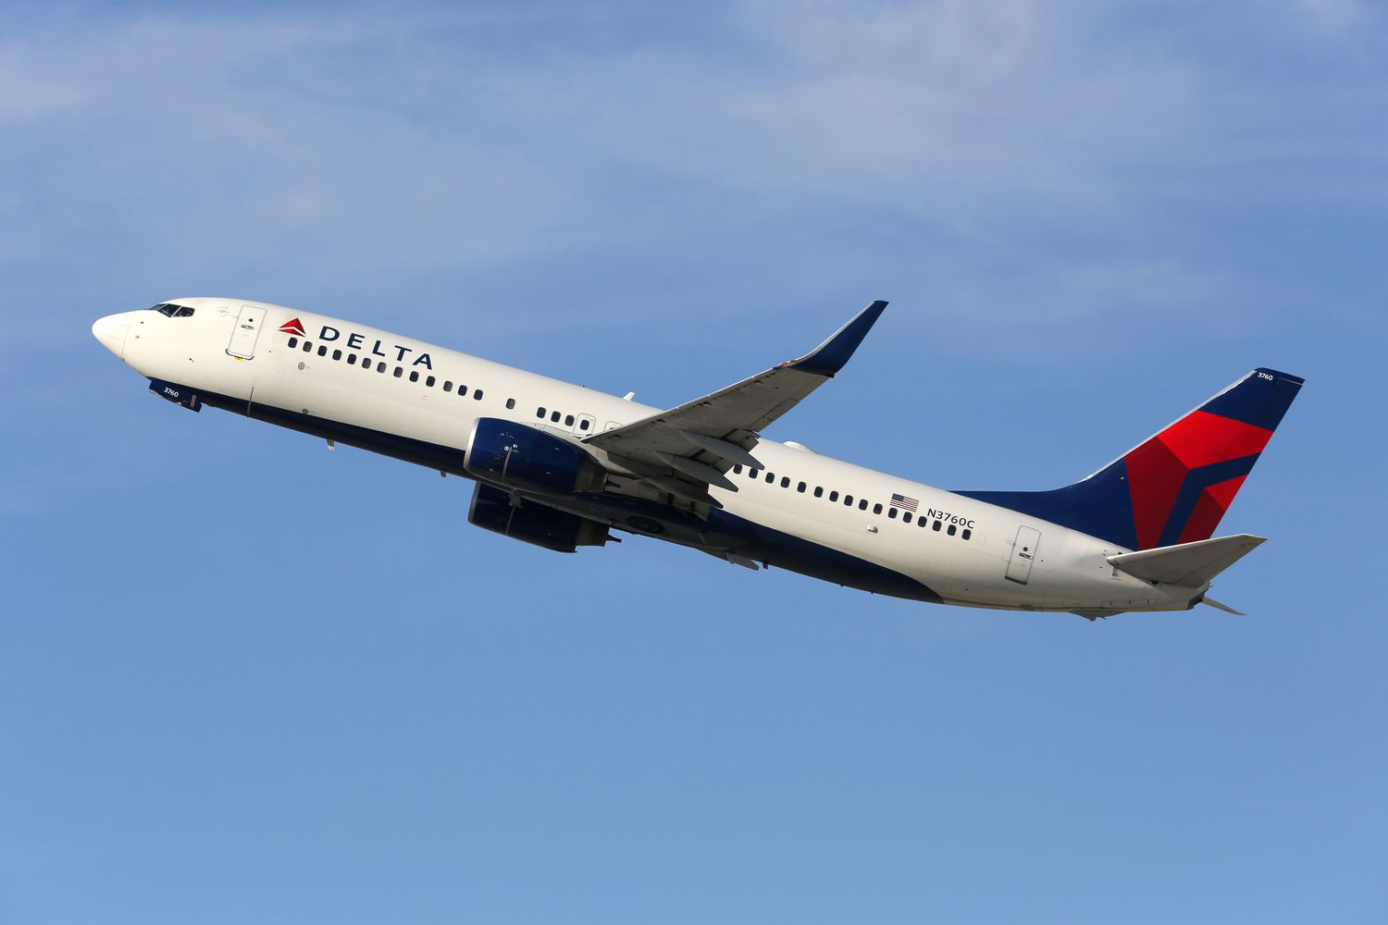
US DOMESTIC AIRLINE FLIGHTS PERFORMANCE
Kunal Sachdev
1A CS

Slide 2

STORY
Task: As a data analyst, monitor and report US Domestic Airline Flights Performance.
Goal: Analyze the performance of the reporting airline to improve fight reliability thereby improving customer reliability.

Slide 3
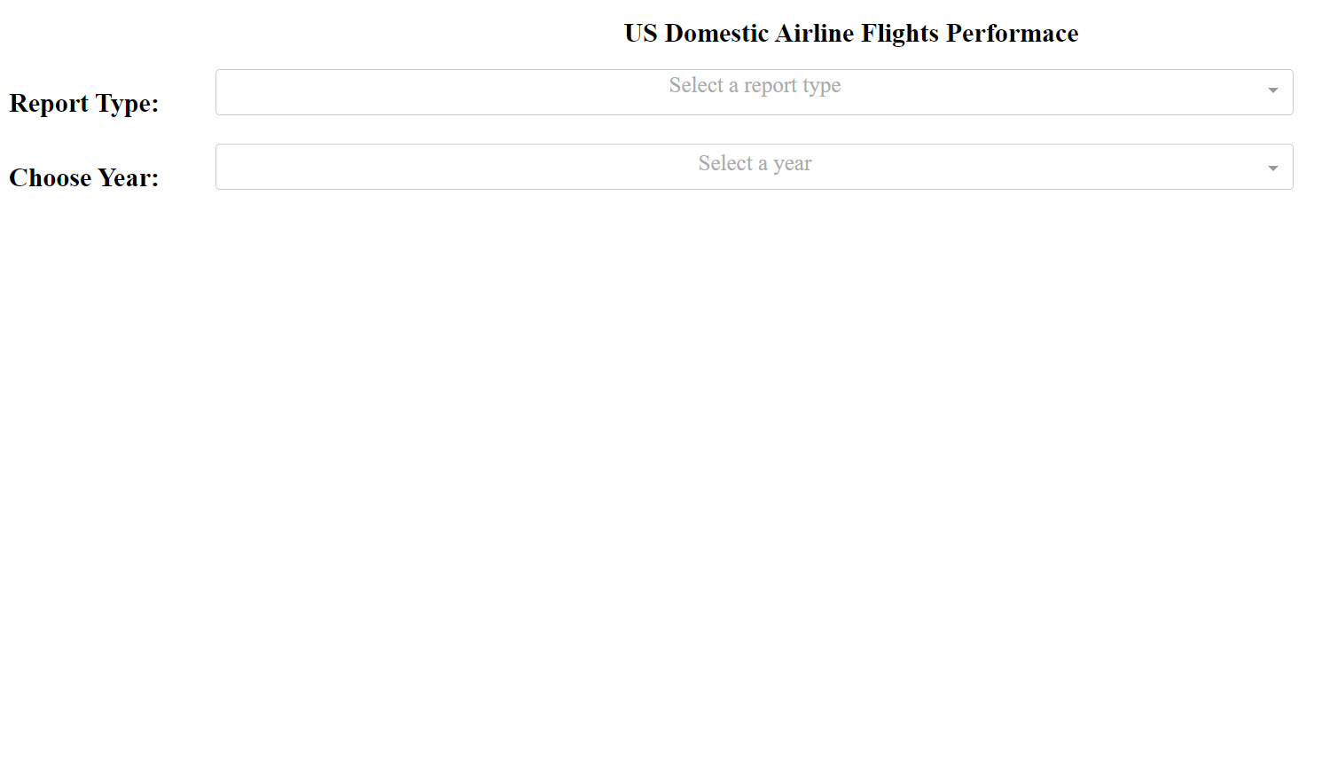
INTERACTIVE WEB DASHBOARD
Report Type:
Yearly Airline Performance Report
Yearly Airline Delay Report
Choose Year:
2005 - 2020

Slide 4
YEARLY AIRLINE PERFORMANCE REPORT 2018

Slide 5
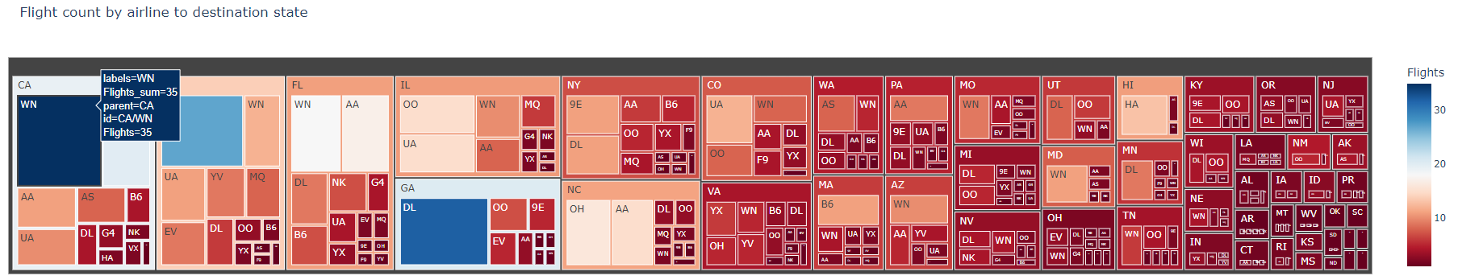
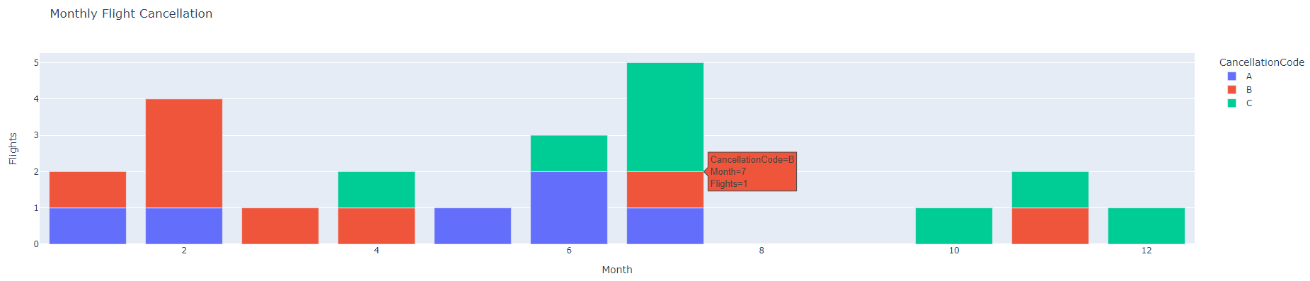

Slide 6
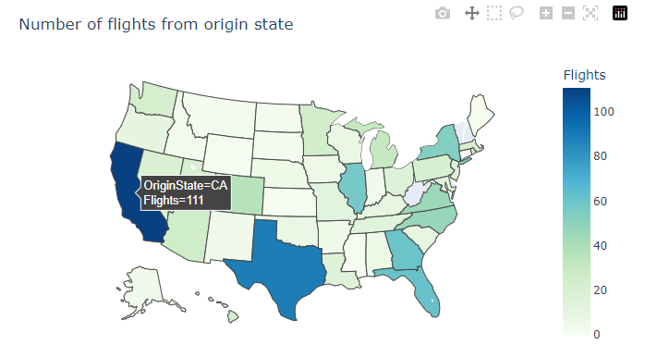
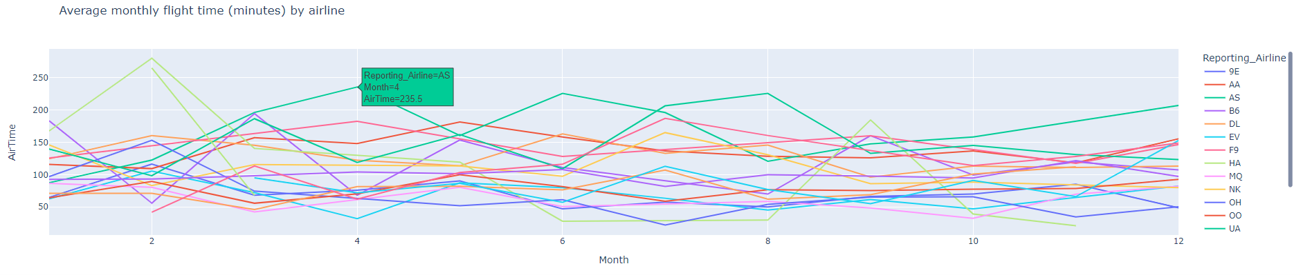

Slide 7
YEARLY AIRLINE DELAY REPORT 2018
Treemap
Total Number of Flights flying to each State from each Reporting Airline.
Hover shows that in 2018, a total of 35 WinAir flights flew TO California.
Bar Chart
Total Number of flights under different Cancellation Categories.
Hover shows that in July 2018, one flight was cancelled with Cancellation Code B.
Chloropleth Map
Total Number of Flights Flying from each State.
Hover shows that in 2018, a total of 111 flights flew FROM California.
Line Chart
Average Flight Time (minutes) by Reporting Airline.
Hover shows that in April 2018, Alaska Airlines reported an average flight time of 235.5 minutes.

Slide 8
YEARLY AIRLINE DELAY REPORT 2018

Slide 9
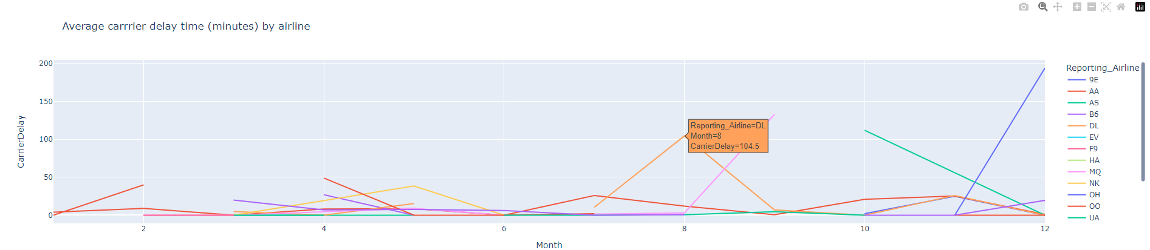
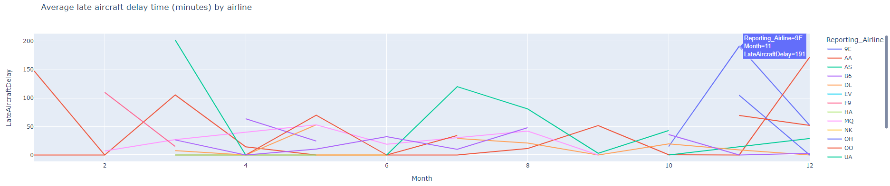

Slide 10
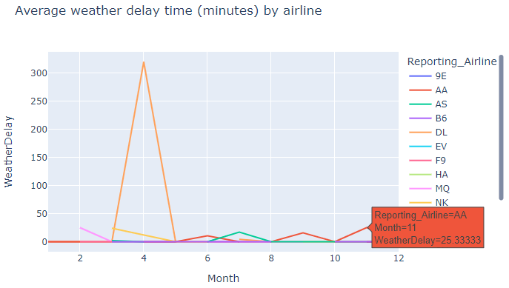
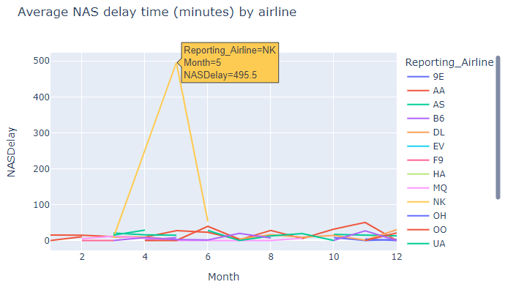

Slide 11
YEARLY AIRLINE DELAY REPORT 2018
Line Chart
Monthly average carrier delay by reporting airline for the given year.
Hover shows that in August 2018, Delta Airlines reported an average carrier delay of 104.5 minutes.
Line Chart
Monthly average late aircraft delay by reporting airline for the given year.
Hover shows that in November 2018, Endeavor Air reported an average late aircraft delay time of 191 minutes.
Line Chart
Monthly average weather delay by reporting airline for the given year.
Hover shows that in November 2018, American Airlines reported an average weather delay of 25.33 minutes.
Line Chart
Monthly average national air system (NAS) delay by reporting airline for the given year.
Hover shows that in May 2018, Spirit Airlines reported an average NAS delay of 495.5 minutes.

Slide 12
THANK YOU

