Slide 1
Driving Innovation Through
GenAI & Data Science
Summer Internship
May’ 25 – Aug’ 25
Kunal Sachdev
GenAI Engineer Intern

Slide 2
AGENDA
GenAI-powered Business Insights with Visualization
Grievance Prediction Modelling – Enhancement
Integrating QRC data
TOF Feature Analysis
Mis-selling Prediction Modelling
Acknowledgements

Slide 3
Data Genie – GenAI Powered Business Insights
GenAI POC

Slide 4
GenAI-powered Business Insights with Visualization
To empower business leaders with cutting-edge GenAI tools for decision intelligence.
200+ BI Reports published daily
C-suite Executives have to view the detailed reports and extract required insights manually.
A unified GenAI-powered chat interface to provide data insights in natural language from enterprise Data Lake (Dataverse). Newly created Dataverse is the single source of truth for this project.
Converting Hourly Login report, as Proof-of-concept (POC), into conversational GenAI-powered insights – in collaboration with AWS and Lumiq.
User Inputs Query
Question Intent Decoding
SQL Generation
Text/Graph Output

Slide 5
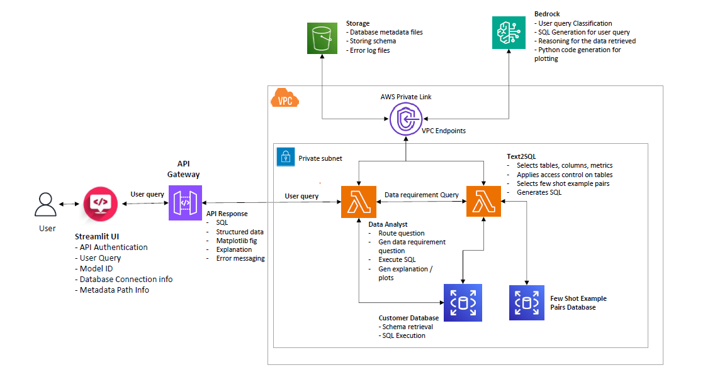
Conversational Analytics with GenAI – Technical Architecture

Slide 6







Conversational Analytics with GenAI – Technical Flow
User Inputs Query
Question Intent Decoding
SQL Generation
Text/Graph Output
Streamlit Frontend
API Authentication
API Gateway
Redshift DB configuration
Model ID – Claude 3.0 Sonnet
Metadata Info
Validate User Input
Decode Question Intent: SQL or SQL + Plot
Establish DB connection with SQLAlchemy Engine
Extract Table Schema
AWS Lambda – Query Bot
OpenSearch similarity search
Prompt assembly – system prompt, SQL prompt, few-shot examples
Bedrock Model Invoke
Code rectification
Row-level security (RLS)
Generate natural language answer
Display answer, SQL, plot

Slide 7


GenAI-powered Business Insights with Visualization – First Principles
Interface and Login:
Chat-bot interface
API-based interface
Mobile App/POS/Website – In-app authentication and authorization
Data privacy and security
Row-level security (Eg: A zonal head can access data only for that zone)
Masking/Removing access to PII
Simple, Intuitive UI
SSO enabled
User-friendly
Error handling for invalid prompts
Model Training and Accuracy
Regulatory Compliance – PII cannot travel outside India during cross-region inference (CRIS)
Feedback loop implementation – auto and manual
Model Drift Detection over time

Slide 8
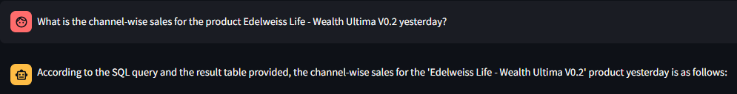
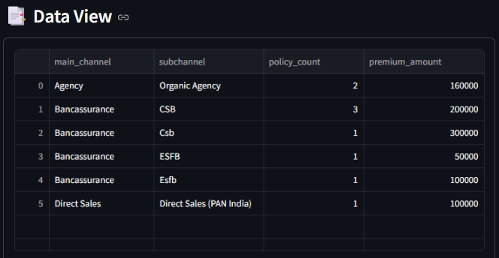
GenAI – Accomplishment & Way Forward
Demonstrated a GenAI-based chat interface to provide business insights for Hourly Logins with RLS.
Way Forward:
Integration of Speech-to-Text for user input.
User feedback loop for generated responses.
Display frequently-used queries for bookmarking/favorites.
Follow-up question suggestions.
Next report for implementation – Operational Reporting (Underwriting, Pending Inventory, etc.)

Slide 9
Grievance & Mis-selling Prediction Models
QRC Integration, TOF Feature Analysis, Mis-selling Prediction

Slide 10

Grievance Prediction – Integrating QRC Data
Integrating 49L+ customer queries, requests, and complaints (QRC) with existing Grievance model
New Data Integrated:
A policy’s holder’s number of queries, and number of requests before their first complaint date.
QRC Data Sourced from D365 mid-2022 onwards.
Machine Learning Model:
Training Data Period: Apr 2017 – March 2024
Validation Data period: April 2024 – July 2025
Model Trained:
5 LightGBM Ensemble with different random samples
Average of top-3 predictions of the 5 models.
Model Predictions shared every week with Grievance Team
Top Decile Coverage increase from 76% to 97%

Slide 11
Grievance Prediction – Performance Comparison
New Grievance Model - Top Decile Coverage increase from 76% to 97%
Current Grievance Model: (Till 20-July-2025)
Performance shown on all active policies (NCD/NBMIS records as of Jan’ 25)
New Grievance Model: (Live from 21-July-2025 Onwards)
Performance shown on all active policies (NCD/NBMIS records as of July’ 25)

Slide 12
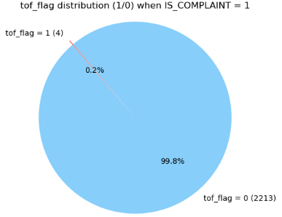
Grievance Prediction – Transfer-of-Funds (TOF) Feature Analysis
Hypothesis: Transfer-of-funds (TOF) is an important predictor for grievance prediction
Analysis done on Pure TOF cases.
Chi-Square Test:
There is a statistically significant association between TOF and Grievance.
Cramer’s V Test:
The strength of said association is negligible – it’s too weak to be meaningful
Conclusion: TOF is not an important predictor for Grievance (at least for now)

Slide 13
Mis-selling Prediction – New Model
Training a new model to predict policy Mis-selling
Target variable:
Whether a policy was mis-sold to a particular customer
Includes QRC data in training.
Machine Learning Model:
Training Data Period: Apr 2017 – March 2024
Validation Data period: Apr 2024 – July 2025
Model Trained:
5 LightGBM Ensemble with different random samples
Average of top-3 predictions of the 5 models.
Model Predictions shared every week with Grievance Team
Model output: Top Decile Coverage of 90.56%

Slide 14
Mis-selling Prediction – Performance
Mis-selling Model – Top Decile Coverage of 90.56%
New Mis-selling Model: (Live from 21-July-2025 Onwards)
Performance shown on validation data (NCD/NBMIS records April’ 24 – July’ 25)
Significant Variables
Significant Derived Variables
Base Sum Assured
Premium (wo Tax)
Proposer Age, Policy Term
Query Count, Request Count
Historic Mean Age of Life Insured for LA Occupation Type for Grievance policies
Historic Mean Annual Premium for an Occupation Type
Historic Product Policy Count for Grievance Policies
Historic Region Grievance Rate

Slide 15
Acknowledgements

Slide 16
Acknowledgements
I would like to express my sincere gratitude to:
Senior Leadership
Core Data Team
Mr. Kayzad Hiramanek (COO)
Mrs. Saba Adil (CHRO)
Mr. Clint Misquitta (Head HR)
Mrs. Deepa Duraisamy (Head – Data & Analytics)
Mr. Suraj Sahoo (Data Scientist III)
Mr. Nilanjan Chowdhury (Data Scientist II)
Mr. Karan Sharma (Project Manager – AI/Data Science)
HR
Rohini Shetty
Charu Kaushik

Slide 17
thank you!

Slide 18
Grievance Prediction – Transfer-of-Funds (TOF) Feature Analysis
Hypothesis: Pure Transfer-of-funds (TOF) is an important predictor for grievance prediction
Chi-Square Test: To test the association b/w two variables
P-value: 0.016 (< 0.05)
There is a statistically significant association between tof_flag and IS_COMPLAINT
Cramer’s V Test: Measures the strength of said association
Value: 0.0087 (very close to 0)
Extremely weak association between tof_flag and IS_COMPLAINT.
Conclusion: Pure TOF is not an important predictor for Grievance (at least for now)

