Slide 1
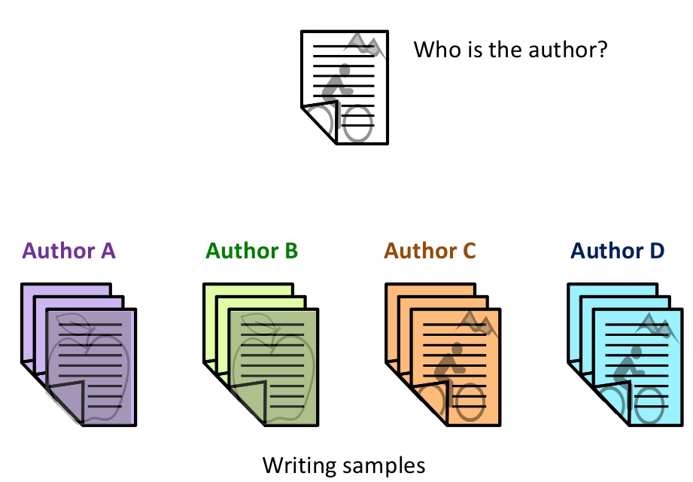
Problem Statement:
Authorship attribution is basically the task of finding the author of a document. A script from an unknown author is compared with all the authors' textual records for a match.
Authorship Analysis includes Author Profiling, Similarity Detection, Authorship Attribution
Applications of Authorship Attribution: Plagiarism detection, Computer Forensic, Analysis of literature
Daniel Defoe was an English writer, trader, journalist, pamphleteer and spy. He is most famous for his novel Robinson Crusoe, published in 1719, which is claimed to be second only to the Bible in its number of translations.

Slide 2
Dataset Pre-processing:
Dataset preprocessing is a task that involves transforming raw data into an understandable format. It includes removal of various unnecessary text from the text files used.
Removing the bullets and numbers
Removing all the URLs from the text data
Removing special characters and symbols
Removing text symbols which are not required from beginning of files
After implementing preprocessing steps, calculated statistics for given 150 file

Slide 3
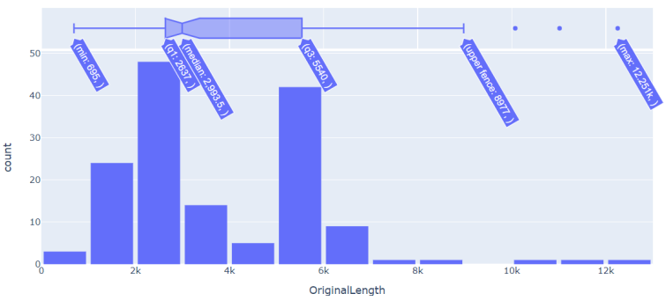
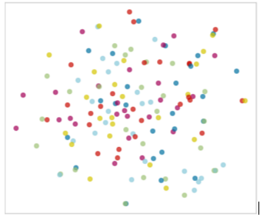
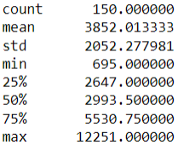
TSNE Projection of 150 Text files

Slide 4

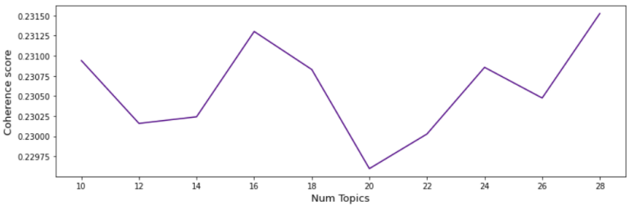
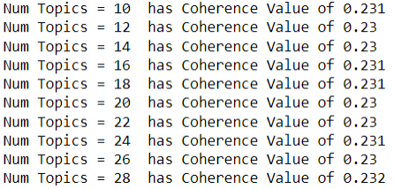
Unsupervised Methods:
Topic Modelling:
Stop word Removal
Tokenization
Lemmatizing (Considered Lemmatization over stemming)
Creating Dictionary, corpus, Term document frequency.
As a result, calculated the coherence score and perplexity which comes out to be.

Slide 5
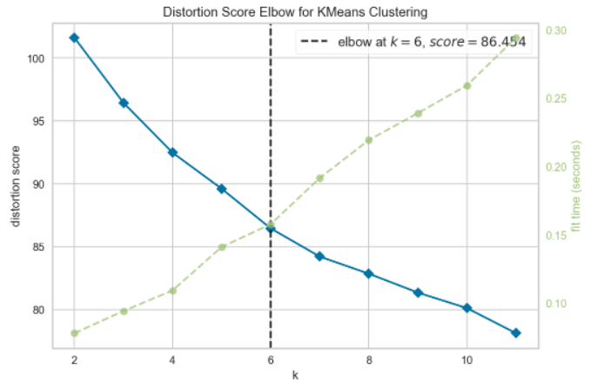

K Means:
An unsupervised Learning algorithm, which groups the unlabeled dataset into different clusters.
Using Elbow method which is used to determine number of clusters in a dataset. WCSS is the sum of squared distance between each point and the centroid in a cluster.

Slide 6
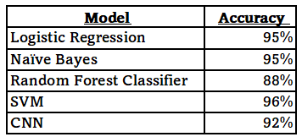
Summarization Table:

Slide 7
Challenges Faced/Lesson Learned:
Learnt importance of data quality.
Learnt that certain approaches are not suitable for high dimensional data and the importance of feature selection.
Processing all the 150 files all together on CPU was difficult.
Data Preprocessing plays a vital role before implementing any thing on given text file.
In order to visualize clusters, PCA is used to convert the high dimensional feature vector to a 2D one and then the chunks are plotted

