Slide 1
Null Axis Customer Support Chatbot
Kunal Kiran Sutar (25/11/2025)
1/7

Slide 2
WorkFlow
2/7

Slide 3
WorkFlow
User Prompt
2/7

Slide 4
WorkFlow
User Prompt
Intent Classification (LLM)
2/7

Slide 5
WorkFlow
User Prompt
Technical Support
Intent Classification (LLM)
Sales lead
Feature request
2/7

Slide 6
WorkFlow
User Prompt
Greeting
Technical Support
Intent Classification (LLM)
Sales lead
Feature request
2/7

Slide 7
WorkFlow
User Prompt
Greeting
Greet back
Technical Support
Intent Classification (LLM)
Sales lead
Feature request
2/7

Slide 8
WorkFlow
User Prompt
Greeting
Greet back
Technical Support
Intent Classification (LLM)
Sales lead
Feature request
Human request
2/7

Slide 9
WorkFlow
User Prompt
Greeting
Greet back
Technical Support
Intent Classification (LLM)
Sales lead
Feature request
Human request
Connect to a human
2/7

Slide 10
WorkFlow
User Prompt
Greeting
Greet back
Technical Support
Search in KB
Intent Classification (LLM)
Sales lead
Feature request
Human request
Connect to a human
2/7

Slide 11
WorkFlow
User Prompt
Greeting
Greet back
Technical Support
Search in KB
Intent Classification (LLM)
Sales lead
Check missing fields
Feature request
Human request
Connect to a human
2/7

Slide 12
WorkFlow
User Prompt
Greeting
Greet back
Technical Support
Search in KB
Intent Classification (LLM)
Politely ask for the missing fields
Sales lead
Check missing fields
Feature request
Human request
Connect to a human
2/7

Slide 13
WorkFlow
User Prompt
Greeting
Greet back
Technical Support
Search in KB
Intent Classification (LLM)
Politely ask for the missing fields
Sales lead
Check missing fields
Save
lead
Feature request
Human request
Connect to a human
2/7

Slide 14
WorkFlow
User Prompt
Greeting
Greet back
Technical Support
Search in KB
Intent Classification (LLM)
Politely ask for the missing fields
Sales lead
Check missing fields
Save
lead
Feature request
Save feature request
Human request
Connect to a human
2/7

Slide 15
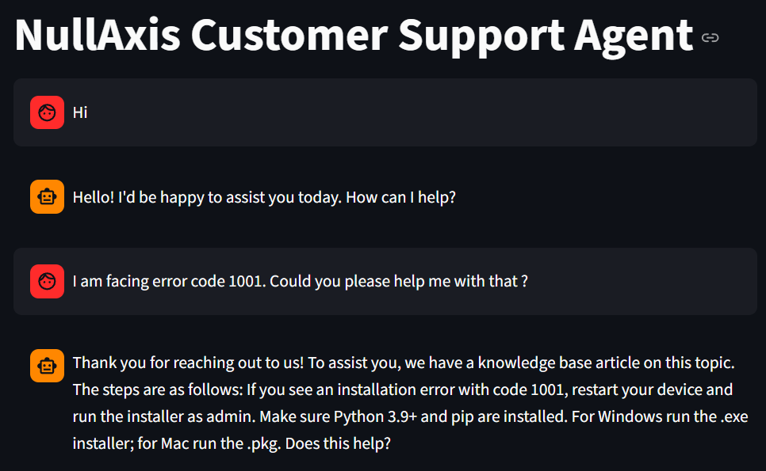
Technical Support Section
3/7

Slide 16
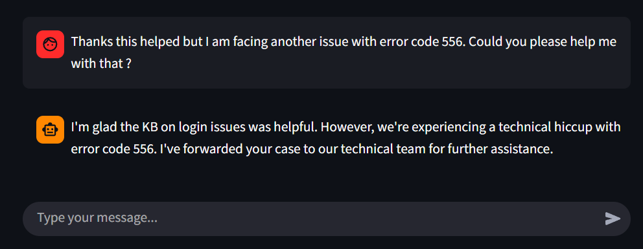
Technical Support Section
As there is no KB for the error code 556
The agent correctly forwards it to technical person
4/7

Slide 17
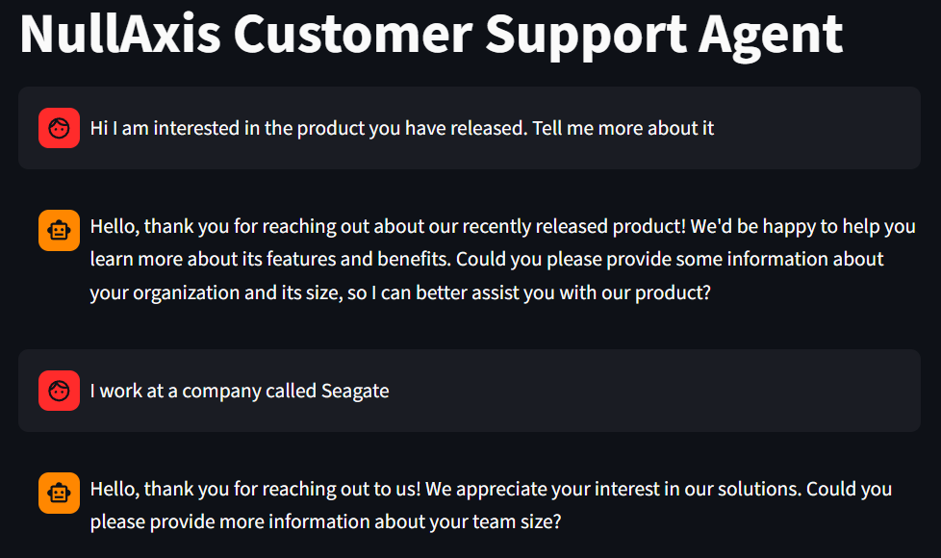
Sales Lead
5/7

Slide 18
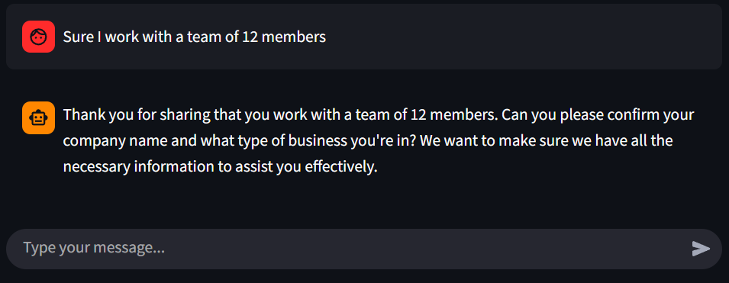
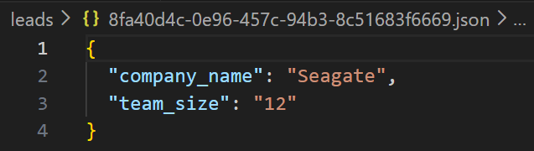
Sales Lead
Deliberately give the agent incomplete information to check if it can handle such situations
6/7

Slide 19
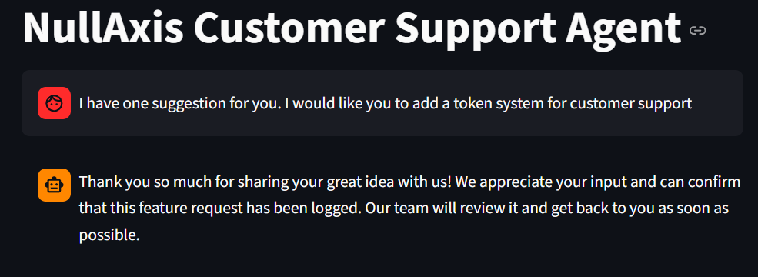
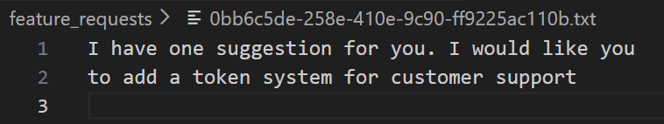
Feature request
7/7

Slide 20
Thank you

