Slide 1
Object-Oriented Software Design (lecture 7)

Slide 2
Object-oriented Concepts
Basic Mechanisms:
  Objects:
    A real-world entity.
    A system is designed as a set of interacting objects.
    Consists of data (attributes) and functions (methods) that operate on data
    Hides organization of internal information (Data abstraction)
    Examples: an employee, a book etc.

Slide 3
Object-oriented Concepts
m8
m7
mi are methods
of the object
m1
Data
m6
m2
m5
Object
m3
m4
Model of an object

Slide 4
Object-oriented Concepts
  Class:
    Instances are objects
    Template for object creation
    Examples: set of all employees, different types of book

Slide 5
Object-oriented Concepts
  Methods and message:
    Operations supported by an object
    Means for manipulating the data of other objects
    Invoked by sending message
    Examples: calculate_salary, issue-book, member_details, etc.

Slide 6
Object-oriented Concepts
  Inheritance:
    Allows to define a new class (derived class) by extending or modifying existing class (base class)
    Represents Generalization-specialization relationship
    Allows redefinition of the existing methods (method overriding)

Slide 7
Object-oriented Concepts
  Multiple Inheritance:
    Subclass can inherit attributes and methods from more than one base class
    Multiple inheritance is represented by arrows drawn from the subclass to each of the base classes

Slide 8
Object-oriented Concepts
LibraryMember
Base Class
LibraryMember
Base Class
Faculty
Students
Staff
Derived
Classes
Faculty
Students
Staff
Multiple
Inheritance
UnderGrad
PostGrad
Research
UnderGrad
PostGrad
Research

Slide 9
Object-oriented Concepts
Key Concepts:
  Abstraction:
    Consider aspects relevant for certain purpose
    Suppress non-relevant aspects
    Supported at two levels i.e. class level where base class is an abstraction & object level where object is a data abstraction entity

Slide 10
Object-oriented Concepts
  Advantages of abstraction:
    Reduces complexity of software
    Increases software productivity
  It is shown that software productivity is inversely proportional to software complexity

Slide 11
Object-oriented Concepts
  Encapsulation:
    Objects communicate outside world through messages
    Objects data encapsulated within its methods

Slide 12
Object-oriented Concepts
Methods
m4
m3
Data
m5
m2
m6
m1
Concept of encapsulation

Slide 13
Object-oriented Concepts
  Polymorphism:
    Denotes to poly (many) morphism (forms)
    Same message result in different actions by different objects (static binding)

Slide 14
What is an object?
a) An object is an instance of a class
b) An object includes encapsulation of data
c) An object is not an instance of a class
d) All of the mentioned

Slide 15
Advantages of Object-oriented design
  Code and design reuse
  Increased productivity
  Ease of testing & maintenance
  Better understandability
  Its agreed that increased productivity is chief advantage

Slide 16
Advantages of Object-oriented design
  Initially incur higher costs, but after completion of some projects reduction in cost become possible
  Well-established OO methodology and environment can be managed with 20-50% of traditional cost of development

Slide 17
Object modelling using UML
  UML is a modelling language
  Not a system design or development methodology
  Used to document object-oriented analysis and design
  Independent of any specific design methodology

Slide 18
UML
  Based Principally on
    OMT [Rumbaugh 1991]
    Booch’s methodology[Booch 1991]
    OOSE [Jacobson 1992]
    Odell’s methodology[Odell 1992]
    Shlaer and Mellor [Shlaer 1992]

Slide 19
Why UML is required?
  Model is required to capture only important aspects
  UML a graphical modelling tool, easy to understand and construct
  Helps in managing complexity

Slide 20
UML diagrams
  Nine diagrams to capture different views of a system
  Provide different perspectives of the software system
  Diagrams can be refined to get the actual implementation of the system

Slide 21
UML diagrams
  Views of a system
    User’s view
    Structural view
    Behavioral view
    Implementation view
    Environmental view

Slide 22
UML diagrams
Behavioural View
Sequence Diagram
Collaboration Diagram
- State-chart Diagram
- Activity Diagram
Structural View
Class Diagram
Object Diagram
User’s View
Use Case
Diagram
Implementation View
Component Diagram
Environmental View
Deployment Diagram
Diagrams and views in UML

Slide 23
Are all views required?
  NO
  Use case model, class diagram and one of the interaction diagram for a simple system
  State chart diagram in case of many state changes
  Deployment diagram in case of large number of hardware components

Slide 24
Use Case model
  Consists of set of “use cases”
  An important analysis and design artifact
  Other models must confirm to this model
  Not really an object-oriented model
  Represents a functional or process model

Slide 25
Use Cases
  Different ways in which system can be used by the users
  Corresponds to the high-level requirements
  Represents transaction between the user and the system
  Define behavior without revealing internal structure of system
  Set of related scenarios tied together by a common goal

Slide 26
Use Cases
  Normally, use cases are independent of each other
  Implicit dependencies may exist
  Example: In Library Automation System, renew-book & reserve-book are independent use cases. But in actual implementation of renew-book, a check is made to see if any book has been reserved using reserve-book

Slide 27
Example of
Use Cases
  For library information system
    issue-book
    Query-book
    Return-book
    Create-member
    Add-book, etc.

Slide 28
Representation of
Use Cases
  Represented by use case diagram
  Use case is represented by ellipse
  System boundary is represented by rectangle
  Users are represented by stick person icon (actor)
  Communication relationship between actor and use case by line
  External system by stereotype

Slide 29
Example of
Use Cases
Tic-tac-toe game
Play Move
Player
Use case model

Slide 30
Why develop
Use Case diagram?
  Serves as requirements specification
  Users identification helps in implementing security mechanism through login system
  Another use in preparing the documents (e.g. user’s manual)

Slide 31
Factoring
Use Cases
  Complex use cases need to be factored into simpler use cases
  Represent common behavior across different use cases
  Three ways of factoring
    Generalization
    Includes
    Extends

Slide 32
Factoring Using
Generalization
Pay membership fee
Pay through credit card
Pay through library pay card
Use case generalization

Slide 33
Factoring Using
Includes
Base use case
<<include>>
Common
use case
Use case inclusion
Base use case
Base use case
<<include>>
<<include>>
<<include>>
<<include>>
Base use case
Base use case
Base use case
Paralleling model

Slide 34
Factoring Using
Extends
Base
use case
<<extends>>
Common
use case
Use case extension

Slide 35
Which of the following are the valid relationships in Use Case Diagrams
a) Generalization
b) Include
c) Extend
d) All of the mentioned

Slide 36
Class diagram
  Describes static structure of a system
  Main constituents are classes and their relationships:
    Generalization
    Aggregation
    Association
    Various kinds of dependencies

Slide 37
Class diagram
  Entities with common features, i.e. attributes and operations
  Classes are represented as solid outline rectangle with compartments
  Compartments for name, attributes & operations
  Attribute and operation compartment are optional for reuse purpose

Slide 38
Example of
Class diagram
LibraryMember
LibraryMember
LibraryMember
Member Name
Membership Number
Address
Phone Number
E-Mail Address
Membership Admission Date
Membership Expiry Date
Books Issued
Member Name
Membership Number
Address
Phone Number
E-Mail Address
Membership Admission Date
Membership Expiry Date
Books Issued
issueBook( );
findPendingBooks( );
findOverdueBooks( );
returnBook( );
findMembershipDetails( );
Different representations of the LibraryMember class

Slide 39
Association Relationship
Library Member
1
borrowed by
*
Book
Association between two classes

Slide 40
Aggregation Relationship
  Represent a whole-part relationship
  Represented by diamond symbol at the composite end
  Cannot be reflexive(i.e. recursive)
  Not symmetric
  It can be transitive

Slide 41
Aggregation Relationship
Document
1
*
1
*
Line
Paragraph
Representation of aggregation

Slide 42
Composition Relationship
  Life of item is same as the order
Order
1
*
Item
Representation of composition

Slide 43
Class Dependency
Dependent Class
Independent Class
Representation of dependence between class

Slide 44
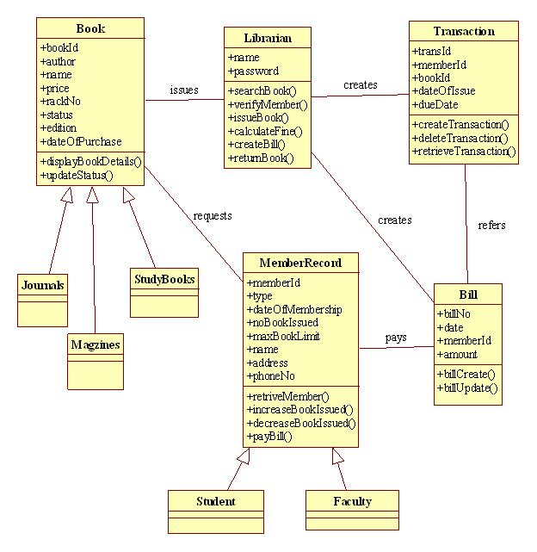


Slide 45
Object diagram
LibraryMember
Mritunjay
B10028
C-108, Laksmikant Hall
1119
Mrituj@cse
25-02-04
25-03-06
NIL
IssueBook( );
findPendingBooks( );
findOverdueBooks( );
returnBook( );
findMembershipDetails( );
LibraryMember
Mritunjay
B10028
C-108, Laksmikant Hall
1119
Mrituj@cse
25-02-04
25-03-06
NIL
LibraryMember
Different representations of the LibraryMember object

Slide 46
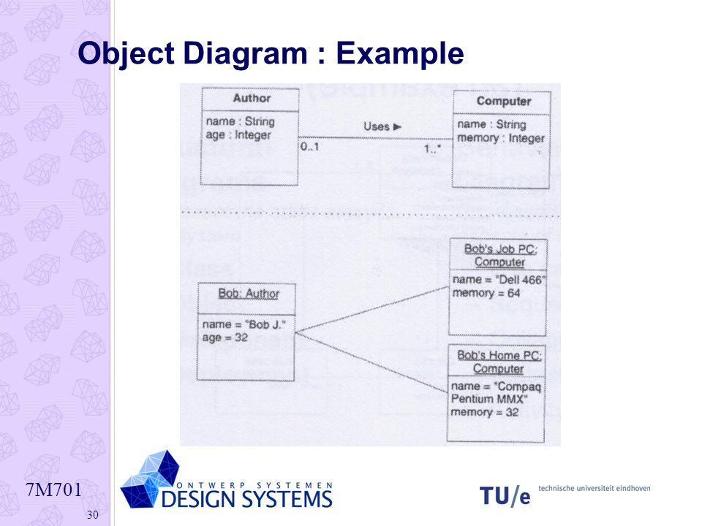

Slide 47
Classes and interfaces are a part of
a) Structural things
b) Behavioral things
c) Grouping things
d) Annotational things

Slide 48
Interaction diagram
  Models how groups of objects collaborate to realize some behaviour
  Typically each interaction diagram realizes behaviour of a single use case

Slide 49
Interaction diagram
  Two kinds: Sequence & Collaboration
  Two diagrams are equivalent but portrays different perspective
  These diagram play a very important role in the design process

Slide 50
Sequence diagram
  Shows interaction among objects as two-dimensional chart
  Objects are shown as boxes at top
  If object created during execution then shown at appropriate place
  Objects existence are shown as dashed lines (lifeline)
  Objects activeness, shown as rectangle on lifeline

Slide 51
Sequence diagram
  Messages are shown as arrows
  Message labelled with message name
  Message can be labelled with control information
  Two types of control information: condition ([]) & an iteration (*)

Slide 52
Example of
Sequence diagram
:Library
Boundary
:Library
Book
Renewal
Controller
:Library
Book
Register
:Book
:Library
Member
renewBook
find MemberBorrowing
displayBorrowing
selectBooks
bookSelected
* find
[reserved]
[reserved]
apology
update
apology
confirm
confirm
updateMemberBorrowing
Sequence Diagram for the renew book use case

Slide 53
Collaboration diagram
  Shows both structural and behavioural aspects
  Objects are collaborator, shown as boxes
  Messages between objects shown as a solid line
  Message is shown as a labelled arrow placed near the link
  Messages are prefixed with sequence numbers to show relative sequencing

Slide 54
Example of
Collaboration diagram
:Library
Book
Register
6: * find
:Book
[reserved]
9: update
8: apology
5: book
Selected
10: confirm
:Library
Boundary
1: renewBook
:Library
Book
Renewal
Controller
[reserved]
7: apology
3: display
Borrowing
4: selectBooks
2: findMemberBorrowing
12: confirm
:Library
Member
updateMemberBorrowing
Collaboration Diagram for the renew book use case

Slide 55
Activity diagram
  New concept, possibly based on event diagram of Odell [1992]
  Represent processing activity, may not correspond to methods
  Activity is a state with an internal action and one/many outgoing transition

Slide 56
Activity diagram
  Can represent parallel activity and synchronization aspects
  Swim lanes enable to group activities based on who is performing them
  Example: academic department vs. hostel

Slide 57
Activity diagram
  Normally employed in business process modelling
  Carried out during requirement analysis and specification
  Can be used to develop interaction diagrams

Slide 58
Example of
Activity diagram
Academic Section
Accounts Section
Hostel Office
Hospital
Department
check
student
records
receive
fees
allot
hostel
create
hospital
record
receive
fees
register
in
course
conduct
medical
examination
allot
room
issue
identity card
Activity diagram for student admission procedure at IIT

Slide 59
State Chart diagram
  Based on the work of David Harel [1990]
  Model how the state of an object changes in its lifetime
  Based on finite state machine (FSM) formalism

Slide 60
State Chart diagram
  Elements of state chart diagram
  Initial State: Filled circle
  Final State: Filled circle inside larger circle
  State: Rectangle with rounded corners
  Transitions: Arrow between states, also boolean logic condition (guard)

Slide 61
Example of
State Chart diagram
order received
Unprocessed
Order
[reject] checked
[accept] checked
Rejected
Order
Accepted
Order
[some items available]
processed / deliver
[some items not
available] processed
Pending
Order
[all items
available]
newsupply
Fulfilled
Order
Example: State chart diagram for an order object

Slide 62
Example 1: Tic-Tac-Toe Computer Game
A human player and the computer make alternate moves on a 3 3 square.
A move consists of marking a previously unmarked square.
The user inputs a number between 1 and 9 to mark a square
Whoever is first to place three consecutive marks along a straight line (i.e., along a row, column, or diagonal) on the square wins.

Slide 63
Example 1: Tic-Tac-Toe Computer Game
As soon as either of the human player or the computer wins,
  a message announcing the winner should be displayed.
If neither player manages to get three consecutive marks along a straight line,
  and all the squares on the board are filled up,
  then the game is drawn.
The computer always tries to win a game.

Slide 64
Example 1: Use Case Model
Tic-tac-toe game
Play Move
Player

Slide 65
Example 1: Sequence Diagram
:playMove
Boundary
:playMove
Controller
:board
acceptMove
checkMoveValidity
move
[invalidMove]
[invalidMove]
announceInvalidMove
announceInvalidMove
checkWinner
[game over]
[game over]
announceResult
announceResult
playMove
checkWinner
[game over]
[game over]
announceResult
announceResult
displayBoardPositions
getBoardPositions
[game not over]
promptNextMove
Sequence Diagram for the play move use case

Slide 66
Example 1: Class Diagram
Board
PlayMoveBoundary
int position[9]
checkMove Validity
checkResult
playMove
announceInvalidMove
announceResult
displayBoard
Controller
announceInvalidMove
announceResult

Slide 67
Example 2: Supermarket Prize Scheme
Supermarket needs to develop software to encourage regular customers.
Customer needs to supply his residence address, telephone number, and the driving licence number.
Each customer who registers is assigned a unique customer number (CN) by the computer.

Slide 68
Example 2: Supermarket Prize Scheme
A customer can present his CN to the staff when he makes any purchase.
The value of his purchase is credited against his CN.
At the end of each year, the supermarket awards surprise gifts to ten customers who make highest purchase.

Slide 69
Example 2: Supermarket Prize Scheme
Also, it awards a 22 carat gold coin to every customer whose purchases exceed Rs. 10,000.
The entries against the CN are reset on the last day of every year after the prize winner’s lists are generated.

Slide 70
Example 2: Use Case Model
Supermarket
Prize scheme
register
customer
Customer
Clerk
register
sales
Sales Clerk
select
winners
Manager

Slide 71
Example 2: Sequence Diagram for the Select Winners Use Case
:SelectWinner
Boundary
:SelectWinner
Controller
:Sales
History
:Sales
Record
:Customer
Register
:Customer
Record
Select
Winners
SelectWinners
SelectWinners
*computeSales
*browse
[for each winner]
announces
find WinnerDetails
[for each winner]
browse
Sequence Diagram for the select winners use case

Slide 72
Example 2: Sequence Diagram for the Register Customer Use Case
:SelectWinner
Boundary
:SelectWinner
Controller
:Customer
Register
:Customer
Record
register
register
checkDuplicate
*match
[duplicate]
showError
generateCIN
create
:Customer
Record
register
displayCIN
Sequence Diagram for the register customer use case

Slide 73
Example 2: Sequence Diagram for the Register Sales Use Case
:Register
Sales
Boundary
:Register
Sales
Controller
:Sales
History
RegisterSales
registerSales
registerSales
:Sales
Record
create
confirm
confirm
Sequence Diagram for the register sales use case

Slide 74
Example 2: Sequence Diagram for the Register Sales Use Case
:Register
Sales
Boundary
:Sales
History
registerSales
RegisterSales
:Sales
Record
create
confirm
Refined Sequence Diagram for the register sales use case

Slide 75
Example 1: Class Diagram
SalesHistory
CustomerRegister
selectWinners
registerSales
findWinnerDetails
register
1
1
*
*
SalesRecords
CustomerRecord
salesDetails
name
address
computerSales
browse
create
browse
checkDuplicate
create

Slide 76
Summary
We discussed object-oriented concepts
  Basic mechanisms: Such as objects, class, methods, inheritance etc.
  Key concepts: Such as abstraction, encapsulation, polymorphism, composite objects etc.

Slide 77
Summary
We discussed an important OO language UML
  Its origin, as a standard, as a model
  Use case representation, its factorisation such as generalization, includes and extends
  Different diagrams for UML representation
  In class diagram we discussed some relationships association, aggregation, composition and inheritance

Slide 78
Summary
  Some more diagrams such as interaction diagrams (sequence and collaboration), activity diagrams, state chart diagram
We discussed OO software development process and patterns
  In this we discussed some patterns example and domain modelling

