Slide 1


Professor :
Jack Polnar
U59797517
CS779
Boston University
ECOMMERCE
ANALYTICS
DASHBOARD
Student :
Kunal Vishwa Sivakumar

Slide 2

Student :
Kunal Vishwa Sivakumar
CS779
Boston University
Dataset
ERD’s
Normalised Tables
Python Connector
Data Warehouse
Stored Procedure
Views
Tableau
Conclusion
Recommendations
OVERVIEW

Slide 3




TOOLS USED

Slide 4
QUESTIONS
1.WHAT ARE THE MONTHLY TOTAL SALES AND QUANTITY SOLD PER STORE LOCATION?
2.HOW EFFECTIVE WERE PROMOTIONS IN INCREASING TOTAL SALES VOLUME?
3.WHAT ARE THE TOP 10 BEST-SELLING PRODUCTS BASED ON TOTAL QUANTITY SOLD?
4.WHICH STORE HAD THE HIGHEST SALES DURING A SPECIFIC MONTH?
LET'S ANSWER IT :)

Slide 5
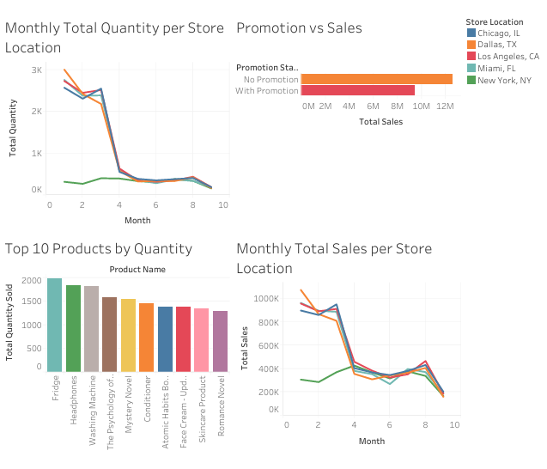







RESULTS
SCD TYPE 2
SCD TYPE 3

Slide 6

RECOMMENDATION
FOR NEXT STEP
STREAM THIS TO MONGODB USING KAFKA AND TRY THERE

Slide 7


Professor :
Jack Polnar
Kunal Vishwa Sivakumar
CS779
Boston University
THANK YOU

