Slide 1
















STATISTICAL ANALYSIS OF STOCK MARKET TRENDS AND PERFORMANCE
KUNAL VISHWA SIVAKUMAR
U59797517

Slide 2

INTRODUCTION: OVERALL PROJECT OBJECTIVE
The primary goal of this project is to analyze stock market trends and performance by focusing on the daily returns of publicly traded companies over a five-year period.

Slide 3

DATASET
The dataset used for this project is the "All Stocks 5-Year" dataset, sourced from Kaggle. It contains daily stock market data for publicly traded companies in the S&P 500 index over a five-year period.
Stock Prices
Ticker Symbols
Date
Volume

Slide 4




DATE CONVERSION
DAILY RETURNS CALCULATION
HANDLING MISSING VALUES
DATA
CLEANING
TOP COMPANIES SELECTION
INSTANCE REDUCTION FOR ANALYSIS
DATA CONSISTENCY
FILTERING COMPANIES WITH INSUFFICIENT DATA

Slide 5





Post-hoc Analysis (if ANOVA is significant)
Descriptive Statistics
STATISTICAL METHODS USED FOR ANALYSIS
Regression Analysis (Linear Regression)
Analysis of Variance (ANOVA)

Slide 6


STATISTICAL METHODS
Analysis of Variance (ANOVA)
Descriptive Statistics
Price Range
Daily Change
Daily Returns
Relative Change
ANOVA is used to test if there are significant differences in the average daily returns among companies with varying trading volumes.
Regression Analysis (Linear Regression)
Post-hoc Analysis (if ANOVA is significant)
Explores the relationship between trading volume, price range, daily change, relative change, and daily returns.
Post-hoc analysis, using tests like Tukey's HSD, identifies specific group differences when ANOVA shows significant results.

Slide 7


RESULT
ANOVA AND REGRESSION ANALYSIS
PREDICTED DAILY RETURNS
The ANOVA test yielded a p-value of 0.984, which is much higher than the significance level of 0.05., So fail to reject the null hypothesis for trading volume .
A multiple linear regression model was applied to predict daily returns using factors such as trading volume, price range, daily change, and relative change. The model explained 61.5% of the variance in daily returns, successfully predicting daily returns with a moderate accuracy, as indicated by the error metrics.
The model successfully predicted daily returns, with the predicted values being slightly close to the actual observed values, indicating the model's effectiveness in forecasting daily stock returns using multiple factors.

Slide 8
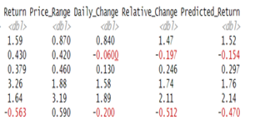


OUTPUT
RETURN PRICE :
PREDICTED RETURN :
REGRESSION_MODEL <- LM(RETURN ~ VOLUME + PRICE_RANGE + DAILY_CHANGE + RELATIVE_CHANGE, DATA = SAMPLED_DATA)

Slide 9


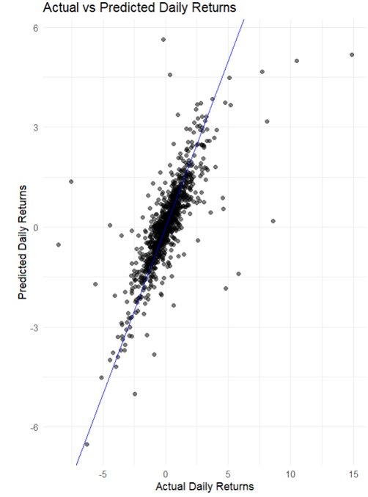
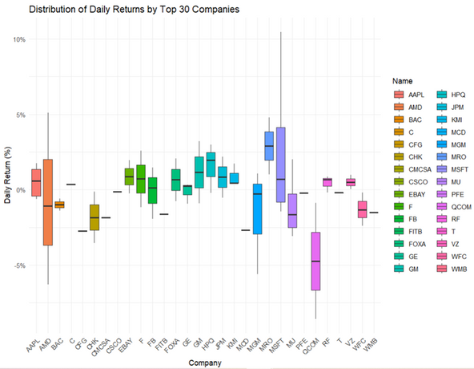
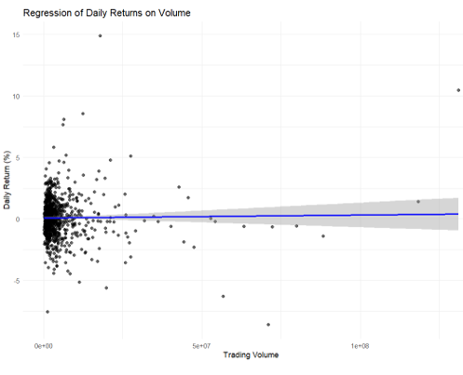


VISUALIZATION
ACTUAL
VS
PREDCITED
BOX PLOT
REGRESSION PLOT

Slide 10


CONCLUSION AND LIMITATIONS
CONCLUSION
LIMITATIONS
ANOVA results indicated no significant differences in daily returns across companies, suggesting that stock returns are not strongly influenced by trading volume.
The regression model explained 61.5% of the variation in daily returns, highlighting the influence of trading volume, price range, and relative change.
Sampling: Reducing the dataset to 1,000 observations, while necessary for computational efficiency, may have excluded important patterns or trends present in the full dataset.
Focus on Daily Returns: The analysis focuses solely on daily returns, ignoring longer-term trends or patterns. As a result, the conclusions drawn may not apply to medium- or long-term stock price predictions.

Slide 11

THANK YOU!

