Slide 1


Visual Grade
Student Performance Analyzer
Kunal Vishwa Sivakumar
CS-521 Final Term Project

Slide 2

Problem Statement
Managing and analyzing student grades is time-consuming and prone to manual errors.
Lack of an efficient way to track performance trends and classify students by grade level.
Need for a tool that automates grade tracking and provides actionable insights.

Slide 3

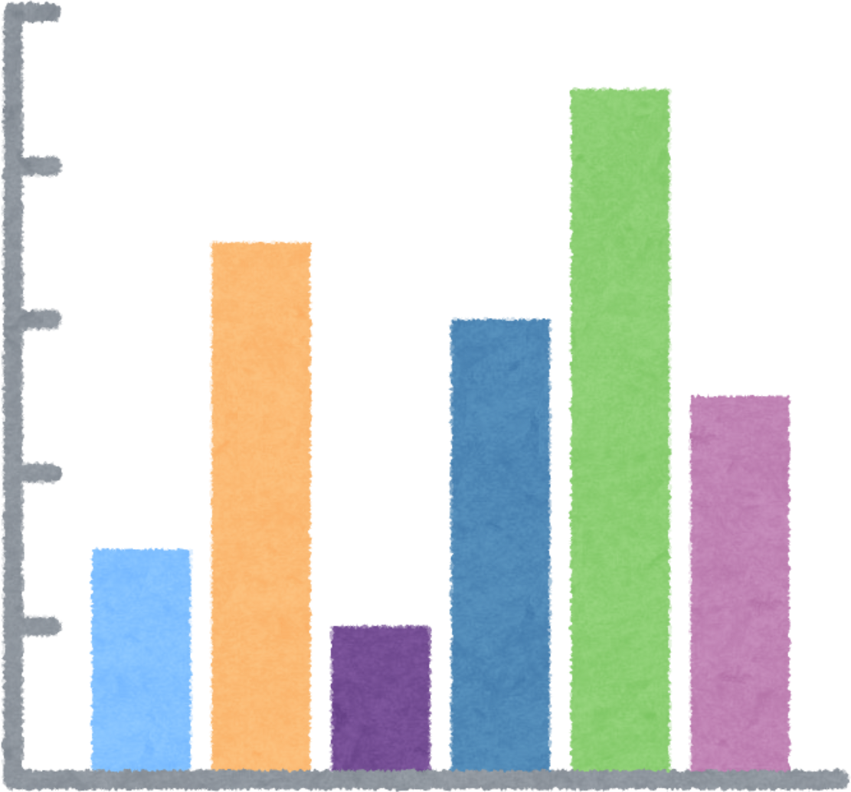

Project Goals
Objectives :
Key Features :
Automate grade management.
Analyze performance with classification and visualization.
Dynamic grade addition and validation.
Bar chart visualization for average grades.

Slide 4


Load and manage student data from a file.
Calculate averages and classify grades.
Project workflow
Visualize trends with bar charts using matplotlib.
Save updates back to the file system.

Slide 5

Code Highlights
Data Visualization: Simple bar charts with matplotlib.
OOPS IMPLEMENTATION
FILE HANDLING
Student class with private/public attributes and methods.
Use of __init__, __repr__, and validation logic.
Read/write student data with robust error handling (try-except).

Slide 6




CONTAINER TYPE
ITERATION TYPE
CONDITIONAL STATEMENTS
PROJECT FEATURES & CODE REQUIREMENTS
TRY BLOCKS
USER-DEFINED FUNCTIONS
INPUT AND/OR OUTPUT FILE
USER-DEFINED CLASS
UNIT TESTS
FILE I/O

Slide 7
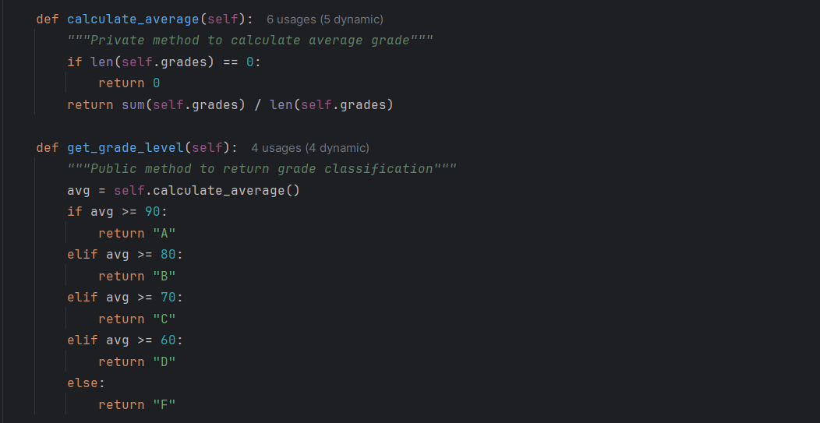

Code Snippets

Slide 8
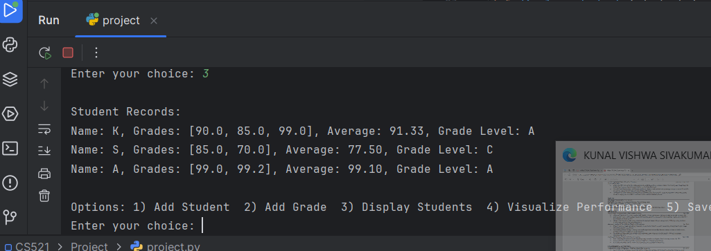

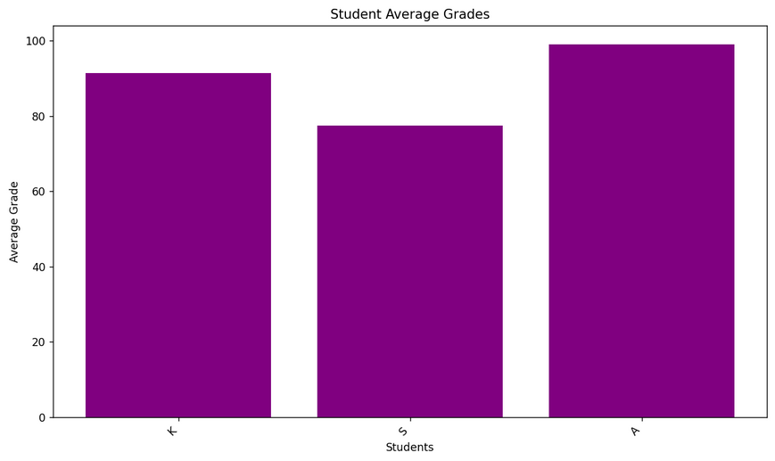

Results and Demo
How does the second paragraph contribute to the overall content of the text?
Successfully calculates and classifies grades (e.g., A, B, C).
Generates clear bar charts for performance insights.

Slide 9


Demonstrates Python skills: OOP, file handling, visualization.
Addresses grade analysis challenges effectively.
Future Enhancements:
Add more visualization styles (e.g., pie charts).
Create a web-based UI for broader access.
Conclusion

Slide 10




