Slide 1
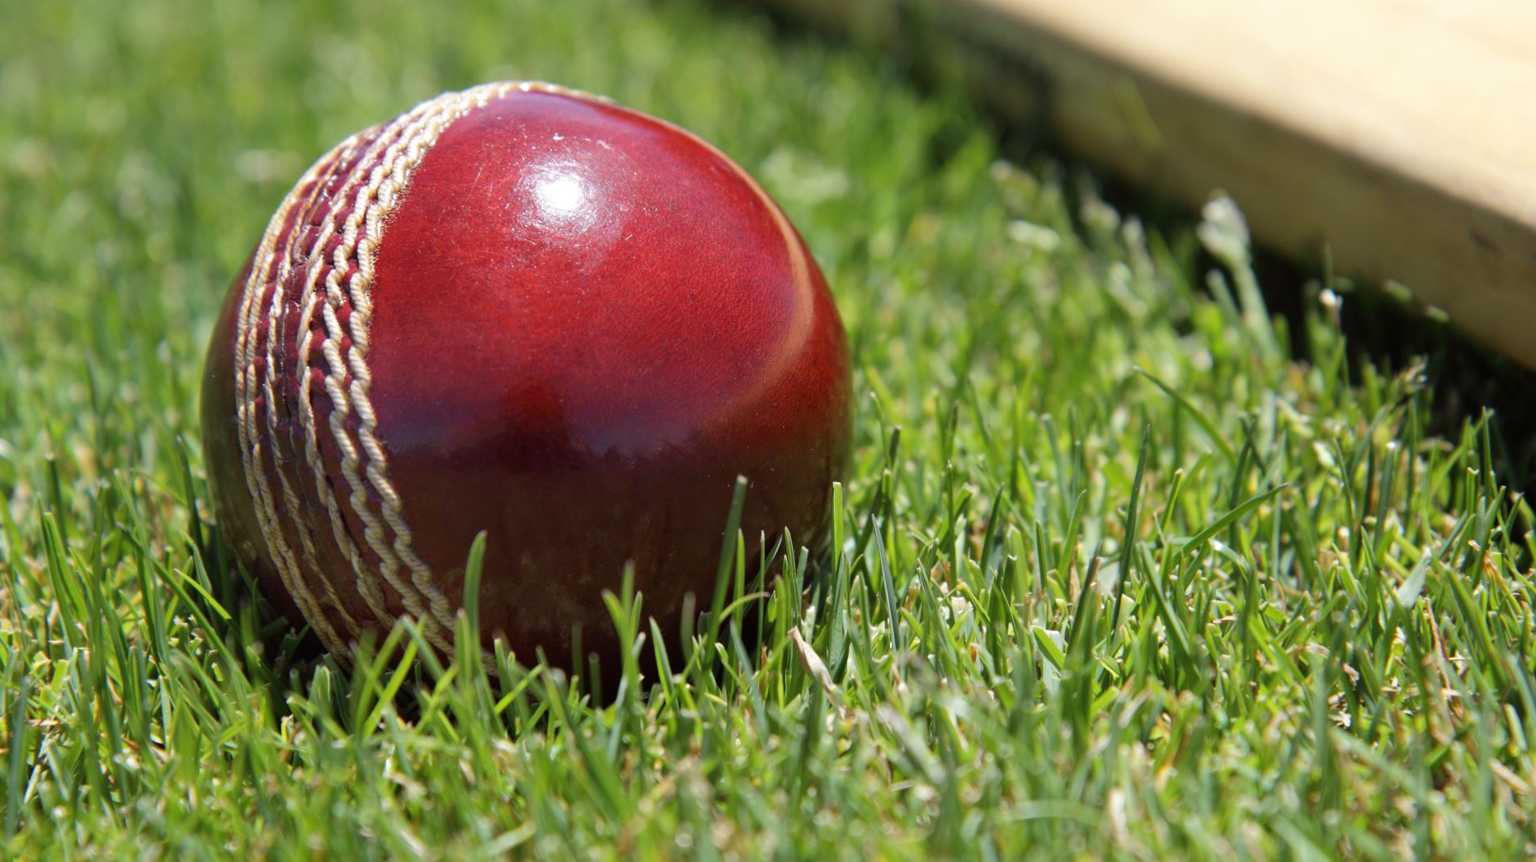
PROJECT: INDIAN CRICKET TEAM ODI ANALYSIS AND VISUALISATION SYSTEM
SUBMITTED BY: KUNAL SUBMITTED TO: MR. HARKIRAT SINGH

Slide 2



Slide 3
INDEX
INTRODUCTION
OBJECTIVES
IDEA , DATASET AND CLEANING
SCREENSHOTS OF DATA CLEANING PROCESS
FUTURE SCOPE
CONCLUSION

Slide 4
INTRODUCTION TO PROJECT
The project analyzes the performance of the Indian Cricket Team in ODI matches.
It uses historical match data to find useful insights.
Python and Pandas are used for data analysis.
Charts and graphs are created to visualize the results.
The project helps understand team performance in a simple way.

Slide 5
OBJECTIVES
To analyze the performance of the Indian Cricket Team in ODI matches.
To analyse the team's win and loss records.
To compare the team performance against different teams and at different grounds.
Analysis using simple charts and graphs for better understanding.

Slide 6
IDEA , DATA AND CLEANING
Cricket is very popular in India.
I love cricket so i chose this project .
I wanted to work on a topic that is interesting and on real-world dataset.
Searched for ODI cricket dataset online on too many platforms and found it on Kaggle.
Checked the data for missing or incorrect values.
Cleaned and organized the dataset using Pandas.

Slide 7
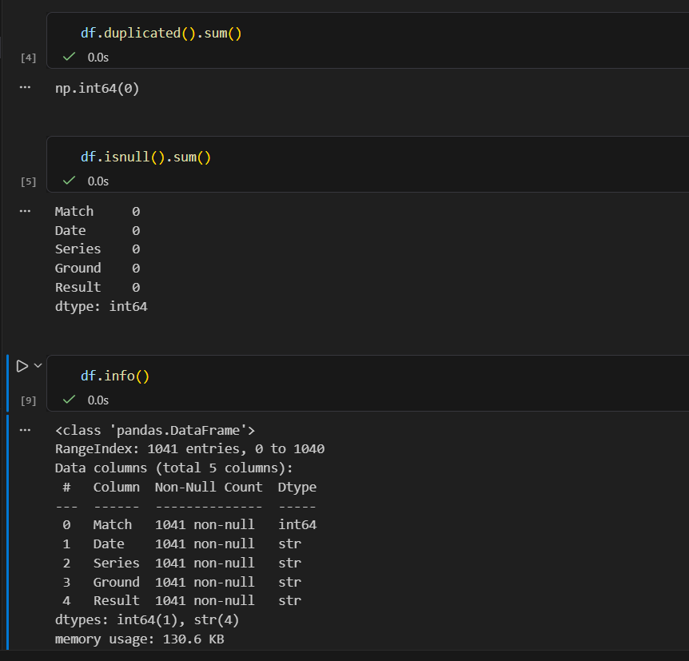
SCREENSHOT DATA CLEANING

Slide 8
FUTURE SCOPE
Add live cricket data so the analysis stays up to date.
Create an interactive dashboard for better visualization.
Use Machine Learning to predict future match results.
Compare India's performance with other international teams.

Slide 9
CONCLUSION
This project helps analyze the Indian Cricket Team's ODI performance using data.
Charts and graphs make the results easy to understand.
Python and Pandas make data analysis simple and efficient.
The project shows how data analytics can help understand sports performance better.

Slide 10


