Slide 1

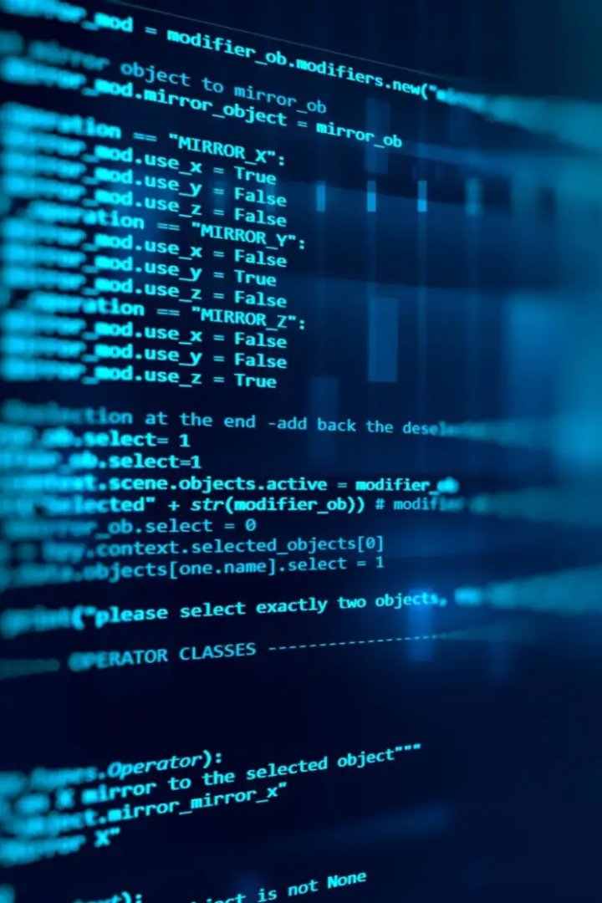
Introduction to Web Development
Web development is the process of building websites and applications for the internet. It requires a combination of technical and creative skills, including design, coding, and problem-solving. In this presentation, we'll explore the key technologies and languages used in web development.

Slide 2
Key Technologies and Languages
In today's digital landscape, staying up-to-date with the latest technologies and programming languages is essential. From front-end development with HTML, CSS, and JavaScript, to back-end technologies like Python, Java, and PHP, having a strong foundation in these key areas can greatly enhance your career prospects. Additionally, staying abreast of emerging technologies such as machine learning, blockchain, and cloud computing can give you a competitive edge in the industry.

Slide 3
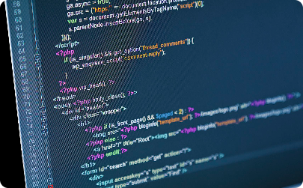
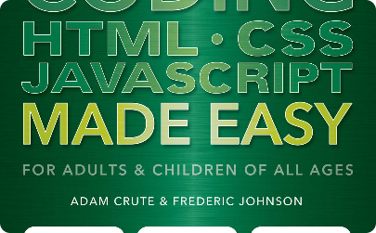
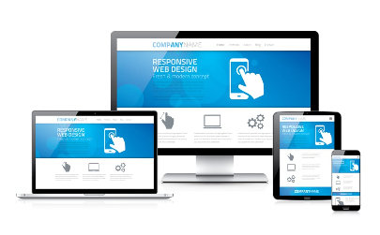
HTML
What is HTML?
Learning HTML
Responsive Design
HTML stands for HyperText Markup Language, it is the standard markup language used to create web pages. It defines the structure and content of a web page and is considered the building block of the web.
Learning HTML is easy with many online resources and books available for beginners. After learning the basics, start practicing by creating simple web pages.
Responsive design is a technique used to create a website that adapts its layout to fit any screen size. It's essential to create a good user experience and improve SEO rankings.

Slide 4
CSS
CSS Basics
Design and Layout
Responsive CSS
CSS stands for Cascading Style Sheets. It's used to define the layout and design of a web page. To use CSS effectively, it's essential to understand basic principles like selectors, properties, and values.
CSS allows developers to create visually appealing and functional websites. With CSS, you can customize the appearance of text, images, and other elements. It's crucial to learn the best practices for creating good design and layout.
With media queries in CSS, you can create a responsive website that adapts to different screen sizes. It's essential to learn how to use media queries to optimize the design for smaller devices.

Slide 5
JavaScript
1
What is JavaScript?
JavaScript is a programming language used to make web pages interactive. It allows developers to add animations, forms, and other features to websites.
JavaScript Frameworks
2
Frameworks like React, Angular, and Vue are popular tools used to develop complex web applications. They offer reusable components and high-level abstractions for common tasks.
3
Testing and Debugging
JavaScript can be challenging to debug, especially in complex applications. Learning debugging and testing techniques is essential to ensure high-quality code.

Slide 6
Backend Languages
Python
Ruby on Rails
PHP
Python is a popular choice for web development, thanks to its simplicity, readability, and strong community. It's used for scripting, automation, big data, and web development.
Ruby on Rails is a web framework built on the Ruby programming language. It's known for its speed, simplicity, and focus on convention over configuration.
PHP is a server-side scripting language used in web development to create dynamic web pages and web applications. It's easy to learn and widely supported by web hosting companies.

Slide 7
Conclusion
In conclusion, web development is a dynamic and ever-evolving field with a variety of technologies and languages. To become a successful web developer, it's essential to learn the basics, practice regularly, and keep up with the latest trends and best practices. Ready to take your next steps? Join a web development community, attend online courses and conferences, and start building real-world applications.

