Slide 1

Movie Rental
Capstone Project

Slide 2
SUMMARY
Overview :- The “Movie Rental” dataset includes information about Customers, Actors , Payment, Rental, Sales and demographic information.
Objective :- To analyze the “Movie rental” dataset in order to explore the Purchasing pattern, customer details, trend and other demographic details.
Goal :- To get the insights from the given dataset in order to make informed decision such that we can boost the Movie rental business.
Report and Presentation :- There are certain tasks involved to complete the project and at the end report and presentation should be submitted that is extracted from the Raw data. Such as Power Bi report, presentation, MEC breakdown.

Slide 3
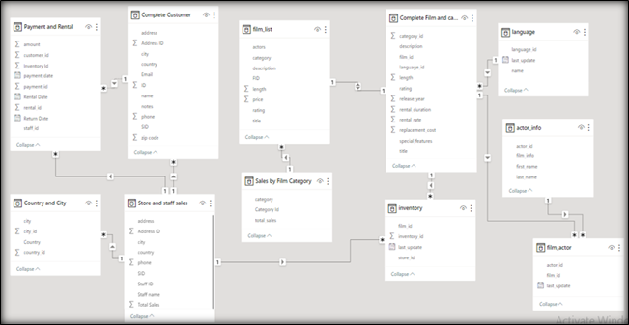
Overview
Actor Info :- This table contains all the data about the Actors i.e actor_id, Actor_Name, Film_info.
Customer :- This table contains the data about the Customer.
Films and Category :- This table contains data about films, price, rental details. Each Film is falls under different category.
City and Country :- This table contains data regarding City and Country. Customers and Staff are associated with their City and Country.
Film list :- This table has data about Actors involved in the film and rating given to each film.
Inventory :- This table contains Inventory_id, Store_Id, Fil_id. Film_id is linked with Inventory_id.
Language :- This table contains language_id which is associated with different-different languages.
Rental and Payment :- This table contains Rental_id, Payment_id, customer_id, Inventory_id, Staff_id and payment. These id are interlinked with each other such that we can fetch details as required.
Sales by Film category :- This table contains total sales as per the film category.
Sales by staff of the store :- This table contains data of sales acquired by each staff member.

Slide 4

Objective
There are certain steps/methods involved to in order to analyze and get insight from the given dataset:-
Extract the data/connecting the data set to ETL tool such as Power BI.
Go through the given dataset i.e evaluate the dataset/tables and Transforming the data.
Data cleaning if required.
Data modelling.
Adding extra table, column or measures as per the requirement.
MECE breakdown of the dataset i.e write down the questions/insight we can get from the given data set.
Prepare the charts in order to support or to have the clear understanding of the answers/insights.
Prepare the Power BI report with clear understanding and cleaniness.

Slide 5
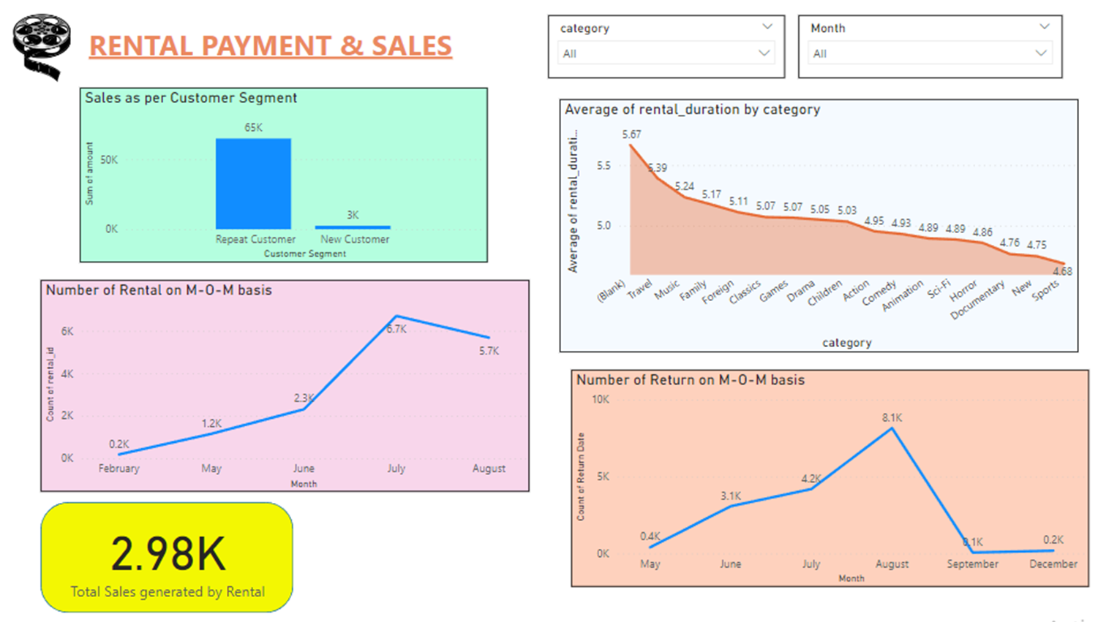
Goal
Our Goal is to insight from the given dataset in order to make informed decision.
With the help of insights we can see the trend, customer requirement and other important information.
This help us to make decision in a positive way as we would have data and insights.
The insights will also recommend us certain measures, steps that we can follow to improve the buisness and that will also help in the growth of the organization.
So all the insight must be accurate and easy to understand.

Slide 6
Report and Presentation
At last after getting all the details and the finding from the given data we have to present it in a very prominent way such that reports are easy to understand and logical.
We have also prepared the PPT on how the thing are done.
We have prepared Power BI report, EDA analysis report and ER Diagram.
We have faced many issues while finding the answers of the given question because as per the questions we were not having relevant data/records.

