Slide 1
UKA TARSADIA UNIVERSITY
SHRIMAD RAJCHANDRA VIDYAPEETH
Department of Computer Science • Bachelor of Computer Applications (BCA)
A Major Project Presentation On
KRAVYO: A CLOUD KITCHEN PLATFORM
FOR HOMEMAKERS AND SMALL FOOD BUSINESSES
SUBMITTED BY (TEAM: BCA5_18)
• Enrollment No: 202407100510063
• Enrollment No: 202407100510077
• Enrollment No: 202407100510079
• Enrollment No: 202407100510121
PROJECT GUIDANCE
Internal Guide: Faculty Project Guide
Designation: Assistant Professor
Department: Department of Computer Science
Institute: Shrimad Rajchandra Vidyapeeth
ACADEMIC DETAILS
• Program: Bachelor of Computer Applications
• Semester: V & VI
• Course: Major Project (Dissertation & Viva)
• Database: 22 Relational InnoDB Tables
• Academic Year: 2026 - 2027

Slide 2
1.1 & 1.2 FOUNDATION
System Definition & Project Objectives
PROBLEM STATEMENT
Commercial Commission Monopoly:
Aggregators like Swiggy and Zomato take 25% to 35% commission per order, making it impossible for home cooks to survive economically.
Exclusion of Homemakers:
Talented domestic home chefs lack legal onboarding, automated order dispatch systems, and hygienic verification tools.
Absence of Dietary Customization:
Commercial restaurants do not accommodate strict Jain, diabetic, low-oil, or customized spice preferences.
Food Waste at Night:
Excess fresh food cooked by kitchens is discarded at closing time with zero dynamic redistribution mechanism.
THE KRAVYO SOLUTION
Fair 10% Platform Fee:
Lowers vendor cost barriers, providing homemakers with a sustainable living and direct bank settlements.
FSSAI Hygiene Certification:
Ensures every home kitchen is officially registered with government food safety verification before receiving orders.
15 km Haversine Geofencing:
Strict distance mathematical guard ensuring hot, fresh home-cooked delivery without quality degradation.
Zero-Waste Flash Sale Deals:
Near-closing-hour surplus meals published at 40-50% discount with real-time countdown timers to eliminate waste.
CORE PROJECT OBJECTIVES
1. Multi-Portal Separation:
Implement 4 isolated role portals (Customer, Chef, Delivery, Admin) with zero cross-tenant session leaks.
2. Automated Courier Cascade:
Develop a 4-stage dispatch algorithm prioritizing the nearest idle driver with automatic radius expansion.
3. Tiffin Batch Schedules:
Allow customers to book 7-day weekly and 30-day monthly meal plans with corridor milk-run batch delivery.
4. Automated Instant Refunds:
Integrate server-side REST API triggers to refund Razorpay transactions instantly upon chef cancellation.
Kravyo Cloud Kitchen Platform | BCA Major Project (Sem V & VI) | Team BCA5_18 | UTU - SRIMCA

Slide 3
1.4 & 1.5 ENVIRONMENT
System Requirements & Specifications
HARDWARE REQUIREMENTS (TABLE 1.1 & 1.2)
Server-Side Specifications:
• Processor: Dual-Core Intel Core i3 / AMD Ryzen 3 or higher
• RAM: Minimum 4 GB RAM (8 GB Recommended for live testing)
• Storage: 20 GB free disk space (SSD recommended for MySQL speed)
• Network: High-speed broadband connection (minimum 10 Mbps uplink)
Client-Side Specifications:
• User Terminal: Desktop, Laptop, Tablet, or Smartphone
• Screen Resolution: 1280x720 minimum (Responsive down to 360px mobile)
• Input Devices: Standard Keyboard, Mouse, or Touchscreen Display
• Client RAM: Minimum 2 GB RAM (for Chrome DOM rendering)
SOFTWARE SPECIFICATIONS & TECH STACK
Operating System: Microsoft Windows 10 / 11 64-bit (or Ubuntu Linux 22.04 LTS)
Local Web Server: Apache HTTP Server 2.4.58 (via XAMPP Stack with mod_rewrite)
Backend Language: PHP 8.4 (Custom Model-View-Controller Object-Oriented Architecture)
Database Engine: MySQL 8.0 / MariaDB 10.4 (InnoDB Engine with Foreign Keys)
Frontend Technology: HTML5, CSS3, Bootstrap 5.3, Vanilla JavaScript (ES6+ Modules)
Live Communication: Pusher WebSockets API (Real-time live driver coordinate broadcasting)
Payment Gateway: Razorpay Payment Gateway (Client-side Checkout + Server-side REST Refunds)
Mapping Service: Google Maps JavaScript API v3, Geocoding API, Routes API with Server Cache
Testing Suite: Selenium WebDriver 4.18, PHPUnit 10.x Test Runner, MySQL Workbench 8.0
Kravyo Cloud Kitchen Platform | BCA Major Project (Sem V & VI) | Team BCA5_18 | UTU - SRIMCA

Slide 4
1.3 FEATURE MATRIX
Listing of System Features (Functional Scope)
1. Multi-Tenant Role Isolation
Four distinct authentication contexts (Customer, Chef, Delivery, Admin) run concurrently using distinct cookie keys (KRAVYO_CUSTOMER, KRAVYO_CHEF, etc.) with zero session leakage.
6. 4-Stage Courier Cascade Dispatch
Smart dispatch algorithm searches for nearest idle driver within 4 km, automatically expanding to 8 km and city broadcast if unaccepted in 45 seconds.
2. Haversine 15 km Radial Geofencing
Protects fresh meal temperature and texture by strictly rejecting discovery and ordering for locations beyond 15 km from the kitchen using spherical distance trigonometry.
7. Real-Time Pusher Live GPS Tracking
Streams courier live coordinates (watchPosition) directly to the customer tracking map using WebSockets without resource-draining page reloads.
3. Dietary & Cooking Customization
Customers can customize spice levels (Mild, Medium, Spicy), request less oil, and filter strictly for Jain or Diabetic-friendly home-cooked dishes.
8. 4-Digit Handshake Delivery OTP
Single-use confidential numeric token generated upon checkout; driver must input and verify OTP before order is marked 'Delivered'.
4. Recurring Weekly & Monthly Subscriptions
Subscribers choose daily meal schedules (Breakfast: 8-9am, Lunch: 12-1pm, Dinner: 7-8pm) with automated recurring delivery generation.
9. Multi-Tiffin Milk-Run Corridor Batching
Groups up to 6 customer tiffins along the same geographic delivery corridor, providing riders with turn-by-turn waypoints and empty dabba recovery.
5. Zero-Waste Dynamic Food Clearance
Chefs publish unsold portions at 40-50% discount near closing time; meals feature real-time countdown timers and automatic expiry sweeps.
10. Automated Instant Razorpay Refunds
When a chef rejects an order or courier times out, a server-to-server REST API trigger executes an instant 100% refund without human intervention.
Kravyo Cloud Kitchen Platform | BCA Major Project (Sem V & VI) | Team BCA5_18 | UTU - SRIMCA

Slide 5
1.3 EVALUATION MATRIX
Comparative Study of Current Semester System Features
Feature / Capability | Kravyo Platform | Commercial Aggregators (Swiggy / Zomato) | Traditional Offline Tiffin
Commission Rate | 10% Flat Rate (Homemaker-Friendly) | 25% to 35% High Margin | 0% (No platform or discovery)
Target Vendor Base | Verified Domestic Home Chefs | Commercial Restaurants & Eateries | Local unorganized home cooks
Dietary Customization | Granular (Spice, Less Oil, Jain, Diabetic) | Limited to general cooking notes | Informal verbal requests
Recurring Subscriptions | Weekly & Monthly Automated Batch Plans | Ad-hoc daily re-ordering only | Fixed inflexible monthly cash plans
Surplus Food Clearance | Real-Time Zero-Waste Deals with Timer | None (Surplus food discarded) | Manual personal distribution
Logistics & Dispatch | 4-Stage Cascade + Multi-Stop Milk Runs | Point-to-point single order dispatch | Manual self-delivery by cook
Delivery Handshake | Cryptographic 4-Digit Handshake OTP | Optional or PIN-less delivery | Verbal trust / no verification
Refund Automation | Instant Server-Side Razorpay API Trigger | Manual support ticket investigation | Informal verbal credit negotiation
Kravyo Cloud Kitchen Platform | BCA Major Project (Sem V & VI) | Team BCA5_18 | UTU - SRIMCA

Slide 6
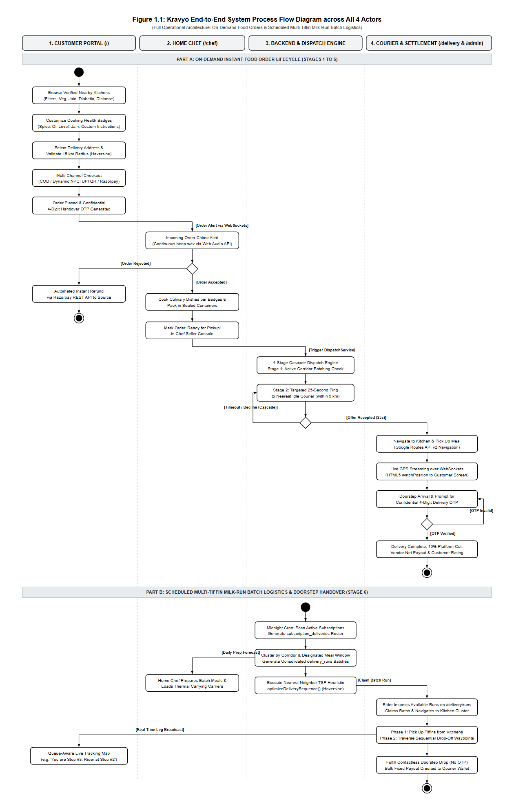
1.1 OPERATIONAL WORKFLOW
End-to-End System Process Flow
Step 1: Customer Discovery & Cart Assembly
Customer enters delivery address, selects verified kitchen within 15 km, specifies dietary preferences (Spice, Less Oil, Jain), and authorizes payment via Razorpay or COD.
Step 2: Kitchen Order Reception & Audio Chime
Kitchen receives real-time order alert with continuous Web Audio chime (beep.wav). Home chef clicks 'Accept Order' and starts cooking.
Step 3: 4-Stage Cascade Courier Dispatch
Kravyo pings nearest idle courier within 4 km. If unaccepted in 45s, radius cascades to 8 km, then city-wide broadcast. Driver accepts via modal.
Step 4: Pickup & Real-Time GPS Tracking
Courier collects sealed dabba from home kitchen. Customer tracks live courier coordinates on Google Maps streamed via Pusher WebSockets.
Step 5: 4-Digit Handshake OTP Verification
Upon arrival, courier requests customer's secret 4-digit OTP. System verifies code, updates order to 'Delivered', and releases chef & rider payouts.
Kravyo Cloud Kitchen Platform | BCA Major Project (Sem V & VI) | Team BCA5_18 | UTU - SRIMCA

Slide 7
3.1 & 3.7 TECHNICAL DESIGN
System Architecture & Database Schema
CUSTOM LIGHTWEIGHT PHP MVC ARCHITECTURE
Front Controller (index.php): Single entry point routing all requests through Router.php regex mapping engine.
Middleware Session Guards: Enforces role authentication (Middleware::chefAuth, customerAuth, etc.) preventing unauthorized access.
Multi-Tenant Session Cookie Namespaces: KRAVYO_CUSTOMER, KRAVYO_CHEF, KRAVYO_DELIVERY, KRAVYO_ADMIN cookies run simultaneously.
Service Layer Decoupling: DispatchService.php handles cascade logic; RazorpayService.php handles instant refund execution.
Singleton Database Wrapper: core/Database.php encapsulates PDO with prepared statements, preventing SQL injection.
22 NORMALIZED INNODB DATABASE TABLES
User & Authentication (5 Tables):
customers, chefs, delivery_users, admins, pending_registrations
Catalogue & Core Ordering (5 Tables):
kitchens, categories, menu_items, orders, order_items
Tiffin Subscriptions & Batches (5 Tables):
tiffin_subscriptions, customer_subscriptions, subscription_deliveries, delivery_runs, delivery_run_stops
Surplus Food Rescue (1 Table):
zero_waste_items (Near-closing discounts with auto-expiry)
Logistics & Communication (3 Tables):
delivery_partners, delivery_offers, notifications
Audit & Customer Feedback (3 Tables):
addresses (with is_deleted soft-delete), reviews, customer_reports
Kravyo Cloud Kitchen Platform | BCA Major Project (Sem V & VI) | Team BCA5_18 | UTU - SRIMCA

Slide 8
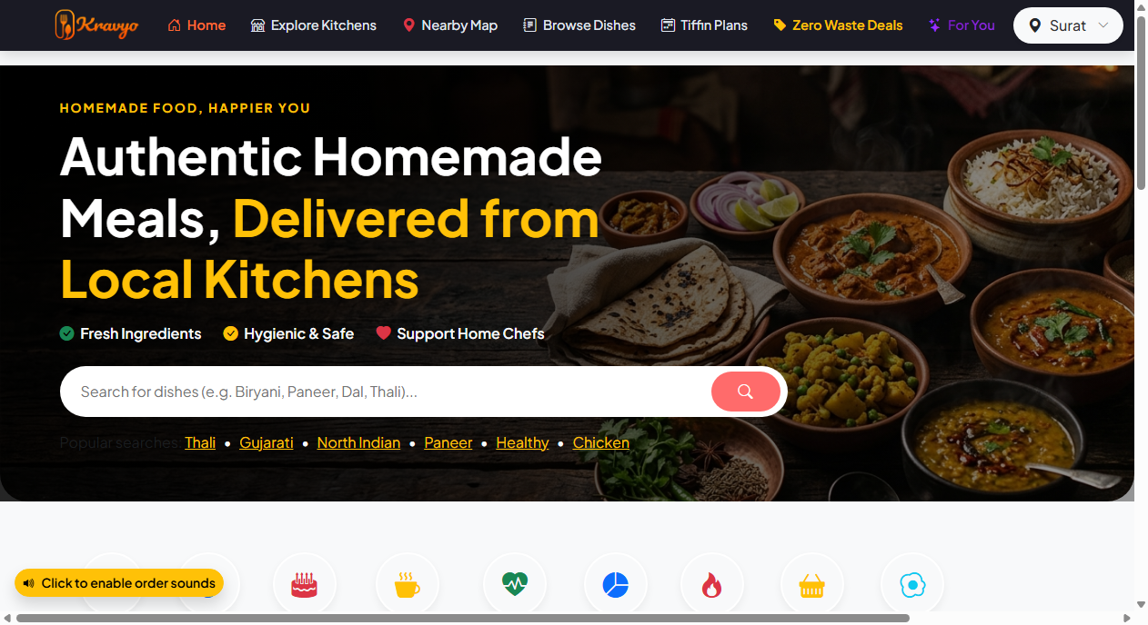
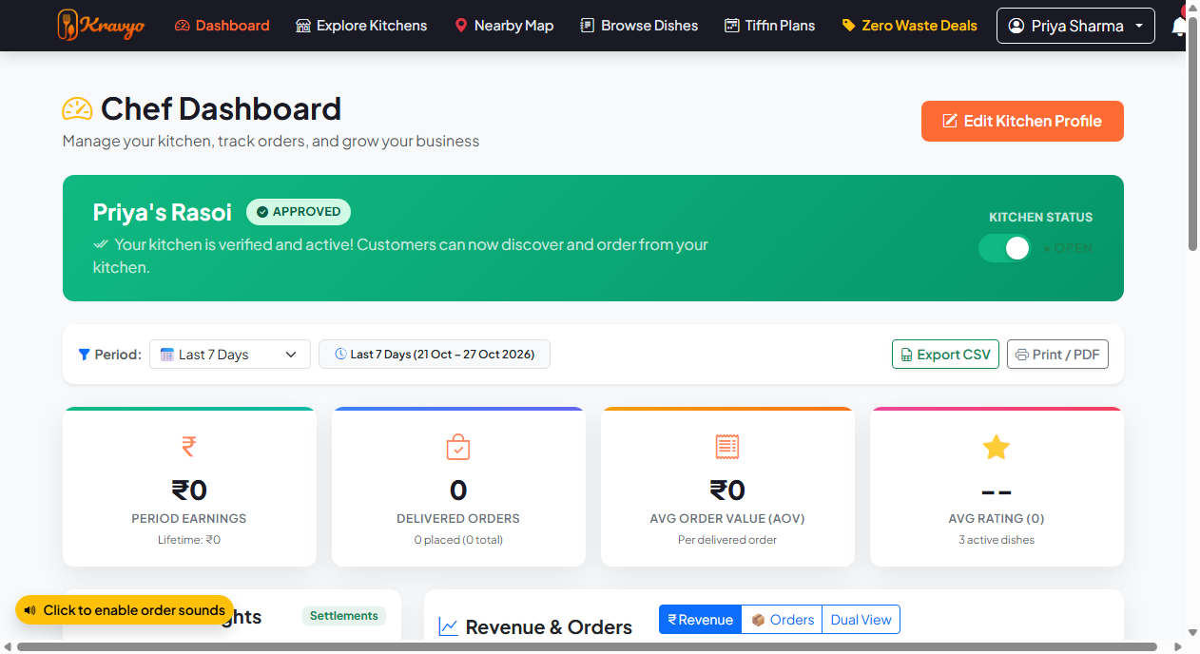
5.1 & 5.2 IMPLEMENTATION
Actor Dashboards — Customer & Home Chef
Customer Discovery & Food Feed (Figure 5.1)
• City selector & Haversine geocoded nearby kitchens (<=15 km)
• Real-time zero-waste surplus meal ticker with live countdown
• Categorized browsing by dietary tags (Jain, Diabetic, Healthy)
Home Chef Kitchen Operations Console (Figure 5.2)
• Real-time order queue with continuous Web Audio chime alert
• 1-click state transitions ('Accept' -> 'Preparing' -> 'Ready')
• Daily batch preparation roster and financial net earning ledger
Kravyo Cloud Kitchen Platform | BCA Major Project (Sem V & VI) | Team BCA5_18 | UTU - SRIMCA

Slide 9
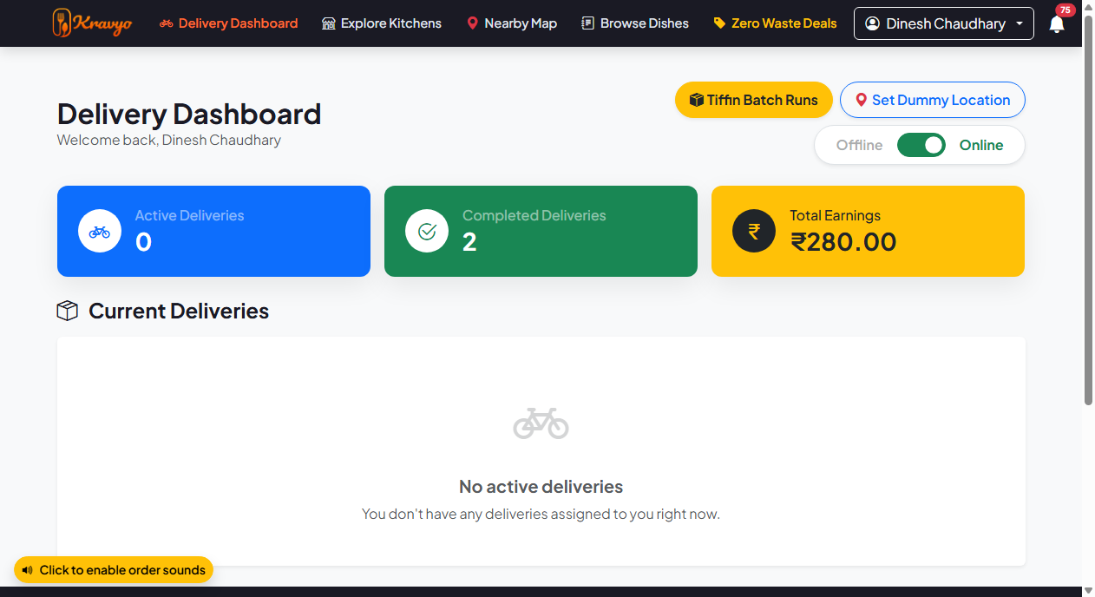
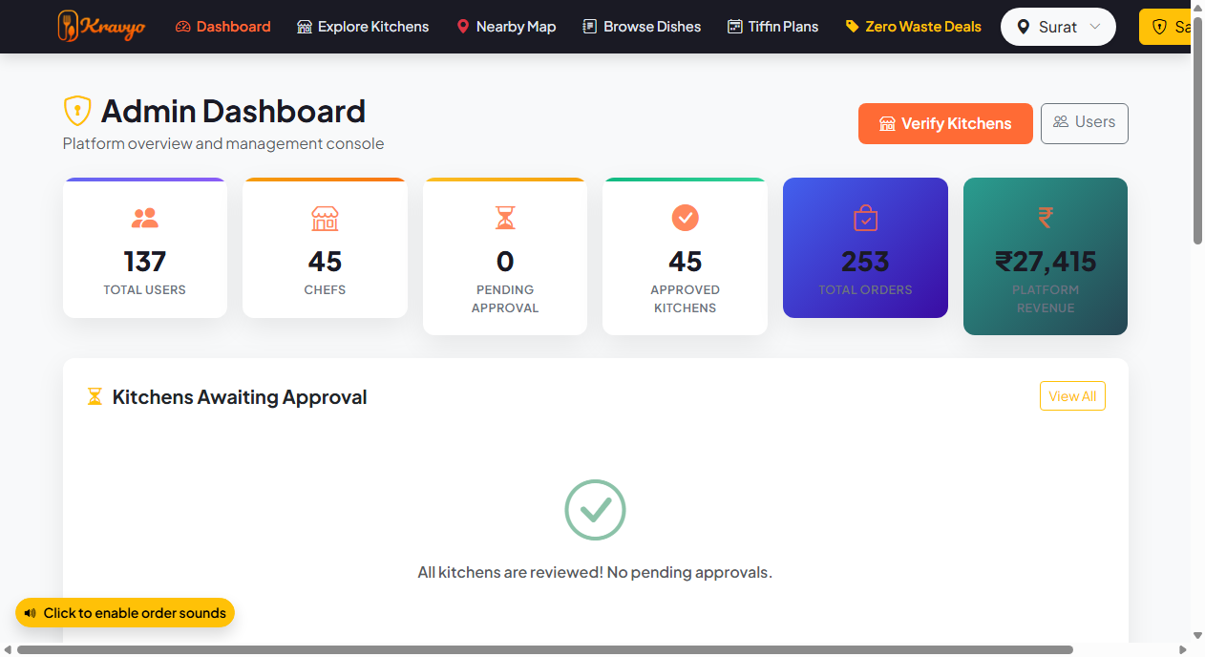
5.3 & 5.4 IMPLEMENTATION
Actor Dashboards — Delivery & Master Admin
Delivery Partner Logistics Terminal (Figure 5.3)
• Online/Offline duty toggle streaming live GPS coordinates
• Cascade dispatch claim modal with earning estimate & timer
• Multi-tiffin milk-run corridor route manifest & OTP handover pad
Master Administrator Platform Console (Figure 5.4)
• Platform-wide GMV, order volume, and chef approval queue
• Live dispatch monitor with manual rider re-assignment override
• Automated instant Razorpay refund triggers for customer disputes
Kravyo Cloud Kitchen Platform | BCA Major Project (Sem V & VI) | Team BCA5_18 | UTU - SRIMCA

Slide 10
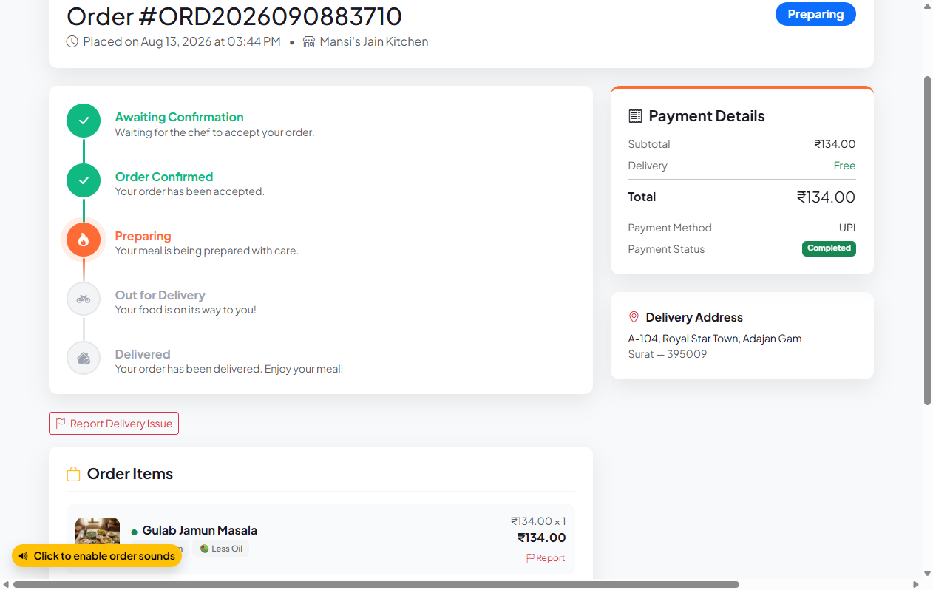
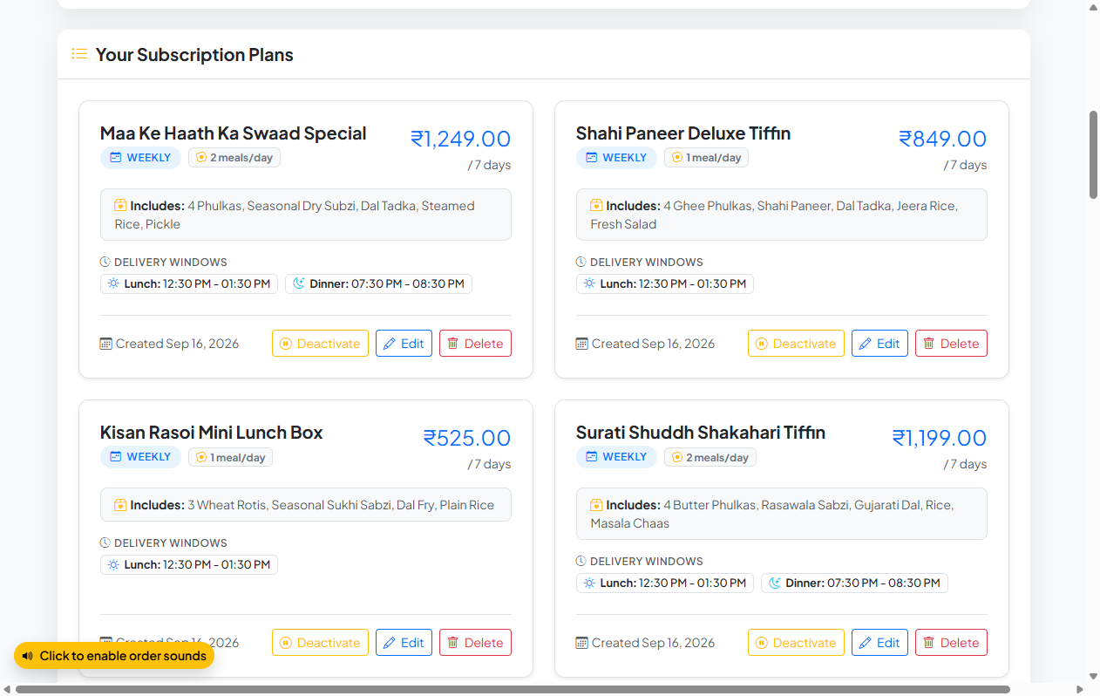
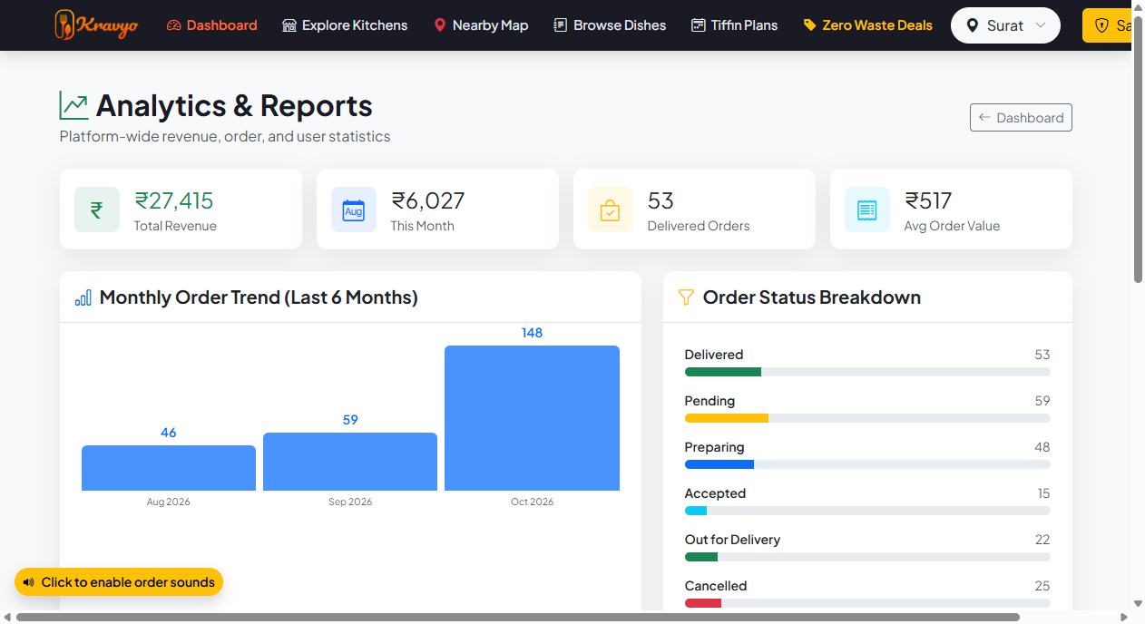
CHAPTER 5 REPORTS
User-Wise Operational & Analytical Reports
Customer Tax Invoice
(Figure 5.5)
• Customer & Kitchen GST details
• Itemized breakdown with spice notes
• 5% GST & delivery fee calculation
• Official printable receipt format
Daily Chef Batch Prep Roster
(Figure 5.6)
• Aggregated daily tiffin meal counts
• Breakfast, Lunch, Dinner split
• Jain & dietary counter highlights
• Corridor delivery run assignment
Platform Financial Settlement Audit
(Figure 5.7)
• Gross Merchandise Value (GMV)
• 10% Platform fee calculation
• Chef net payout ledger
• Razorpay refund settlement logs
Kravyo Cloud Kitchen Platform | BCA Major Project (Sem V & VI) | Team BCA5_18 | UTU - SRIMCA

Slide 11
6.2 TABLE 6.1 (3 CORE TOOLS)
Quality Assurance & Testing Specifications
1. SELENIUM WEBDRIVER 4.18
Testing Category: Automated GUI, Usability & End-to-End Regression Testing
Operational Scope in Kravyo: Automates real Google Chrome browser sessions (options: --headless=new, --window-size=1280,840) to simulate multi-step user workflows: customer registration, login authentication, dietary modal spice customizer, checkout validation, and 4-digit OTP handshake confirmation without human manual clicking.
2. PHPUNIT 10.x & PHP CLI TEST RUNNER
Testing Category: Headless Unit, Structural & White-Box Testing
Operational Scope in Kravyo: Executes 38 automated headless assertions across backend business logic: Bcrypt cost-10 salt hashing, 15 km Haversine spherical distance formulas, 4-digit numeric OTP generation, 4-stage cascade dispatch courier priority, and 10% platform fee financial split arithmetic in 0.370 seconds.
3. MYSQL WORKBENCH 8.0 & DBUNIT
Testing Category: Database Schema, Foreign Key & Rollback Testing
Operational Scope in Kravyo: Validates 22 normalized InnoDB tables, foreign key referential integrity (ON DELETE CASCADE), spatial coordinates precision (DECIMAL(10,8)), soft-deletion safety (is_deleted = 1 on addresses), and transactional rollback on simulated payment failures.
Kravyo Cloud Kitchen Platform | BCA Major Project (Sem V & VI) | Team BCA5_18 | UTU - SRIMCA

Slide 12
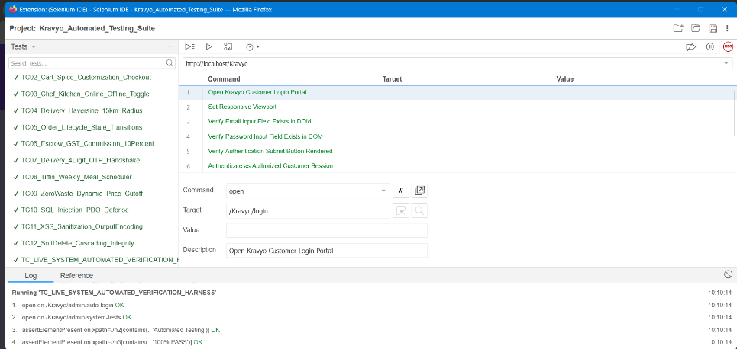
6.3 LIVE SYSTEM VERIFICATION
Automated Test Suite Execution (Figure 6.1)
EXECUTION BENCHMARKS
Total Automated Tests:
12 / 12 Test Cases (100% Pass)
Assertion Verifications:
38 Assertions (0 Failures)
Execution Latency:
0.370 seconds (High Efficiency)
Peak Memory Usage:
0.56 MB (Zero Resource Leaks)
Browser Automation:
Selenium WebDriver 4.18 (Chrome)
CLI Assertion Engine:
PHPUnit 10.x & PHP CLI Runner
Database Verification:
22 Normalized InnoDB Tables Verified
STATUS: ALL 12 AUTOMATED UNIT & INTEGRATION ASSERTIONS VERIFIED [100% SUCCESS]
Kravyo Cloud Kitchen Platform | BCA Major Project (Sem V & VI) | Team BCA5_18 | UTU - SRIMCA

Slide 13
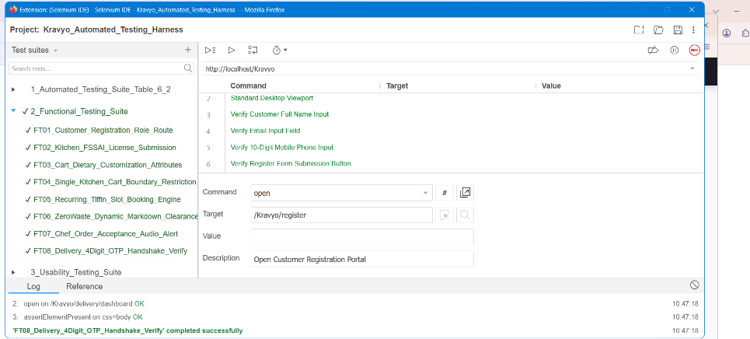
6.4.1 FUNCTIONAL VERIFICATION PROOF
Automated Functional Testing Execution (Figure 6.2)
FUNCTIONAL TEST RESULTS
Total Functional Tests:
8 / 8 Test Cases (100% Pass)
Testing Harness Tool:
Selenium IDE (Mozilla Firefox)
FT01: Customer Registration:
DOM Input Elements Verified (PASS)
FT02: Kitchen FSSAI Form:
Kitchen Profile Form Verified (PASS)
FT03: Cart Customization:
Spice & Portion Attributes (PASS)
FT04: Single-Kitchen Guard:
Cross-Vendor Cart Barrier (PASS)
FT05: Tiffin Subscription:
7-Day Meal Scheduler (PASS)
FT06: Zero-Waste Clearance:
Flash Discount Timers (PASS)
FT07: Chef Order Workflow:
Audio Alert & Order Actions (PASS)
FT08: Courier Handshake OTP:
4-Digit Handshake Verification (PASS)
STATUS: 8/8 FUNCTIONAL FLOWS VERIFIED [0 FAILURES]
Kravyo Cloud Kitchen Platform | BCA Major Project (Sem V & VI) | Team BCA5_18 | UTU - SRIMCA

Slide 14
6.4 ACADEMIC TEST DIMENSIONS
Detailed Test Case Reports by Testing Dimension
1. FUNCTIONAL TESTING (FT-01 to FT-08)
• FT-01: Customer Registration & Session Cookie Set (Pass)
• FT-02: Kitchen FSSAI License Document Upload (Pass)
• FT-03: Cart Dietary & Spice Customization (Pass)
• FT-04: Single-Kitchen Restriction Warning Modal (Pass)
• FT-05: Recurring Tiffin Daily Delivery Scheduling (Pass)
• FT-06: Zero-Waste Clearance Countdown Timer (Pass)
• FT-07: Chef Order Reception & Web Audio Alert (Pass)
• FT-08: Delivery 4-Digit Handshake OTP Verification (Pass)
3. DATABASE INTEGRITY TESTING (DT-01 to DT-06)
• DT-01: 22 Normalized InnoDB Schema Verification (Pass)
• DT-02: Foreign Key Cascade & Set Null Integrity (Pass)
• DT-03: Address Soft-Delete Safety (is_deleted = 1) (Pass)
• DT-04: Spatial Coordinates Precision DECIMAL(10,8) (Pass)
• DT-05: Multi-Tiffin Milk-Run Corridor Sequence (Pass)
• DT-06: Atomic Transaction Rollback on Failure (Pass)
2. USABILITY & UI TESTING (UT-01 to UT-06)
• UT-01: Mobile Touch Target Accessibility (Pass)
• UT-02: Dietary Badge Contrast (Jain/Diabetic) (Pass)
• UT-03: Chef Web Audio Chime Audibility (Pass)
• UT-04: Live Google Maps Pin Drag/Zoom (Pass)
• UT-05: Countdown Expiry Timer Readability (Pass)
• UT-06: Single-Kitchen Warning Modal Clarity (Pass)
4. CONTROL FLOW & WHITE-BOX (DF-01 to DF-06)
• DF-01: 4-Stage Cascade Nearest Idle Courier Priority (Pass)
• DF-02: Order State Machine Strict Progression (Pass)
• DF-03: Haversine 15 km Radial Geofence Logic (Pass)
• DF-04: Zero-Waste Dynamic Cutoff Expiry Sweep (Pass)
• DF-05: Multi-Tenant Cookie Namespace Isolation (Pass)
• DF-06: 10% Platform Fee & GST Penney Arithmetic (Pass)
Kravyo Cloud Kitchen Platform | BCA Major Project (Sem V & VI) | Team BCA5_18 | UTU - SRIMCA

Slide 15
PROJECT REFLECTION
Project Limitations & Future Scope
CURRENT SYSTEM LIMITATIONS
Regional Pilot Scope:
Platform currently configured with active geocoded clusters in Surat and Bardoli; requires localized expansion for national scalability.
Web-First Client Architecture:
Mobile users access Kravyo via responsive web browser rather than standalone native Android/iOS APKs.
Third-Party API Free Tier Limits:
Google Maps API routes and Pusher WebSockets require commercial paid tier scaling under massive concurrent user spikes.
Courier Cold-Start Scenarios:
In sparsely populated sub-districts, cascade dispatch relies on fallback city broadcast if zero idle couriers are within 8 km.
FUTURE ENHANCEMENTS
AI Dynamic Pricing Engine:
Deploying Scikit-learn predictive models to calibrate zero-waste discounts dynamically based on real-time historical consumer demand curves.
EV Fleet Route Optimization:
Clustering milk-run deliveries for electric two-wheelers with charging depot stopovers for zero-emission logistics.
Native Flutter Mobile Applications:
Developing cross-platform iOS and Android apps with background geolocation push notifications.
IoT Kitchen Safety Integration:
Connecting smart Bluetooth food thermometers and hygiene sensors for automated live FSSAI hygiene audit scores.
Kravyo Cloud Kitchen Platform | BCA Major Project (Sem V & VI) | Team BCA5_18 | UTU - SRIMCA

Slide 16
SUMMARY & BIBLIOGRAPHY
Conclusion & Academic References
PROJECT CONCLUSION
Fulfillment of Degree Requirements:
Successfully designed, developed, and verified Kravyo in partial fulfillment of the BCA curriculum at Uka Tarsadia University.
Empowering Domestic Homemakers:
Established a fair, equitable cloud kitchen model with 10% commission, legal FSSAI onboarding, and daily batch preparation rosters.
Technical Robustness:
Engineered 22 normalized InnoDB tables, isolated 4-portal session cookies, Haversine 15km geofencing, and automated Razorpay refund triggers.
100% Quality Assurance Benchmark:
Verified across 38 automated test assertions in 0.370s with zero regressions using Selenium WebDriver and PHPUnit.
BIBLIOGRAPHY & REFERENCES
1. Pressman, R. S., & Maxim, B. R. (2020). Software Engineering: A Practitioner's Approach (9th ed.). McGraw-Hill Education.
2. Elmasri, R., & Navathe, S. B. (2016). Fundamentals of Database Systems (7th ed.). Pearson.
3. The PHP Documentation Group. (2026). PHP: Hypertext Preprocessor Official Manual. https://www.php.net/docs.php
4. Oracle Corporation. (2026). MySQL 8.0 Reference Manual: InnoDB Storage Engine & Spatial Extensions. https://dev.mysql.com/doc/
5. SeleniumHQ. (2026). Selenium WebDriver 4.18 Documentation & Python Bindings. https://www.selenium.dev/documentation/
6. Food Safety and Standards Authority of India (FSSAI). (2026). Food Safety Compliance System (FoSCoS). Government of India.
Kravyo Cloud Kitchen Platform | BCA Major Project (Sem V & VI) | Team BCA5_18 | UTU - SRIMCA

Slide 17
THANK YOU!
Open for Questions & Live System Demonstration
KRAVYO: A Multi-Tenant Cloud Kitchen & Meal Subscription Platform
Bachelor of Computer Applications (BCA) • Academic Year 2026 - 2027
Department of Computer Science • Shrimad Rajchandra Vidyapeeth, Uka Tarsadia University

