Slide 1



Marketing Campaign Result

Slide 2
contents
01
02
03
04
Introduction
Goals And KPI’S
Recommended Analysis
Conclusion

Slide 3



Introduction
Problem & Background This project evaluates marketing campaign success for Maven Marketing using data from 2,240 customers. Key tasks include identifying data issues, understanding web purchase drivers, and assessing campaign success rates. The goal is to identify top products and channels while highlighting areas for improvement. Maven Marketing's data covers customer demographics, product preferences, and campaign responses, enabling a thorough performance analysis.

Slide 4

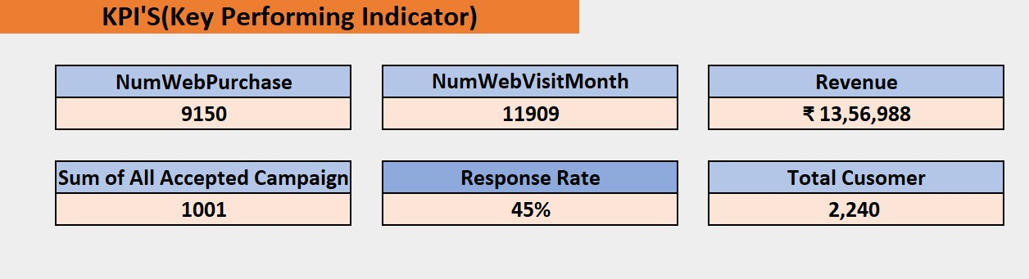
Goals And KPI’S
Goals Enhance marketing campaigns to drive online sales, increase website traffic, improve customer engagement, and maximize revenue.
KPI’S

Slide 5

Recommended Analysis
Q.1 Are there any null values or outliers? How will you handle them?
Missing Values: We opted to impute the missing income values using the mean value of the entire income column. This approach assumes that the missing values are distributed randomly across the income spectrum. Outliers: We addressed the outlier of 666666 by replacing it with the second-highest income value in the dataset.

Slide 6
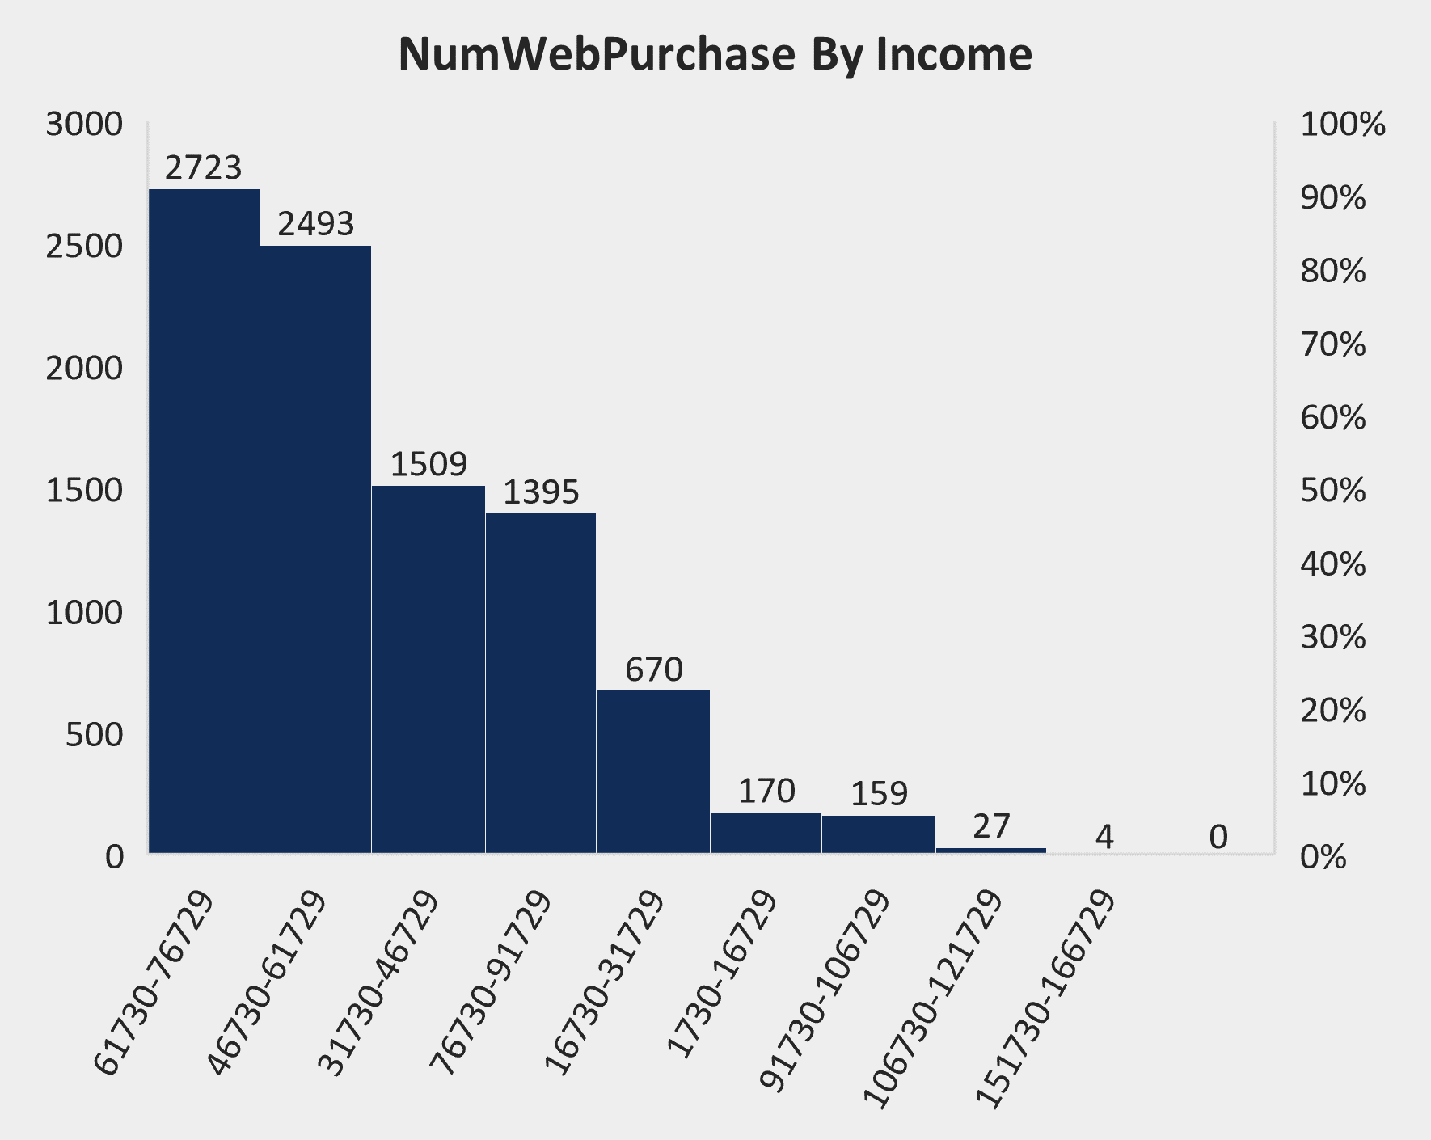
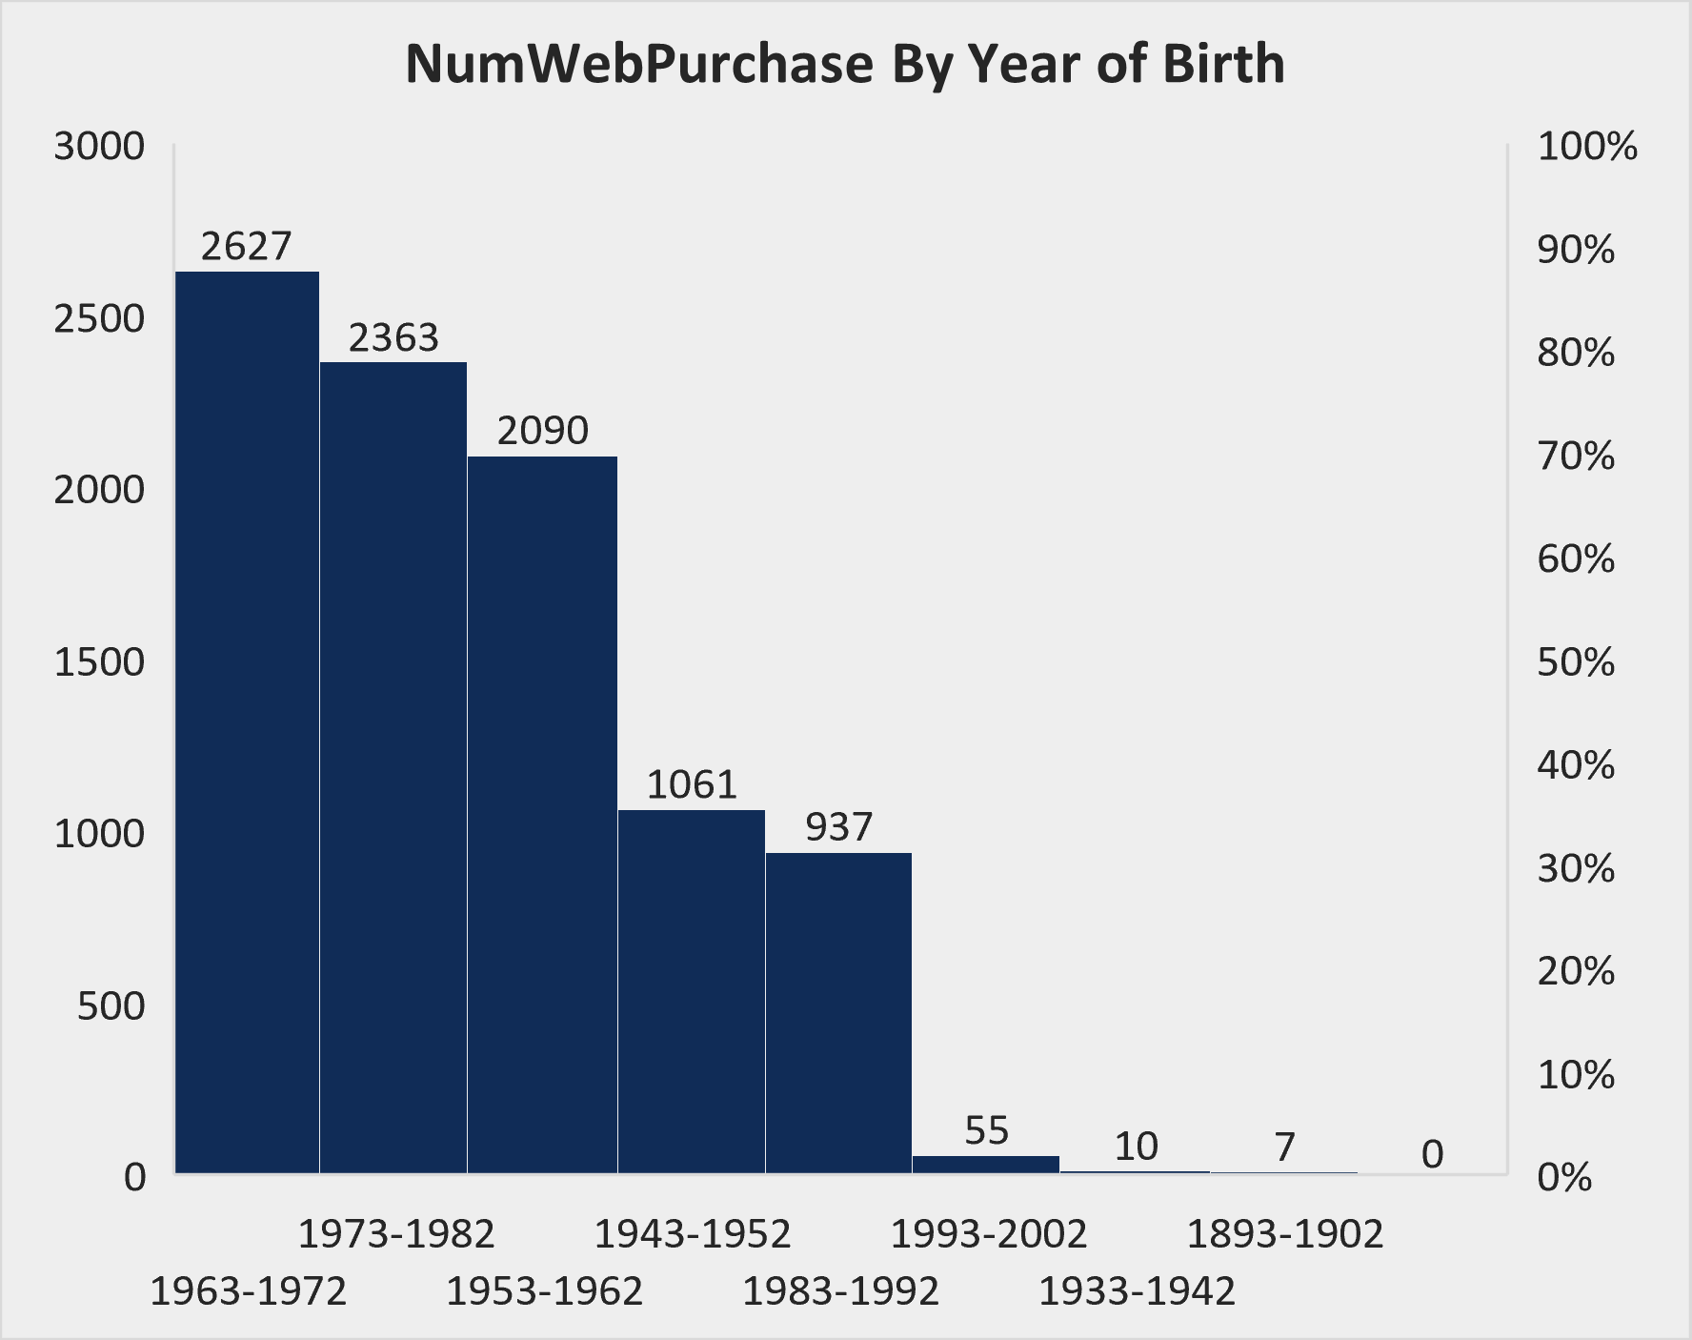
Q.2 What factors are significantly related to the number of web purchases?

Slide 7
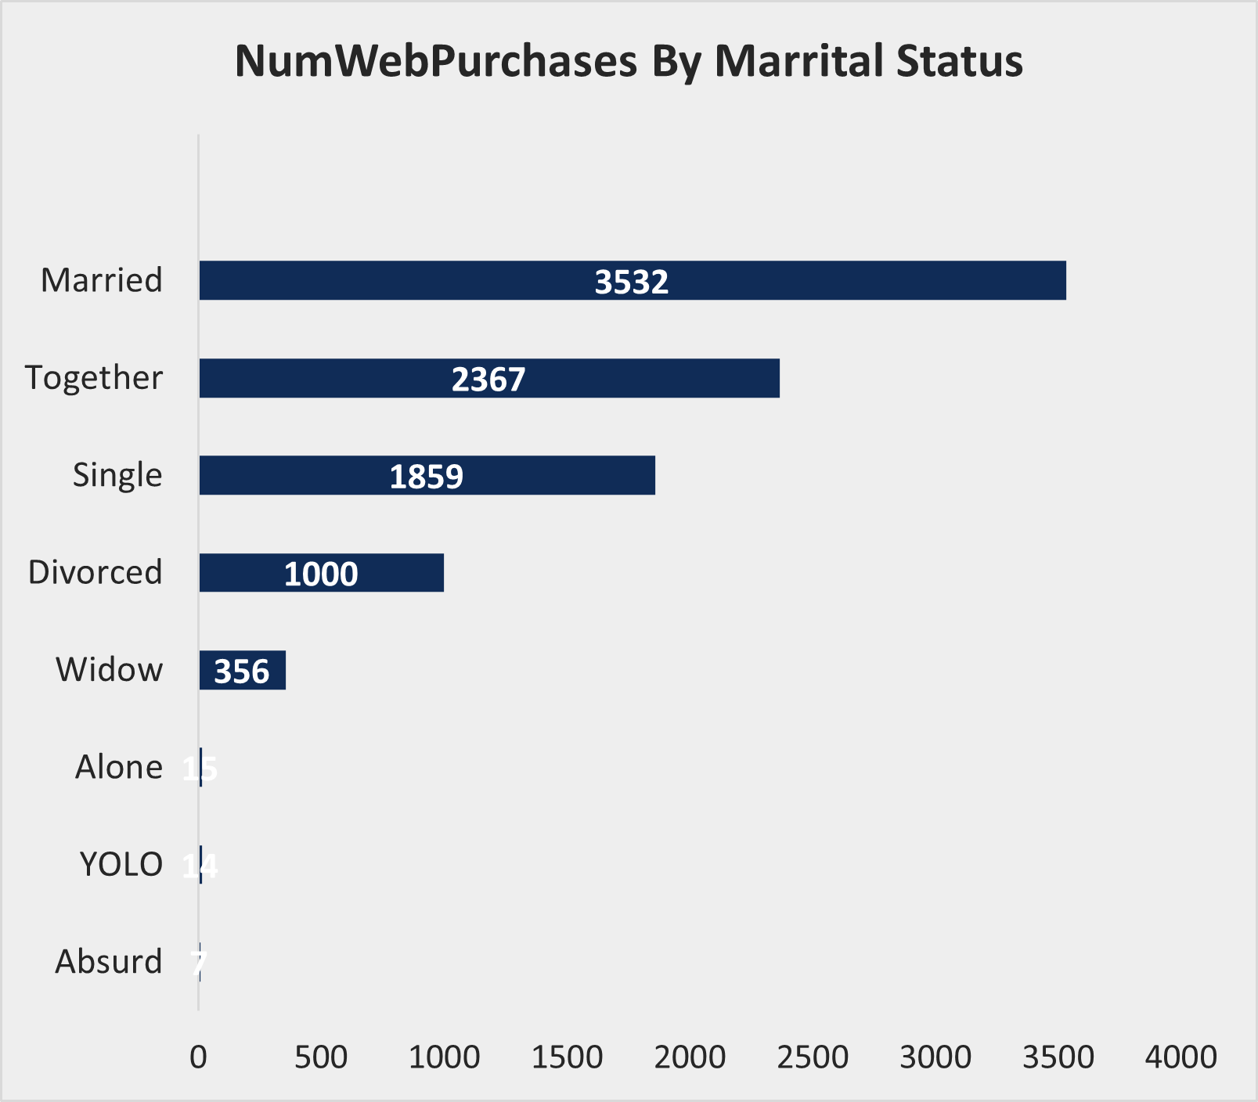
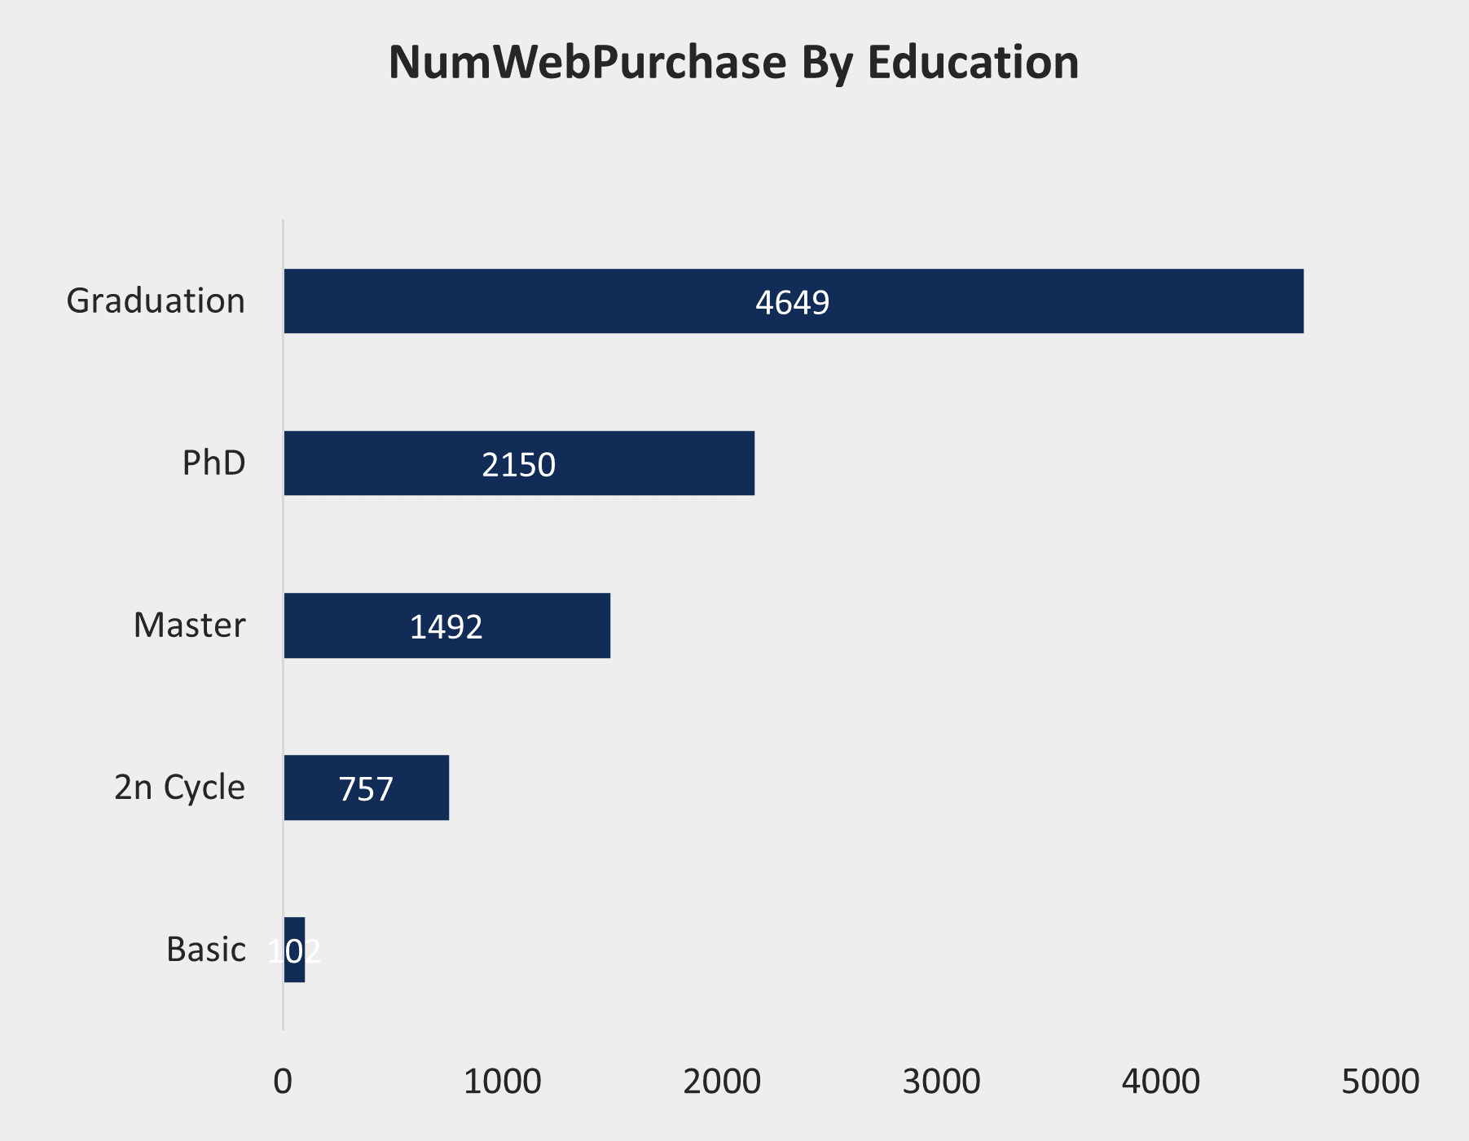
Q.2 What factors are significantly related to the number of web purchases?
Factors significantly related to the number of web purchases include year of birth, education background, marital status, and income.

Slide 8
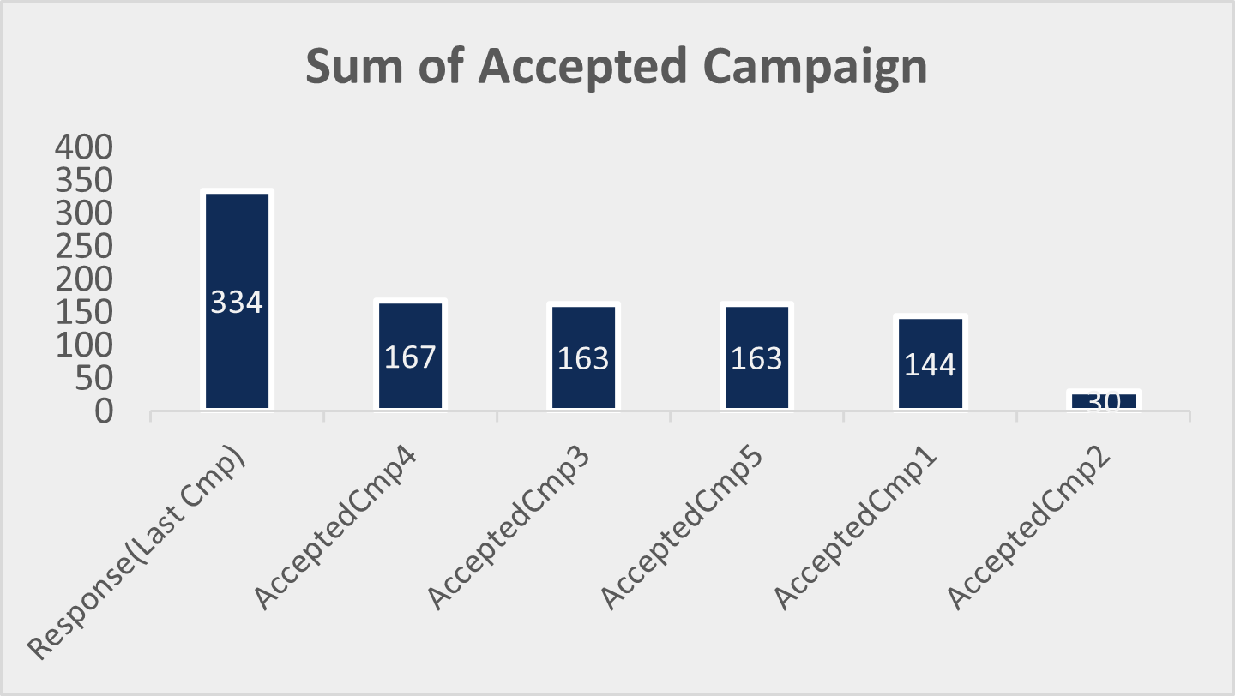

Q.3 Which marketing campaign was the most successful?
Determined the most successful campaign based on customer acceptance of the offered discount, as indicated by the highest response rate, which corresponds to the last campaign known as the "Response" campaign.

Slide 9
Q4. What does the average customer look like?
Defined the average customer as born between 1963 and 1982, married, with higher education, and an annual income ranging between $151,000 and $167,000.

Slide 10
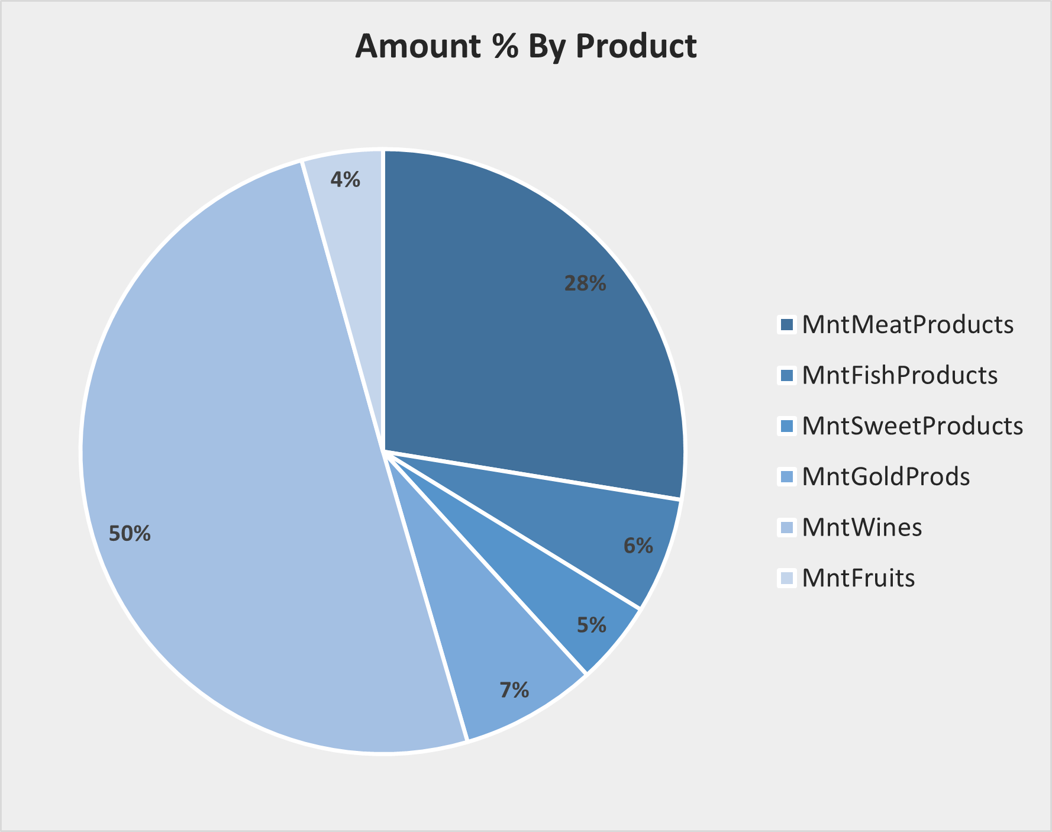
Q.5 Which products are performing best?
Identified wines as the best-performing product category based on total spending amounts in the last two years.

Slide 11
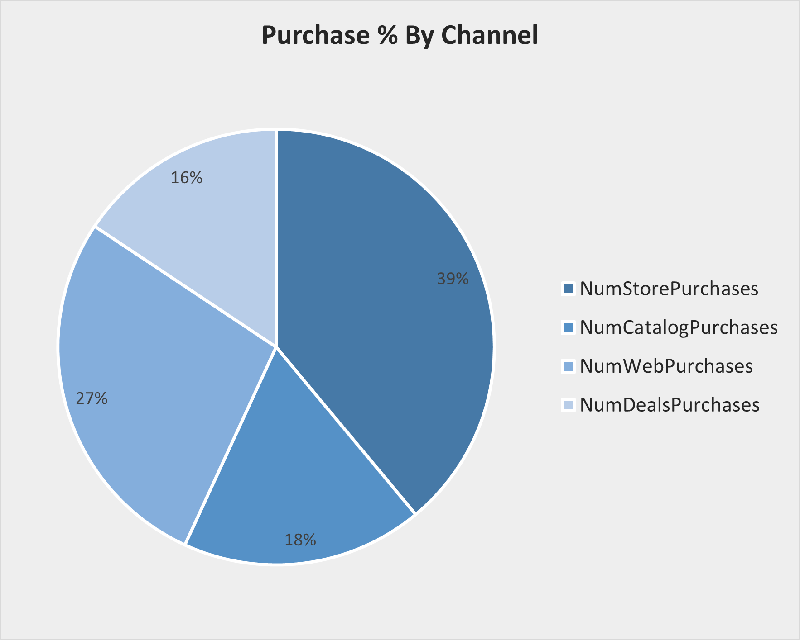
Q.6 Which channels are underperforming?
Identified underperforming marketing channels by examining the total number of discount purchases, highlighting channels with the lowest engagement rates.

Slide 12
Conclusion
The Marketing Campaign Analysis project provided Maven Marketing with valuable insights into their customer base, product performance, and the effectiveness of their marketing campaigns. By addressing data quality issues, identifying key factors influencing customer behavior, and evaluating the success of marketing efforts, this analysis offers a data-driven foundation for optimizing future marketing strategies. The insights derived from this project will help Maven Marketing to better target their audience, improve customer engagement, and maximize overall business performance.

Slide 13

Thanks!

